Slide 1
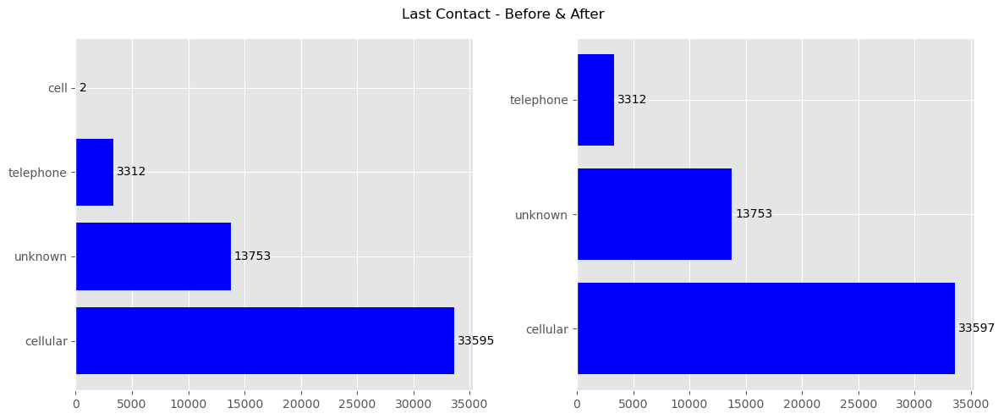
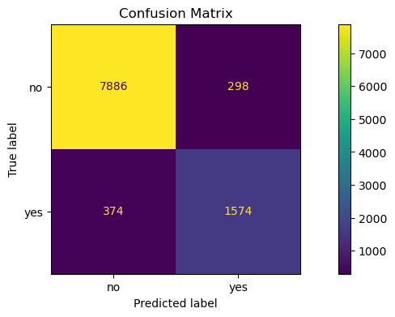
ITNPBD6: Wallace Communications - Student ID: 2710017
Project Methodology – CRISP [1]
Business Understanding
From briefing paper: need to identify customers likely to take a mobile contract. A binary classification exercise with Y/N target
High call costs, suggest need to accurately identify customers but avoid ‘False Positives’
Data Understanding
Tools: VSCode, Jupyter Notebook, Python, Pandas, Scikit-learn [4]
Loaded the CSV file. Data exploration & visualisation
Potential data issues, eg: missing, duplicates, outliers, unbalanced
Data Preparation
This was refined over several iterations of Prep and Modelling, and see comments on variables
Data split 80:20. train_test_split, to: X_train, X_test, y_train, y_test and cross-fold validation will be used on the train data
Repeatable data transformation using Pipeline & ColumnTransformer Fitted to train data and applied individually to train and test
Categorical variables encoded using OneHotEncoder
Numerical variables scaled using: RobustScaler
Modelling
Selected 3 candidate model types
Model training and hyper parameter tuning (see below)
The best trained model for each type saved for evaluation
Evaluation
Transformations applied to the reserved test data
Each model used to make and evaluate predictions (see below)
Deployment
The data transformation pipeline, selected model type and best hyperparameters were used to retrain the model on ALL data
This model was saved using Pickle for use on future data
Variables & Data Preparation
20 original variables -> 9 dropped leaving 10 features and 1 target
50,662 original data items -> 50,660 retained (see notes on outliers and balancing)
Dropped of note: ID (flat & wide); Town (101 categories & no significant contribution to modelling); Country (Towns all UK, despite 5 other countries recorded)
NB: dropped after iteratively modelling and identifying limited contribution
Unbalanced & outliers: CurrentBalance, ThisCampaign
Unbalanced target: NewContractThisCampaign
Minor cleaning: HasTVPackage, LastContact (All occurrences of ‘cell’ -> ‘cellular’)
Variable | Type
Age, ThisCampaign | Numeric - Discrete
CurrentBalance | Numeric - Continuous
Job, Married, Education, Housing, HasTVPackage, LastContact, OutcomePreviousCampaign | Categorical
NewContractThisCampaign | Target - Categorical
Model Training and Hyper Parameters
A pipeline was created for each model type, with a grid of several types of hyper parameters, each with several values to be evaluated.
The finally selected hyperparameters and their values were those identified with the most beneficial impact after multiple iterations of training and evaluation
A scoring metric of Precision seemed to best fit with the business objectives, but F1-Score and ROC-AUC were also used during iterations
For each model and iteration of cross-fold validation (GridSearchCV, CV=5):
i) hyper parameters changed; 2) fitted against train data 3) cross-validation completed; 3) inspected top 10 ranked by the scoring metric
Once the best combinations for each model were identified, the best_estimator_ was saved and used to evaluate and compare the 3 models
Model | Hyper Parameters (Best Combinations) | Validation Metric (Best Score + Elapsed Secs)
Logistic Regression | Solver: saga, Penalty: l2, C: 5, ClassWeight: balanced, MaxIter: 500 | Precision (0.35, 14)
Random Forest | Criterion: entropy, nEstimators: 100, MaxDepth: 50, ClassWeight: balanced, | Precision (0.81, 64)
MLPClassifier | HiddenLayerSizes: (25,5), Activation: tanh, alpha: 0.1, MaxIter: 500 | Precision (0.36, 17)
Model Evaluation: Random Forest
Training results: the Random Forest model performs significantly better than the other two
Business perspective: model evaluation needs to consider how comprehensively clients for marketing are predicted, but without including too many that are not interested (as this is a waste of expensive call centre time). The confusion matrix helps with this
Ideal quadrants: True/Positives (bottom right) are high but False/Positives (top right) are low. Also, too many False/Negatives (bottom left) mean that potential customers are getting missed
Specific metrics: high Precision whilst maintaining a high Recall. The F1-Score helps show both
The Random Forest model gave good results: Precision: 0.84, Recall: 0.81 and F1-Score 0.82
Final Comments
Feature importance: 73% of the performance comes from just 4 features: CurrentBalance, Age, ThisCampaign (all numerical) plus OutcomePreviousCampaign.
Unbalanced & Outliers: For several features plus the target. Early iterations attempted to address these (eg using SMOTE [2] and repeatable outlier removal > STDev*5). However, this surprisingly did not improve model performance
However, the use of RobustScaler and a balanced ClassWeight had a better impact and reduced the number of data points lost
References
[1] P. Chapman et al., ‘CRISP-DM 1.0’, 1999.
[2] N. V. Chawla, K. W. Bowyer, L. O. Hall, and W. P. Kegelmeyer, ‘SMOTE: synthetic minority over-sampling technique’, Journal of artificial intelligence research, vol. 16, pp. 321–357, 2002.
[3] A. Géron, Hands-on machine learning with Scikit-Learn, Keras, and TensorFlow, 3rd Edition. O’Reilly Media, Inc., 2022.
[4] [F. Pedregosa et al., ‘Scikit-learn: Machine Learning in Python’, Journal of Machine Learning Research, vol. 12, no. 85, pp. 2825–2830, 2011.

