Slide 1
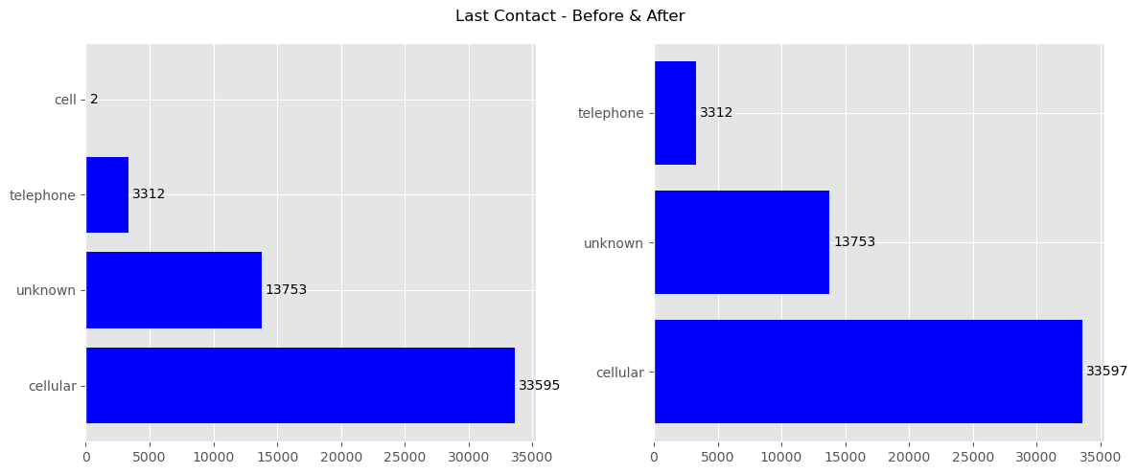
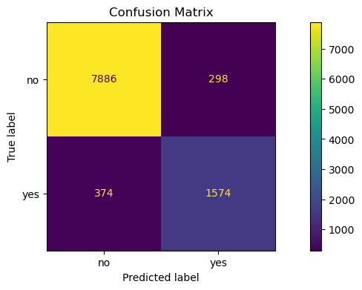
ITNPBD6: Wallace Communications - Student ID: 2710017
2. Project Methodology
The CRISP [1] process was followed, and the following steps were completed:
Business Understanding
Assignment briefing paper
Data Understanding
CSV file load
Data exploration, visualisation
Data Preparation
Basic data cleaning
Dropped 9 variables that were not useful
An 80:20 train/test data split with X,y
Repeatable transformation pipeline, fitted to training data and then applied to test data:
Categorical onehot encoding
RobustScaler normalisation
Modelling
Selected 3 candidate models
Hyperparameter tuning using GridSearch with CV=5
Evaluation
Used Test data to make y predictions
Evaluation metrics Metrics: Precision, Recall, F1-Score, RORC-AUC
Precision used to assess business fitness
Deployment
Not undertaken
3. Variables
20 original variables, 9 dropped, leaving 10 features (X) and 1 target (y). Most variables were categorical, this creates an increase in features for modelling after onehot encoding. Partially for this reason, the Jobs variable was dropped as it had 101 values.
Variable | Type
Age, CurrentBalance, ThisCampaign | Numeric
Job, Married, Education, Housing, HasTVPackage, LastContact, OutcomePreviousCampaign | Categorical
NewContactThisCampaign | Target - Categorical
4. Data Preparation
The bar plots below show the variable last_contact which needed cleaning by changing the value ‘cell’ to ‘cellular’.
5. Model Training and Hyper Parameters
A GridSearch was used with CV=5, with a pipeline specifying multiple values for each parameter. This was fitted against the training data, the results ranked against the validation metric and the top 10 inspected. The ‘best_estimator’ was saved to be used for the final model evaluation.
Model | Hyper Parameters (Best Combinations) | Validation Metric (Best Score + Elapsed Secs)
Logistic Regression | Solver: saga, Penalty: l2, C: 5, ClassWeight: balanced, MaxIter: 500 | Precision Score (0.35, 14)
Random Forest | Criterion: entropy, nEstimators: 100, MaxDepth: 50, ClassWeight: balanced, | Precision Score (0.81, 64)
MLPClassifier | HiddenLayerSizes: (25,5), Activation: tanh, alpha: 0.1, MaxIter: 500 | F1 Score (0.36, 17)
6. Final Model and Results – Random Forest
According to the business briefing, call centre costs are high and so it is important to only target customers that are likely to take out a new contract. Therefore, whilst it is important to identify customers, it is also important not to have too many ‘False Positives’ which would waste call centre time.
- The confusion matrix helps show the ‘True Positives’ are high (bottom right) but keeping ‘False Positives’ low (top right).
- The Precision Score of 0.84 and F1 Score of 0.82 also reflect a strong prediction.
8. References
[1] P. Chapman et al., ‘CRISP-DM 1.0’, 1999. [2] N. V. Chawla, K. W. Bowyer, L. O. Hall, and W. P. Kegelmeyer, ‘SMOTE: synthetic minority over-sampling technique’, Journal of artificial intelligence research, vol. 16, pp. 321–357, 2002. [3] A. Géron, Hands-on machine learning with Scikit-Learn, Keras, and TensorFlow, 3rd Edition. O’Reilly Media, Inc., 2022.
7. Insight about data or models gained
For example, did you learn anything about specific features that drive the model? Is the model biased towards particular groups in the data? Is the model you've chosen good for helping us to understand why particular predictions are made?

