Slide 1
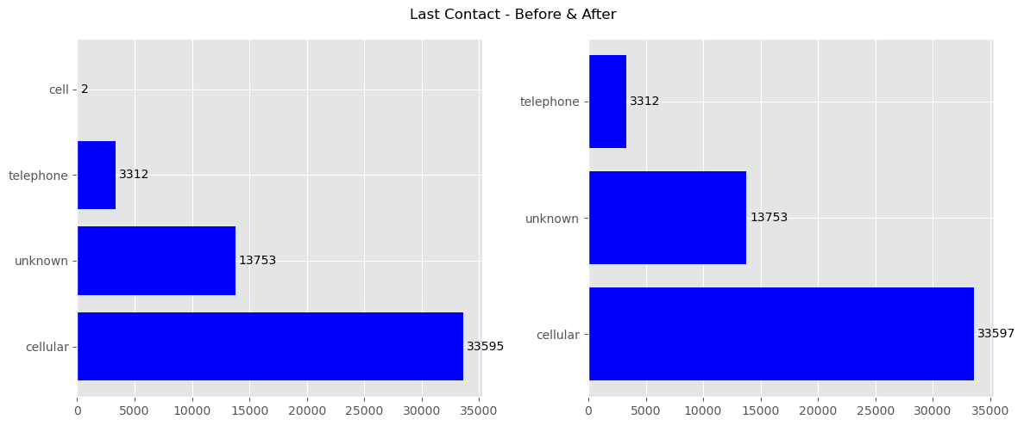
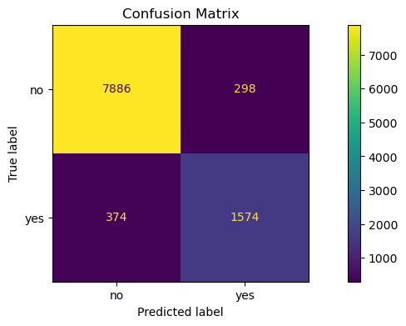
ITNPBD6: Wallace Communications - Student ID: 2710017
Project Methodology – CRISP [1]
Business Understanding
From briefing paper: need to identify customers likely to take a mobile contract. A binary classification exercise with Y/N target
High call costs, suggest need to accurately identify customers but avoid ‘False Positives’
Data Understanding
Tools: VSCode, Jupyter Notebook, Python, Pandas, Scikit-learn [4]
Loaded the CSV file. Data exploration & visualisation
Identify data issues, eg: missing, duplicates, outliers, unbalanced
Data Preparation
Refined over several iterations of Prep and Modelling (see variables)
Data split 80:20 using train_test_split to: X_train, X_test, y_train, y_test (cross-fold validation to be used on train)
Repeatable data transformation using Pipeline & ColumnTransformer, fitted to train data then applied to separate train and test
Categorical variables encoded using OneHotEncoder
Numerical variables scaled using RobustScaler
Modelling
Selected 3 candidate model types
Model training and hyper parameter tuning (see below)
The best trained model for each type saved for evaluation
Evaluation
Transformations applied to the reserved test data
Each model used to make and evaluate predictions (see below)
Deployment
The data transformation pipeline, selected model type and best hyperparameters were used to retrain the model on ALL data
This model was saved using Pickle for use on new data
Variables & Data Preparation
20 original variables -> 9 dropped leaving 10 features and 1 target
50,662 original data items -> 50,660 retained (see notes on outliers and balancing)
Dropped of note: ID (flat & wide); Town (101 categories & no significant contribution to modelling); Country (Towns all UK, despite 5 other countries recorded)
Columns dropped only after iteratively modelling and identifying their contribution
Unbalanced & outliers: CurrentBalance, ThisCampaign
Unbalanced target: NewContractThisCampaign
Minor cleaning: HasTVPackage, LastContact (2 occurrences of ‘cell’ -> ‘cellular’)
Variable | Type
Age, ThisCampaign | Numeric - Discrete
CurrentBalance | Numeric - Continuous
Job, Married, Education, Housing, HasTVPackage, LastContact, OutcomePreviousCampaign | Categorical
NewContractThisCampaign | Target - Categorical
Model Training and Hyper Parameters
Pipelines created for each model type with a grid of several types of hyper parameters, each with several values
A scoring metric of Precision seemed to best fit with the business objectives, but F1-Score and ROC-AUC were also used for comparisons
Multiple model training & evaluation iterations were then completed. Each using cross-fold validation, GridSearchCV, CV=5:
i) hyper parameter types & values changed; 2) fitted against train data 3) cross-validation completed; 3) inspected top 10 ranked by the scoring metric
The best combinations of hyperparameter types and their values were identified, best_estimator_saved and used to evaluate across the 3 models
Model | Hyper Parameters (Best Combinations) | Validation Metric (Best Score + Elapsed Secs)
Logistic Regression | Solver: saga, Penalty: l2, C: 5, ClassWeight: balanced, MaxIter: 500 | Precision (0.35, 14)
Random Forest | Criterion: entropy, nEstimators: 100, MaxDepth: 50, ClassWeight: balanced, | Precision (0.81, 64)
MLPClassifier | HiddenLayerSizes: (25,5), Activation: tanh, alpha: 0.1, MaxIter: 500 | Precision (0.36, 17)
Model Evaluation: Random Forest
Training results: the Random Forest model performs significantly better than the other two
Business perspective: model evaluation needs to consider how comprehensively clients for marketing are predicted, but without including too many that are not interested (as this is a waste of expensive call centre time). The confusion matrix helps with this
Ideal quadrants: True/Positives (bottom right) are high but False/Positives (top right) are low. Also, too many False/Negatives (bottom left) mean that potential customers are getting missed
Specific metrics: high Precision whilst maintaining a high Recall. The F1-Score helps show both
The Random Forest model gave good results: Precision: 0.84, Recall: 0.81 and F1-Score 0.82
Final Comments
Feature importance: 73% of the performance comes from just 4 features: CurrentBalance, Age, ThisCampaign (all numeric) plus OutcomePreviousCampaign.
Unbalanced & Outliers: For several features plus the target. Early iterations attempted to address these (eg using SMOTE [2] and repeatable outlier removal > STDev*5). But, this surprisingly did not improve model performance so not utilised
However, the use of RobustScaler and a balanced ClassWeight had a better impact whilst also avoiding the loss of data points
References
[1] P. Chapman et al., ‘CRISP-DM 1.0’, 1999.
[2] N. V. Chawla, K. W. Bowyer, L. O. Hall, and W. P. Kegelmeyer, ‘SMOTE: synthetic minority over-sampling technique’, Journal of artificial intelligence research, vol. 16, pp. 321–357, 2002.
[3] A. Géron, Hands-on machine learning with Scikit-Learn, Keras, and TensorFlow, 3rd Edition. O’Reilly Media, Inc., 2022.
[4] F. Pedregosa et al., ‘Scikit-learn: Machine Learning in Python’, Journal of Machine Learning Research, vol. 12, no. 85, pp. 2825–2830, 2011.

