Slide 1

Stuart Murray

Slide 2
Introduction
- Market Overview (1)
- Competitive Overview (2)
- Positioning and Strategy (3)
- Pricing; Sales and Implementation Forecast (4)
- Marketing / Advertising (5)
- Product Release and Key Features (6)
- Approval (7)
- Team (8)

Slide 3
Market Overview
Total Market Opportunities:
- 1400 Eligible Hospitals
- 1300 Ineligible Hospitals
Drug Spend: 11.3 billion spending on DSH in fiscal year of 2009 (1a)
Projected Growth: 2.1% annually from 2008 – 2017 (1b)
Potential Market Opportunities:
- 2,000 Aids Clinics (Auditing Emphasis)
- 150 Children’s Hospitals (340b Coalition)
- Retail Pharmacies (Could be 100% 340b) (340b Coalition)
- Corrections
Further Potential: Organ Transplant Centers; Critical Access Hospitals; Maternal & Child Health Centers; Substance Abuse and Mental Health Centers; Critical Access Hospitals; Sole Community Hospitals; Rural Referral Centers

Slide 4
Competitive Overview
Talyst is market leader with over 120 installs (2a)
Three wholesalers are closest competition: (2b,2c)
    McKesson 340B Manager (Weaknesses are tracking, reports, pricing)
    Cardinal Sentry Data Systems RCM (Weaknesses are implementation, pricing)
    AmerisourceBergen Dimension 21 (Weaknesses are implementation, reporting)
    ∗ Seek to lock in much larger distribution revenues with larger 340B savings (2d)
    ∗ Collectively, have perhaps 100-150 installs (2d)
    3. Smaller competition worth noting: (2b,2c)
    Integrated Informatics 340BMGR (Strengths are wholesaler neutrality and pricing)
    SunRx (Strengths are wholesaler neutrality and pricing)
    eAudit Solutions 340B Replenishment (Strengths are wholesaler neutrality)

Slide 5
Positioning and Strategy (1)
Beds | 0-100 | 101-200 | 201-300 | 301-400 | 401-500 | 501-600 | 601-700 | 701-800 | 800-900 | 901+
DSH Eligible | 443 | 414 | 199 | 131 | 77 | 59 | 28 | 17 | 5 | 19
Talyst Customer | 11 | 16 | 10 | 16 | 7 | 12 | 6 | 1 | 0 | 3
Percentage of Market Segment | 2.48% | 3.86% | 5.03% | 12.21% | 9.09% | 20.34% | 21.43% | 5.88% | 0.00% | 15.79%
Target less than 100 bed segment based on pricing model (4a)
∗ Primary competition seeks to lock-in much larger distribution revenues with larger 340B saving (2d)
∗ Primary competition passes over these hospitals because based on their pricing, these smaller hospitals save no money
Beds | 0-100 | 101-200 | 201-300 | 301-400 | 401-500 | 501-600 | 601-700 | 701-800 | 800-900 | 901+
DSH Potentially Eligible | 511 | 402 | 200 | 95 | 45 | 24 | 13 | 13 | 5 | 3

Slide 6
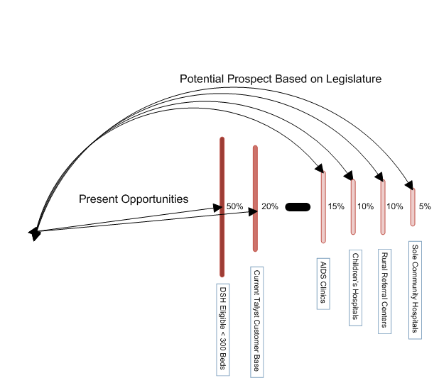
Positioning and Strategy (2): Market Penetration
(3a)

Slide 7
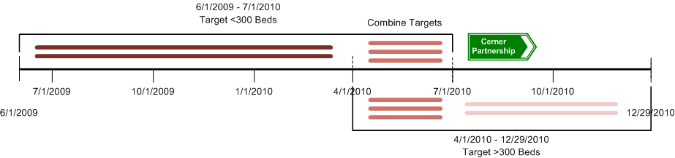
Positioning and Strategy (3): Timeline Based on Features
(3b)
Targeting <300 beds with an emphasis on DSH nursing home chains and sister hospitals
As features increase to include EDI, full vendor hosting & possible consulting partnership with Cerner we augment our target market to larger hospital populations
Pricing can be increased to match feature set in Q4 with possibility of monthly fees
3. This direction continues to leverage distinctive competency: Market Leader

Slide 8
Pricing; Sales and Implementation Forecast
All prices reflect 10% Prime Vendor Program Discount)
Standard Pricing | <100 Beds | >=100Beds
One-Time Set Up Fee | $4,500 | $6,000
Monthly Usage Fee | $750 | $2,000
Q2 – Q4 2009 Implementations: 24 (4b)
Q1 – Q4 2010 Implementations: 48 (4b)
(4a)

Slide 9
Marketing & Sales
Marketing Communication Strategy (5a)
Sales Prospecting Strategy (5b)
  “50 Additional Customers in 12 months”
        Target Talyst current customers (405) with AutoSplit recognition (90 Day Free / 287 w/o)
        Partnership with HD Smith / Ernst and Young (Esp. if we go towards auditing)
        Partnership with Cerner (Long Term)
        Target 1,000+ eligible hospitals with <300 beds
        Continue calling on 300+ eligible hospitals with =>300 beds
        Prospect targeting potential eligible hospitals (i.e. Children’s Hospitals)

Slide 10
Marketing & Sales (Continued)
Barriers to entry <300 Beds:
  Trust
  Cost
  Complexity
  Manual process already in place for much smaller hospitals
Value Add:
  Market Leader (Never failed an audit, wholesaler neutral)
  Simple and transparent pricing model (ROI Calculator)
  Knowledge base website (known as the experts in 340B)
  Less than 5 minutes a day to track and save

Slide 11
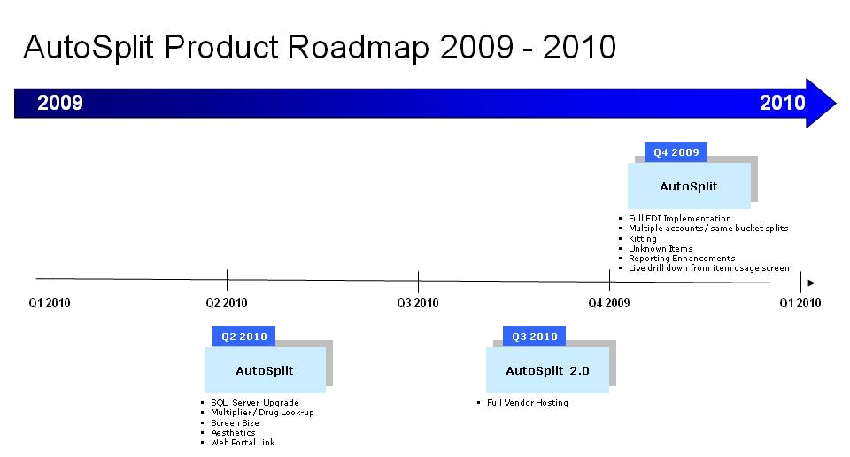
Product Roadmap and Key Features
(6c)

Slide 12
Q4 Product Release and Key Features (6B)
Feature Name | Code Time (Days) | Deadline | Test Time (Days)
Full EDI Implementation | 30 | Aug 10th | 2
Splitting Multiple Accounts in to the same bucket | 30 | Sept 10th | 2
Kitting | 3 | Sept 15th | 1
Unknown Items | 5 | Oct 1st | 1
Reporting Graphics Upgraded | 3 | Oct 15th | 1
Live Drill Down for “Item Usage Screen” | 4 | Oct 15th | 1

Slide 13
Budget Request
 | 2009 | 2010
Projected Sales | 21 | 50
Total Sales | 32 | 50
Gross Margin | $1,600,000 | $2,400,000
Direct Overhead Costs | $420,000 | $520,000
Contribution Margin | $1,180,000 | $1,880,000
Total Revenue | $1,600,000 | $240,0000
Request: Additional 100K
Projected Return: 800K (portion reoccurring)

Slide 14
Threats, Recommendations & Approval
Threats:
    What if Wholesalers give this away for free
    H.R. 444 and inpatient eligibility
Recommendations:
    Take what is in front of us; DSH Eligible Hospitals 300 beds and lower
    Do not change product to fit AIDS Clinics until we see their needs
    Cerner partnership for consulting, vendor hosting and customer base
Approvals:
    Feature set
    Positioning
    Budget

