Slide 1
Clustering
10/9/2002

Slide 2
Idea and Applications
Clustering is the process of grouping a set of physical or abstract objects into classes of similar objects.
  It is also called unsupervised learning.
  It is a common and important task that finds many applications.
Applications in Search engines:
  Structuring search results
  Suggesting related pages
  Automatic directory construction/update
  Finding near identical/duplicate pages

Slide 3
When & From What
Clustering can be based on:
  URL source
    Put pages from the same server together
  Text Content
    -Polysemy (“bat”, “banks”)
    -Multiple aspects of a single topic
  Links
    -Look at the connected components in the link graph (A/H analysis can do it)
Clustering can be done at:
  Indexing time
  At query time
    Applied to documents
    Applied to snippets

Slide 4
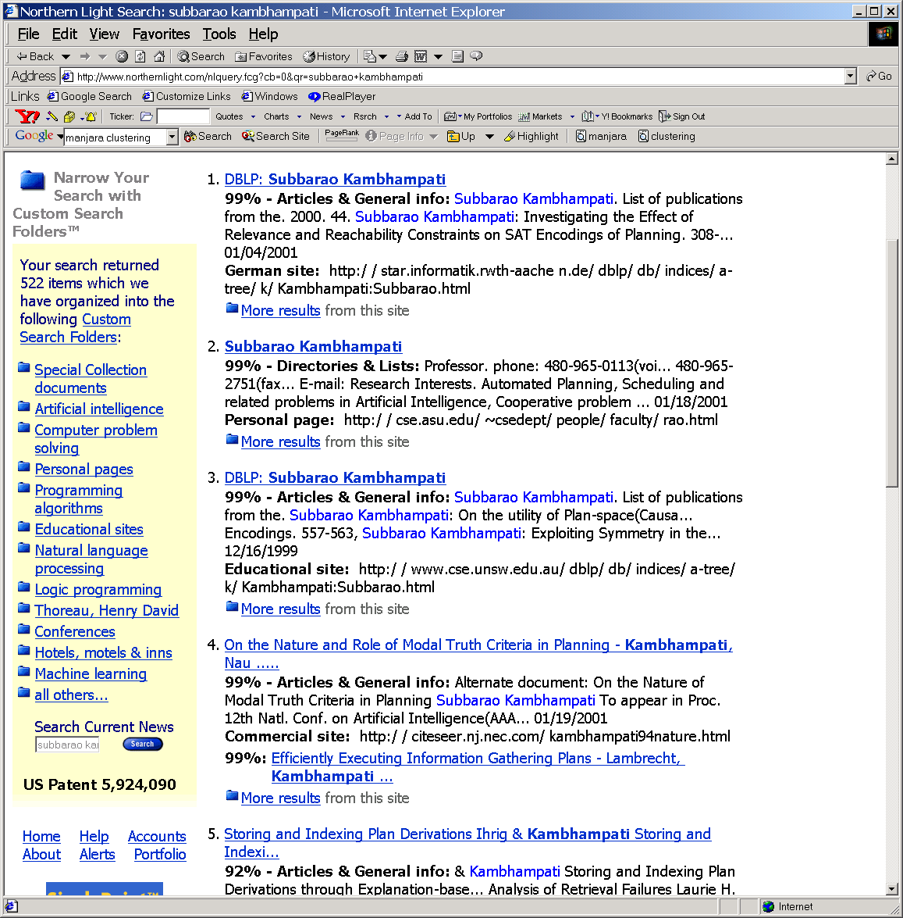
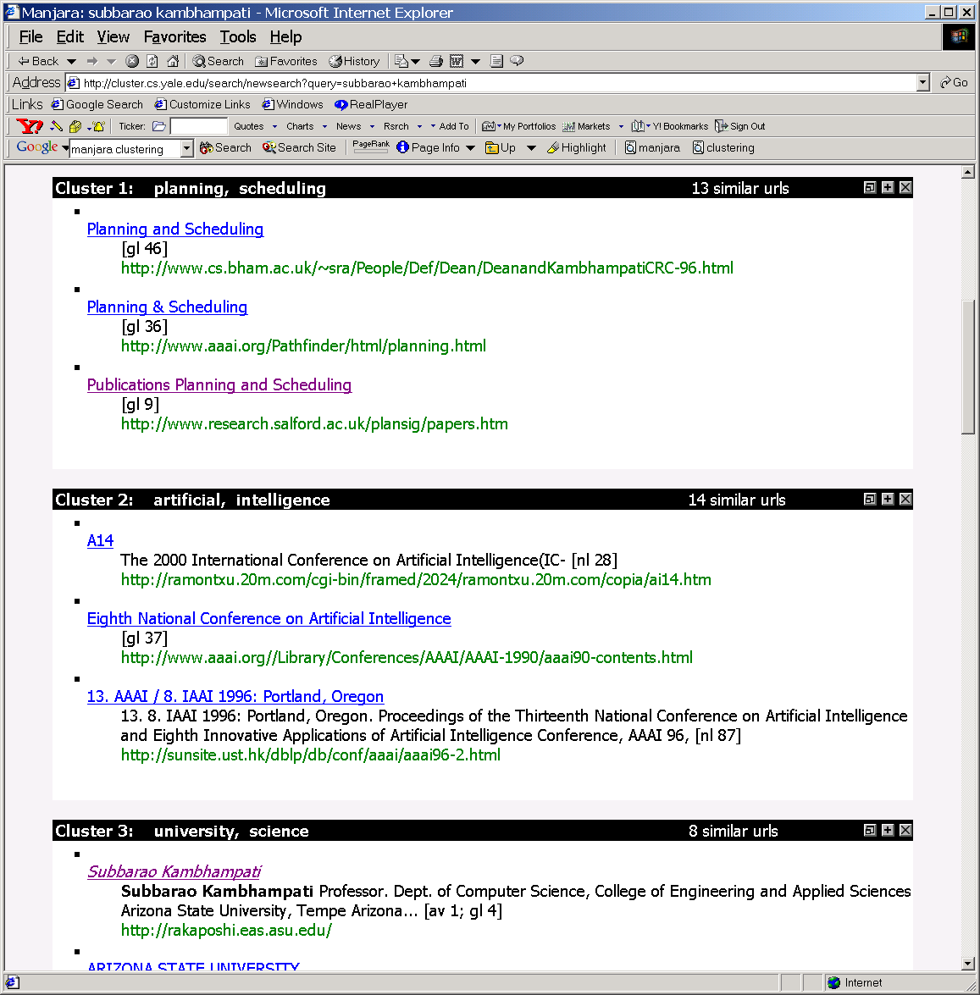
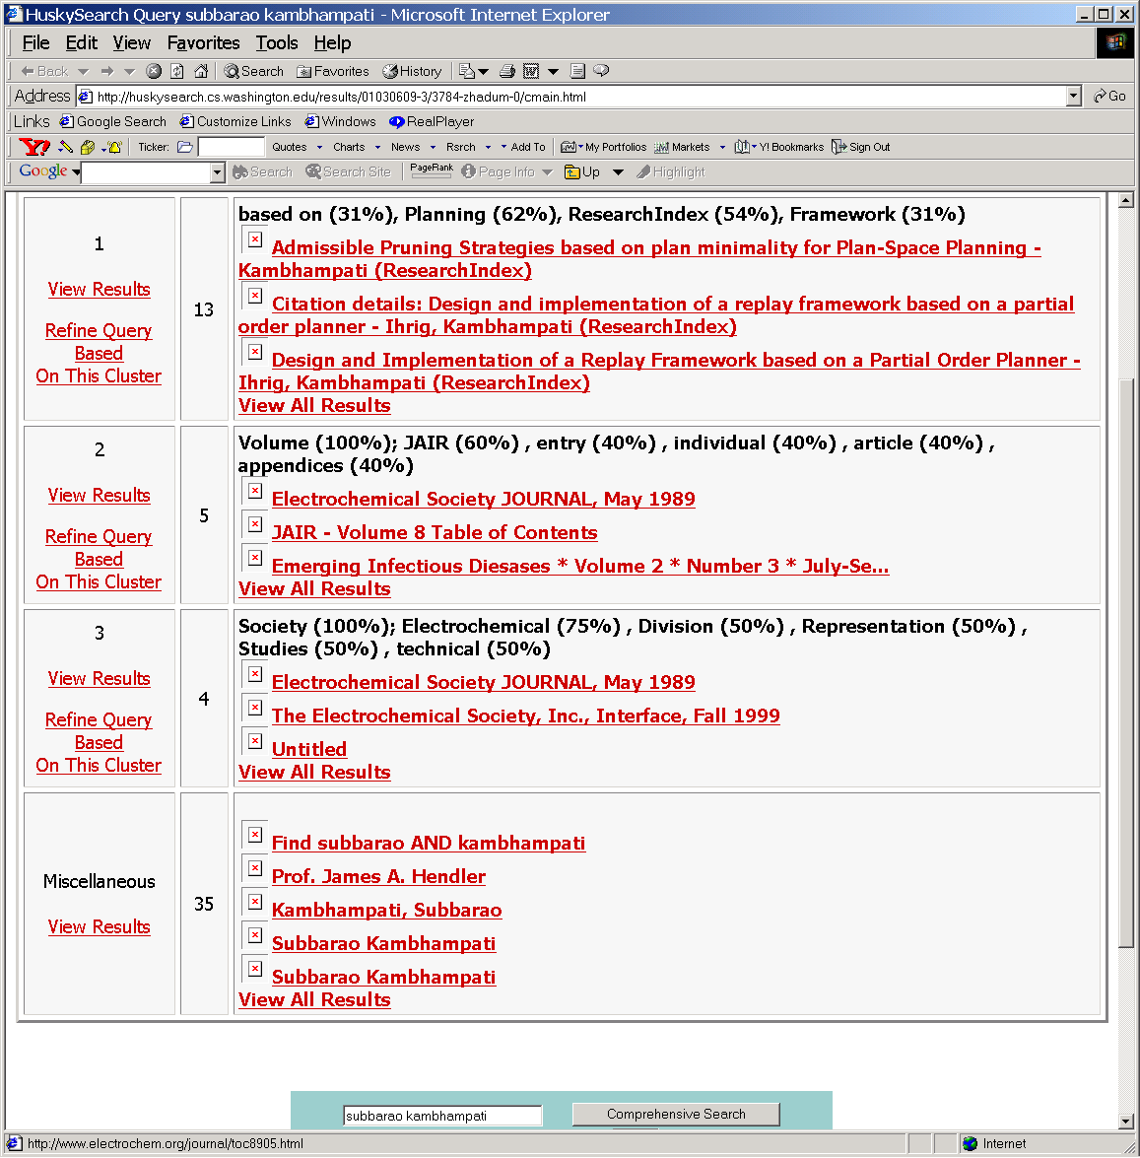

Slide 5

Concepts in Clustering
  “Defining distance between points
    Cosine distance (which you already know)
    Overlap distance
  A good clustering is one where
    (Intra-cluster distance) the sum of distances between objects in the same cluster are minimized,
    (Inter-cluster distance) while the distances between different clusters are maximized
    Objective to minimize: F(Intra,Inter)
  Clusters can be evaluated with “internal” as well as “external” measures
    Internal measures are related to the inter/intra cluster distance
    External measures are related to how representative are the current clusters to “true” classes
      See entropy and F-measure in [Steinbach et. Al.]

Slide 6
Inter/Intra Cluster Distances
Intra-cluster distance
(Sum/Min/Max/Avg) the (absolute/squared) distance between
  All pairs of points in the cluster OR
  Between the centroid and all points in the cluster OR
  Between the “medoid” and all points in the cluster
Inter-cluster distance
Sum the (squared) distance between all pairs of clusters
Where distance between two clusters is defined as:
  distance between their centroids/medoids
    (Spherical clusters)
  Distance between the closest pair of points belonging to the clusters
    (Chain shaped clusters)

Slide 7
Lecture of 10/14

Slide 8
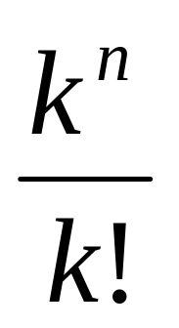
How hard is clustering?
One idea is to consider all possible clusterings, and pick the one that has best inter and intra cluster distance properties
Suppose we are given n points, and would like to cluster them into k-clusters
  How many possible clusterings?
Too hard to do it brute force or optimally
Solution: Iterative optimization algorithms
  Start with a clustering, iteratively improve it (eg. K-means)

Slide 9
Classical clustering methods
Partitioning methods
  k-Means (and EM), k-Medoids
Hierarchical methods
  agglomerative, divisive, BIRCH
Model-based clustering methods

Slide 10
K-means
Works when we know k, the number of clusters we want to find
Idea:
  Randomly pick k points as the “centroids” of the k clusters
  Loop:
    For each point, put the point in the cluster to whose centroid it is closest
    Recompute the cluster centroids
    Repeat loop (until there is no change in clusters between two consecutive iterations.)
Iterative improvement of the objective function:
Sum of the squared distance from each point to the centroid of its cluster

Slide 11
K-means Example
For simplicity, 1-dimension objects and k=2.
  Numerical difference is used as the distance
Objects: 1, 2, 5, 6,7
K-means:
  Randomly select 5 and 6 as centroids;
  => Two clusters {1,2,5} and {6,7}; meanC1=8/3, meanC2=6.5
  => {1,2}, {5,6,7}; meanC1=1.5, meanC2=6
  => no change.
  Aggregate dissimilarity
    (sum of squares of distanceeach point of each cluster from its cluster center--(intra-cluster distance)
  = 0.5²+ 0.5²+ 1²+ 0²+1² = 2.5
|1-1.5|²

Slide 12
K Means Example
(K=2)
Pick seeds
Reassign clusters
Compute centroids
Reasssign clusters
x
x
x
Compute centroids
x
x
x
Reassign clusters
Converged!
[From Mooney]

Slide 13
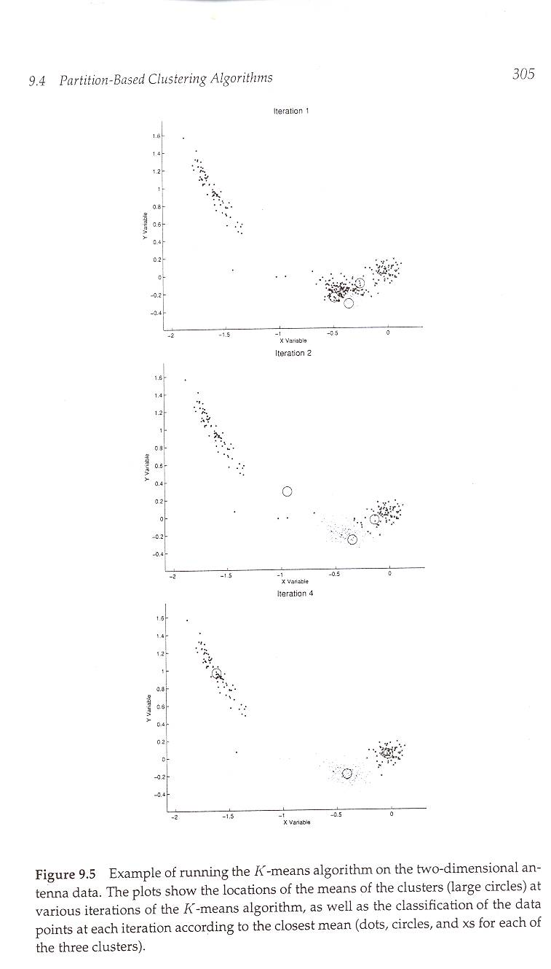
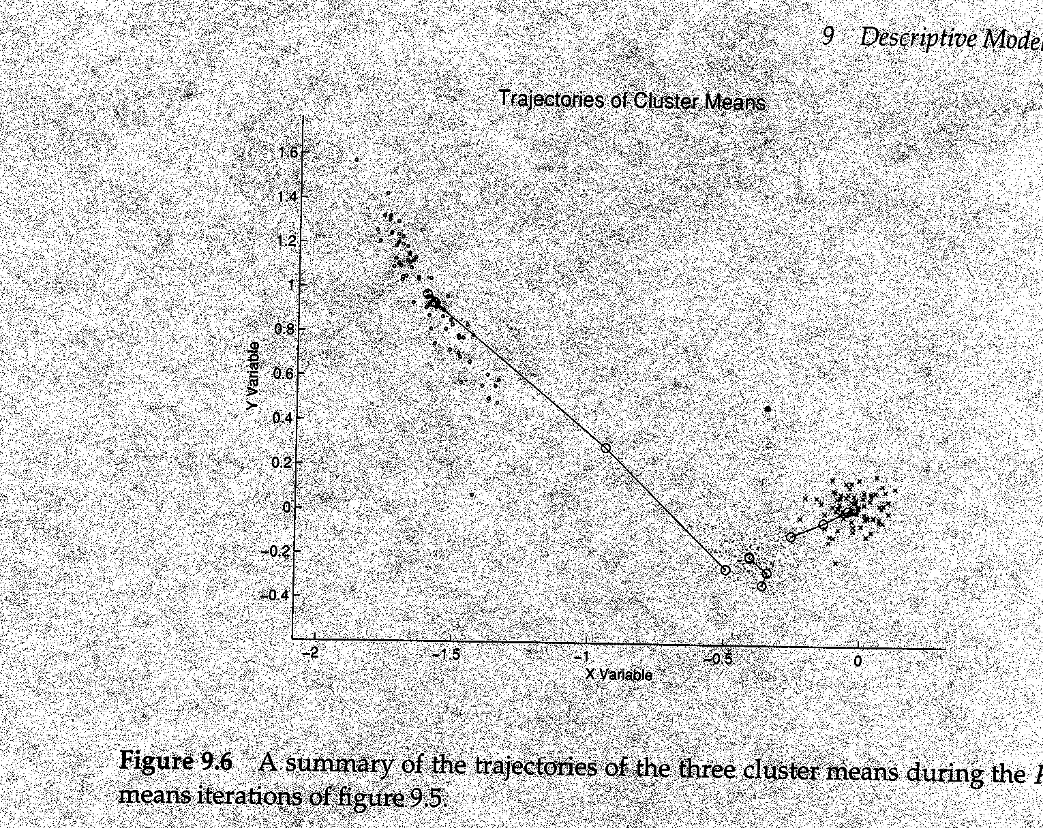
Example of K-means in operation
[From Hand et. Al.]

Slide 14
Time Complexity
Assume computing distance between two instances is O(m) where m is the dimensionality of the vectors.
Reassigning clusters: O(kn) distance computations, or O(knm).
Computing centroids: Each instance vector gets added once to some centroid: O(nm).
Assume these two steps are each done once for I iterations: O(Iknm).
Linear in all relevant factors, assuming a fixed number of iterations,
  more efficient than O(n²) HAC (to come next)

Slide 15

Problems with K-means
Need to know k in advance
  Could try out several k?
    Unfortunately, cluster tightness increases with increasing K. The best intra-cluster tightness occurs when k=n (every point in its own cluster)
Tends to go to local minima that are sensitive to the starting centroids
  Try out multiple starting points
Disjoint and exhaustive
  Doesn’t have a notion of “outliers”
    Outlier problem can be handled by K-medoid or neighborhood-based algorithms
Assumes clusters are spherical in vector space
  Sensitive to coordinate changes, weighting etc.
Example showing
sensitivity to seeds
In the above, if you start
with B and E as centroids
you converge to {A,B,C}
and {D,E,F}
If you start with D and F
you converge to
{A,B,D,E} {C,F}

Slide 16
Variations on K-means
Recompute the centroid after every (or few) changes (rather than after all the points are re-assigned)
  Improves convergence speed
Starting centroids (seeds) change which local minima we converge to, as well as the rate of convergence
  Use heuristics to pick good seeds
    Can use another cheap clustering over random sample
  Run K-means M times and pick the best clustering that results
    Bisecting K-means takes this idea further…
Lowest aggregate
Dissimilarity
(intra-cluster
distance)

Slide 17
Bisecting K-means
Hybrid method 1
Can pick the largest
Cluster or the cluster
With lowest average
similarity
For I=1 to k-1 do{
  Pick a leaf cluster C to split
  For J=1 to ITER do{
    Use K-means to split C into two sub-clusters, C₁ and C₂
    Choose the best of the above splits and make it permanent}
  }
Divisive hierarchical clustering method
uses K-means

Slide 18

Class of 16th October
Midterm on October 23rd. In class.

Slide 19
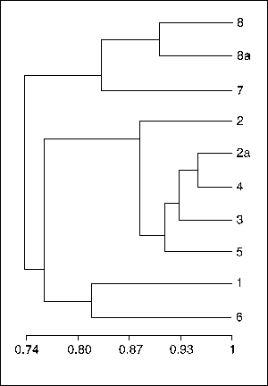
Hierarchical Clustering Techniques
Generate a nested (multi-resolution) sequence of clusters
Two types of algorithms
  Divisive
    Start with one cluster and recursively subdivide
    Bisecting K-means is an example!
  Agglomerative (HAC)
    Start with data points as single point clusters, and recursively merge the closest clusters
“Dendogram”

Slide 20
Hierarchical Agglomerative Clustering Example
{Put every point in a cluster by itself.
For I=1 to N-1 do{
let C₁ and C₂ be the most mergeable pair of clusters
Create C_{1,2} as parent of C₁ and C₂}
Example: For simplicity, we still use 1-dimensional objects.
  Numerical difference is used as the distance
Objects: 1, 2, 5, 6,7
agglomerative clustering:
  find two closest objects and merge;
  => {1,2}, so we have now {1.5,5, 6,7};
  => {1,2}, {5,6}, so {1.5, 5.5,7};
  => {1,2}, {{5,6},7}.
1
2
5
6
7

Slide 21
Single Link Example

Slide 22
Properties of HAC
Creates a complete binary tree (“Dendogram”) of clusters
Various ways to determine mergeability
  “Single-link”—distance between closest neighbors
  “Complete-link”—distance between farthest neighbors
  “Group-average”—average distance between all pairs of neighbors
  “Centroid distance”—distance between centroids is the most common measure
Deterministic (modulo tie-breaking)
Runs in O(N²) time
People used to say this is better than K-means
    But the Stenbach paper says K-means and bisecting K-means are actually better

Slide 23
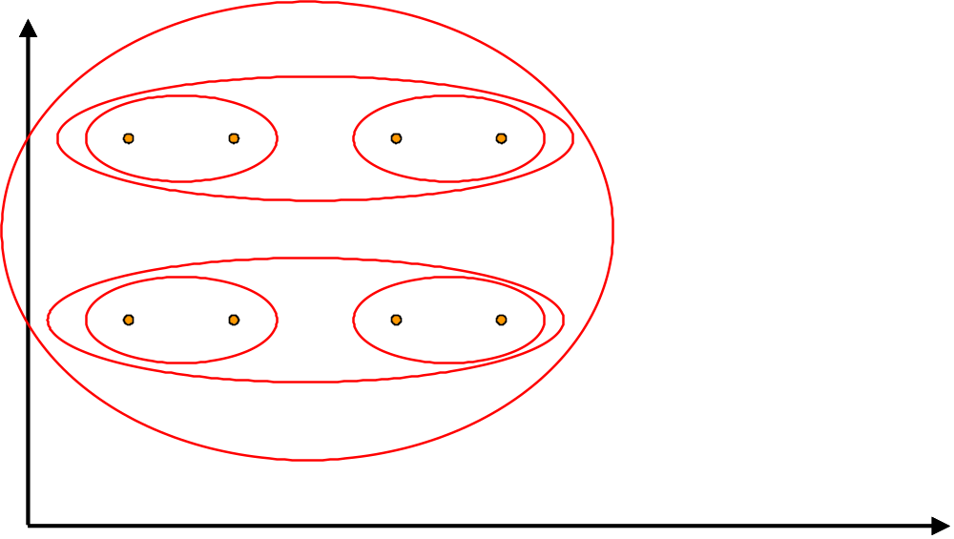
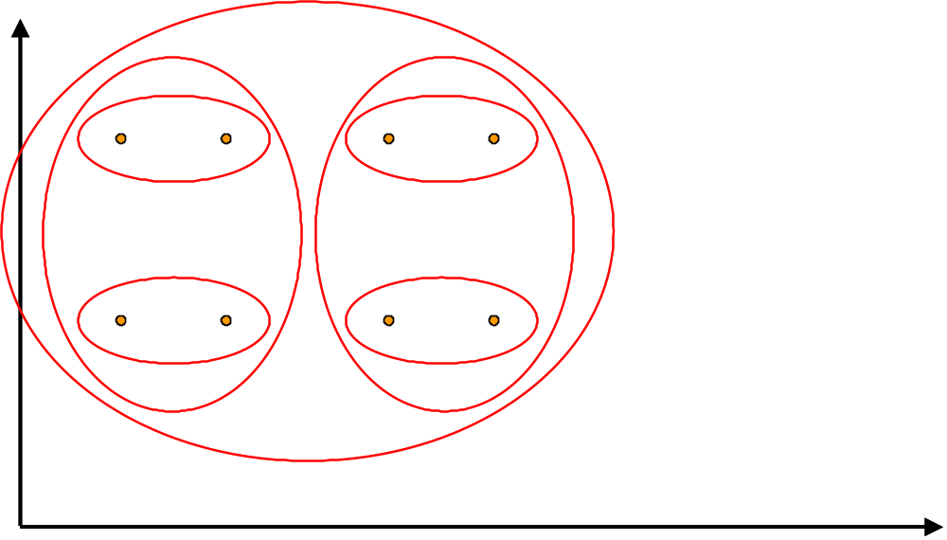
Impact of cluster distance measures
“Single-Link”
(inter-cluster distance=
distance between closest pair of points)
“Complete-Link”
(inter-cluster distance=
distance between farthest pair of points)
[From Mooney]

Slide 24
Complete Link Example

Slide 25
Bisecting K-means
Hybrid method 1
Can pick the largest
Cluster or the cluster
With lowest average
similarity
For I=1 to k-1 do{
  Pick a leaf cluster C to split
  For J=1 to ITER do{
    Use K-means to split C into two sub-clusters, C₁ and C₂
    Choose the best of the above splits and make it permanent}
  }
Divisive hierarchical clustering method
uses K-means

Slide 26
Buckshot Algorithm
Hybrid method 2
Cut where
You have k
clusters
Combines HAC and K-Means clustering.
First randomly take a sample of instances of size √n
Run group-average HAC on this sample, which takes only O(n) time.
Use the results of HAC as initial seeds for K-means.
Overall algorithm is O(n) and avoids problems of bad seed selection.
Uses HAC to bootstrap K-means

Slide 27
Text Clustering
HAC and K-Means have been applied to text in a straightforward way.
Typically use normalized, TF/IDF-weighted vectors and cosine similarity.
Optimize computations for sparse vectors.
Applications:
  During retrieval, add other documents in the same cluster as the initial retrieved documents to improve recall.
  Clustering of results of retrieval to present more organized results to the user (à la Northernlight folders).
  Automated production of hierarchical taxonomies of documents for browsing purposes (à la Yahoo & DMOZ).

Slide 28
Which of these are the best for text?
Bisecting K-means and K-means seem to do better than Agglomerative Clustering techniques for Text document data [Steinbach et al]
  “Better” is defined in terms of cluster quality
    Quality measures:
      Internal: Overall Similarity
      External: Check how good the clusters are w.r.t. user defined notions of clusters

Slide 29
Challenges/Other Ideas
High dimensionality
  Most vectors in high-D spaces will be orthogonal
  Do LSI analysis first, project data into the most important m-dimensions, and then do clustering
    E.g. Manjara
Phrase-analysis
  Sharing of phrases may be more indicative of similarity than sharing of words
    (For full WEB, phrasal analysis was too costly, so we went with vector similarity. But for top 100 results of a query, it is possible to do phrasal analysis)
    Suffix-tree analysis
    Shingle analysis
Using link-structure in clustering
  A/H analysis based idea of connected components
  Co-citation analysis
    Sort of the idea used in Amazon’s collaborative filtering
Scalability
  More important for “global” clustering
  Can’t do more than one pass; limited memory
  See the paper
    Scalable techniques for clustering the web
    Locality sensitive hashing is used to make similar documents collide to same buckets

Slide 30
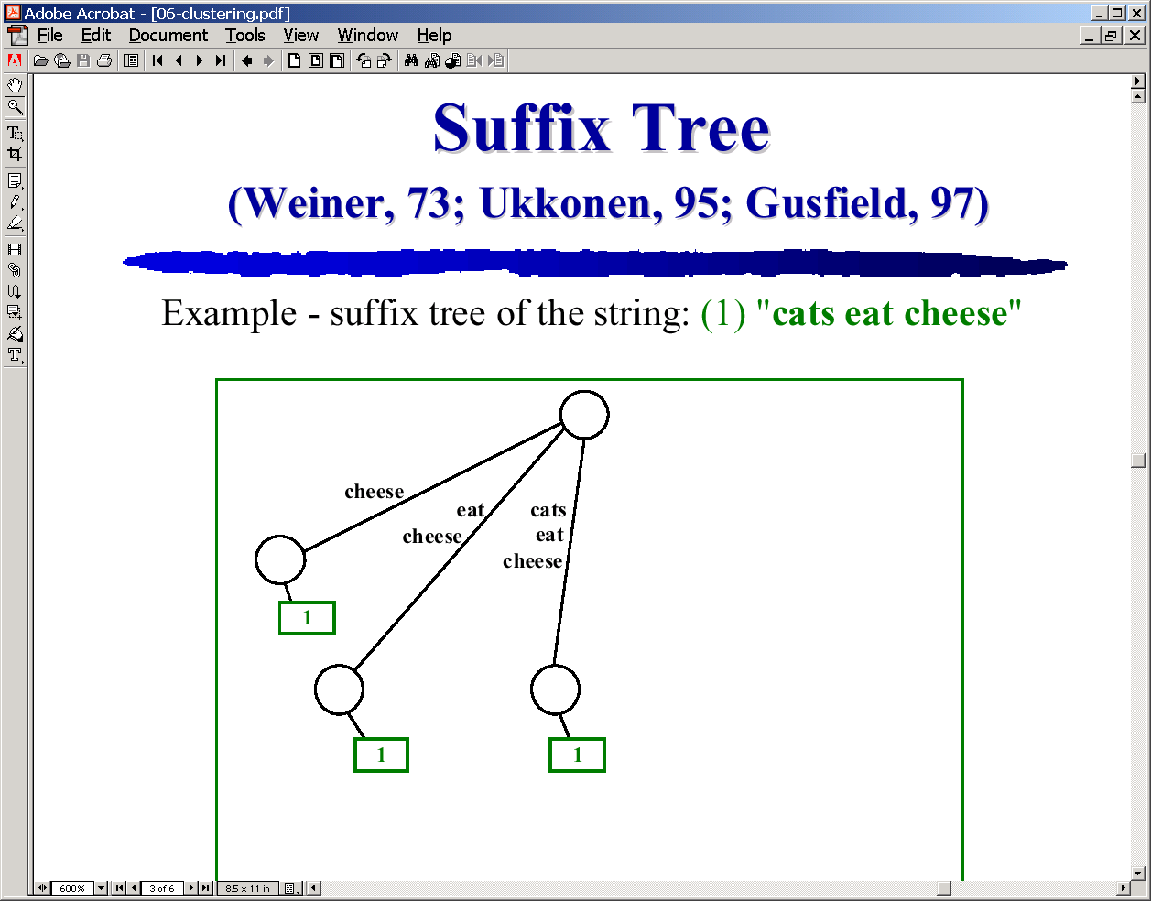
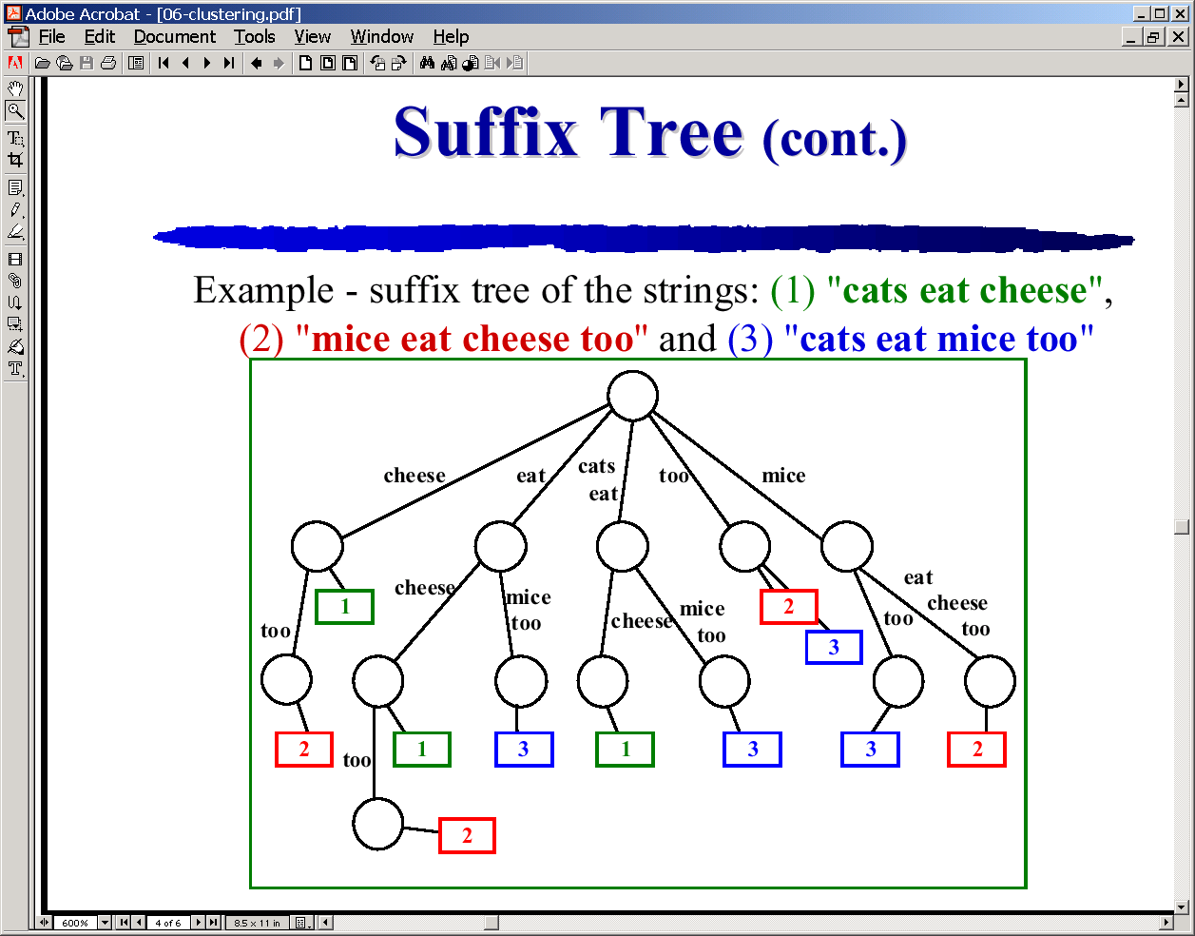
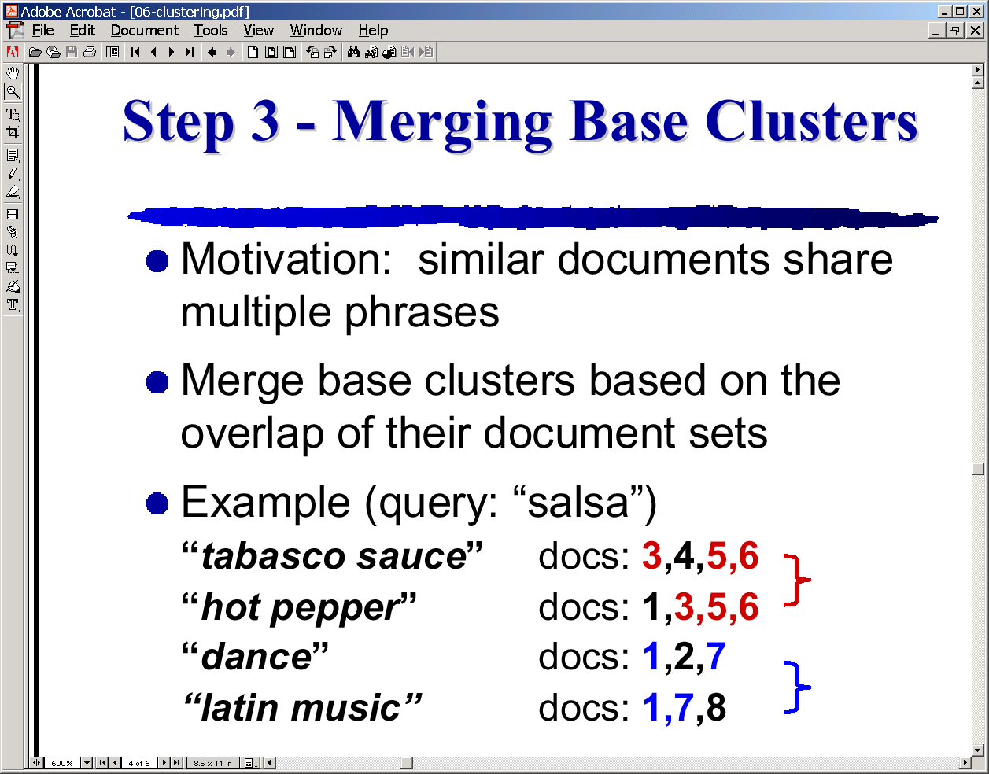
Phrase-analysis based similarity
(using suffix trees)

Slide 31
Other (general clustering) challenges
Dealing with noise (outliers)
  “Neighborhood” methods
    “An outlier is one that has less than δ points within ε distance” (δ, ε pre-specified thresholds)
    Need efficient data structures for keeping track of neighborhood
      R-trees
Dealing with different types of attributes
  Hard to define distance over categorical attributes

