Slide 1
CS476 Bioinformatics Algorithms: Introduction
Dr. Gunes Ercal
gercal@siue.edu

Slide 2
What is bioinformatics?
Biology + Informatics
Computational analysis of biological data for various purposes.
We focus on algorithms for comparative genomics.
A solid background in both biology and computer science is ideal, though a subset of fundamental biological understanding suffices for most bioinformatics purposes.
In a mixed bio-CS team, a common “language” of terms suffices.

Slide 3
Why bioinformatics?
Advances in DNA sequencing technology lead to slew of data.
Functional genomics questions:
Is such and such DNA location functional – if so, in what way?
What genes relate to such and such biological function?
Personal questions: Determination of genetic traits, heredity, disease:
What is the probability that our future child will have Cystic Fibrosis?
Evolutionary questions: Phylogenetic trees and networks

Slide 4
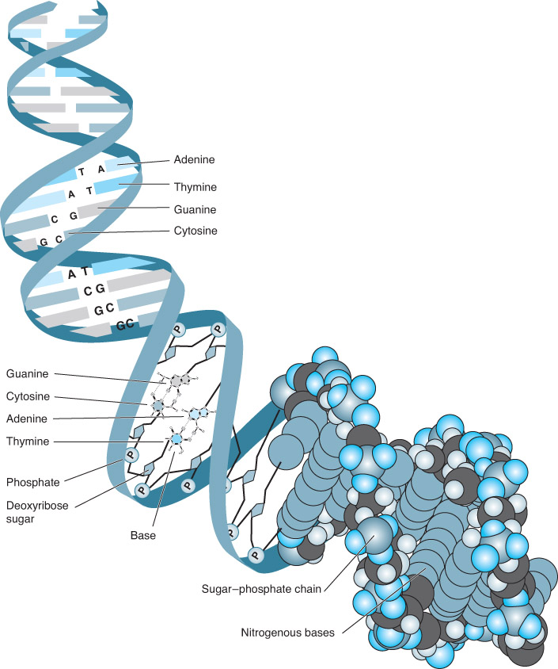
Figure 01.F07: The two strands of base-paired nucleotides that make up a DNA molecule.
DNA: Deoxyribonucleic Acid
Holds our genetic code: Genes
Naturally conducive to computational analysis:
“Strings” over alphabet {A,C,G,T}
(We will drive home this point.)

Slide 5
Before proceeding…
This is a computer science course, not a biology course.
This course also emphasizes algorithms for bioinformatics problems.
Algorithmic problem specification: Input and Output as function of in
The bioinformatics problem statements require
Input form specification:
Strings: over {A,C,G,T} for DNA, {A,C,G,U} for RNA, or 20-letter Amino-Acid alphabet
AA substitution matrix
Biological models and assumptions
Mutation models:
Types of mutations, their relative likelihood, mutation rate
Choice of appropriate reference sequences to compare
Distance measures to quantify dissimilarity of sequences
Maximum parsimony assumptions in modeling evolution
Models related to underlying DNA sequencing technology

Slide 6
Don’t Fret about Biological Background
Biology is an expansive and deep science
Completely understanding the motivations and modeling assumptions for bioinformatics problems may require arbitrarily deep biological study.
You are more than welcome to question assumptions yourself!
I present the most basic biological definitions and fundamentals required today, also motivating biological models in problems as they arise throughout the course.
Short Molecular Biology and Biotechnology Introduction:
Chapter 2 of textbook “Algorithmic Aspects of Bioinformatics”
Another useful reference is NWABR site:
https://www.nwabr.org/teacher-center/introductory-bioinformatics-genetic-testing#lessons
https://www.nwabr.org/teacher-center/advanced-bioinformatics-genetic-research#lessons

Slide 7
Basics
Genes are portions of DNA that encode proteins.
Proteins are the real “building blocks” for all bodily processes!
DNA is packaged in the form of chromosomes.
Basically one long strand of DNA, unwound and accessible for sequencing.
In humans: 23 pairs (maternal and paternal) of chromosomes
22 pairs of homologous autosomes + 1 pair of sex chromosomes (X or Y)
DNA: Double helix nucleotide chains
Each nucleotides composed of:
One of 4 nucleo-bases: Adenine (A), Thymine (T), Guanine (G), Cytosine (C)
Sugar + Phosphate group, called sugar phosphate backbone
Double helix from complementarity of bases and strands: A and T, C and G
Strand orientation: 5’ to 3’ coding strand (numbering carbons on sugar)

Slide 8
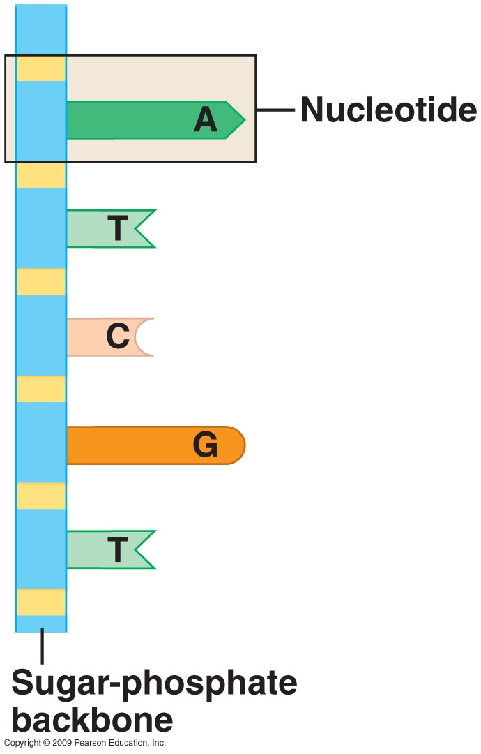
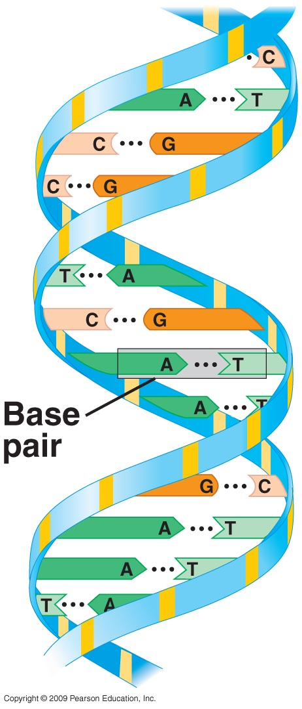

Slide 9
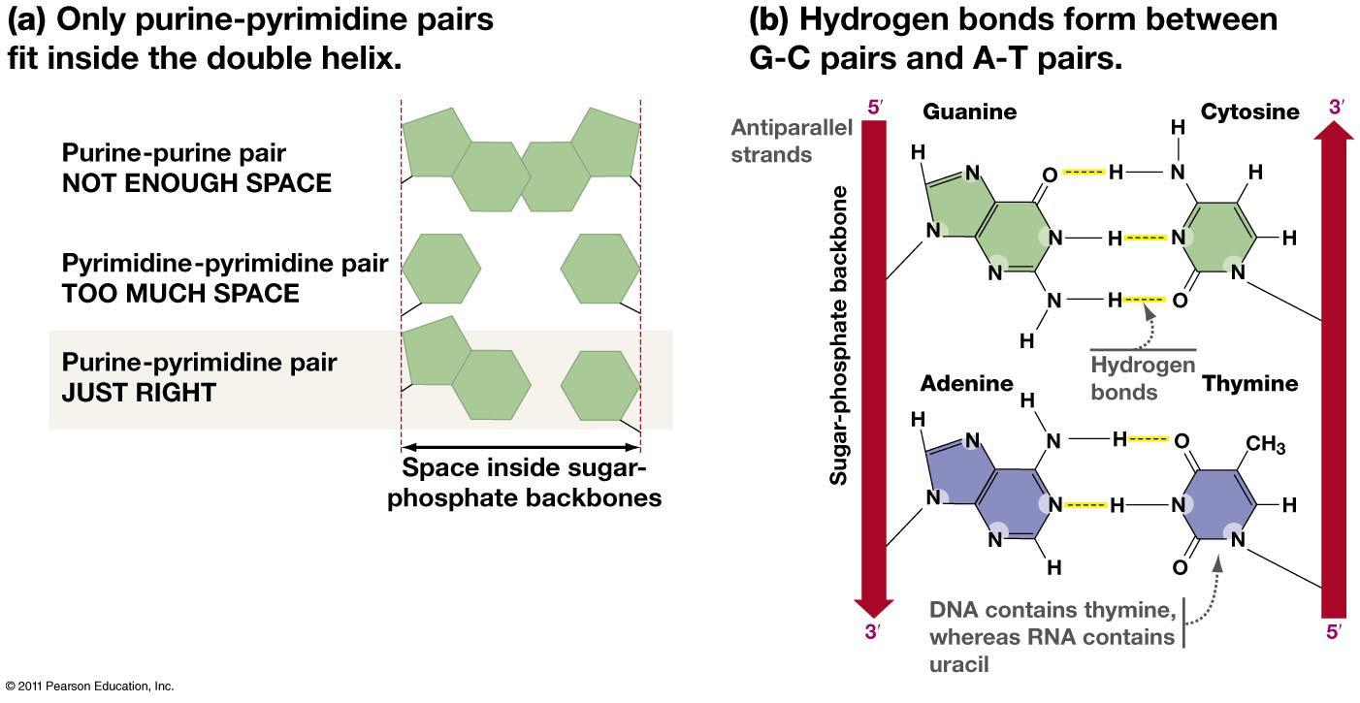

Slide 10
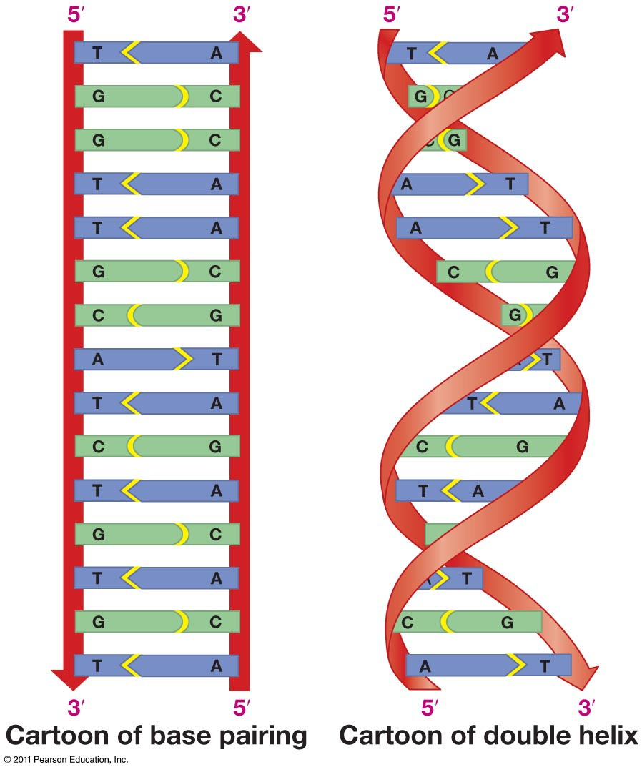

Slide 11
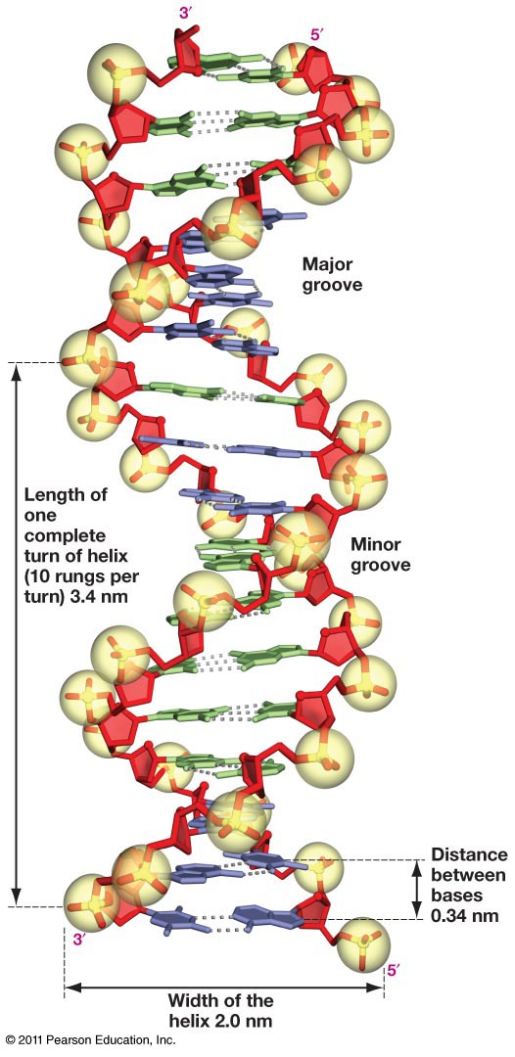

Slide 12
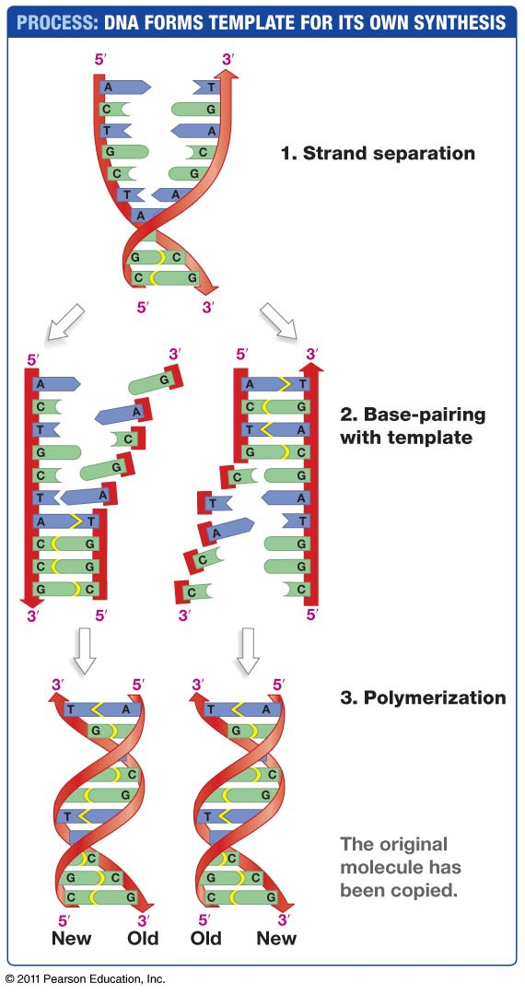
DNA structure is ideal for copying

Slide 13
Basics: Onto Proteins, building blocks of life
Proteins are polypeptide chains: Strings of amino acids
There are 20 different AAs
How do DNA strings of A’s, C’s, G’s, and T’s get “translated” into AAs?
Complications: DNA is sheltered within a cell’s nucleus.
RNA is the conduit between DNA and protein synthesis
Like DNA, RNA is also a string over a 4-letter alphabet:
Adenine, Uracil, Guanine, Cytosine
Three RNA bases make a codon coding for an amino acid!
WLOG: We are talking about string inputs.

Slide 14
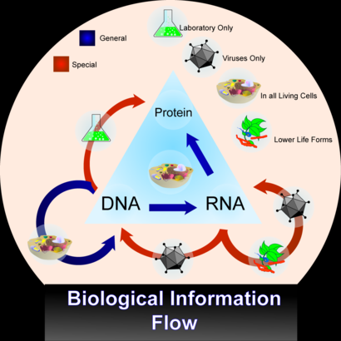
The Central Dogma of Molecular Biology

Slide 15
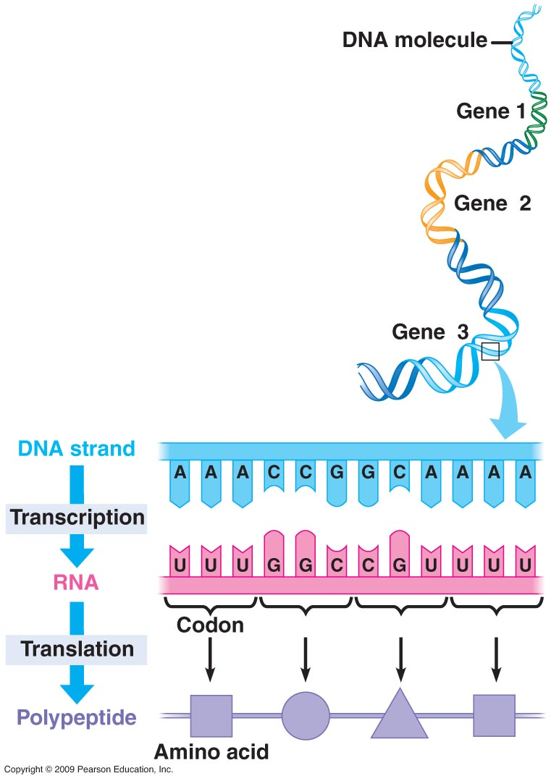

Slide 16
RNA
In many ways like DNA: It is generated by transcription from the DNA.
Differences:
Uses Uracil instead of Thymine
Less stable
Usually single stranded
Can be translated by protein
Exactly what does it look like?
It is a copy of the “Coding” strand of DNA
DNA/RNA synthesis ALWAYS from 5’ to 3’
Means we read the template strand in a 3’ to 5’ direction.
Because we need antiparallel and we must only add to 3’ end.

Slide 17
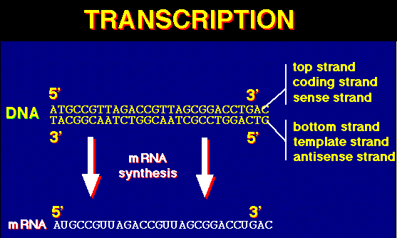
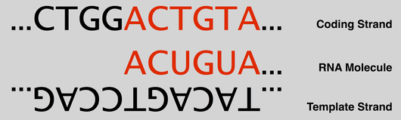
http://rosalind.info/media/coding_template_strands.png

Slide 18
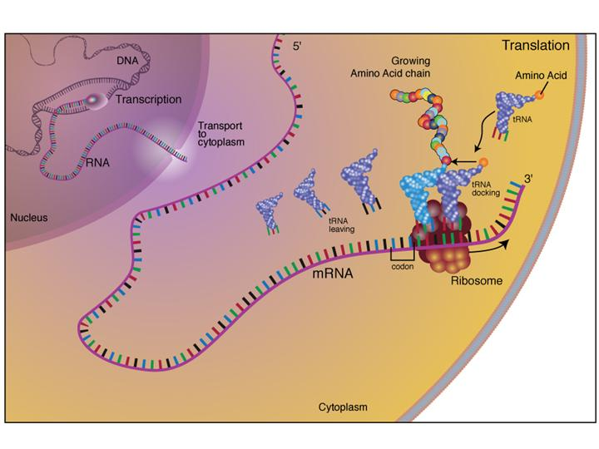
http://www.microbe.net/wp-content/uploads/2011/05/translation.jpg

Slide 19
DNA -> RNA -> Protein
Have DNA.
Use process of Transcription to make RNA
Makes sense based on word. Same basic language (language of nucleotides) but slightly different form
Then use process of Translation to make protein

Slide 20
Translation: Reading the genetic code
DNA Nucleotides (bases) are read in groups of 3.
So basically, 3 ATG makes one “word” and each word is an amino acid. (a protein building block)
Like a language with only 4 letters.
Example:
ATG = Methionine (Met)
Translation from the nucleotide language to the amino acid language.

Slide 21
3-letter words over 4-letter alphabet
Codons
4³=64 – so this leaves 64 possible three letter combinations.
Only 20 AA’s, so that is plenty.
There are multiple ways to get some Aas
All of the info is contained in the following codon chart.

Slide 22
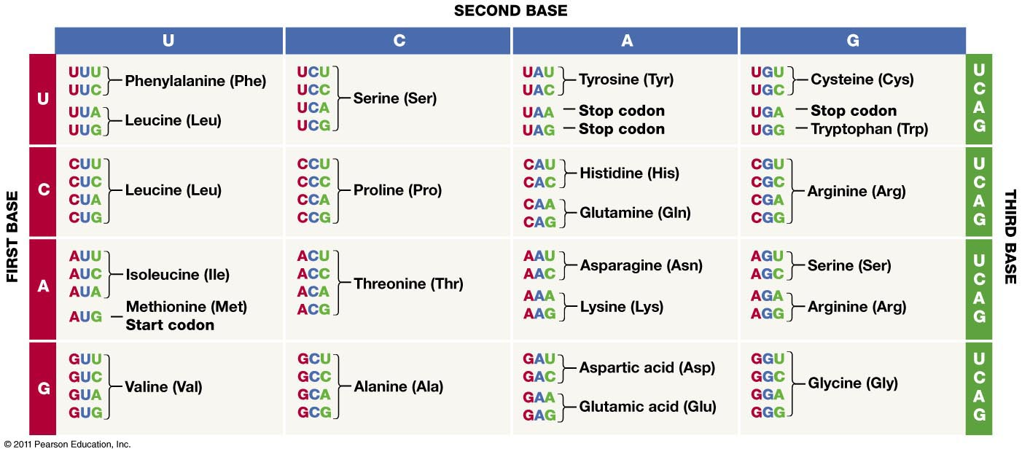
The codon chart

Slide 23
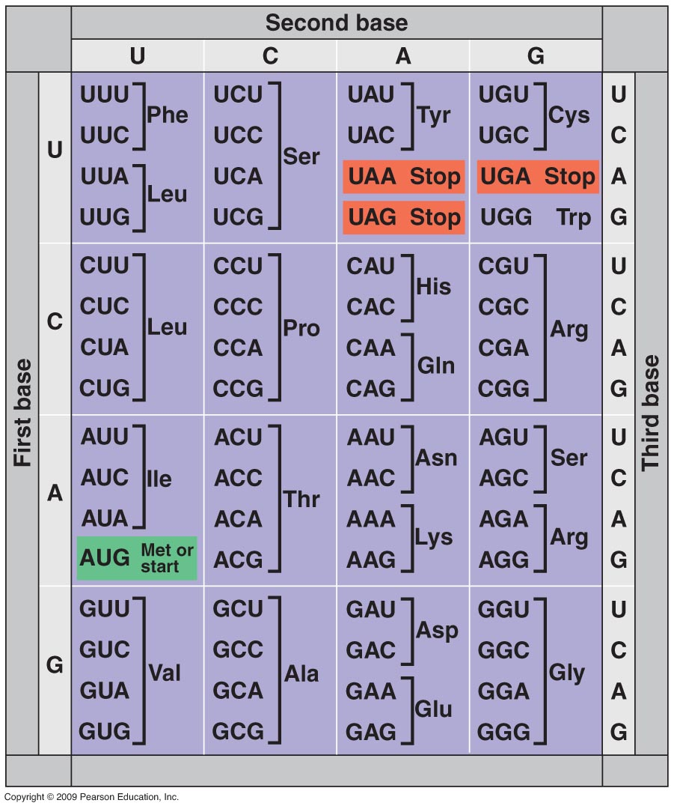
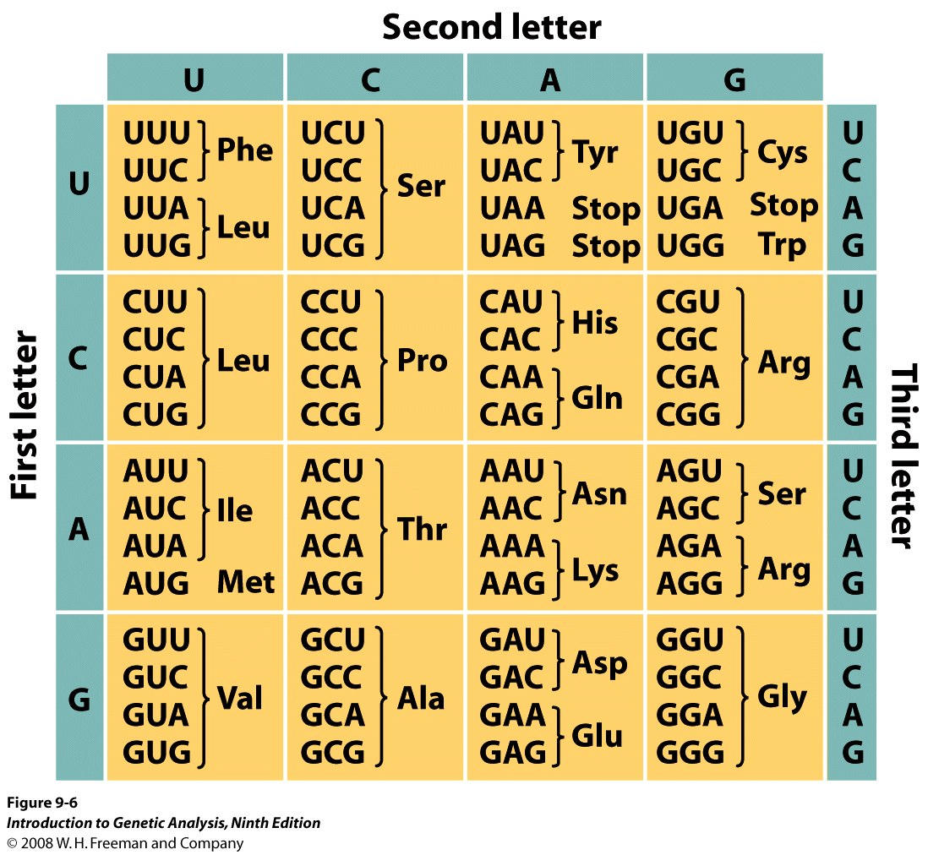

Slide 24
Special Codons
There are two types of special codons.
1) Start Codon = ATG. Know this.
It codes for Methionine.
All proteins start with Methionine.
It sets the “frame”

Slide 25
Stop Codons
2) Also three “nonsense” or stop codons. Means the protein synthesis stops at that point. Nothing comes after it.
UAG, UAA, UGA (or with a “T” when in DNA)
This is how the machinery that makes Protein knows to stop.

Slide 26
Rules of the genetic code
1) it is redundant – All AA’s except Trp and Met are coded by more than one codon.
2) It is unambiguous – Single codon NEVER codes for more than 1 amino acid.
ASK: is english language unambiguous?
NO: Bat, spring, block, pin, bowl, junk.

Slide 27
Rules of the genetic code cont’d…
3) non-overlapping.
Each codon belongs to itself.
Each base is part of only one codon.

Slide 28
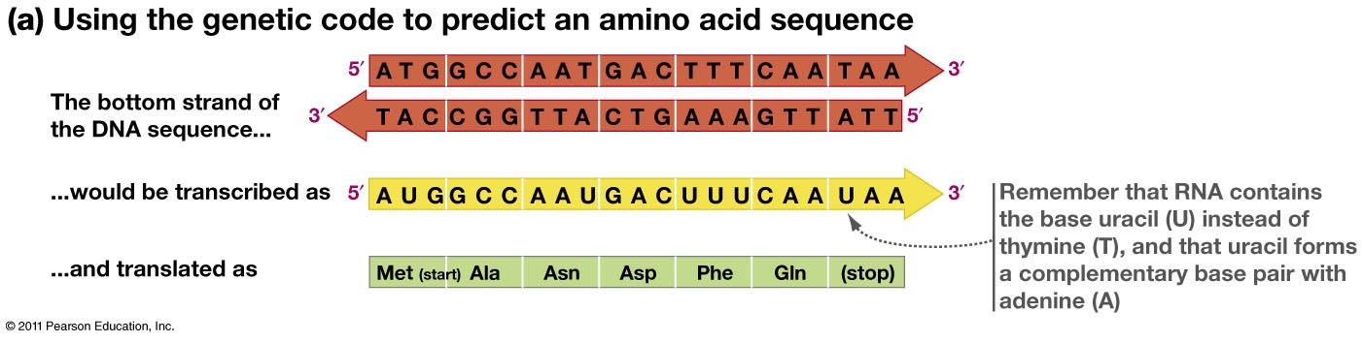

Slide 29
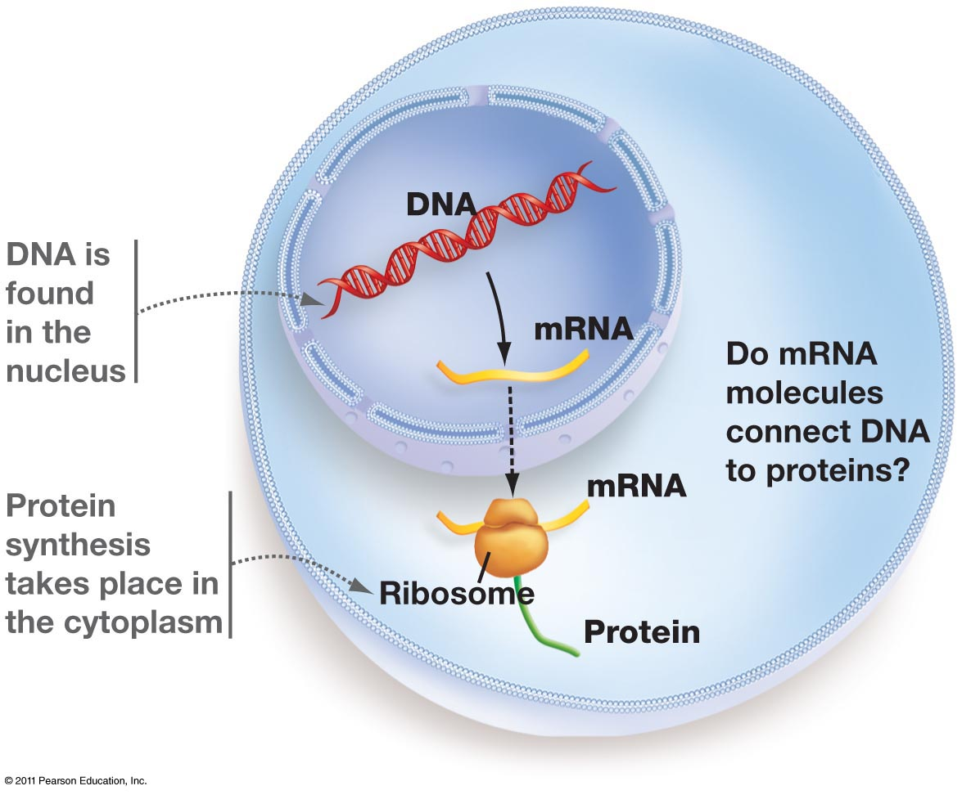
From gene to protein

Slide 30
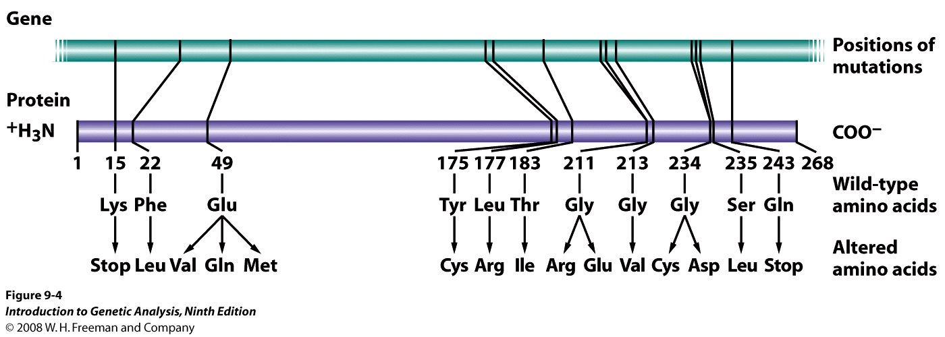
Proteins and Genes are Colinear
Mutations in DNA show specific corresponding changes in the protein
Genes are converted to proteins in a linear fashion

Slide 31
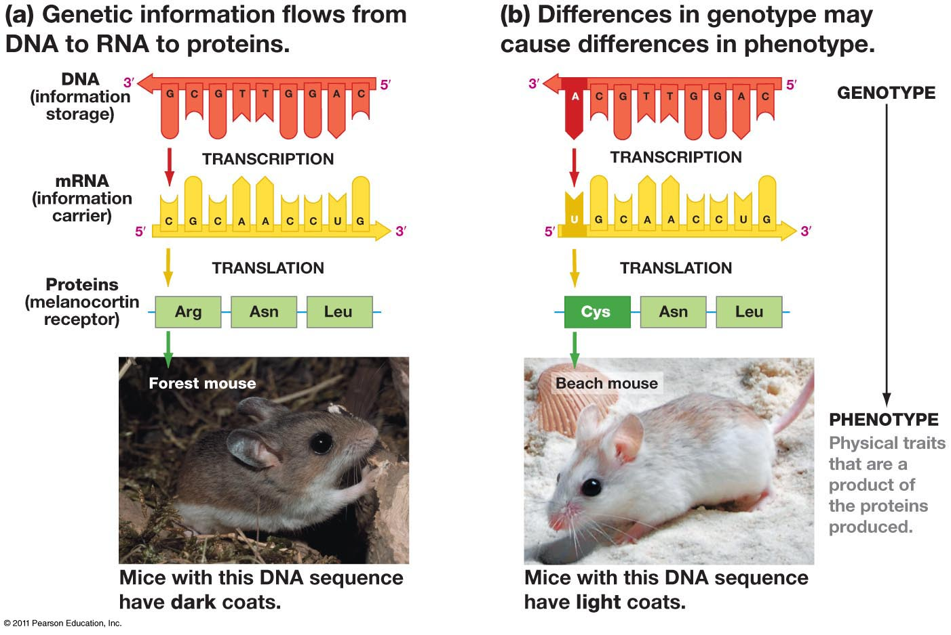
Mutations

Slide 32
From genes to protein
1 gene for 1 protein hypothesis.
Each gene has a corresponding protein.
If the gene is altered, that will lead to alterations in the protein.
This is how mutations work. It is a permanent alteration to DNA. Often leads to an alteration in the composition of a protein.
This can then lead to a change in the function of the protein

Slide 33
3 types of mutation events
4 Outcomes of Mutations
Point mutation
changing one base
SNP
Single
Nucleotide
Polymorphism
Insertion/Deletion
Rarer events
Occurs in “blocks”
Silent mutations:
no AA change.
Normally in 3rd NT of codon
Missense mutations:
Point mutation changes a codon such that resulting AA is changed
Nonsense mutations
Point mutation changes an AA codon to a STOP codon resulting in unfinished/shorter protein
Frameshift mutations
From insertion or deletion
Note: Genome rearrangements far
rarer but important in macro-evolution.

Slide 34
 | Complementary (A-T) | Complementary (G-C)
Purines | Adenine | Guanine
Pyrimidines | Thymine | Cytosine

Slide 35
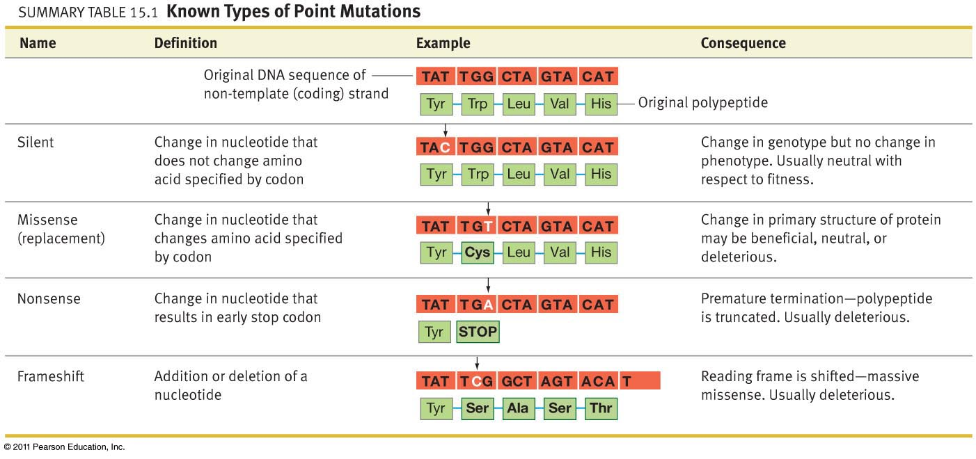
CCG UGG AGA GAC UAA
Pro – Trp – Arg –Asp - Stop
CCG UCG AGA GAC UAA
Pro – Ser – Arg –Asp - Stop
CCG UGG CGA GAC UAA
Pro – Trp – Arg –Asp - Stop
CCG UGG AGA GAC UAA
Pro – Stop
CCG UGG AGA CGA CUA
Pro – Trp – Arg –Arg - Leu

