Slide 1
Neighbor Join Example
Gunes Ercal

Slide 2
Consider the following distance matrix
 | A | B | C | D
A | 0 | 4 | 10 | 10
B | 4 | 0 | 2 | 12
C | 10 | 2 | 0 | 6
D | 10 | 12 | 6 | 0

Slide 3





First calculate average distances r(x)
Then calculate transition distances td(x,y)
Choose the pair (i,j) with smallest td(i,j)
Upon merging into cluster K, recalculate all distances from K to other nodes x.
Also recalculate d of i and j to K:
Repeat all of above until 2 clusters remain.

Slide 4
“Pseudo-average” distances
r(A) = (4+10+10)/2 = 12
r(B) = (4+2+12)/2 = 9
r(C) = (10+2+6)/2 = 9
r(D) = (10+12+6)/2 = 14

Slide 5
Compute Transition Distances
r(A) = 12, r(B) = 9, r(C) = 9, r(D) = 14
TD | A | B | C | D
A | 0 | 4-12-9 = -17 | 10-12-9 = -11 | 10-12-14 = -16
B | -17 | 0 | 2-9-9 = -16 | 12-9-14 = -11
C | -11 | -16 | 0 | 6-9-14 = -17
D | -16 | -11 | -17 | 0

Slide 6
There is a tie for min TD distance!
The “default” thoughtless tie-breaker is just lexicographic: <A,B> before <C,D>.
There could be any kind of tie-breaker based on any property.
Here, however, we will take a natural tie-breaker considering distances d: Pick min d(x,y) over tying pairs.
Here that happens to also be the lexicographically smaller one: (A,B) since 4 < 6.
TD | A | B | C | D
A | 0 | -17 | -11 | -16
B | -17 | 0 | -16 | -11
C | -11 | -16 | 0 | -17
D | -16 | -11 | -17 | 0

Slide 7

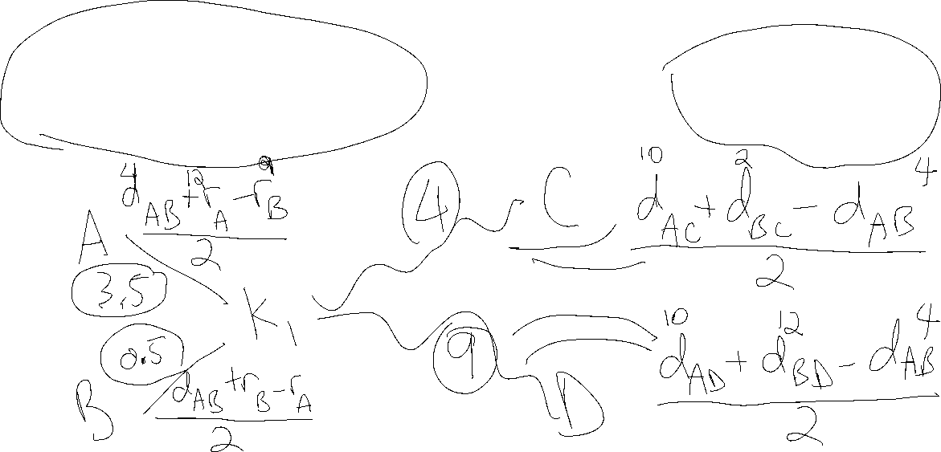
After merging K1=(A,B), recompute d(K1,x).

Slide 8
New distance matrix
d | K1 = (A,B) | C | D
K1 = (A,B) | 0 | 4 | 9
C | 4 | 0 | 6
D | 9 | 6 | 0

Slide 9
Recompute pseudo-ave dists and TD matrix
r(AB) = 13, r(C) = 10, r(D) = 15
TD | AB | C | D
AB | 0 | 4-13-10 = -19 | 9-13-15 = -19
C | -19 | 0 | 6-10-15 = -19
D | -19 | -19 | 0

Slide 10
All Ties!!!
But, if we use d(x,y) as tie-breaker, then (AB,C) wins (because of 4 d).
TD | AB | C | D
AB | 0 | -19 | -19
C | -19 | 0 | -19
D | -19 | -19 | 0

Slide 11

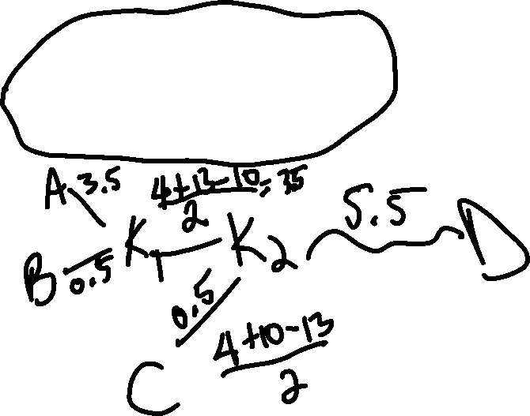

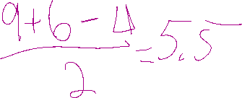
After merging K2=(K1,C), recompute d(K2,x).

Slide 12
Final comments
We get (((A, B), C), D)
With branch lengths: (((A:3.5, B:0.5):3.5, C:0.5), D:5.5)
From the last matrix, it is clear that the following are also valid phylogenetic tree topologies: (((A,B), D), C) and ((A,B), (C,D))
Can you compute the distances for those two?
From slide 6 (the first TD matrix), we could have chosen (C,D) to merge first. In that case, you might wonder if there are other valid phylogenetic trees involving (C,D) as well…
What about UPGMA on the same example?
What pair has the smallest distance, i.e. the first pair UPGMA merges.

