Slide 1
Molecular Evolution

Slide 2
Evolutionary Trees
Evolutionary Tree: A tree constructed from DNA sequences of several organisms.
  Leaves represent existing species.
  Internal vertices represent ancestors.
  Edges represent evolutionary steps.
  Root represents the oldest evolutionary ancestor of the existing species represented in the tree.

Slide 3
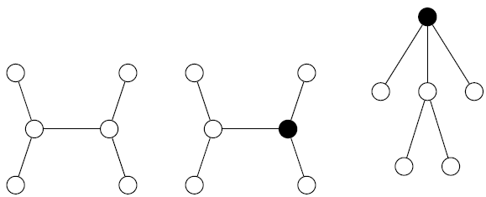
Rooted and Unrooted Trees
In an unrooted tree, the position of the root (“oldest ancestor”) is unknown.
Otherwise, the tree is rooted and can be oriented with the root at the top.
Unrooted Tree
Rooted Tree
Root at the Top

Slide 4
Distance in Trees
Edges may have weights reflecting:
  Number of mutations on evolutionary path from one species to another.
  Time estimate for evolution of one species into another.
In a tree T, we often compute:
  d_{i,j}(T) = the length of a path between leaves i and j
  d_{i,j}(T) = tree distance between i and j

Slide 5
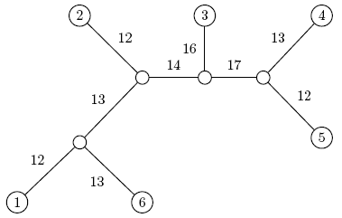
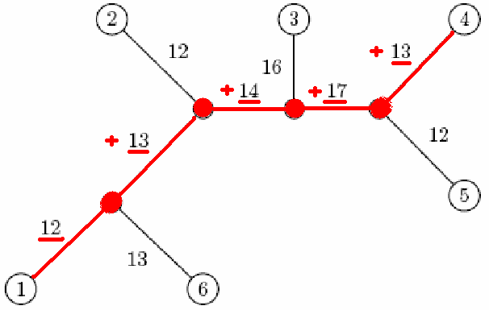
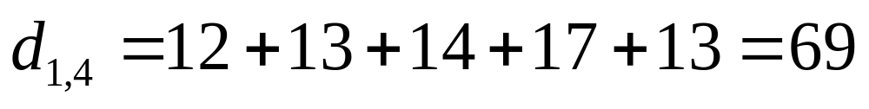
Distance in Trees: Example
j
i

Slide 6
Distance Matrix
Given n species, we can compute the n x n distance matrix D_{i,j}.
D_{i,j} may be defined as the edit distance between a gene in species i and species j, where the gene of interest is sequenced for all n species.
Note the difference between D_{i,j} and d_{i,j}(T).

Slide 7
Fitting Distance Matrix
Given n species, we can compute the n x n distance matrix D_{i,j}.
The evolution of these genes is described by a tree that we don’t know.
We need an algorithm to construct a tree that best fits the distance matrix D_{i,j}.
Fitting means D_{i, j} = d_{i, j}(T).
Lengths of path in an (unknown) tree T
Edit distance between species (known)

Slide 8
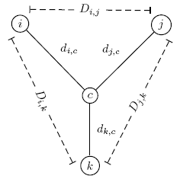
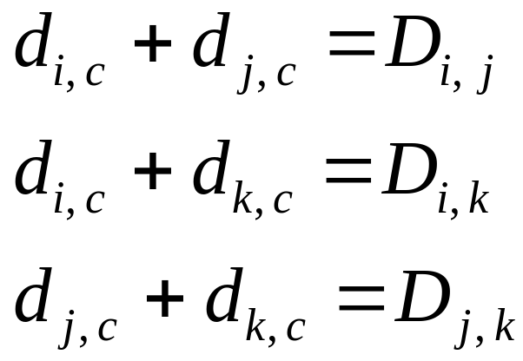
Reconstructing a 3-Leaved Tree
Tree reconstruction for any 3x3 matrix is straightforward.
We have 3 leaves i, j, k and a center vertex c.
Observe:

Slide 9
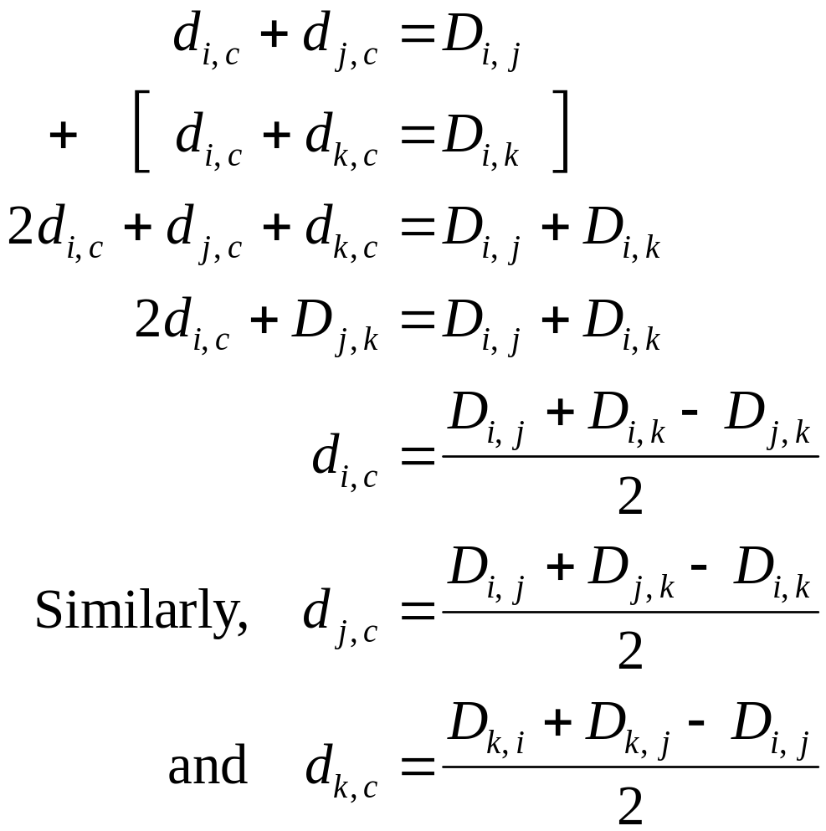
Reconstructing a 3-Leaved Tree

Slide 10
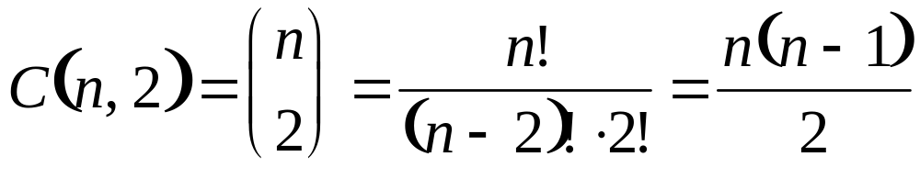
Trees with > 3 Leaves
A binary tree with n leaves has 2n – 2 edges.
This means fitting a given tree to a distance matrix D requires solving a system of C(n, 2) equations with 2n – 2 variables.
  Recall:
This set of equations is not always possible to solve for n > 3, as it was in the n = 3 case.

Slide 11
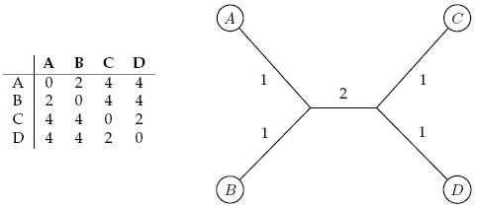

Additive Distance Matrices
Matrix D is additive if there exists a tree T with d_{i,j}(T) = D_{i,j}
D is nonadditive otherwise.
Additive Matrix
Nonadditive Matrix

Slide 12
Distance Based Phylogeny Problem
Goal: Reconstruct an evolutionary tree from a distance matrix.
Input: n x n distance matrix D_{i, j}.
Output: Weighted tree T with n leaves fitting D.
If D is additive, this problem has a solution and there is a simple algorithm to solve it.

Slide 13
Section 5:
Neighbor-Joining Algorithm

Slide 14
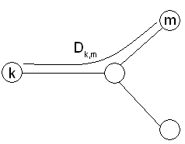
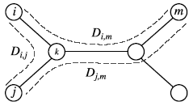
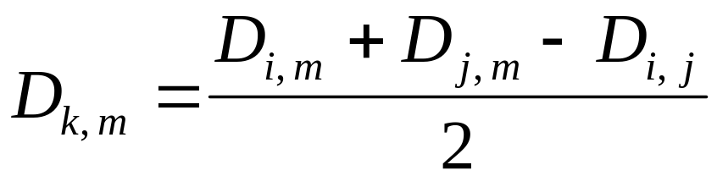
Using Neighboring Leaves to Construct the Tree
Find neighboring leaves i and j with parent k.
Then compress leaves i and j into k as follows:
  Remove the rows and columns of i and j.
  Add a new row and column corresponding to k, where the distance from k to any other leaf m can be recomputed by the equation below:
Compressing i and j into k

Slide 15
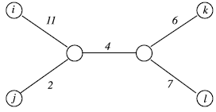
How Do We Find Neighboring Leaves?
Proposal: To find neighboring leaves we simply select a pair of closest leaves in the tree.
  WRONG
Closest leaves in the tree aren’t necessarily neighbors.
  Example: i and j are neighbors, but d_{i,j} = 13 > d_{j,k} = 12
Finding a pair of neighboring leaves is a nontrivial problem

Slide 16


Neighbor-Joining Algorithm
1987: Naruya Saitou and Masatoshi Nei develop a neighbor-joining algorithm for phylogenetic tree reconstruction.
Idea: Finds a pair of leaves that are close to each other but far from other leaves: Implicitly finds a pair of neighboring leaves.
Advantages: Works well for additive and other non-additive matrices and does not have the flawed molecular clock assumption.
Naruya Saitou
Masatoshi Nei

Slide 17
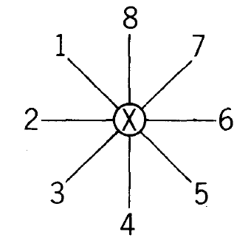
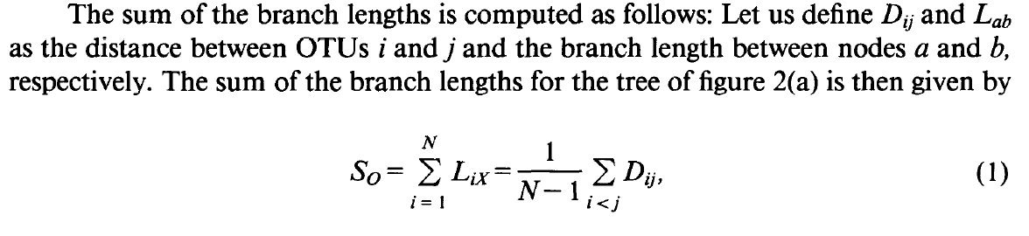

Slide 18
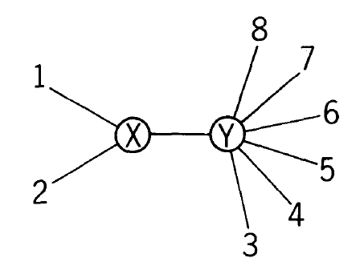
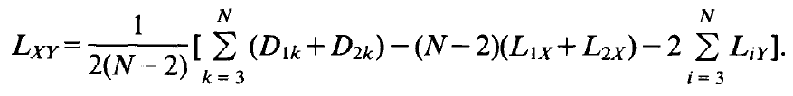

Slide 19
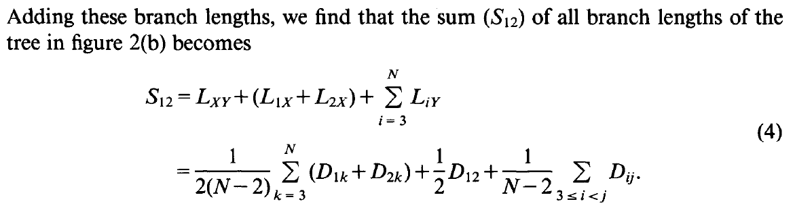
The goal of the Neighbor Join method (and other parsimony methods) is to choose a sequence of neighbors to join such that the resulting tree has the minimum total branch length.

Slide 20




First calculate average distances r(x)
Then calculate transition distances td(x,y)
Choose the pair (i,j) with smallest td(i,j)
Upon merging into cluster K, recalculate all distances from K to other nodes x.
Also recalculate d of i and j to K:
Repeat all of above until 2 clusters remain.

Slide 21
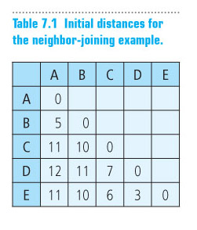
Figure 07.T01: Initial distances for the neighbor-joining example.

Slide 22
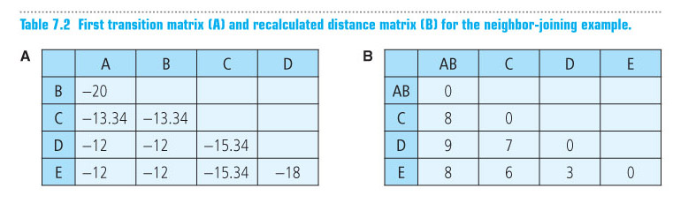
Figure 07.T02: First transition matrix and recalculated distance matrix for the neighbor-joining example.

Slide 23
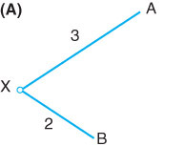
Figure 07.F07A: Species A and B merge to form the first cluster, with a common ancestor designated by X.

Slide 24
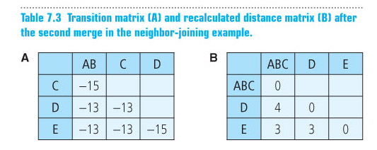
Figure 07.T03: Transition matrix and recalculated distance matrix after the second merge in the neighbor-joining example.

Slide 25
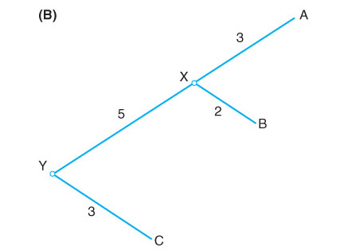
Figure 07.F07B: Species C merges with the AB cluster, giving a common ancestor designated by Y.

Slide 26
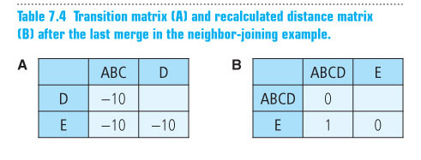
Figure 07.T04: Transition matrix and recalculated distance matrix after the last merge in the neighbor-joining example.

Slide 27
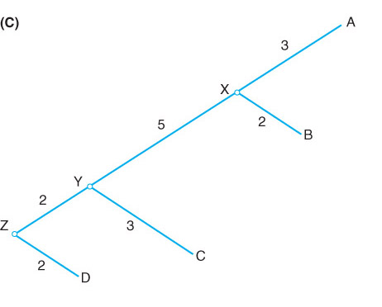
Figure 07.F07C: Species D merges with the ABC cluster, giving a common ancestor designated by Z.

Slide 28
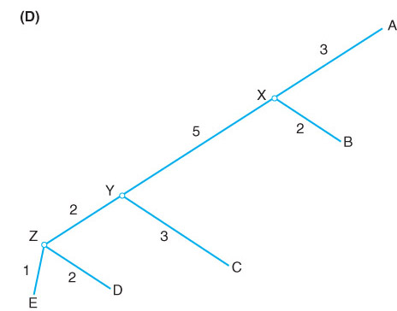
Figure 07.F07D: The finished tree after adding the branch to species E.

Slide 29
Section 6:
Additive Phylogeny

Slide 30
Degenerate Triples
A degenerate triple is a set of three distinct elements
1 ≤ i , j , k ≤ n for which D_{i,j} + D_{j,k} = D_{i,k}
Interpretation: Element j in a degenerate triple i, j, k lies on the evolutionary path from i to k (or is attached to this path by an edge of length 0).
  Example: Illustrated below are the two possible examples.
i
k
i
j
k
0
j

Slide 31
Looking for Degenerate Triples
Why are degenerate triples of any interest?
If distance matrix D has a degenerate triple i, j, k then j can be “removed” from D thus reducing the size of the problem.
If distance matrix D does not have a degenerate triple i, j, k, one can “create” a degenerative triple in D by shortening all hanging edges (in the tree).
i
k
i
j
k
0
j

Slide 32
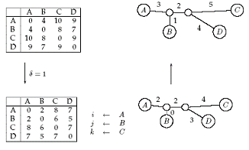
Shortening Hanging Edges
Shorten all “hanging” edges (edges that connect leaves) until a degenerate triple is found.

Slide 33
Finding Degenerate Triples
If there is no degenerate triple, the length of all hanging edges is reduced by the same amount δ, so that all pair-wise distances in the matrix are reduced by 2δ.
Eventually this process collapses one of the leaves (when δ = length of shortest hanging edge), forming a degenerate triple i, j, k and reducing the size of the distance matrix D.
The attachment point for j can be recovered in the reverse transformations by saving D_{i,j} for each collapsed leaf.

Slide 34
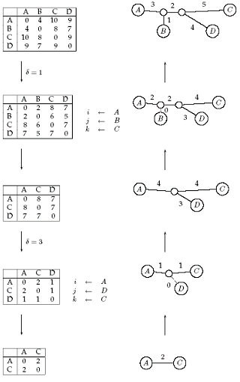
Reconstructing Trees for Additive Matrices
At right is an example of constructing a tree for an additive matrix.
The first stage is to continually find degenerate triples and compress the matrix until we only have two vertices.
We then iteratively draw the tree by reversing this process.

Slide 35
AdditivePhylogeny Algorithm Part I
AdditivePhylogeny(D)
if D is a 2 x 2 matrix
T = tree of a single edge of length D_{1,2}
return T
if D is non-degenerate
δ = trimming parameter of matrix D
for all 1 ≤ i ≠ j ≤ n
D_{ij} = D_{ij} - 2δ
else
δ = 0

Slide 36
AdditivePhylogeny Algorithm Part II
Find a triple i, j, k in D such that D_{ij} + D_{jk} = D_{ik}
x = D_{ij}
Remove j^{th} row and j^{th} column from D
T = AdditivePhylogeny(D)
Add a new vertex v to T at distance x from i to k
Add j back to T by creating an edge (v,j) of length 0
for every leaf l in T
if distance from l to v in the tree ≠ D_{l,j}
output “matrix is not additive”
return
Extend all “hanging” edges by length δ
return T

Slide 37
The Four Point Condition
AdditivePhylogeny provides a way to check if our distance matrix D is additive
An even more efficient check for additivity of our matrix is the “four-point condition.”

Slide 38
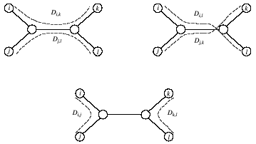
The Four Point Condition: Motivating Example
Compute:

Slide 39
The Four Point Condition: Motivating Example
Compute: 1. D_{i,k} + D_{j,l},
1

Slide 40
The Four Point Condition: Motivating Example
Compute: 1. D_{i,k} + D_{j,l}, 2. D_{i,j} + D_{k,l},
1
2

Slide 41
The Four Point Condition: Motivating Example
Compute: 1. D_{i,k} + D_{j,l}, 2. D_{i,j} + D_{k,l}, 3. D_{i,l} + D_{j,k}
1
3
2

Slide 42
The Four Point Condition: Motivating Example
Compute: 1. D_{i,k} + D_{j,l}, 2. D_{i,j} + D_{k,l}, 3. D_{i,l} + D_{j,k}
1
3
2
1 and 3 represent the same number: the length of all edges + the middle edge (it is counted twice)

Slide 43
The Four Point Condition: Motivating Example
Compute: 1. D_{i,k} + D_{j,l}, 2. D_{i,j} + D_{k,l}, 3. D_{i,l} + D_{j,k}
1
3
2
1 and 3 represent the same number: the length of all edges + the middle edge (it is counted twice)
2 represents a smaller number: the length of all edges – the middle edge

Slide 44
The Four Point Condition Theorem
The four point condition for the quartet i, j, k, l is satisfied if two of the following sums are the same, with the third sum smaller than these first two.
  D_{i, j} + D_{k, l}
  D_{i,} _{k} + D_{j, l}
  D_{i, l} + D_{j, k}
Theorem : An n x n matrix D is additive if and only if the four point condition holds for every quartet 1 ≤ i, j, k, l ≤ n.

Slide 45
Section 7:
Least-Squares Distance Phylogeny

Slide 46
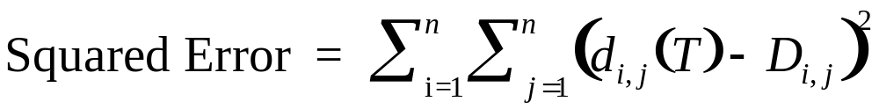
Least Squares Distance Phylogeny Problem
If the distance matrix D is NOT additive, then we look for a tree T that approximates D the best:
Squared Error is a measure of the quality of the fit between distance matrix and the tree: we want to minimize it.
Least Squares Distance Phylogeny Problem: Find the best approximation tree T for a non-additive matrix D.
  This problem is NP-Hard.

