Slide 1
Protein Alignments and Substitution Matrices

Slide 2
Credit and Copyright notice
Most of the images and content in this powerpoint presentation are from Dr. Didier Gonze’s Université Libre de Bruxelles Bioinformatique course.
A subset of the images and content are also based on the course site for Bioinformatics and Functional Genomics by Jonathan Pevsner (ISBN 0-471-21004-8). Copyright © 2009 by John Wiley & Sons, Inc.

Slide 3
Protein vs. DNA alignments
Protein is more informative (20 vs 4 characters)
many amino acids share related biophysical properties
Codons are degenerate:
changes in 3rd position often don’t alter the amino acid
Protein sequences offer a longer “look-back” time
DNA sequences can be translated into protein
and then used in pairwise alignments

Slide 4
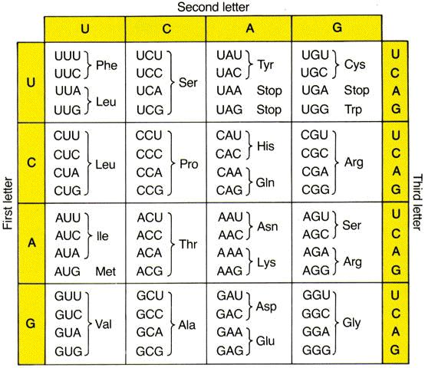

Slide 5
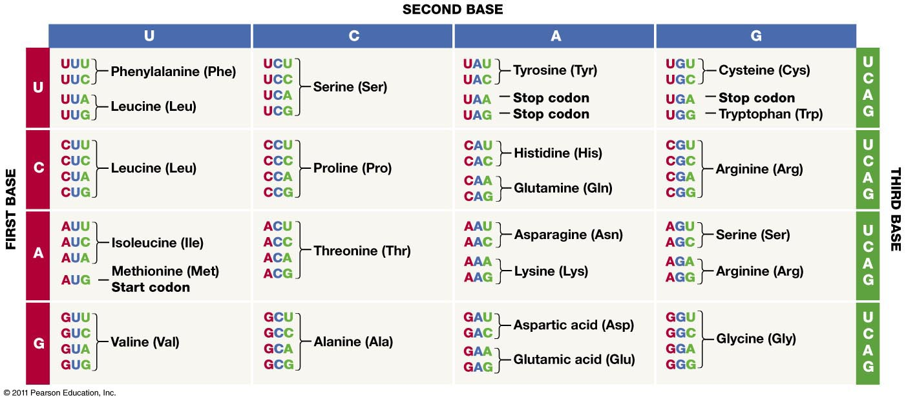
The codon chart

Slide 6
Substitution Matrix
A substitution matrix contains values reflective of the probability that amino acid i mutates into amino acid j for all pairs of amino acids, through a period of evolution.
Constructed by assembling a large and diverse sample of verified alignments of amino acids.
Two major types: PAM and BLOSUM.
PAM: based on rate of divergence between sequences
Larger PAMs -> more evolutionarily dissimilar
BLOSUM: based on conserved domains in proteins
Larger BLOSUMs -> more evolutionarily similar

Slide 7
Global alignment update
Let g < 0 be the gap penalty.
Let S[Xi,Yj] the substitution score of Xi substituted by Yj:
Includes situation that Xi == Yj
Then OPT(i,j) = MAX of
S[Xi,Yj] + OPT(i-1,j-1)
g + OPT(i-1,j) when last event is a deletion
g + OPT(i,j-1) when last event is an insertion

Slide 8
Local Alignment Update
Let g < 0 be the gap penalty.
Let S[Xi,Yj] the substitution score of Xi substituted by Yj.
OPT(i,j) = MAX of
0 ignores prefixes and restarts
S[Xi,Yj] + OPT(i-1,j-1)
g + OPT(i-1,j)
g + OPT(i,j-1)
OPT of the entire alignment is then taken as the maximum over all (i,j) pairs of OPT(i,j)
This allows us to ignore the suffixes that follow.

Slide 9
Semi-Global Alignment
Ignoring a prefix: Set OPT(0,j) = 0 for all j, and OPT(i,0) = 0 for all i.
For all i,j > 0: OPT(i,j) = MAX of
S[Xi,Yj] + OPT(i-1,j-1) when last event is a substitution (Xi <> Yj) or match (Xi = Yj)
g + OPT(i-1,j) when last event is a deletion
g + OPT(i,j-1) when last event is an insertion
Let MAX_end be the max of the OPT matrix’s last row or column.
max { OPT(n,0),OPT(n,1), …, OPT(n,m), OPT(0,m), OPT(1,m), …, OPT(n-1,m))}
The alignment extracted will backtrack from entry MAX_end

Slide 10
PAM matrices:
Point-accepted mutations
Based on alignments of closely related proteins.
PAM1 is the matrix calculated from comparisons of sequences with no more than 1% divergence. At an evolutionary interval of PAM1, one change has occurred over a length of 100 amino acids.
Other PAM matrices extrapolated from PAM1: For PAM250, 250 changes have occurred for two proteins over a length of 100 amino acids.
All the PAM data come from closely related proteins (>85% amino acid identity).

Slide 11
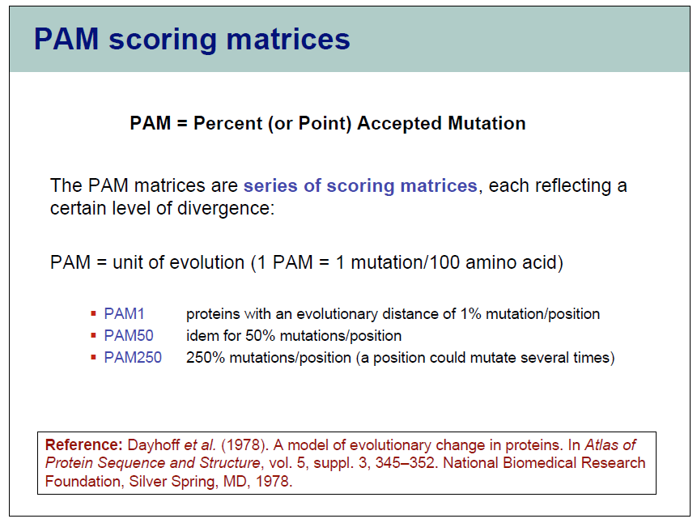

Slide 12
Origin of PAM Matrices
Proposed by Margaret Dayhoff in 1978
Examined 1572 changes in 71 groups of similar proteins (>85%)
Each sequence group organized into a phylogenetic tree
Models order in which substitutions occurred
Parsimony based tree: “minimization” model
Extract multiple alignment
Count the number of changes of each amino acid into every other amino acid
Each substitution considered to be an “accepted mutation”
an amino acid change “accepted” by natural selection
From these extract: Mutation Probability Matrix

Slide 13
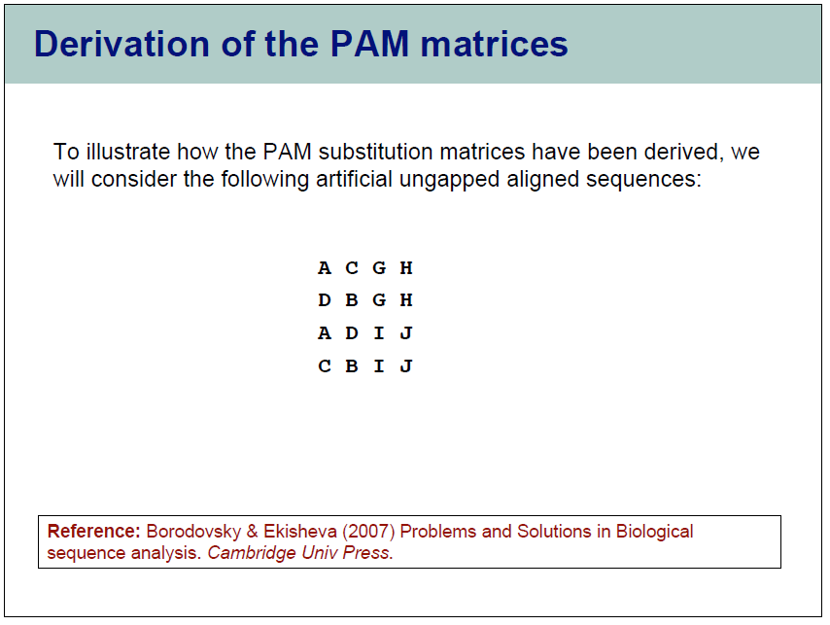

Slide 14
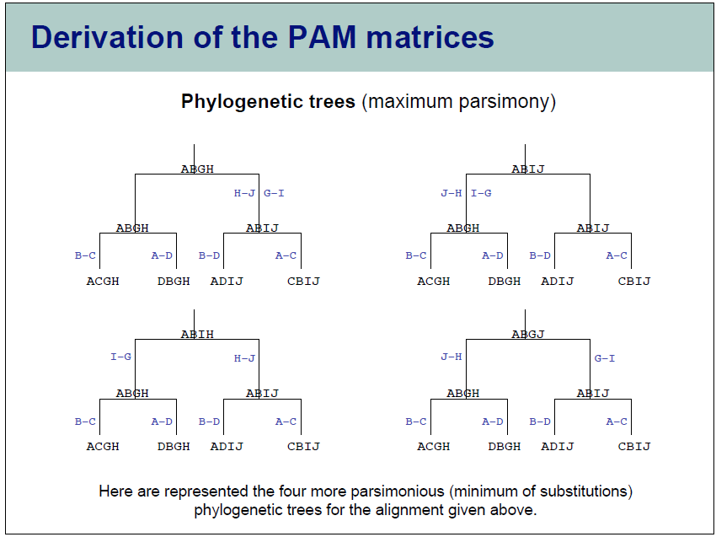

Slide 15
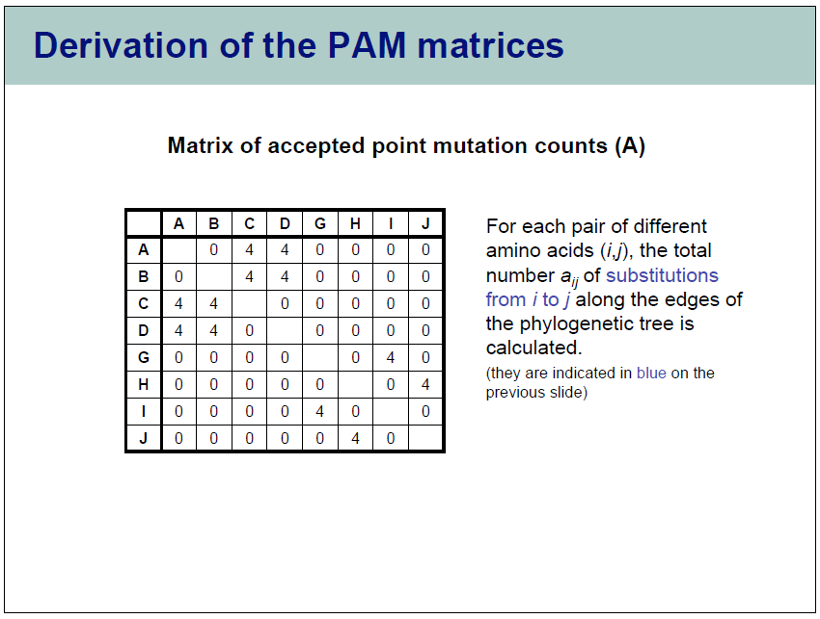

Slide 16
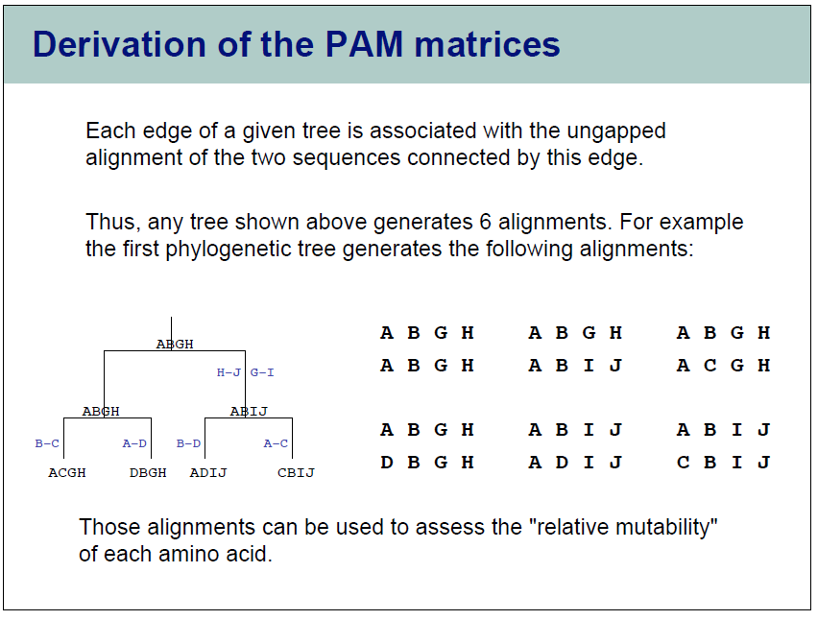

Slide 17
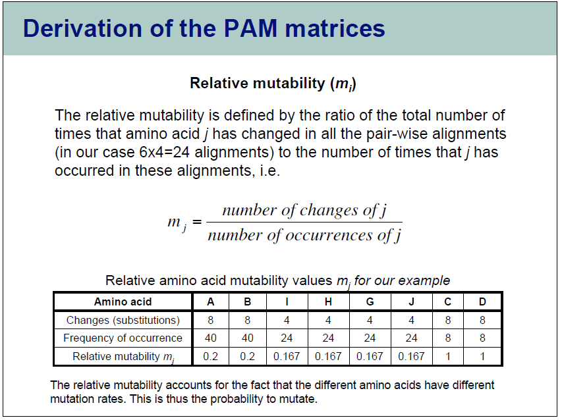

Slide 18
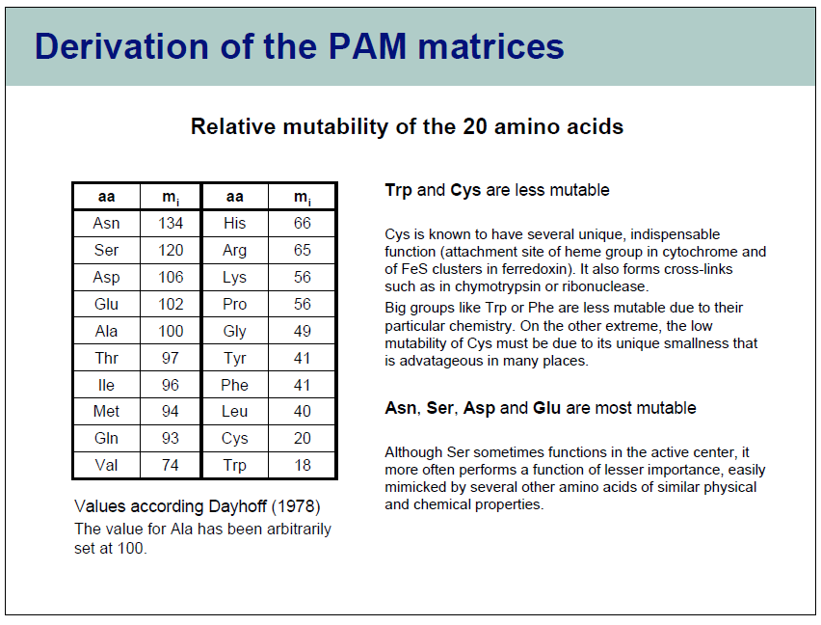

Slide 19
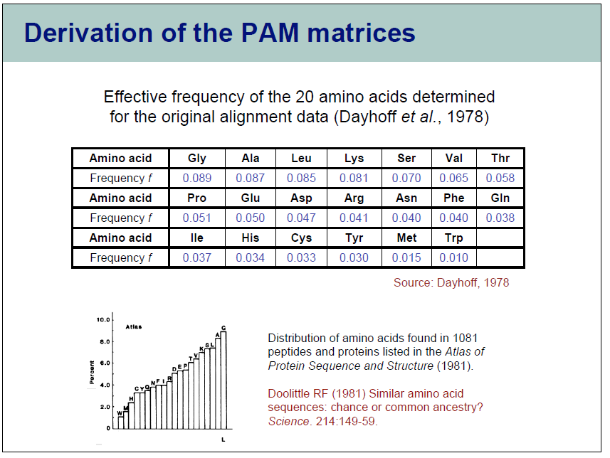

Slide 20
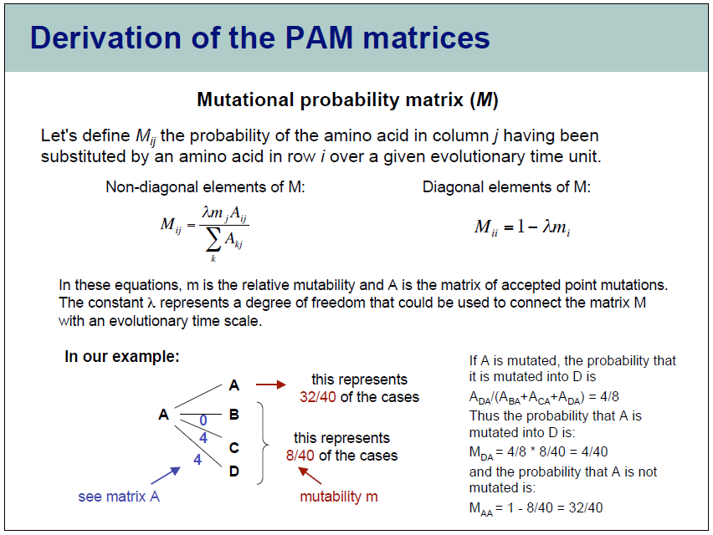

Slide 21
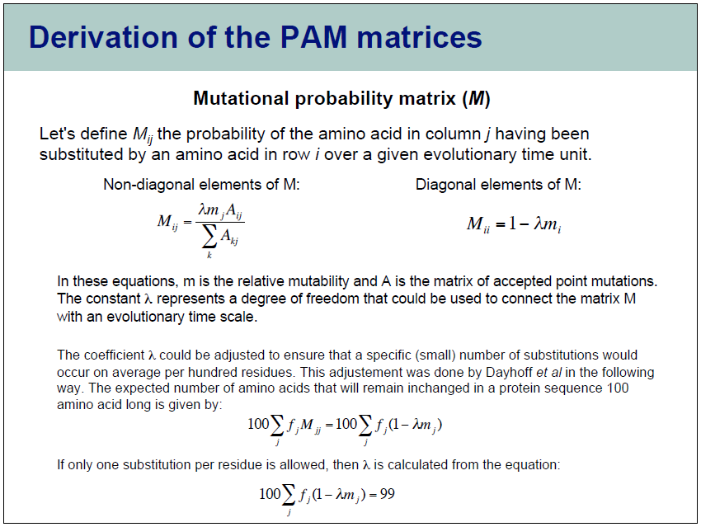

Slide 22
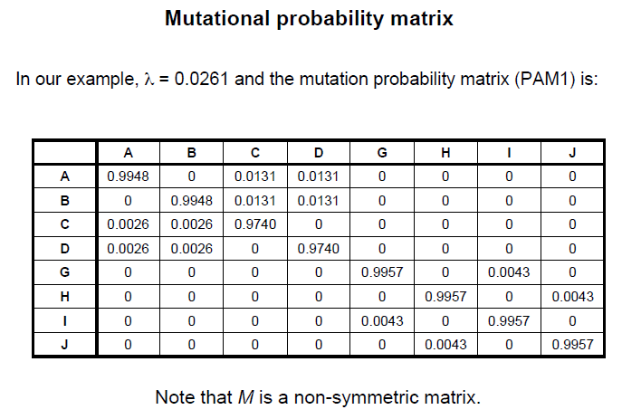

Based on effective frequency matrix of example:

Slide 23
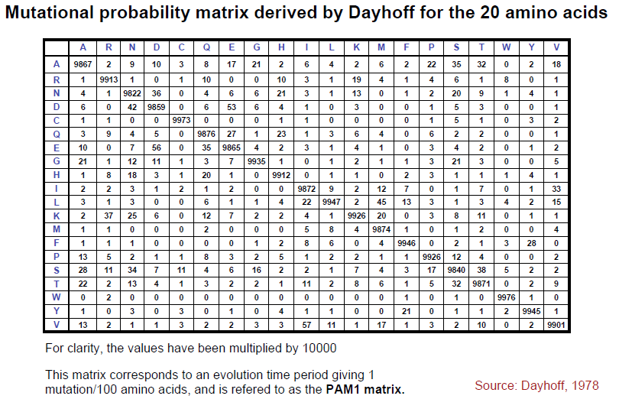

Slide 24
Note: The mutation probability matrices given are
from the column ID to the row ID.
This is different from usual “Markov” and probability transition models. So a transposition of the given matrices may be needed as preprocessing.

Slide 25
Origin of PAM Matrices
Squaring PAM1 mutation probability matrix considers all the ways that an “original” amino acid may have changed over two steps of 1% mutation rate each
This gives PAM2 mutation probability matrix
Markov model
N^{th} power of original PAM mutation matrix yields PAM-N matrix
For staying the same, sum probability that it didn’t change in first step times probability that it didn’t change in second step plus product of all the probability of all changes in first step times probability of changing back
For changing from x -> y, consider sum of products of all the changes that could have happened in first step (x -> z) times probability of changing from that into y (z -> y)

Slide 26
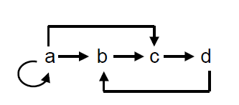
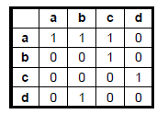
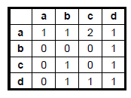




Matrix multiplication
M²_{i,j} = M(row(i))•M(column(j)) = Σ _{k=1 to n} M_{i,k} * M_{k,j}
For general power T:
M^{T+1}_{i,j} = M^{T}(row(i))•M(column(j)) = Σ _{k=1 to n} M^{T}_{i,k} * M_{k,j}
When M represents a graph G:
M^{T}_{i,j} is the number of T-length paths from i to j
The index k acts as an “intermediate node”
_{G}
M
M²

Slide 27
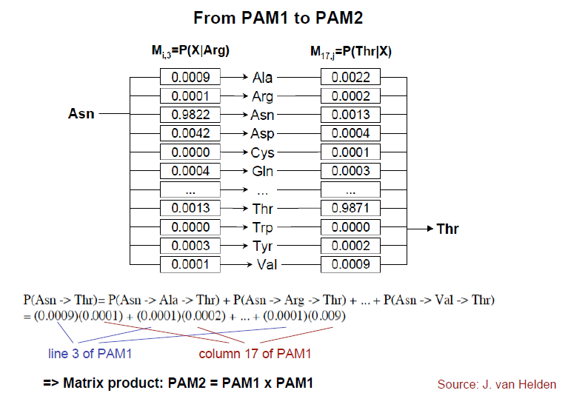
When M represents a Markov chain G:
M^{T}_{i,j} is the t-step transition probability of going from i to j

Slide 28
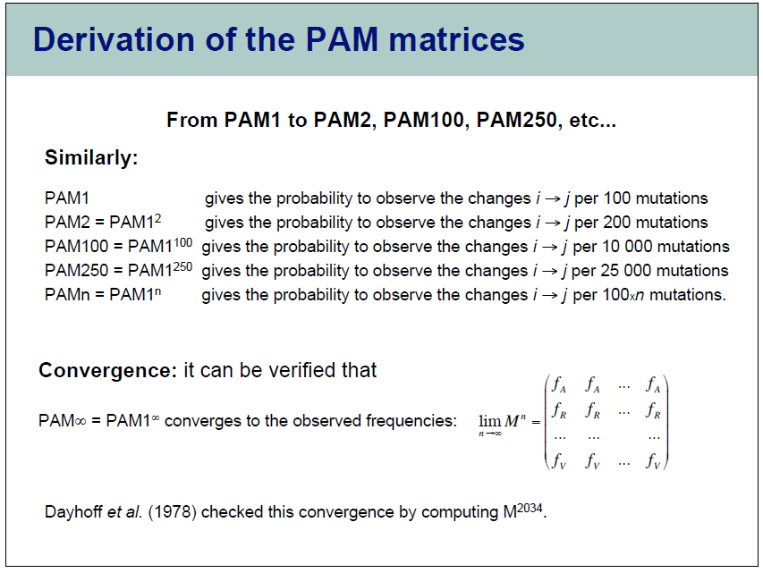

Slide 29
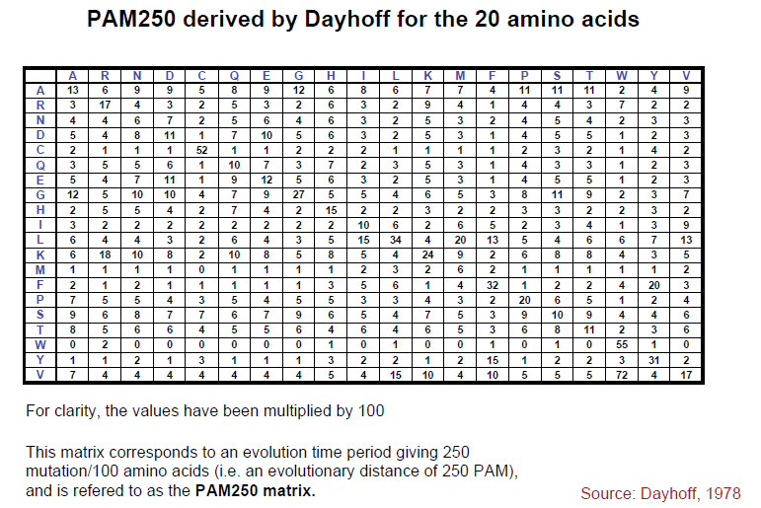

Slide 30
Compare again to PAM1

Slide 31
More Markov Chain basics
Iteration of a Markov chain over increasingly many time steps
Increases entropy
Random walk formulation:
The dependence on the initial conditions decreases with time.
You increasingly “forget where you started”
M∞ represents the stationary distribution
Vector of unconditional frequencies for all columns
This is achieved within 2034 steps for amino acid substitutions in the PAM model.

Slide 32
Dayhoff’s PAM2000 mutation probability matrix:
the rules for very distantly related proteins
PAM∞
A
R
N
D
C
Q
E
G
Ala
Arg
Asn
Asp
Cys
Gln
Glu
Gly
A
8.7%
8.7%
8.7%
8.7%
8.7%
8.7%
8.7%
8.7%
R
4.1%
4.1%
4.1%
4.1%
4.1%
4.1%
4.1%
4.1%
N
4.0%
4.0%
4.0%
4.0%
4.0%
4.0%
4.0%
4.0%
D
4.7%
4.7%
4.7%
4.7%
4.7%
4.7%
4.7%
4.7%
C
3.3%
3.3%
3.3%
3.3%
3.3%
3.3%
3.3%
3.3%
Q
3.8%
3.8%
3.8%
3.8%
3.8%
3.8%
3.8%
3.8%
E
5.0%
5.0%
5.0%
5.0%
5.0%
5.0%
5.0%
5.0%
G
8.9%
8.9%
8.9%
8.9%
8.9%
8.9%
8.9%
8.9%
Top: original amino acid
Side: replacement amino acid
Page 68

Slide 33
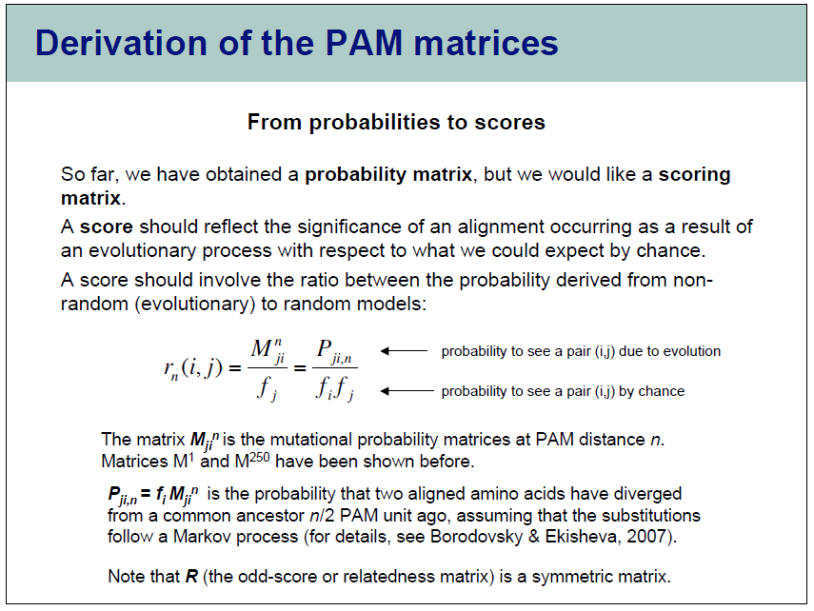
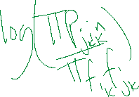

Slide 34
Log-odds scoring
What are the odds that this alignment is meaningful? X₁X₂X₃ … X_{n} Y₁Y₂Y₃ … Y_{n}
Random model: We’re observing a chance event. The probability is where p_{X} is the frequency of X
Alternative: The two sequences derive from a common ancestor. The probability is where q_{XY} is the joint probability that X and Y evolved from the same ancestor.

Slide 35
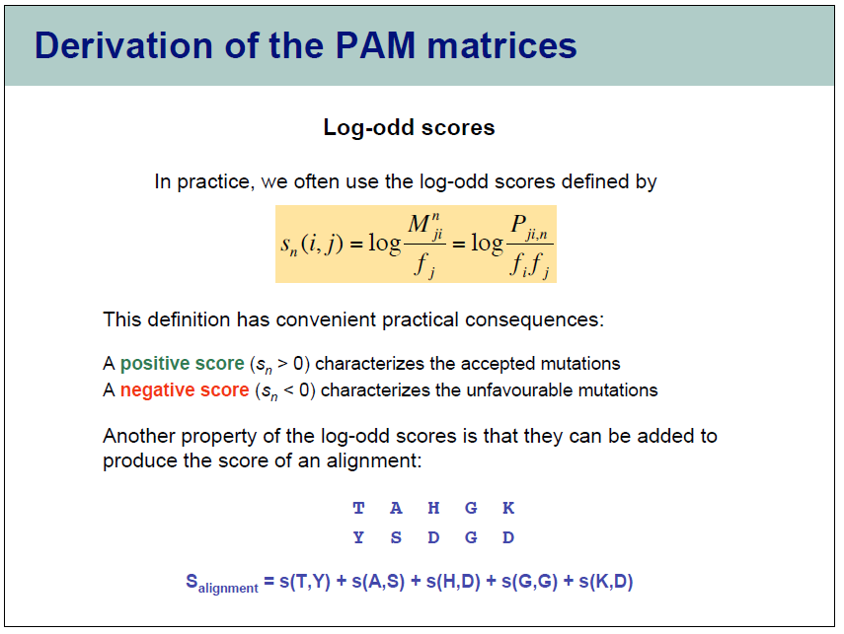
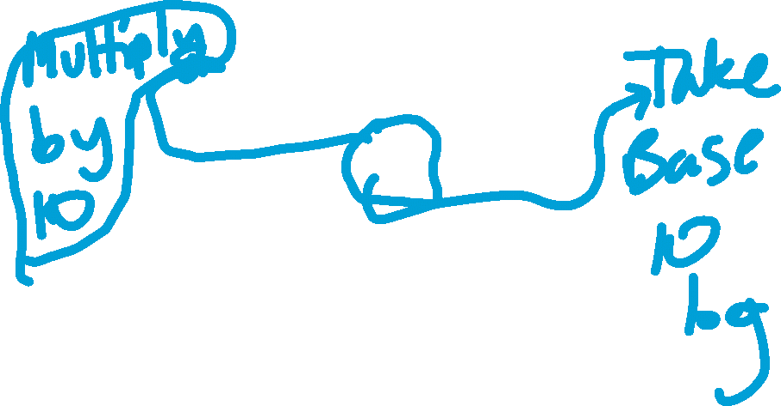

Slide 36
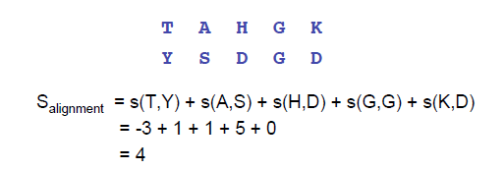
Probabilities and Scores (e.g. PAM250)
Probability of alignment in evolutionary model:
P(align) = P(T,Y)P(A,S)P(H,D)P(G,G)P(K,D)
log(P(align)) = log(P(T,Y))+log(P(A,S))+log(P(H,D))+log(P(G,G))+log(P(K,D))
Taking log odds subtracts contribution of random occurrences.
log(P(x,y)/F(y)) = log(P(x,y))-log(F(y))
Since alignment algorithms are additive, using log odds transformations from mutation probabilities to substitution scores preserves the original probabilistic interpretation.

Slide 37
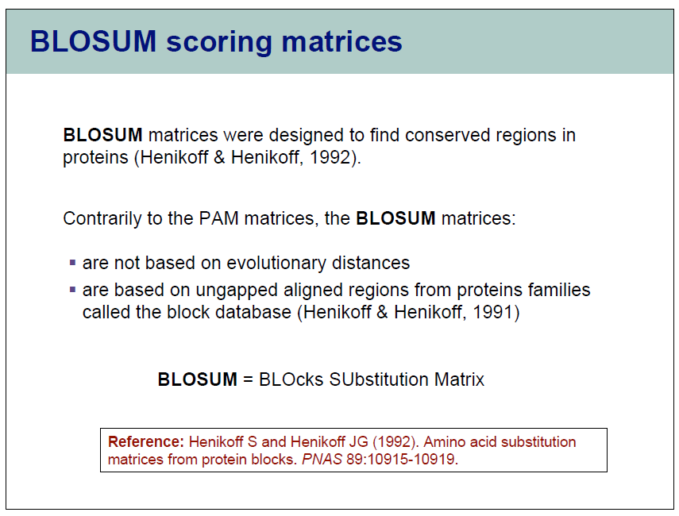

Slide 38
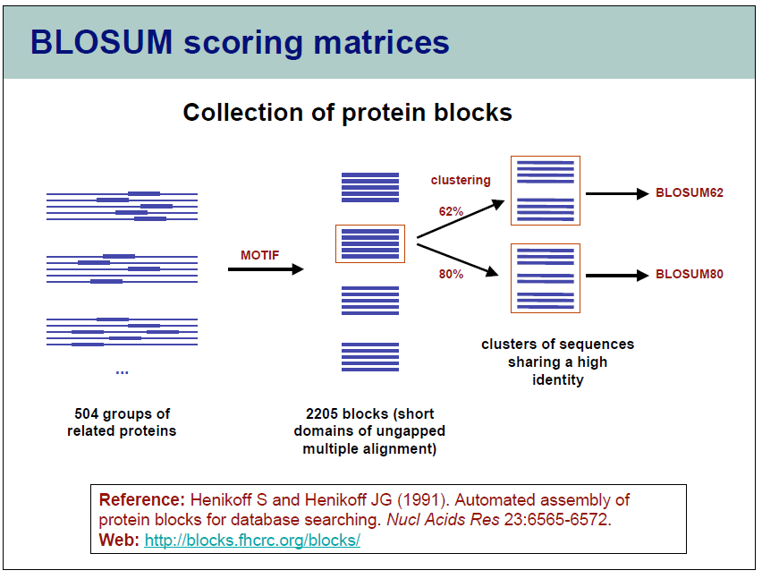

Slide 39
BLOSUM Matrices
All BLOSUM matrices are based on observed alignments;
they are not extrapolated from comparisons of
closely related proteins.
The BLOCKS database contains thousands of groups of
multiple sequence alignments.
BLOSUM62 is the default matrix in BLAST 2.0.
Though it is tailored for comparisons of moderately distant
proteins, it performs well in detecting closer relationships.
A search for distant relatives may be more sensitive
with a different matrix.
Notes:
39

Slide 40
Blosum62 scoring matrix
Notes:
40

Slide 41
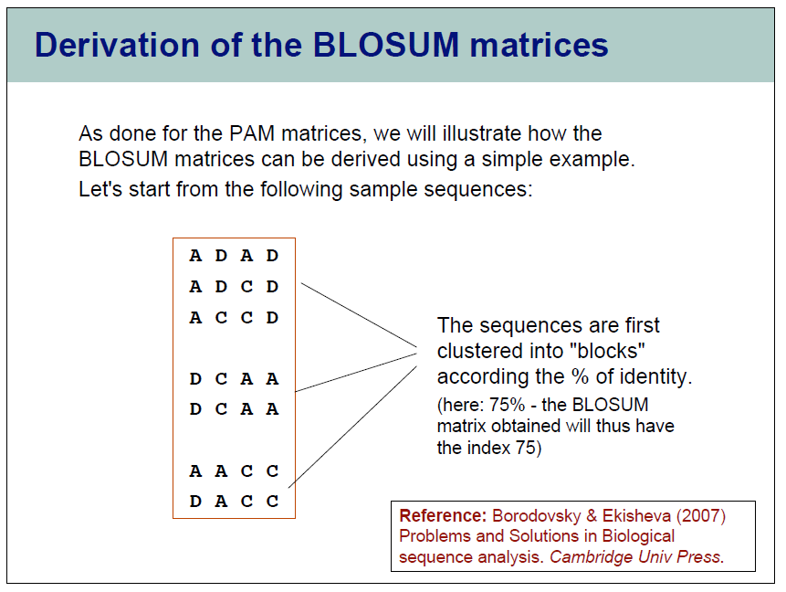

Slide 42
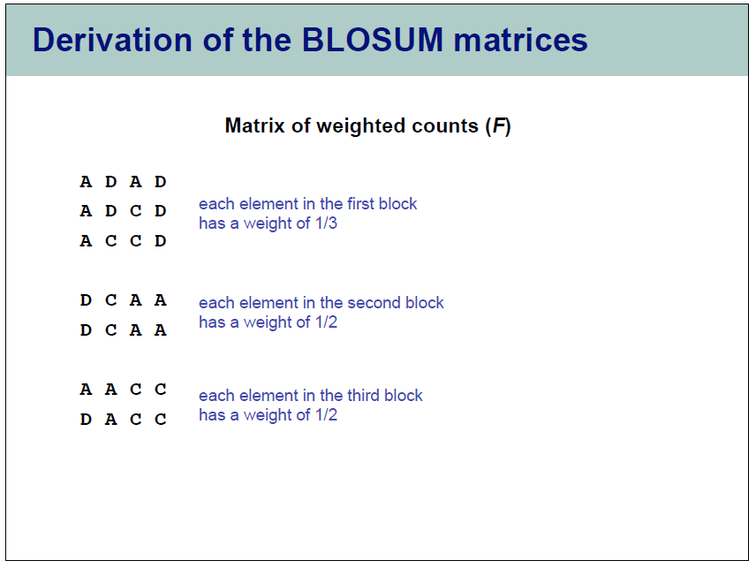

Slide 43
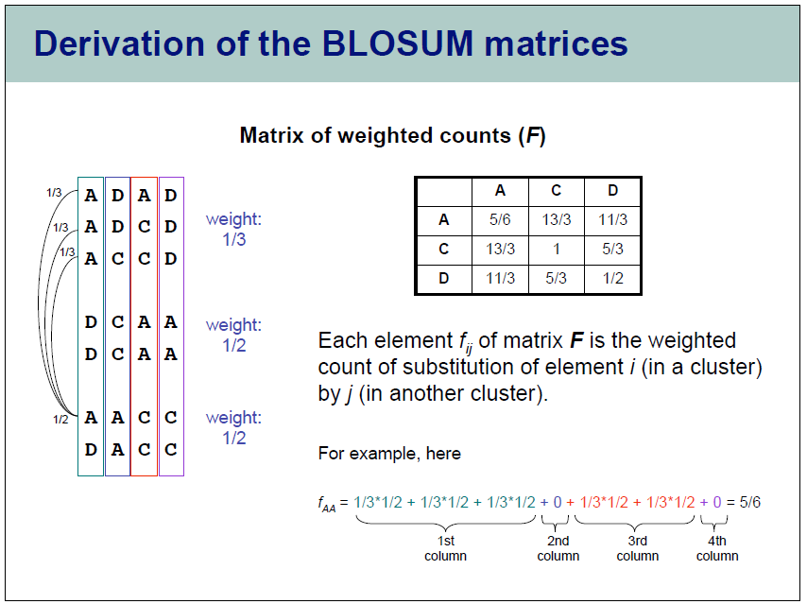

Slide 44
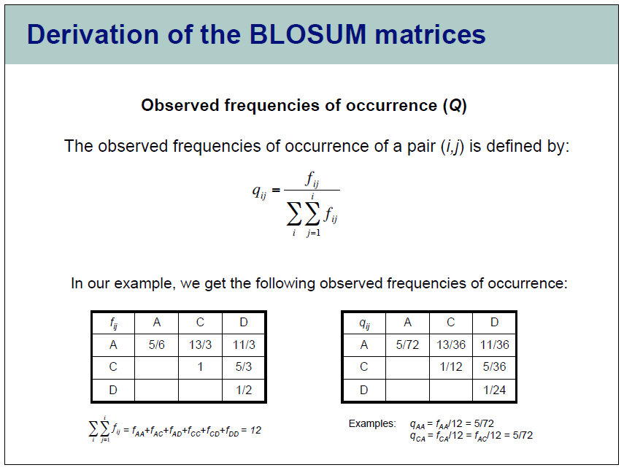

Slide 45
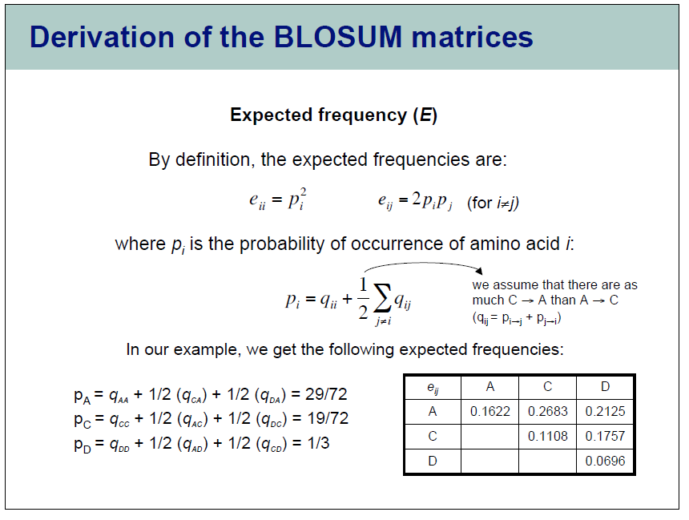

Slide 46
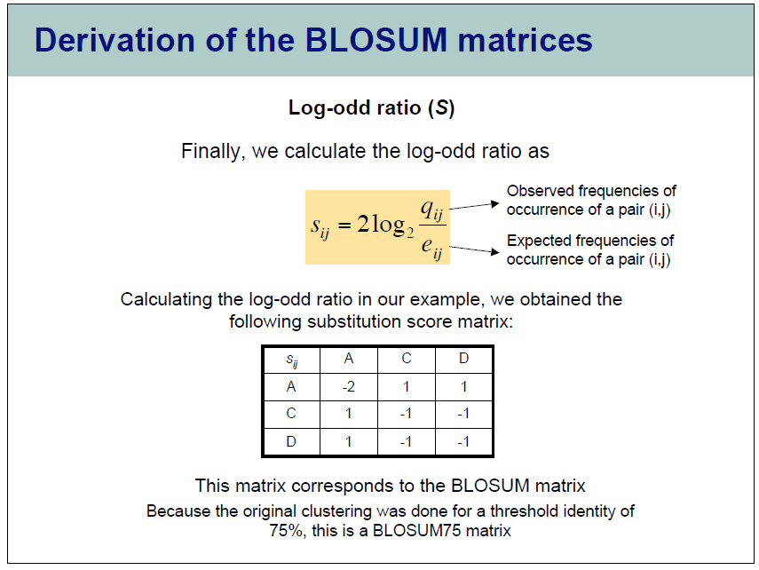

Slide 47
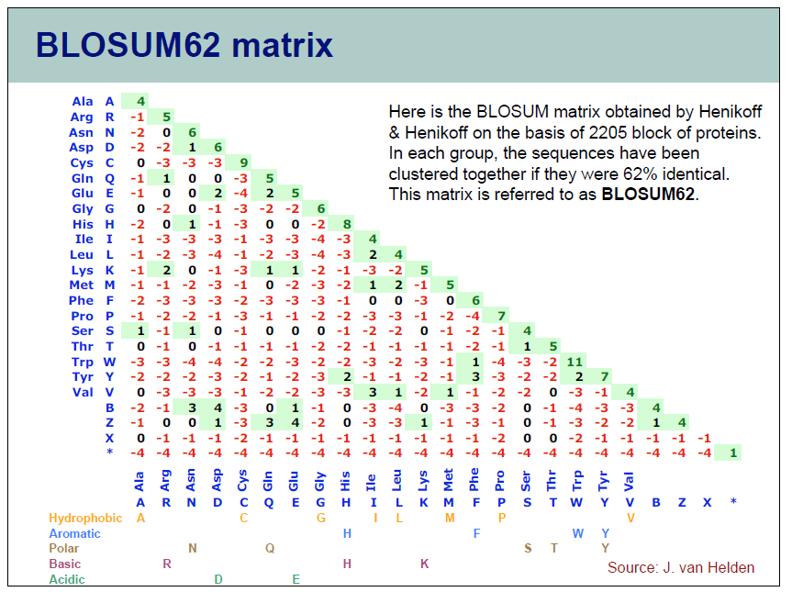

Slide 48
BLOSUM Matrices
All BLOSUM matrices are based on observed alignments;
they are not extrapolated from comparisons of
closely related proteins.
The BLOCKS database contains thousands of groups of
multiple sequence alignments.
BLOSUM62 is the default matrix in BLAST 2.0.
Though it is tailored for comparisons of moderately distant
proteins, it performs well in detecting closer relationships.
A search for distant relatives may be more sensitive
with a different matrix.
Notes:
48

Slide 49
More conserved
Less conserved
Rat versus
mouse globin
Rat versus
bacterial
globin

