Slide 1
Sequence Alignment Variation: Affine Gap Penalties
Gunes Ercal

Slide 2
Acknowledgements
This set of slides borrows heavily from two sources in addition to the Jones and Pevzner reference textbook:
[*] CMU’s CMSC 423 Bioinformatics class slides on “Gap Penalties”
Treats general gap penalties (more general than affine and linear)
[**] Burr Settles’ U. Wisconsin IBS 2008 “Sequence Alignment” presentation
Excellent detailed examples and clear algorithm

Slide 3





Slide 4









Slide 5






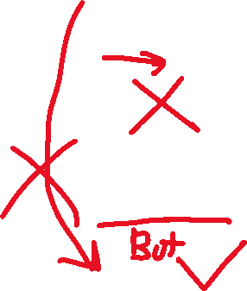


Slide 6















Slide 7










Slide 9



Slide 12





Slide 13
That looks complicated but…
It’s still just a O(nm) time (and space) complexity algorithm!
Quadratic time complexity
Each of the three matrices induces a DAG (Directed Acyclic Graph) where vertices are the matrix entries and there are at most three incoming edges into each vertex
Each graph has size O(nm)
What about alignments with more general gap penalties?

Slide 14
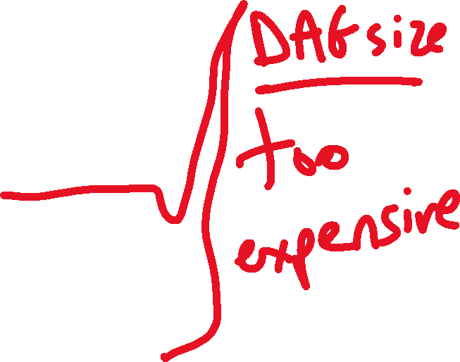


Slide 15
Moral of this story
Affine is more complicated to implement than other variations
3 matrices with pointers between them needed
BUT: The quadratic time complexity is comparable to previous variations
AND: That is especially important because more general gap penalty functions can take at least cubic time
(It’s still nice to know the cubic time algorithm for the general case.)

