Slide 1
Sequence Alignment Variations
Global Alignment (Standard)
Local Alignment
Semi-Global Alignment

Slide 3
Recall: Sequence Alignment
Problem: Given two strings S and T, what is the optimal “alignment” between them?
Minimum amount of changes made to transform S into T, respecting order of characters, as assumption is that S is evolutionarily related to T
Motivation and Applications:
Spell checker, Google “did you mean”
Genetic similarity computation: DNA seq. align.
“changes” from S to T model mutation events
“Most parsimonious” explanation of relationship

Slide 4
Classical Sequence Alignment: Global Alignment
Input parameters: Gap penalty g and Substitution scoring model
Single gap penalty g < 0 modeling Ins and Del, called indels
Substitution Scoring Model:
Simple Model with three parameters: match rewards r > 0 and mismatch substitution score s such that g < s < r
General Substitution Matrix Model: Symmetric |A|x|A| substitution matrix S where diagonal is match rewards
This is a generalization of the simple model where S[j,k] = s iff j <> k, and o.w. S[k,k] = r
The optimization problem becomes: Find the alignment that yields the highest sum score.
(Or, lowest sum cost.)

Slide 5

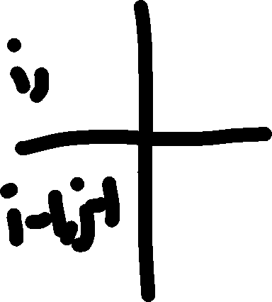
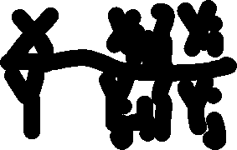




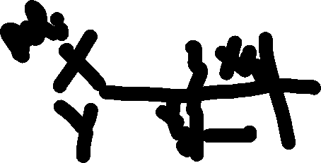
Dynamic Programming for Global Alignment of X and Y with Simple Substitution Scores
Let g < 0 be the gap penalty, r > 0 the match score, and s be mismatch score
If Xi == Yj, then OPT(i,j) = MAX of
r + OPT(i-1,j-1) when last event is a match
g + OPT(i-1,j) when last event is a deletion
g + OPT(i,j-1) when last event is an insertion
Else if Xi <> Yj, then OPT(i,j) = MAX of
s + OPT(i-1,j-1) when last event is a mismatch
g + OPT(i-1,j) when last event is a deletion
g + OPT(i,j-1) when last event is an insertion

Slide 6
Global Alignment with Substitution Matrix
Let g < 0 be the gap penalty
And, let S[Xi,Yj] < r be the substitution score of the <i,j> pair, where the match score for the k^{th} character is simply the diagonal entry S[k,k].
For all i = 0 to n:
For j = 0 to n: OPT(i,j) = MAX of
S[Xi,Yj] + OPT(i-1,j-1) when last event is a substitution (Xi <> Yj) or match (Xi = Yj)
g + OPT(i-1,j) when last event is a deletion
g + OPT(i,j-1) when last event is an insertion

Slide 8






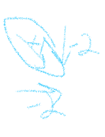




Figure 5.2 Example:
r = 1, s = -1, and g = -2
Corresponding Substitution Matrix:
S | A | C | T | G
A | 1 | -1 | -1 | -1
C | -1 | 1 | -1 | -1
T | -1 | -1 | 1 | -1
G | -1 | -1 | -1 | 1

Slide 9













Figure 5.2 Example:
r = 1, s = -1, and g = -2
Corresponding Substitution Matrix:
S | A | C | T | G
A | 1 | -1 | -1 | -1
C | -1 | 1 | -1 | -1
T | -1 | -1 | 1 | -1
G | -1 | -1 | -1 | 1

Slide 10
Figure 5.2 Example:
r = 1, s = -1, and g = -2
What are the optimal alignments?

Slide 11
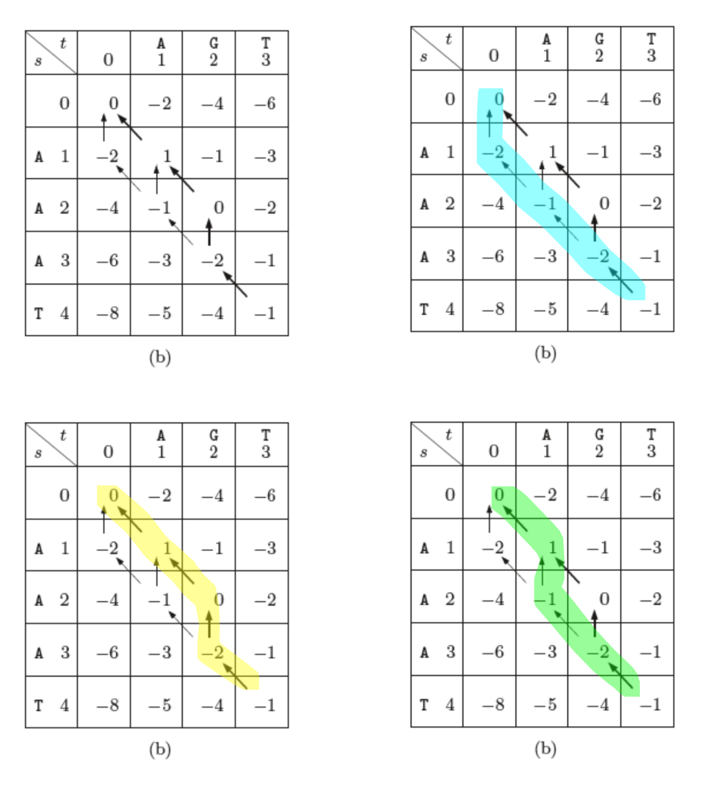



Match the alignments!

Slide 12
Match the alignments!

Slide 13
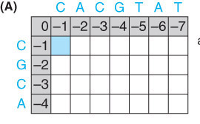
E.g. Let r = 1, g = -1, and s = 0.
Strings to align:
CACGTAT
CGCA
Corresponding Substitution Matrix:
S | A | C | T | G
A | 1 | 0 | 0 | 0
C | 0 | 1 | 0 | 0
T | 0 | 0 | 1 | 0
G | 0 | 0 | 0 | 1

Slide 14
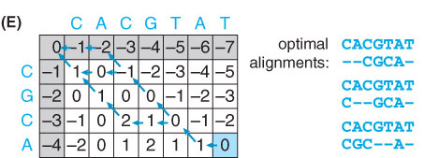

E.g. Let r = 1, g = -1, and s = 0.

Slide 15


E.g. Let r = 1, g = -1, and s = 0.

Slide 16
E.g. Let r = 1, g = -1, and s = 0.

Slide 17
E.g. Let r = 1, g = -1, and s = 0.

Slide 19
Alignment Variation: Local
The best alignment of the best conserved regions

Slide 20
What if….
Sometimes, we wish to find a very well conserved region: Local Alignment
May ignore prefixes/suffixes of either string if they do not improve the alignment score
Algorithmically:
“Resets” an OPT(i,j) score to zero if o.w. negative
Allows zero cost edges from origin to all [i,j] entries
After computing entire OPT matrix with above modification, take the max entry overall

Slide 21
Local Alignment Equations
Let g < 0 be the gap penalty, and S the substitution matrix (diagonal rewards).
OPT(i,j) = MAX of
0 ignores prefixes and restarts
S[Xi,Yj] + OPT(i-1,j-1)
g + OPT(i-1,j)
g + OPT(i,j-1)
OPT of the entire alignment is then taken as the maximum over all (i,j) pairs of OPT(i,j)
This allows us to ignore the suffixes that follow.

Slide 22
Now applying Local Alignment
Let r = 1, g = -1, and s = 0.
 | - | C | A | C | G | T | A | T
- | 0 | 0 | 0 | 0 | 0 | 0 | 0 | 0
C | 0 | 1 | 0 | 1 | 0 | 0 | 0 | 0
G | 0 | 0 | 1 | 0 | 2 | 1 | 0 | 0
C | 0 | 1 | 0 | 2 | 1 | 2 | 1 | 0
A | 0 | 0 | 2 | 1 | 2 | 1 | 3 | 2

Slide 23



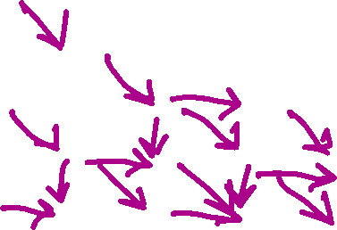


Now applying Local Alignment
Let r = 1, g = -1, and s = 0.
 | - | C | A | C | G | T | A | T
- | 0 | 0 | 0 | 0 | 0 | 0 | 0 | 0
C | 0 | 1 | 0 | 1 | 0 | 0 | 0 | 0
G | 0 | 0 | 1 | 0 | 2 | 1 | 0 | 0
C | 0 | 1 | 0 | 2 | 1 | 2 | 1 | 0
A | 0 | 0 | 2 | 1 | 2 | 1 | 3 | 2

Slide 24

Now applying Local Alignment
Let r = 1, g = -1, and s = 0.
 | - | C | A | C | G | T | A | T
- | 0 | 0 | 0 | 0 | 0 | 0 | 0 | 0
C | 0 | 1 | 0 | 1 | 0 | 0 | 0 | 0
G | 0 | 0 | 1 | 0 | 2 | 1 | 0 | 0
C | 0 | 1 | 0 | 2 | 1 | 2 | 1 | 0
A | 0 | 0 | 2 | 1 | 2 | 1 | 3 | 2

Slide 25
Now applying Local Alignment
Let r = 1, g = -1, and s = 0.
 | - | C | A | C | G | T | A | T
- | 0 | 0 | 0 | 0 | 0 | 0 | 0 | 0
C | 0 | 1 | 0 | 1 | 0 | 0 | 0 | 0
G | 0 | 0 | 1 | 0 | 2 | 1 | 0 | 0
C | 0 | 1 | 0 | 2 | 1 | 2 | 1 | 0
A | 0 | 0 | 2 | 1 | 2 | 1 | 3 | 2

Slide 26
E.g. Let r = 1, g = -1, and s = 0.

Slide 27




Slide 28
Local example: g = -2, s = -1, r = 2
 | 0 | A | A | T | G | T | T | C | C
0 | 0 | 0 | 0 | 0 | 0 | 0 | 0 | 0 | 0
C | 0 | 0 | 0 | 0 | 0 | 0 | 0 | 2 | 2
T | 0 | 0 | 0 | 2 | 0 | 2 | 2 | 0 | 1
G | 0 | 0 | 0 | 0 | 4 | 2 | 1 | 1 | 0
A | 0 | 2 | 2 | 0 | 2 | 3 | 1 | 0 | 0
T | 0 | 0 | 1 | 4 | 2 | 4 | 5 | 3 | 1
T | 0 | 0 | 0 | 3 | 3 | 2 | 6 | 4 | 2
A | 0 | 2 | 2 | 1 | 2 | 2 | 4 | 5 | 3
G | 0 | 0 | 1 | 1 | 3 | 1 | 2 | 3 | 4

Slide 29
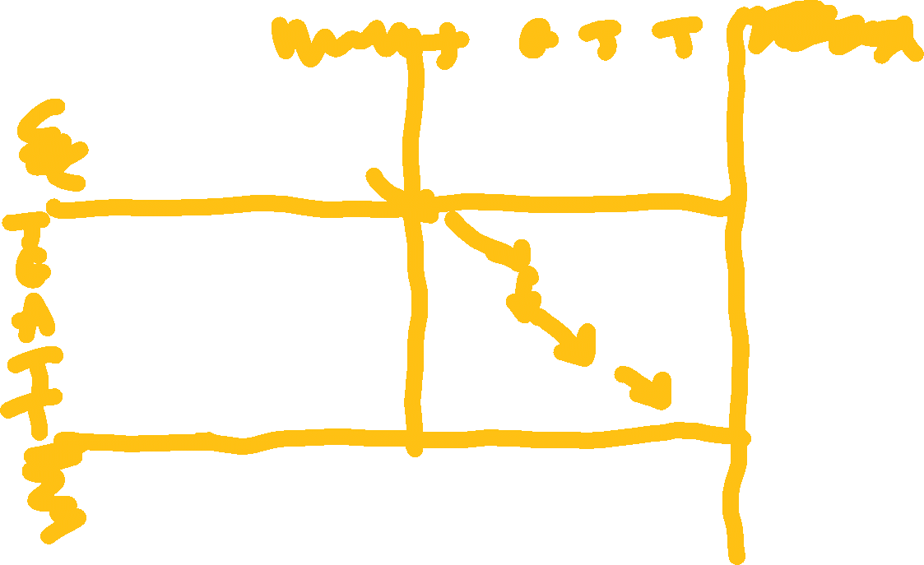
Local example: g = -2, s = -1, r = 2
 | 0 | A | A | T | G | T | T | C | C
0 | 0 | 0 | 0 | 0 | 0 | 0 | 0 | 0 | 0
C | 0 | 0 | 0 | 0 | 0 | 0 | 0 | 2 | 2
T | 0 | 0 | 0 | 2 | 0 | 2 | 2 | 0 | 1
G | 0 | 0 | 0 | 0 | 4 | 2 | 1 | 1 | 0
A | 0 | 2 | 2 | 0 | 2 | 3 | 1 | 0 | 0
T | 0 | 0 | 1 | 4 | 2 | 4 | 5 | 3 | 1
T | 0 | 0 | 0 | 3 | 3 | 2 | 6 | 4 | 2
A | 0 | 2 | 2 | 1 | 2 | 2 | 4 | 5 | 3
G | 0 | 0 | 1 | 1 | 3 | 1 | 2 | 3 | 4

Slide 30
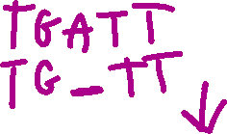
Local example: g = -2, s = -1, r = 2
 | 0 | A | A | T | G | T | T | C | C
0 | 0 | 0 | 0 | 0 | 0 | 0 | 0 | 0 | 0
C | 0 | 0 | 0 | 0 | 0 | 0 | 0 | 2 | 2
T | 0 | 0 | 0 | 2 | 0 | 2 | 2 | 0 | 1
G | 0 | 0 | 0 | 0 | 4 | 2 | 1 | 1 | 0
A | 0 | 2 | 2 | 0 | 2 | 3 | 1 | 0 | 0
T | 0 | 0 | 1 | 4 | 2 | 4 | 5 | 3 | 1
T | 0 | 0 | 0 | 3 | 3 | 2 | 6 | 4 | 2
A | 0 | 2 | 2 | 1 | 2 | 2 | 4 | 5 | 3
G | 0 | 0 | 1 | 1 | 3 | 1 | 2 | 3 | 4

Slide 31
Local example: g = -2, s = -1, r = 2
 | 0 | A | A | T | G | T | T | C | C
0 | 0 | 0 | 0 | 0 | 0 | 0 | 0 | 0 | 0
C | 0 | 0 | 0 | 0 | 0 | 0 | 0 | 2 | 2
T | 0 | 0 | 0 | 2 | 0 | 2 | 2 | 0 | 1
G | 0 | 0 | 0 | 0 | 4 | 2 | 1 | 1 | 0
A | 0 | 2 | 2 | 0 | 2 | 3 | 1 | 0 | 0
T | 0 | 0 | 1 | 4 | 2 | 4 | 5 | 3 | 1
T | 0 | 0 | 0 | 3 | 3 | 2 | 6 | 4 | 2
A | 0 | 2 | 2 | 1 | 2 | 2 | 4 | 5 | 3
G | 0 | 0 | 1 | 1 | 3 | 1 | 2 | 3 | 4

Slide 32
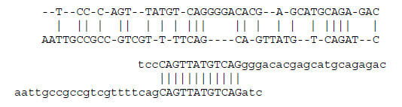
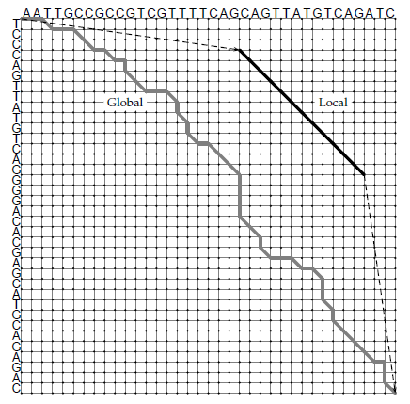
A Broader view of
Local Alignment:
Highly conserved substring

Slide 34
Alignment Variation: Semi-Global
Ignoring blocks of end-gaps for globally related sequences

Slide 35
Sometimes
Two sequences may be related in their respective entireties BUT
One may be much shorter than the other in length
E.g. a gene on a chromosome
Or, they both may be obtained by overlapping “snippets” of a larger sequence
We will see this method of DNA sequencing and reconstruction later.
Examples in English:
UNDONE and DONE : Ignore a prefix of one sequence.
UNDONE and UNDO : Ignore a suffix of one sequence.
UNDONE and DO: Ignore both a prefix and a suffix of a sequence
DONE and UNDO : Ignore a prefix of one sequence and a suffix the other.

Slide 36
Semi-Global Possibilities
UNDONE and DONE : Ignore a prefix of one sequence.
Zero gap penalty in the beginning of a sequence: How to implement?
UNDONE and UNDO : Ignore a suffix of one sequence.
Don’t penalize gap block at end of a sequence: How to implement?
Combination of the above:
UNDONE and DO: Ignore both a prefix and a suffix of a sequence
DONE and UNDO : Ignore a prefix of one sequence and a suffix of the other.

Slide 37
Semi-Global commentary
UNDONE and DONE : Ignore a prefix of one sequence.
Zero gap penalty in the beginning of a sequence: How to implement?
UNDONE and UNDO : Ignore a suffix of one sequence.
Don’t penalize gap block at end of a sequence: How to implement?
Combination of the above:
UNDONE and DO: Ignore both a prefix and a suffix of a sequence
DONE and UNDO : Ignore a prefix of one sequence and a suffix of the other.
NOT a natural semi-global example: CONDOLENCE and REDOING
They are not related globally:
Cannot ignore BOTH prefixes
Cannot ignore BOTH suffixes
Despite similarities, Semi-Global is not the same as Local alignment

Slide 38
So how to accomplish semi-global alignment?
What does zero gap prefix penalty for one string mean?
Set FIRST row and FIRST column to all zeroes. (First ⬄ “Zeroth”)
This allows penalty-free starting of alignment from EITHER
an arbitrary column, XOR
an arbitrary row
What does zero gap suffix penalty for one string mean?
Now: Look at the entry of the OPT matrix corresponding to the MAXIMUM value taken over all entries in the LAST ROW or LAST COLUMN
If that max is achieved in the LAST ROW, say entry OPT(n, colmax): A block of suffix gaps follows across the columns colmax+1 to m of the second string in the alignment.
If that max is achieved in the LAST COLUMN, say entry OPT(rowmax, m): A block of suffix gaps follows across the rows rowmax+1 to n of the first string in the alignment.

Slide 40
Semi-Global Alignment
Ignoring a prefix: Set OPT(0,j) = 0 for all j, and OPT(i,0) = 0 for all i.
For all i,j > 0: OPT(i,j) = MAX of
S[Xi,Yj] + OPT(i-1,j-1) when last event is a substitution (Xi <> Yj) or match (Xi = Yj)
g + OPT(i-1,j) when last event is a deletion
g + OPT(i,j-1) when last event is an insertion
Let MAX_end be the max of the OPT matrix’s last row or column.
max { OPT(n,0),OPT(n,1), …, OPT(n,m), OPT(0,m), OPT(1,m), …, OPT(n-1,m))}
The alignment extracted will backtrack from entry MAX_end

Slide 41
Onto nucleotide sequence examples
See excel file SemiGlobalExamples.xlsx
Continuing there and on virtual whiteboard…

Slide 43
Time Complexity for all variations
It is quadratic!
Theta(nm) where n = |S| and m = |T|.
Note that Theta((n+1)(m+1)) = Theta(nm)
Also O(nm)

