Slide 1

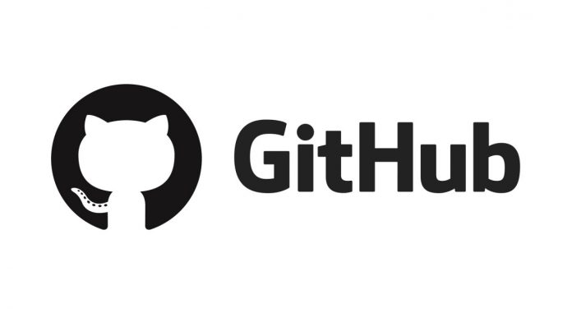
Collaborative coding with Git and GitLab
Catrin Cheung, Best Practice and Impact division

Slide 2
What is GitLab/ GitHub?
Platform used to store code
Used with Git for version control and peer review
GitLab is the internal version of GitHub used within the ONS

Slide 3


What is Git?
Command line programme
Git is the interface that we use to connect our local repository (laptop) with the remote repository (on GitLab)
Access Git in different ways - command line (CLI) or graphical user interface (GUI)
We used Git Bash (Git for Windows) – there are other options

Slide 4
Why work in this way?
Collaborative coding
Peer-review
Version control
Transparency
Capability building
Notes:
Allows us to code collaboratively with greater ease (e.g. no version 1, version 2 etc)
Peer-review (i.e. pull / merge requests)
Version control – view full history (each change made by each contributor)
Transparency – code can be seen by anyone (or made private if needed)
Capability building – openness so others can reuse/adapt our code

Slide 5
Demo / walkthrough

Slide 6
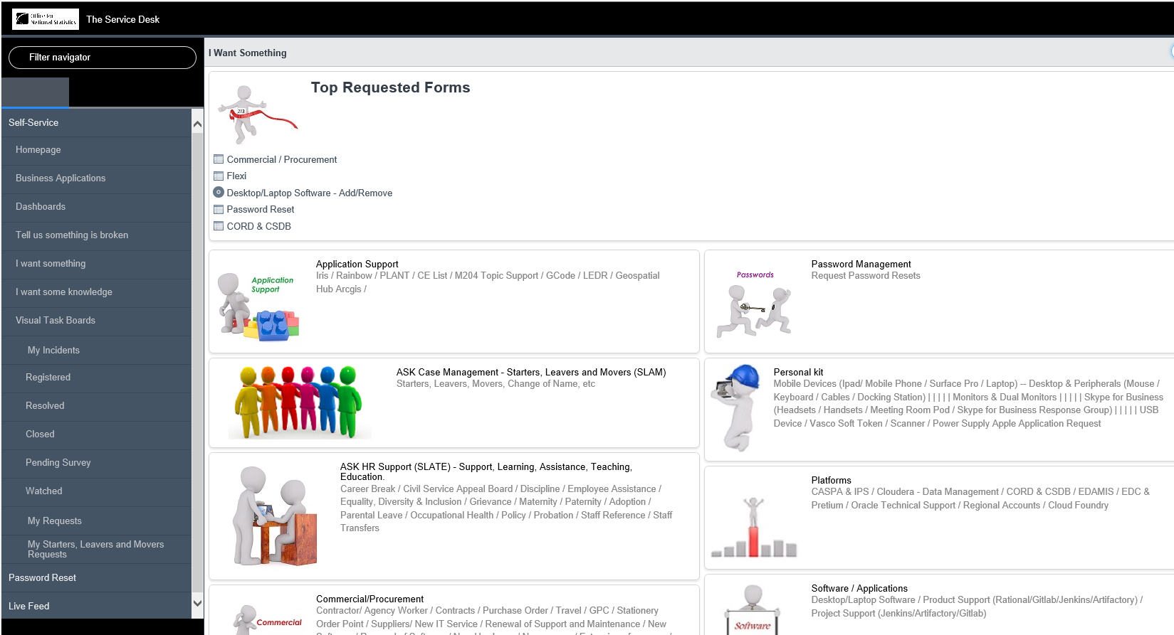
1. Create a project in GitLab
Notes:
When the project is set up, this will contain the bare minimum of a repository. It will contain a master branch - this is what you will be working on initially when setting up the skeleton package. Later when you’re writing code for functions (to clean, link, analyse data etc.), you’ll need to create new branches (more on this in section X)

Slide 7
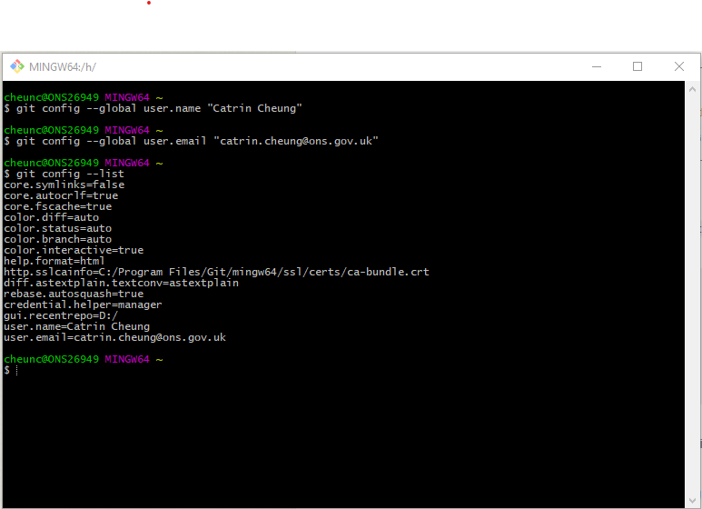
2. Set up user credentials in Git
If you haven’t used Git before you will need to set up Git user credentials before doing anything
Notes:
Skip this step if you’ve already set up in Git
You can check that your user credentials are right with git config --list

Slide 8
3. Set up SSH key
For each repository you will need to secure a SSH key connection
This allows your local repository to communicate with GitLab securely

Slide 9
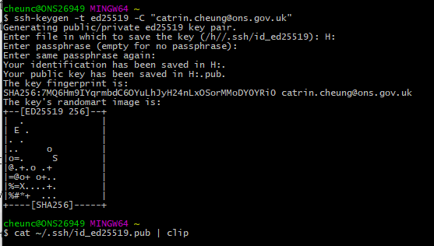
Notes:
This command generates a public and private key. It will also automatically generate a folder including these keys in your default directory. This is the H: drive on an ONS laptop.
Sometimes it will ask you to manually indicate where to save it – enter H;/
GitBash will ask you to set up a password. Remember the password, as you will need it later.
Copy the public key to clipboard using command above

Slide 10
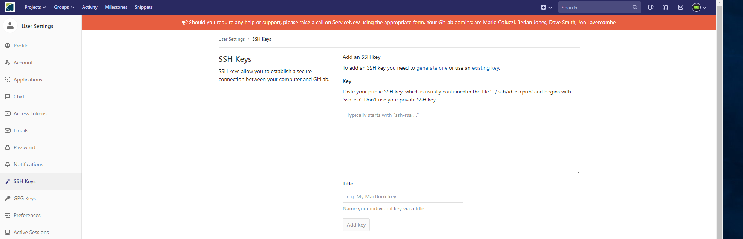
Notes:
You can then paste this to GitLab

Slide 11
4. Connecting local and remote repositories
You can either:
Clone the project created on GitLab to your local repository
Or create a local repository and add to GitLab

Slide 12
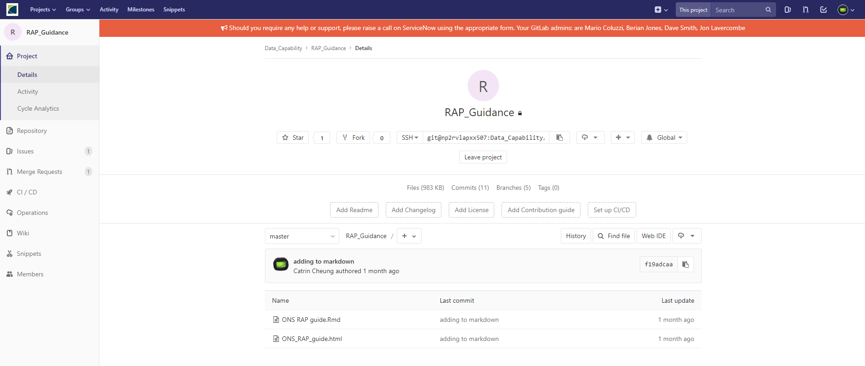
Go to the GitLab project and copy the HTTP for the project

Slide 13
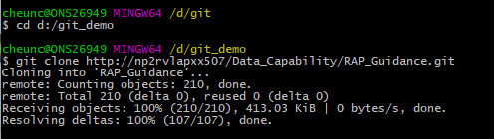
Go to Git
Make sure you’re located in your Git folder where you want the project to be saved
Copy the SSH/HTTP code to clone the project
Notes:
It will ask for your password
Note - you can also clone by copying the SSH key rather than the HTTP. With ONS GitLab however the SSH approach has proven to be unreliable, and we recommended using HTTP.
If you are following the SSH key approach, you will need to enter a password to establish the SSH key connection.
Note – in DAP you wont have to go through all these steps of setting user name and SSH keys

Slide 14
Basic workflow

Slide 15
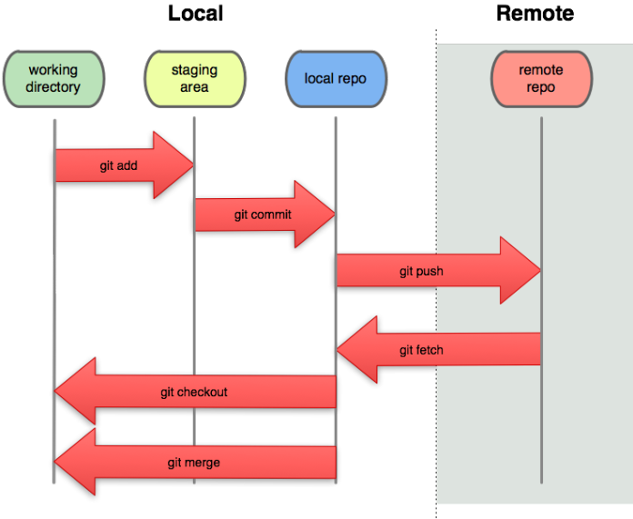
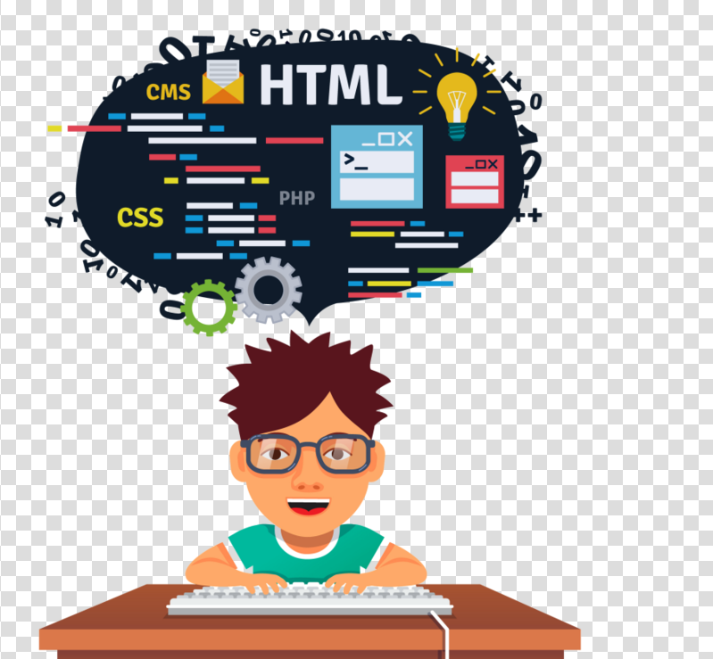


Slide 16
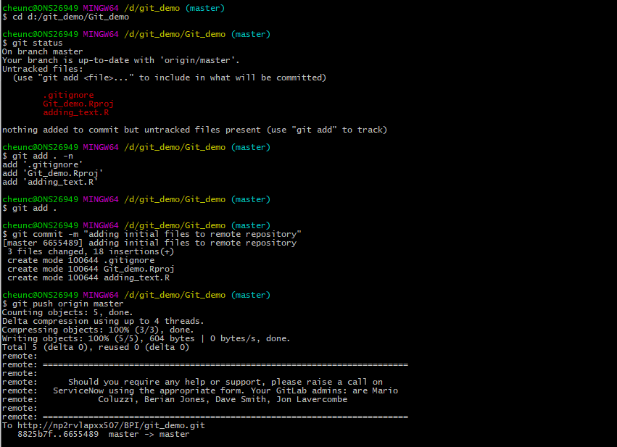
First push
First make sure you are in your repository on git (cd)
Notes:
Example:
Create a new project in Rstudio
Work on some code
Add initial code to the remote repository
Currently, Git doesn’t know it needs to track the folder – git init
Check that the folder is being tracked
Git has identified that there are two folders that need to be pushed

Slide 17
git add . –n
git add .
git commit –m “meaningful comment”
git push origin master
Notes:
After the first push you wont need to use “origin master”

Slide 18
Notes:
After doing this check in the Git Lab that your changes are there

Slide 19
Pulling from Git
Make sure you’re located in your repository in Git
git fetch (whole repository)
git fetch branch (just a particular branch)
git pull
Notes:
As you’re working collaboratively on a project, you’ll need to ensure that you’re working with the latest version of the project. Others may have made changes since you last worked on it. To update your local device with updates made by others, you’ll need to fetch and pull from GitLab.
To fetch a branch from GitLab you’ll firstly need to ensure that you are located in the project. Do this by using the command cd followed by the location where your project is stored e.g.:
Now that the branch(es) are on your local computer, you need to ensure that the version you have just fetched, matches the one on your local device.
Do this by using git pull

Slide 20
Best practice / top tips in Git
Branching
Agree on workflow with colleagues
Pull / merge requests for peer-review
Commit often and add meaningful comments
Make sure you pull and push regularly

Slide 21
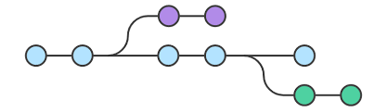
Branching
development
master
development
Notes:
Best not to work with the master branch
Create other ‘development’ branches or ‘experimental’ branches and merge to the master branch when 100% ready
Can create new branches in GitLab or in Git git checkout -b <branch_name>

Slide 22
Pull / merge requests
Peer-review feature of GitLab
Developer creates an issue through a merge request
Assign the issue to an individual/team
Email notification
Other peer-review/fix the code
Push the change
Project maintainer merges this to the main branch
Notes:
GitLab's "merge request" feature is equivalent to GitHub's "pull request" feature.
Merge or pull requests are created in a git management application and ask an assigned person to merge two branches. Tools such as GitHub and Bitbucket choose the name pull request since the first manual action would be to pull the feature branch. Tools such as GitLab and Gitorious choose the name merge request since that is the final action that is requested of the assignee.
A "merge request" should not be confused with the git merge command. Neither should a "pull request" be confused with the git pull command. Both git commands are used behind the scenes in both pull requests and merge requests, but a merge/pull request refers to a much broader topic than just these two commands.

Slide 23
Looking at commit log
git log
git log --since=2019-01-01
git log --author=“catrin”
git log --git loggrep=“bug fix”
Notes:
git log shows all the changes made in the repository by different users. It will display all the commits and hashes. This will take you to another screen, to exit the log press ‘q’ or if you need help press ‘h’
git log –since=2019-01-01
Git log –author=“catrin”
Git log –grep=“bug fix” shows all the commits where a ‘bug fix’ has been mentioned in the comments

Slide 24
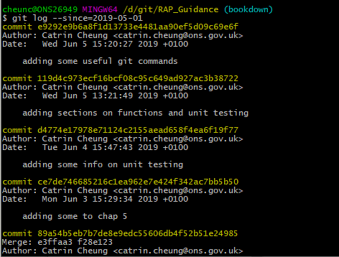

Slide 25
Reversing to previous versions
git revert <commit code>
Follow the workflow of adding, committing, and pushing and the changes will be reverted in GitLab
Notes:
It may ask you for a commit comment
:wq to exit the vi window (the commit comment window)

Slide 26
Other points to note:
If working in DAP this will be easier (don’t have to set up SSH key, don’t need to request command line access etc.)
Principles are the same for GitHub

Slide 27
Any questions?

