Slide 1

RAP in DAP Reproducible Analytical Pipelines in practice
Data Access Platform (DAP)
Capability and Training Support (CATS)
Notes:
What is this session about?
We have RAP example on the code library in DAP, which is our proof on concept.
But this session is about showing an example of what developing a RAP looks like

Slide 2
What is RAP?
Notes:
Who has heard of RAP? If you read the description for today’s session, you should have some idea.
Who uses RAP or RAP principals in their business area?

Slide 3
“The Reproducible Analytical Pipeline (RAP) is a methodology for automating the bulk of steps involved in creating a statistical report”
- UK GovDataScience
Notes:
Here is a definition
However in my opinion, RAP has a slightly broader definition than this.
We might think about the RAP as the finished product, but RAP is all about good practices and ways of working that go into creating that pipeline.

Slide 4
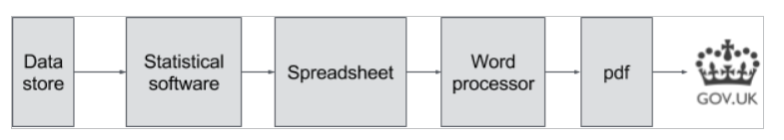
Current processes
Excel
Common software
CORD
CSDB
SAS
SPSS
Notes:
We have all seen some poor business processes in production areas in the ONS. This diagram is a simple version of such processes.
They’re often confusing, Excel intensive, high-risk, sometimes poorly documented and convoluted.
Perhaps they started like this diagram, but over the years there have been many small incremental changes resulting in the tangled mess that some of us have battled with.
- Technology changes, or requirements from stats regulators, or adding functionality

Slide 5
RAP – good practices
Reproducible
Transparency
Accountability
Harmonisation
Notes:
Reproducible – in most cases, after a few clicks we can carry out the analysis on new data to produce a new report
Transparency – code is written and structured in such a way that it’s clearer what happens to the data through its production journey
Accountability – using version control shows who’s coded what and when, we can also keep track of decisions on the processing
Harmonisation – GSS good practice team recommend these methodologies, so we eventually we will have better consistency throughout government

Slide 6
Existing material
RAP companion – Matthew Gregory, Matthew Upson
RAP using R – Matthew Gregory
ONS specific - RAP in DAP
Notes:
RAP companion – a short online book
RAP using R – udemy 7 hour course
In ONS we have a Data Access Platform (DAP) - within DAP there are a certain set of tools available, therefore as DAPCATS we have resources on how to create a RAP in DAP.
[link]
On the code library in DAP there is an example of a RAP in DAP, and the RAP demo screencast talks through that RAP project- so that’s the proof of concept

Slide 7




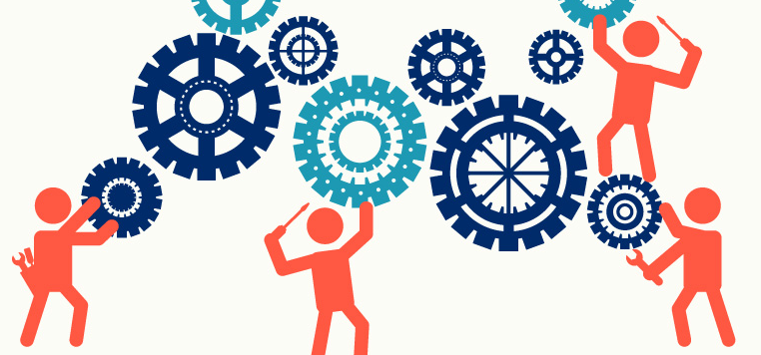
Today’s session
Notes:
However, adopting RAP is quite difficult and can take a bit of time to get used to.
And so what we want to talk about is, how can you and your teams can start implementing RAP practices in your work.
So the emphasis of this session is not on trying to build fantastic wonderful finished product.
Rather the point is to start embedding these principals in everything we do.

Slide 8
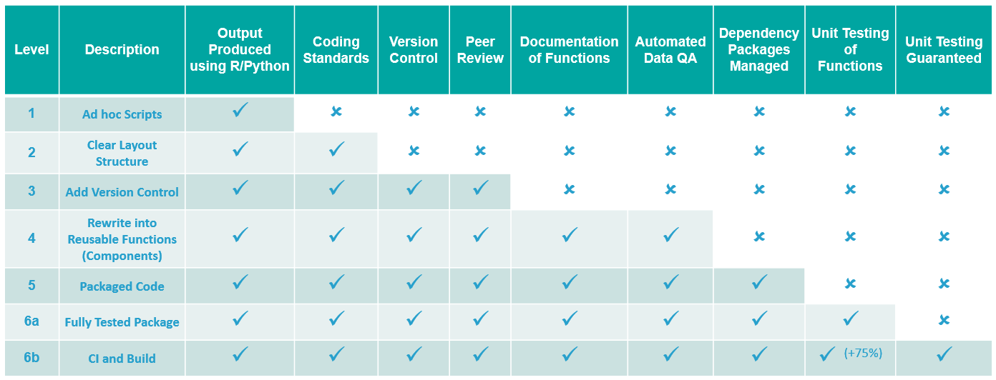
RAP in DAP
Project maturity
Notes:
This is our headline diagram
Don’t need to use every element or level for every project, choose appropriately, guidance in the RAP companion book
Spectrum or sliding scale with exploration code at the top and production code at the bottom
In DAPCATS, since September we have been lucky enough to have 2 grad data scientists 2 software engineers join the team.
Get these graduates to work collaboratively on building a simple RAP, by doing this we would learn the all-important skills involved with RAP and present some of our findings to you.
What we’re going to do is cover a worked example in python of levels 1 to 4 in this diagram, then briefly talk about levels 5 and 6.

Slide 9
CDSW (dev n test)

Slide 10
2.Clear structure layout

Slide 11


Level 2: Coding standards

Slide 12
Clean Code
What is it and why should we care?
Notes:
Over the years there have been many definitions of clean code which have arisen.
To put it simply clean code should be code which is simple and direct, it is easy to understand and easy to change.
At some point in its lifetime all code will be modified, updated or used. This might be by the original writer of the code or it could be by teammates or other programmers.
If the code is clean then it will make life easier for whomever is using or modifying it.

Slide 13


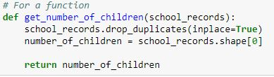
Name it Appropriately
Notes:
As said by computer scientist and author Donald Knuth, "Programs are meant to be read by humans and only incidentally for computers to execute".
It is not only what's in the code but also what type of thing it is.
Variables, classes and functions should all be named in a way that reflects exactly what they are or what they do.
With a general rule that variables and classes are nouns and functions should be named as verbs. Nouns are words which identify a person, place or thing; while verbs are used to describe an action, state or occurrence.
Another good thing to consider when naming dataframes is to think about what is shown in each row. An example is if each row in a dataframe is a loan, then the dataframe is a collection of loan entries, therefore it would make sense to call the dataframe loans.

Slide 14



Don’t be Misleading
Notes:
It is important that any name isn't misleading and that it doesn't give false information. If something is a variable don’t call it a model or if it’s a list don't mention table in the name.
As you can see in this example the pupil_table is not actually a table and therefore it is incorrect to name it as one.

Slide 15




Distinct and Meaningful
Notes:
It's important when you are coding that you do not use the same name for different items, and that your names are both meaningful and pronounceable
It is also important to make sure that you are consistent in your naming. This means that you should always refer to a entity name the same name. As seen in this example "user", "client" and "customer" are all refering to the same group of people. Therefore after naming them "user" in the first line this is how they should be refered to from here on

Slide 16


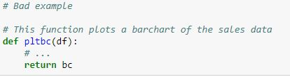

Cut Down Comments
Notes:
If you abide by these guidelines for writing good code, your code will be so clear that it needs few, if any, comments. Comments might seem helpful at first, but as time goes on they become hard to maintain and fall out of sync with the actual code, leading to comments that mislead and confuse. A lot of the time, comments exist to make up for poorly written code and become unnecessary if you use descriptive names and a clear structure
The comment in this first example exists to explain a badly named variable. Better practice would be to just give the variable a clearer name.
Here the author has used abbreviations when naming their function, and then had to add a comment that explains the abbreviations. This is made unnecessary by using sensible naming practices.
Sometimes we use comments to explain our aims and methodology, but this information is better put together into a single README document that accompanies your code.

Slide 17
3.Version control

Slide 18
Level 3: Version Control
Notes:
Now that our analysis can be viewed by other team members, it is even more important that it is clear and readable. The next step in making it more readable is to refactor the code into reusable functions. This is particularly important if your code is going into production.

Slide 19
Gitlab workflow
Raise an issue
Carry out work on a new branch
Raise merge request
Someone else reviews the code and merges branch
Notes:
Raise an issue – in our example this could be renaming variables, or adding labels to our chart
Carry out work on new branch – we create a copy of the project, called a branch, and carry out the work on this new feature branch
Raise a merge request – once we’re happy with the changes to the code we raise a request for the new feature branch to be merged with the master branch
Someone else reviews the code and merges brach – a different team member will review the code and make sure it works before merging the branches

Slide 20
Development
On Features
Starts
Development
Ready For
Release
Issues
Raised
Feature 1
Complete
Feature 2
Complete
Branches
Master
Development
Feature 1
Feature 2

Slide 21
4.Reusable functions

Slide 22
Level 4: Reusable Functions
Notes:
Now that our analysis can be viewed by other team members, it is even more important that it is clear and readable. The next step in making it more readable is to refactor the code into reusable functions. This is particularly important if your code is going into production.

Slide 23
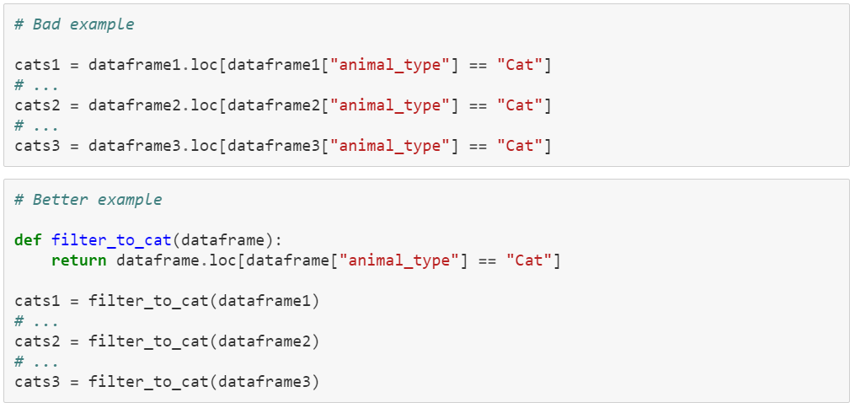
Don’t Repeat Yourself
Notes:
A key principle in writing good code is *Don't Repeat Yourself*. If you keep writing the same chunk of code in multiple places, you increase the likelihood of making a mistake and make it much harder to change things in the future. The way to stop this happening is to write functions.
In this example, we have written the same code three times in different places in our script.
Better practice would be to define a function that filters a dataframe on animal_type, and then call it on each dateframe when needed. This makes your code easier to read and reduces the chance of making an error when retyping or copy and pasting the code.

Slide 24
“The first rule of functions is that they should be small. The second rule of functions is that they should be smaller than that.”
Robert C. Martin, author of Clean Code and the Agile Manifesto
Notes:
In general, the smaller your function, the more obvious its meaning will be. Ideally functions should be 2, 3 or 4 lines long, excluding blank space. However this doesn't mean that you should just cram the same amount of content into fewer lines.

Slide 25
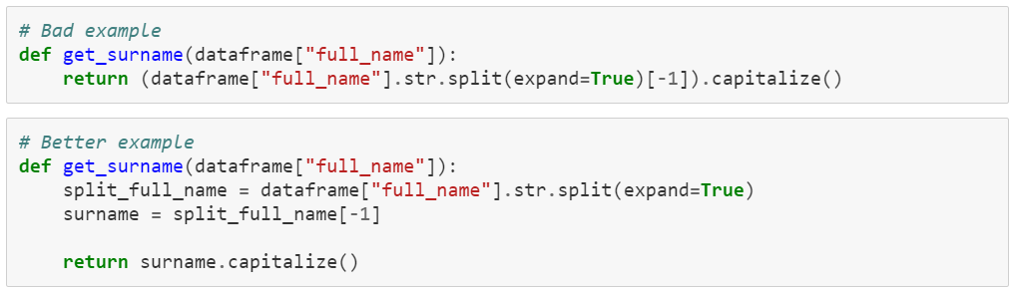
Keep it Small
Notes:
Readability is queen when it comes to clean code. This function looks small, but so much content has been put into one line that is it tricky to work out what the function is doing.
This is the same function rewritten over several lines. On separate lines, we split up the full name, select the surname and then return the formatted surname. It is much easier to work out what is happening here. Instead of stuffing a lot of content into a small space, you should make your functions small by sticking to our next rule: Do One Thing.

Slide 26
“Functions should do one thing. They should do it well. They should do it only.”
Robert C. Martin, author of Clean Code and the Agile Manifesto
Notes:
Functions should do one thing. They should do it well. They should do it only.

Slide 27
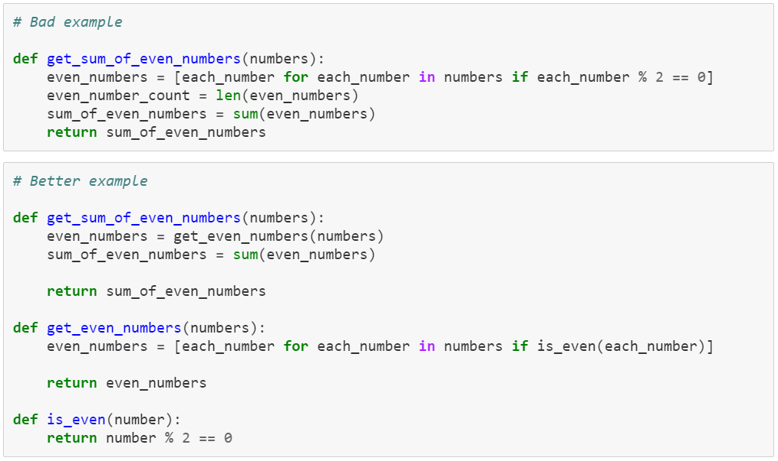
Do One Thing
Notes:
We will now see two versions of the same procedure. In the first example, get_sum_of_even_numbers finds the even numbers, counts how many there are and then adds them together.
One issue with this is that the function performs additional actions in the background, counting the number of even numbers. Your functions should not have side effects, and the offending line has been removed in the second example.

Slide 28
Notes:
In the second example, each function does what their name says they will, and nothing else. If a function does more than one task, it should be split into multiple functions, where each function does one sub-task.
Trying to decide what "one thing" means in practice can be difficult and subjective, however it becomes easier the more examples you read and write. If you want to see more about this, further resources are included at the end of the screencast.

Slide 29
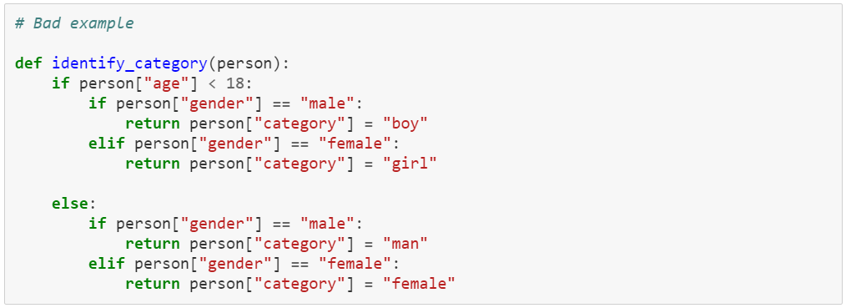
No More Nesting
Notes:
Nesting makes code harder to read and understand, and functions should not be large enough to contain nested loops or conditionals. You should not need to write your functions with more than one or two levels of indentation.
The blocks within any for, while, if or else statements should be one line long and this line should usually be a function call, either an inbuilt function or one you have created.
This example contains too much nesting, which makes it difficult to see when each statement executes.

Slide 30
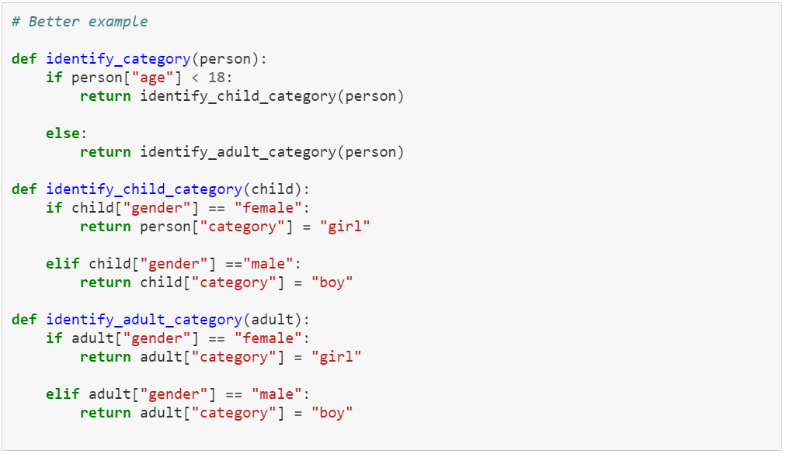
Notes:
Here it has been rewritten to reduce the amount of nested code. Each if, elif or else statement only contains one line of code and is much easier to follow.

Slide 31
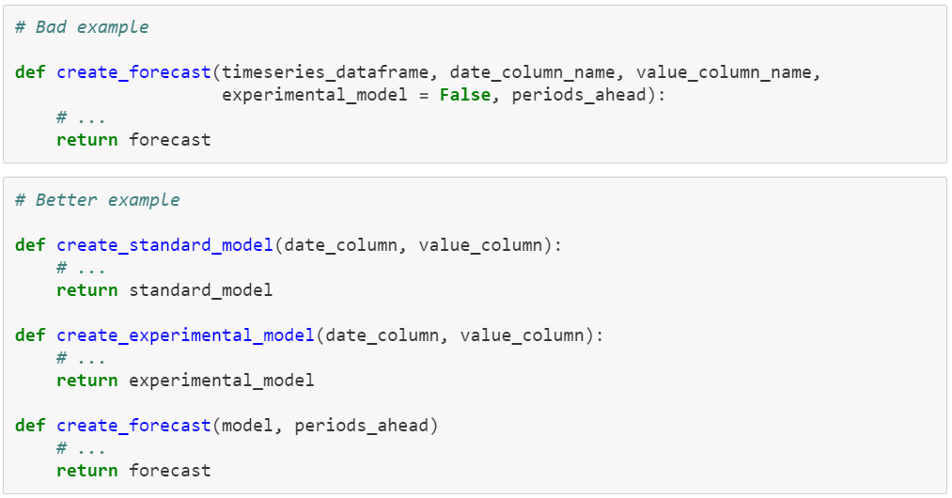
Axe Those Arguments
Notes:
The lower the number of arguments in a function, the better. This is because cutting down the number of arguments makes functions easier to read and much easier to test. As a rule of thumb, functions with 0, 1 or 2 arguments are fine, functions with 3 arguments aren't ideal, and more than three arguments shouldn't be used. If you need lots of arguments, consider whether your function is doing too much.
This function takes a timeseries and creates a forecast using one of two methods. Clearly the function is doing more than one thing, using too many arguments.
This function can be broken down into smaller functions that perform the different subtasks involved in forecasting. There are separate functions that create each model type, and a further function that makes a prediction based on a given model.

Slide 32
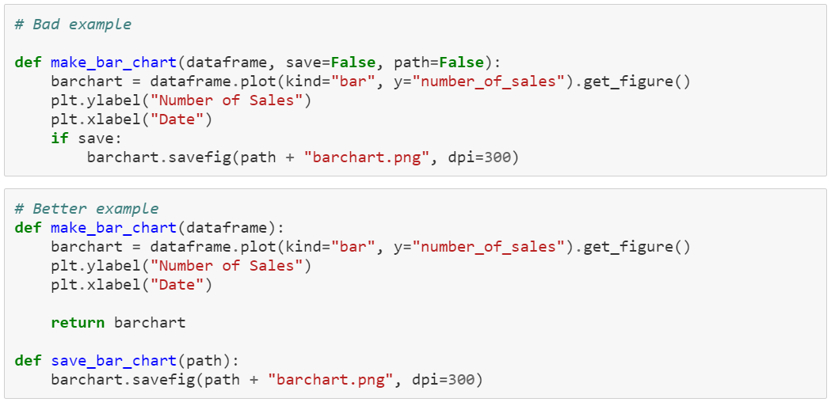
Axe Those Arguments
Notes:
In this next example, we have a function that creates a barchart and saves it if the save argument is set to true. In general, if you are passing in True/False parameters, then your function is doing more than one thing and should be split into multiple functions. In this example, making and saving our barchart are two separate tasks.
In this second example, make_bar_chart only does one thing, creating the barchart. If we want to save it, we can then call save_bar_chart.

Slide 33
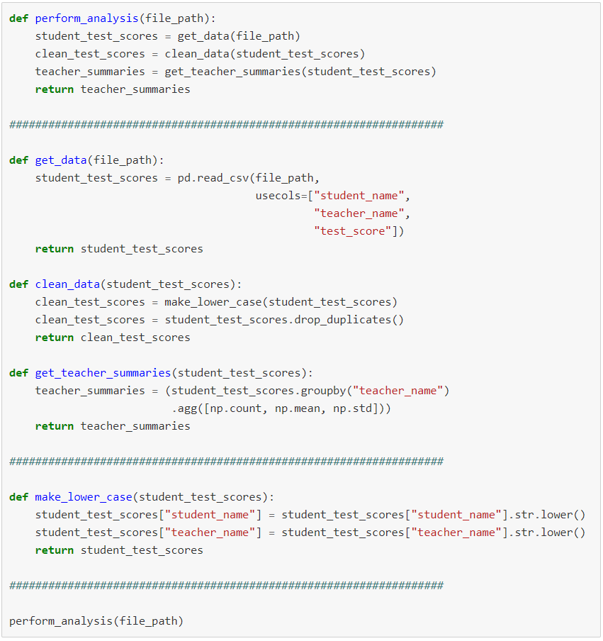
Notes:
We write code to solve problems, and reading the final draft of your code should feel like zooming in on the solution.
The first function in your code should read like a high level overview of what your script does, how it will solve the problem.
Each subsequent function should then step down a level, where each new level expands in increasing detail on how the solution is implemented.
In this example, the first function tells the reader how to analyse student test scores to get summaries for each teacher. There are three main steps, get the data, clean the data and summarise the data by teacher. The next set of functions explains how to perform these three steps. One of these steps requires further detail, which is included at the next layer down, near the bottom of our script.

Slide 34
“I don’t write that way to start. I don’t think anyone could.”
Robert C. Martin, author of Clean Code and the Agile Manifesto
Notes:
Writing code is like any other kind of writing. You wouldn't expect a book to be perfect on the first draft and your code won't be either. You have to work on it, but with every small improvement, you will make life easier for yourself and your colleagues.

Slide 35
5.Packaged Code

Slide 36

Level 5: Packaged Code
Notes:
Packaging code in RAP will assist with dependency management

Slide 37
Purpose
Packaging code for distribution is about making it:
Installable
Versioned
This easily facilitates:
Use
Reuse
Notes:
Packaging code for distribution is about making it:
Installable:
Including dependencies.
It is possible to make a project pip installable from Artifactory so that functionality can be imported and reused in other projects.
Versioned:
Packaging also implies that a particular version is complete or in some way ‘set in stone’
This ensures users aren’t getting inconsistent items.
Packaging in this context is all about distributing project releases
This easily facilitates:
Use:
Standard structure, pip installable, accessible, awareness
Reuse:
Reliability, Shareability, Consistent

Slide 38
How does this apply to RAP?
‘The Reproducible Analytical Pipeline (RAP) is a methodology for automating the bulk of steps involved in creating a statistical report.’
If we can install and import prewritten functionality we know we can trust, this will help the automation process.
What python packages do you make regular use of?
How do you install them?
Notes:
How does this apply to RAP?
‘The Reproducible Analytical Pipeline (RAP) is a methodology for automating the bulk of steps involved in creating a statistical report.’
If we can install and import prewritten functionality we know we can trust, this will help the automation process.
What python packages do you make regular use of?
Pandas, requests, matplotlib etc
How do you install them?
We can pip install packages from artifactory – we can set up a team repo

Slide 39
Creating a package
License
Versioning scheme
Documentation
Installation
Contribution management
Notes:
License: Copyright and liability, requirement for distributing code
Versioning scheme:
In the context of Software Development, semantic versioning gives a good framework for how to version your releases as you continuously maintain your code.
Ensures users aren’t getting inconsistent functionality.
Documentation:
A README will help users understand your project
You may want to include: Name, Descriptions, Installation, Usage, Support, Contributing, Authors, License, Status of the project…
Installation:
pip install from artifactory
Setup.py: ‘Build script’ required for creating the installable package files in the correct format (wheel) to be installable by PIP
Contribution management:
You may want to include a CONTRIBUTING.md so that you can specify how you would expect people to proceed if they wish to make contributions or enhancements to your project

Slide 40
6.Testing

Slide 41
Level 6a: Fully Tested Package
Notes:
Packaging code in RAP will assist with dependency management

Slide 42
What is Unit Testing?
“Since each function or group of functions (unit) is generic, it can be tested with a generic example, so that we know that our unit of code works as expected. If we discover cases where our units do not do perform as expected, we can codify these cases into new tests and work to fix the problem until the test passes. ”
- Data in Government Blog

Slide 43
Why Unit Test?
Ensuring code does what you think it does
Discovering errors in your code and then testing for these errors in future
Ensuring code works as expected after making changes

Slide 44
Level 6b : CI and Build
Notes:
Packaging code in RAP will assist with dependency management

Slide 45
How could we improve our testing?
Test Driven Development
Automated Testing
Code Coverage

Slide 46
Links to RAP related resources
RAP in DAP: https://share.sp.ons.statistics.gov.uk/sites/odts/wiki/Wiki/Good%20Practices.aspx
UK GovDataScience: https://ukgovdatascience.github.io/rap-website/index.html
Clean Code: https://www.investigatii.md/uploads/resurse/Clean_Code.pdf
Skevi’s clean code course: https://github.com/ParaSkeviPericleous/Clean_Code_Workshop
clean-code-ml: https://github.com/davified/clean-code-ml
PEP 8: https://www.python.org/dev/peps/pep-0008/
How to Write Beautiful Python Code with PEP 8: https://realpython.com/python-pep8/#blank-lines
The Zen on Python by Example: https://github.com/hblanks/zen-of-python-by-example
Cookie Cutter, a handy tool for structuring a project: https://drivendata.github.io/cookiecutter-data-science/
Open Government Licence: https://www.nationalarchives.gov.uk/doc/open-government-licence/version/3/

Slide 47
Thanks
In order of appearance:
Wil Roberts,
Lucy Fergusson,
Dion Watts-Evans,
Rowan Hemsi,
Sarah Parry

