Slide 1
Hackvengers-2025
Team Name: Team Epsilon
PS : 2. AI Powered Healthcare Assistant
Title of the Project :
Access to timely diagnostics and mental health support is a global issue. AI can bridge these gaps through smart tools.

Slide 2
Our Vision: An AI Health Assistant Title: Developing a Comprehensive AI Health Assistant Objective: To develop an intelligent AI-powered health assistant capable of: Providing initial diagnostics support. Facilitating regular mental health check-ins. Enabling fitness tracking. The Global Healthcare Challenge Title: Addressing Critical Gaps in Healthcare Problem Statement: Access to timely diagnostics is a significant global challenge. Availability of adequate mental health support remains a critical concern worldwide. The Opportunity: Artificial Intelligence (AI) offers a powerful tool to bridge these gaps through smart and accessible solutions.

Slide 3
Core Features: Mental Health Support
Title: Direct Mental Health Consultation
Feature: Video Call with a Doctor
Functionality:
Provides a secure and private platform for users to connect directly with mental health professionals.
Enables real-time interaction, diagnosis, and personalized support.
Core Features: Physical Health Detection
Title: AI-Powered Physical Health Assessment
Feature: AI Symptom Checker Chatbot
Functionality:
Users can describe their symptoms through text-based interaction.
The AI chatbot analyzes the input to provide preliminary information and potential next steps.
Core Features: Fitness Tracking
Title: Tracking Physical Well-being
Feature: Step Tracker or Health Habit Log
Functionality:
Allows users to monitor their physical activity
levels and healthy habits.
Provides insights and encourages a
healthy lifestyle.

Slide 4
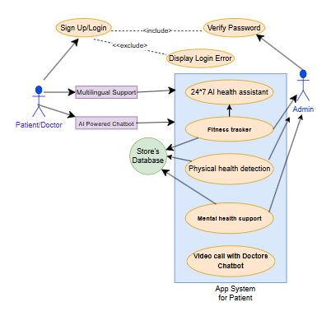
Data flow diagram
Architecture/Block diagram
User health report , steps , heart rate , sleep hours , calories
Fitness Tracker
Chat with AI assistant for instant support
User sign up
AI Assistant
Book appointment or go live with available doctor
Doctor’s appointment
Medical Records
Show all the medical records saved by the user

Slide 5
Our Solution: An AI-Enhanced Healthcare Assistant
Title: Our Implemented AI Health Assistant
Key Features:
Physical Health Detection : AI-powered Chatbot for initial symptom assessment and guidance.
Mental Health Detection: Direct Video Call with a Doctor for professional consultation and support.
Fitness Tracking
Bonus Features:
Emergency Contact Notifications: For immediate
assistance in critical situations.
Health Tips Based on User Data: Personalized
recommendations for improved health and
wellness.
Voice-Command Capabilities: For hands-free
interaction and accessibility.
Potential Impact: Transforming Healthcare Access
Title: Expected Outcomes and Impact
Improved Access: Making basic diagnostics and mental health support more readily available.
Early Detection: Potentially identifying health issues and mental health concerns earlier.
Personalized Support: Providing tailored insights and recommendations.
Empowering Users: Enabling individuals to take a more proactive role in managing their health and well-being.

Slide 6
