Slide 1



Web Security 101
VU StudSec STORM EducaCie

Slide 2


Overview part 1: Client-Server model
Request
Response

Slide 3
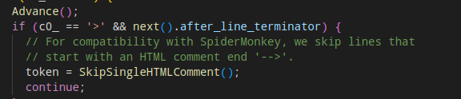

Slide 4



Overview part 2
Request
Response

Slide 5
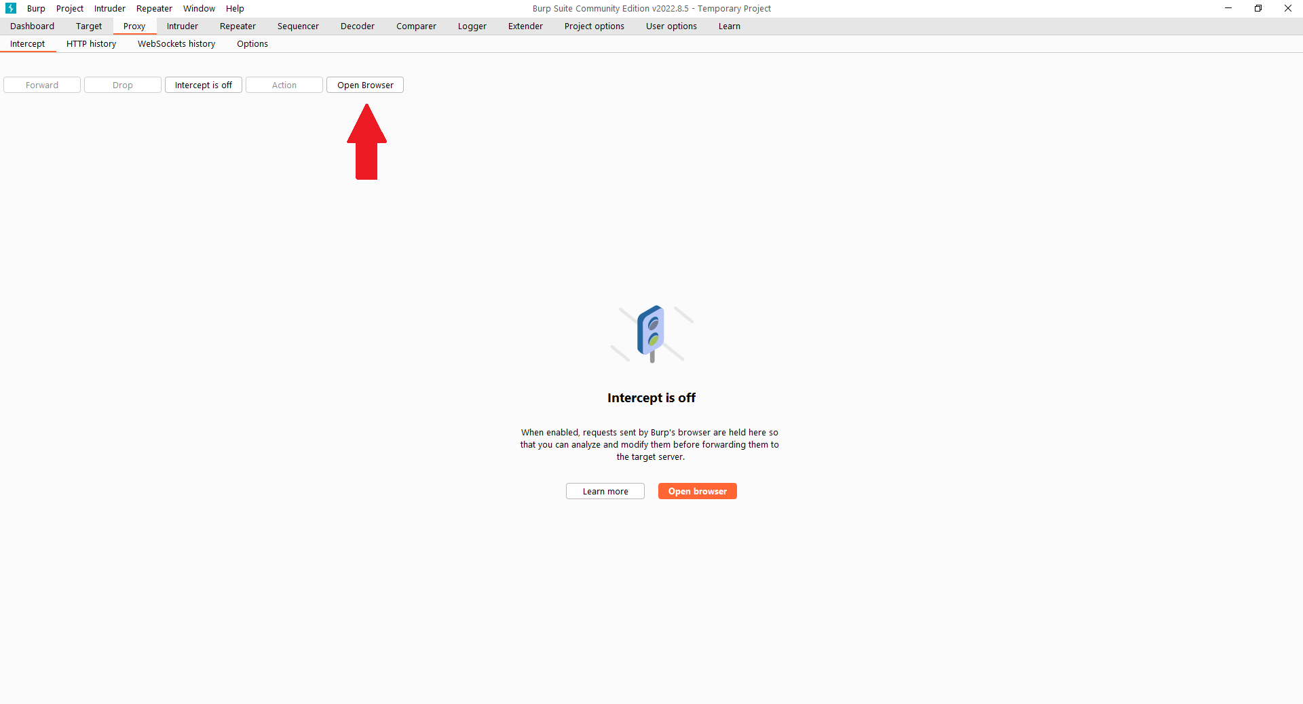
Burp guide
Go to the proxy tab and hit "Open Browser"

Slide 6
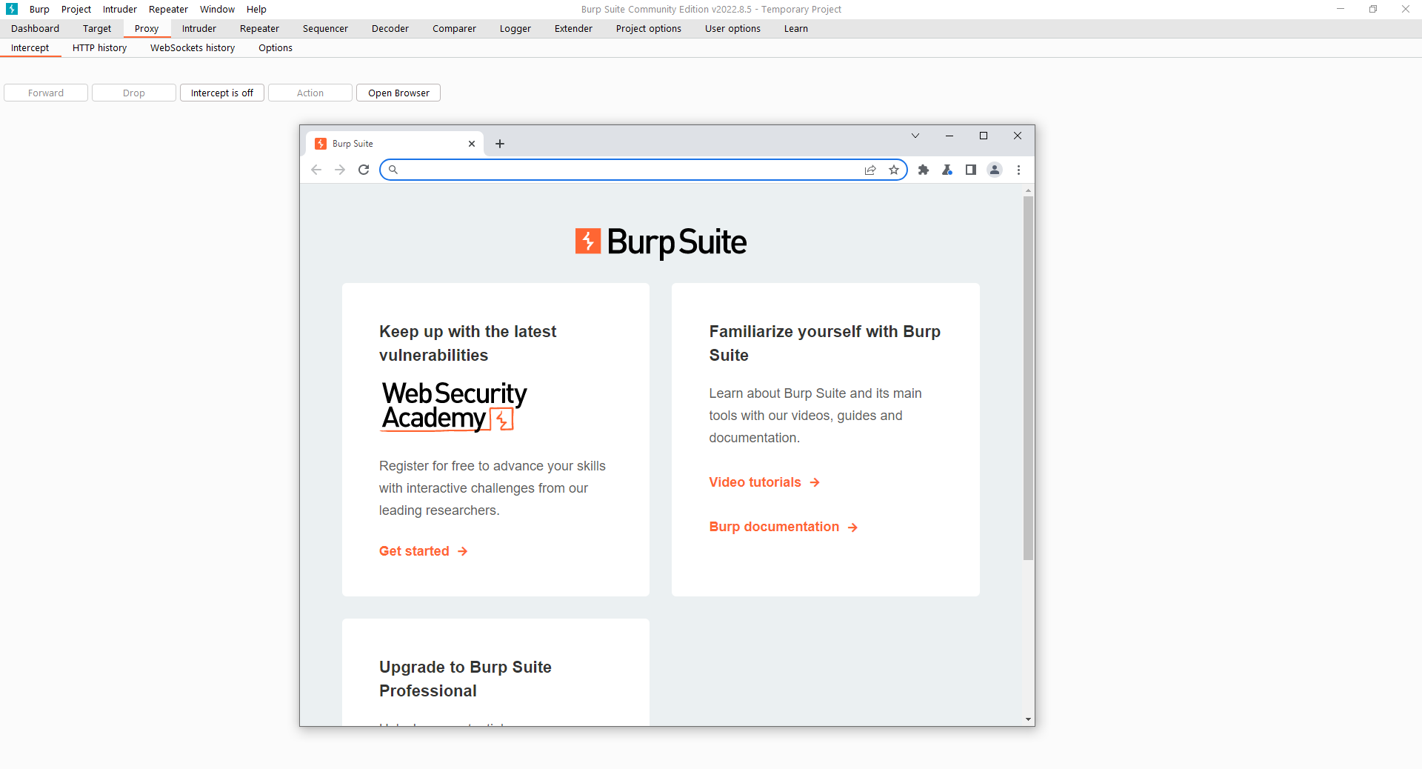
Burp guide

Slide 7

Burp
Request
Request
Response

Slide 8


Mal request
Burp
Request
Request
Response

Slide 9
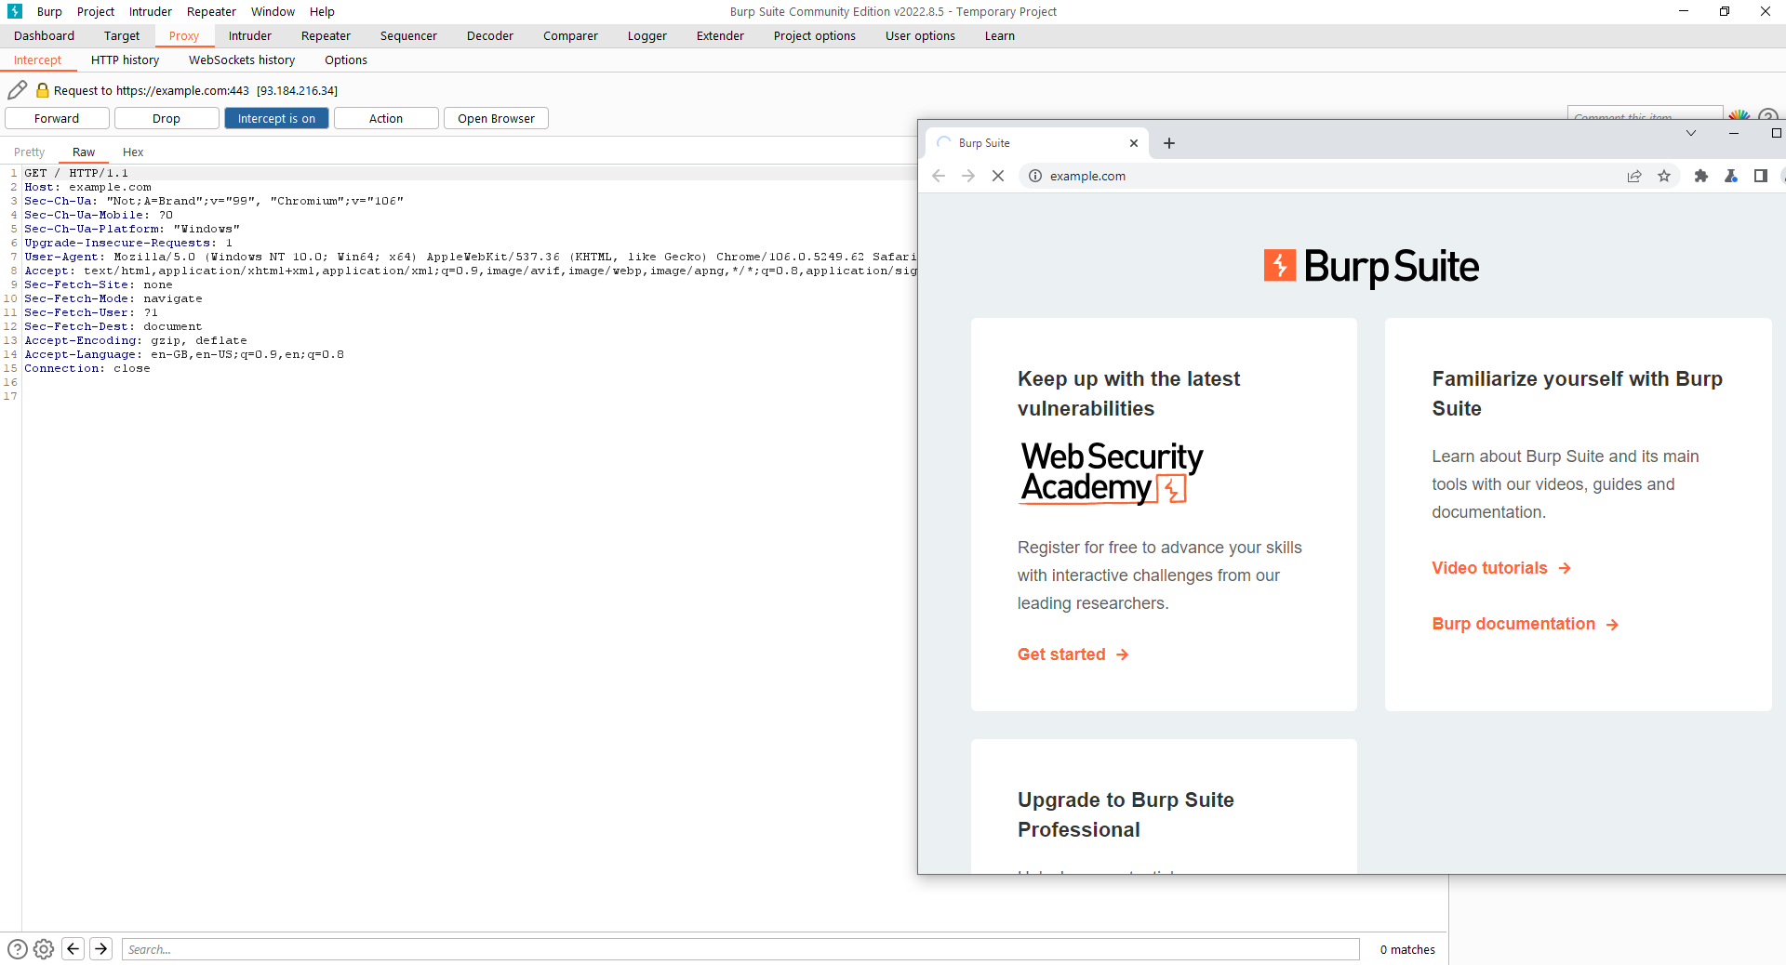
Burp guide
Now when you make a request, it should appear in the interceptor
*Make sure to turn intercept on

Slide 10
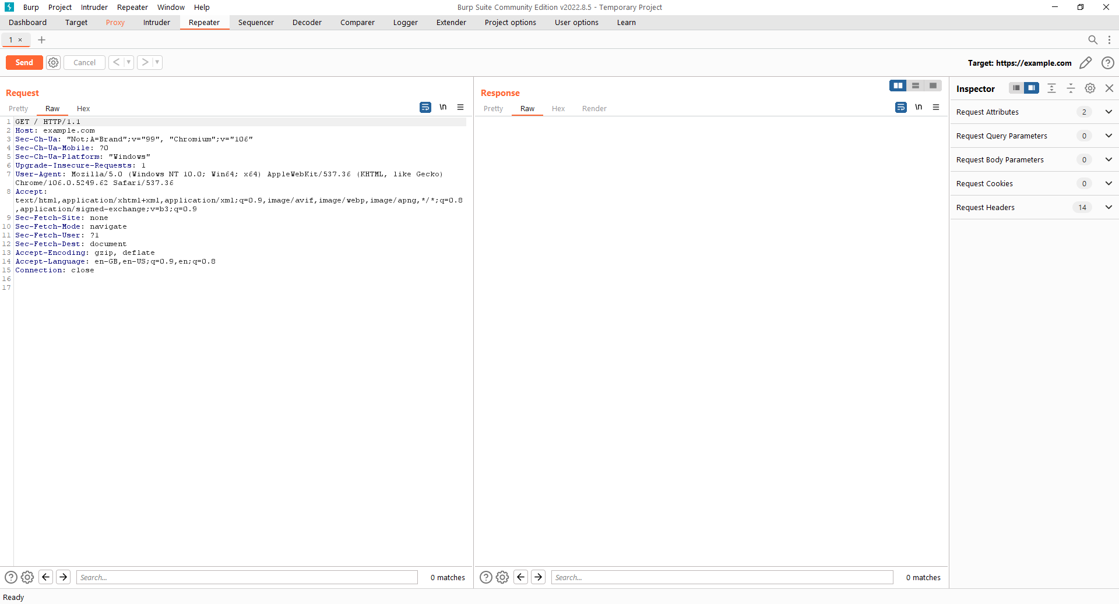
Burp guide
To send a request multiple times, hit ctrl+r to send it to the repeater tab.

Slide 12
Challenge 1: Frontend Validation
Check
Validated data (in theory)

Slide 13
Challenge 1: Frontend Validation
Try to log in as a different user
workshop.studsec.nl

Slide 14

Challenge 2: SQL injection

Slide 15
Challenge 2: SQL injection
Request
Response

Slide 16
Challenge 2: SQL injection
Query
Request
Response
Response

Slide 17
Challenge 2: SQL injection
SELECT * FROM USERS WHERE USER='Aidan' AND PASSWORD='1234'
Username=Aidan&password=1234
Welcome Aidan
['Aidan', '1234', 'aidan@studsec.nl']

Slide 18
Challenge 2: SQL injection
Username=Aidan&Password=1234
PHP: SELECT * FROM USERS WHERE USER='Aidan' AND PASSWORD='1234'
SQL: SELECT * FROM USERS WHERE USER='Aidan' AND PASSWORD='1234'

Slide 19
Challenge 2: SQL injection
Username=Aidan&Password=test' or '1'='1
PHP: SELECT * FROM USERS WHERE USER='Aidan' AND PASSWORD='test' or '1'='1'
SQL: SELECT * FROM USERS WHERE USER='Aidan' AND PASSWORD='test' or '1'='1'

Slide 21
Challenge 2: SQL injection
Can you bypass the login screen?
Bonus: Can you retrieve Aidan's password?
challs.studsec.nl:5680

Slide 22
Challenge 3: Remote Code Execution

Slide 23
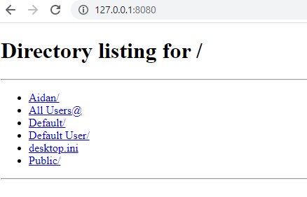
Challenge 3: Remote Code Execution

Slide 24


index.html
GET /robots.txt
open robots.txt
robots.txt
read robots.txt
robots.txt
style.css

Slide 25

result
php source code
GET /home.php
open home.php
result
read home.php
home.php
style.css

Slide 26
File based code + insecure file upload = win

Slide 27

write shell.php
OK
php source code + request data
shell.php
POST /upload.php
open upload.php
OK
read upload.php
upload.php
style.css

Slide 28
malicious code
result
open shell.php
shell.php
POST /upload.php
read shell.php
result
upload.php
style.css

Slide 30
Challenge 3: Remote Code Execution
Run the following command on the server: "cat /etc/passwd"
Bonus: Get a shell
http://workshop.studsec.nl/supersecretfileuploader.php

Slide 31

Questions

