Slide 1

NLP Chatbot Development using Dialogflow

Slide 2
Title Page
Project Title : EatzAI – Restaurant Chatbot System
Supervisor : Abdullah Qamar (abdullah.qamar@vu.edu.pk)
Group ID : F24PROJECT7B8AC
Student VUID : BC200417404
Student Name : Syed Yahya Masood
GitHub: [https://github.com/Student-BC200417404/Prototype-Assignment-BC200417404/tree/main/src/restaurant_web]

Slide 3
Introduction
EatzAI is an AI-powered restaurant management chatbot system designed to streamline customer interactions using natural language. It enables users to place orders, reserve tables, browse the menu, and get answers to frequently asked questions—all through a conversational interface powered by Google Dialogflow. The system architecture is supported by a Laravel backend, which handles data management and API operations, while MySQL stores all essential information like orders, reservations, and menu items. EatzAI includes two main portals: the User Portal, where customers can manage their profile and view order/reservation history; and the Admin Portal, where restaurant staff can control menu items, view customer logs, and manage operational data. This modern solution improves both customer experience and restaurant efficiency through real-time, AI-driven interaction.

Slide 4
Problem Statement
Manual processes are slow & repetitive
Customers face delays in ordering/reserving
Staff overwhelmed with frequent queries
Solution: Smart, automated, real-time chatbot

Slide 5
Project Objectives
Automate common restaurant tasks
Improve customer experience using NLP
Provide admin control over menu/orders
Real-time sync between chatbot and backend

Slide 6
Scope of project
Included
Ordering
Excluded
Reservations
Menu
Order Tracking
Browsing
FAQs
Admin/User Portals
Online Payments
Loyalty Programs
3rd-party POS
Support System

Slide 7
Key Features
Admin/user roles with separate dashboards
Chatbot interaction via Dialogflow
Order/reservation management
Real-time API integration

Slide 8
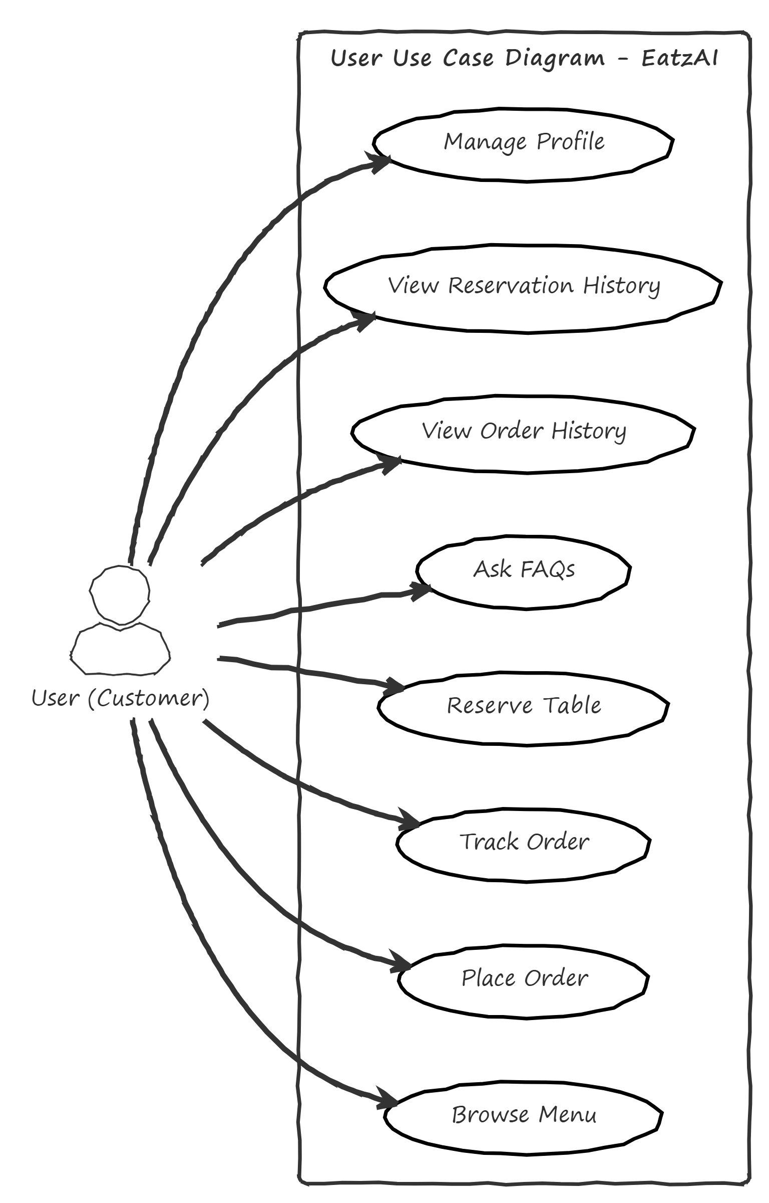
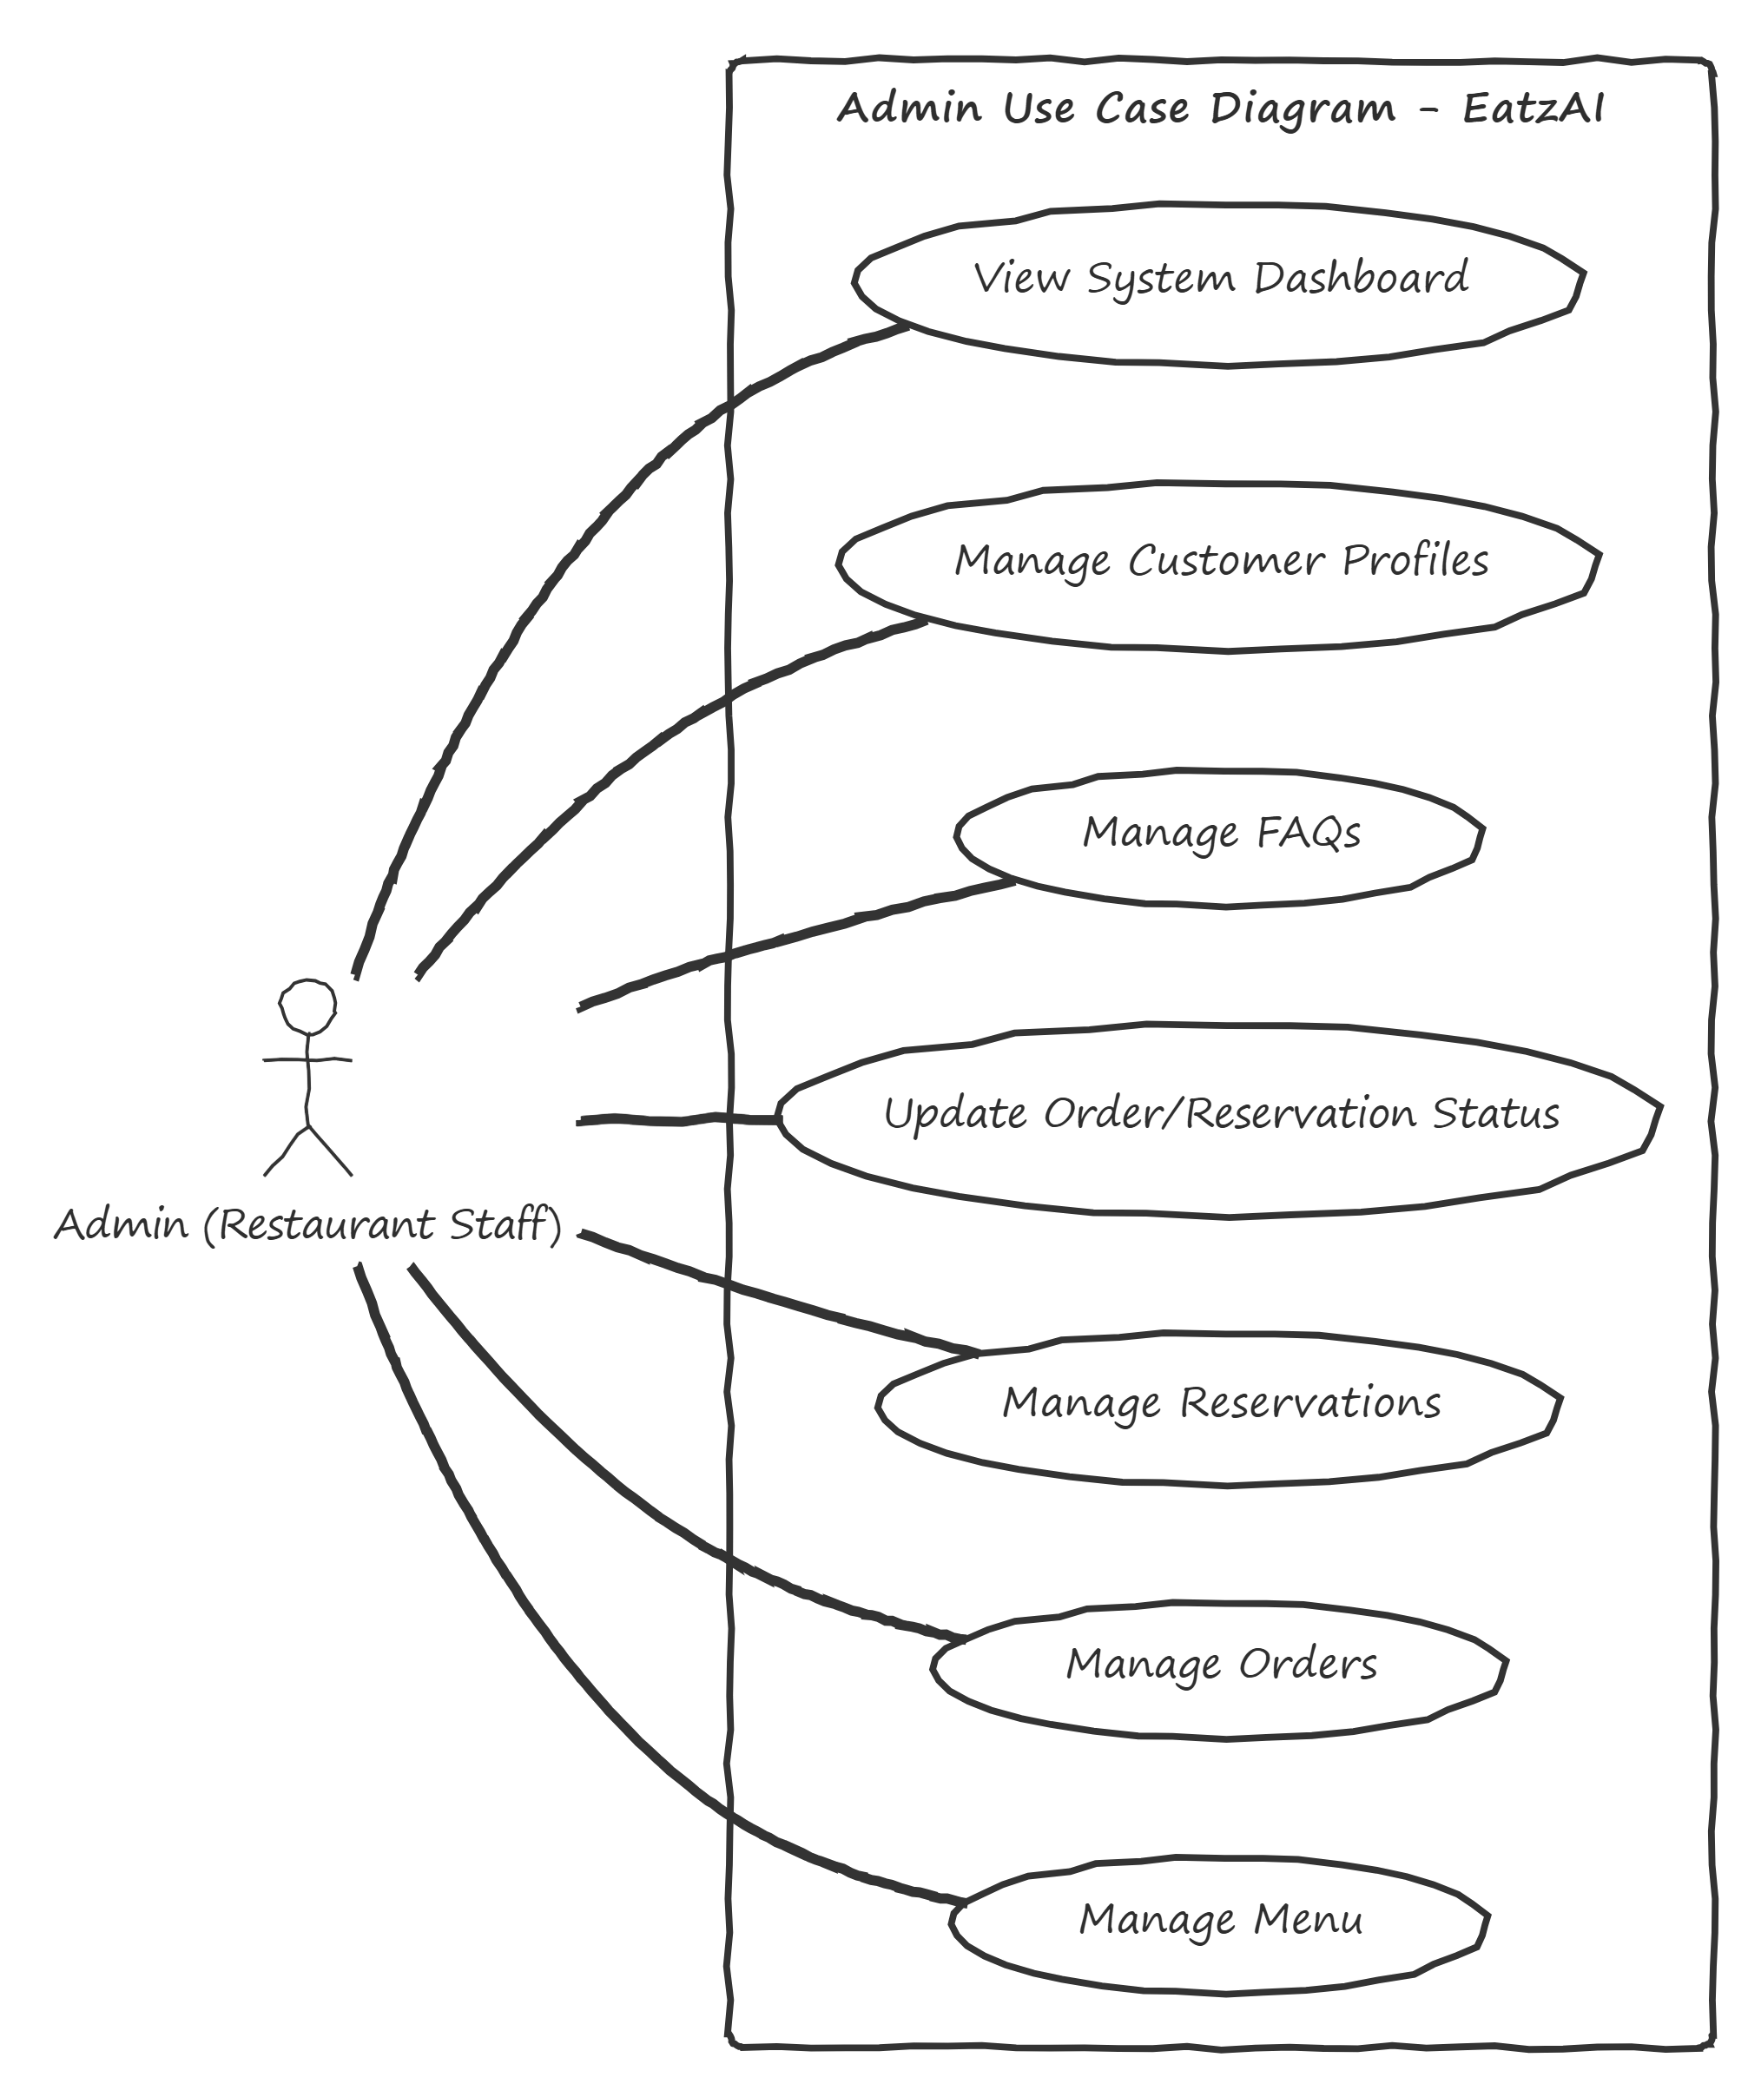
Use Case Diagram

Slide 9
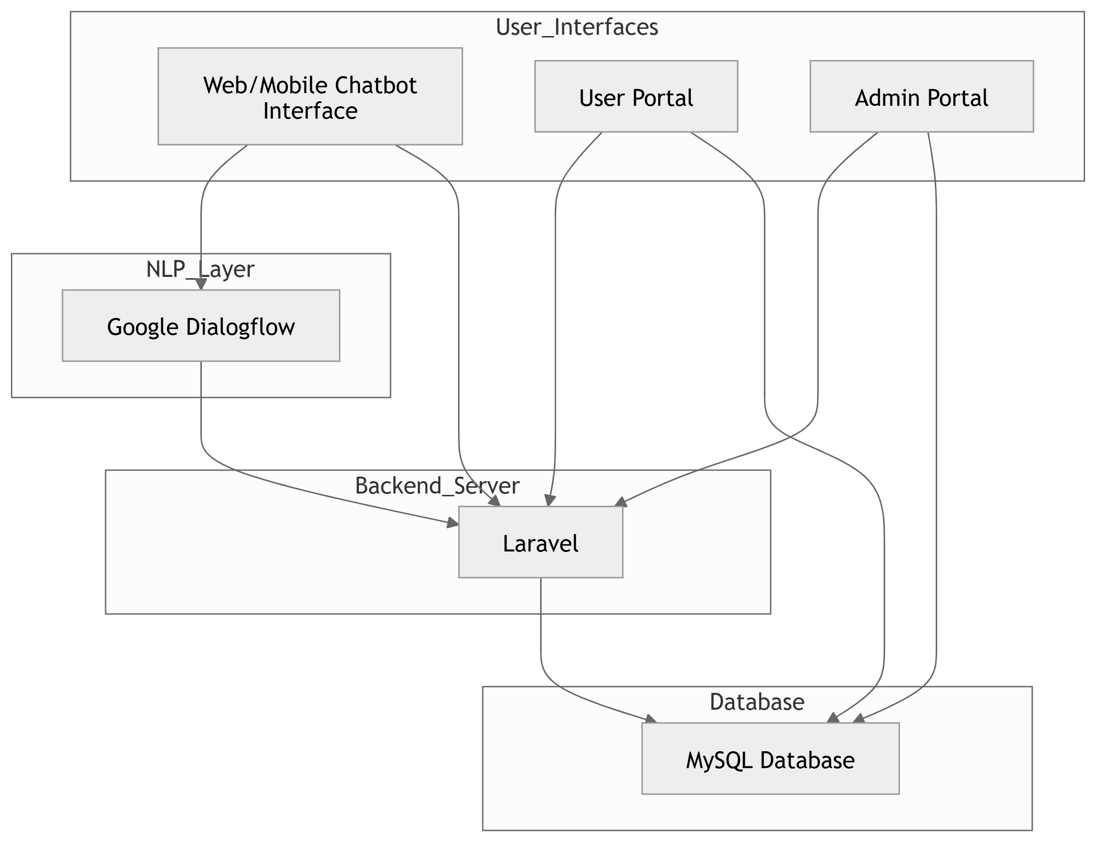
System Architecture

Slide 10
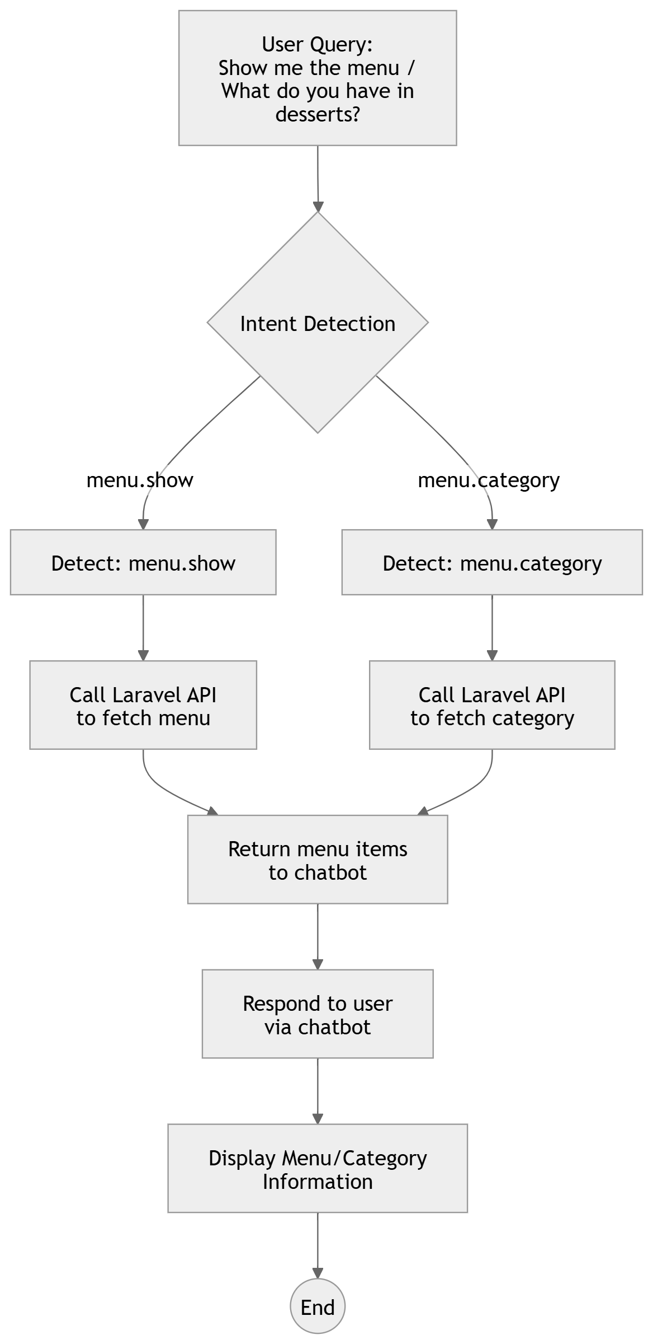
Dialogflow Intents (Menu Navigation Intent Flow)

Slide 11
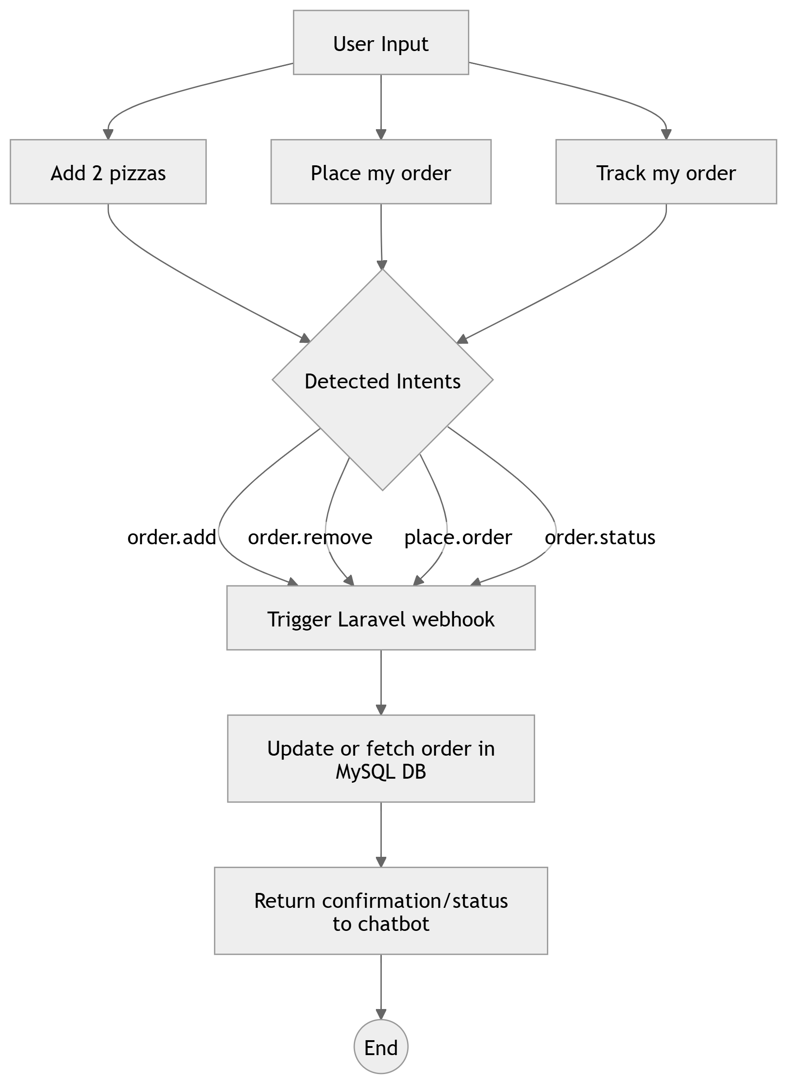
Dialogflow Intents (Order Management Flow)

Slide 12
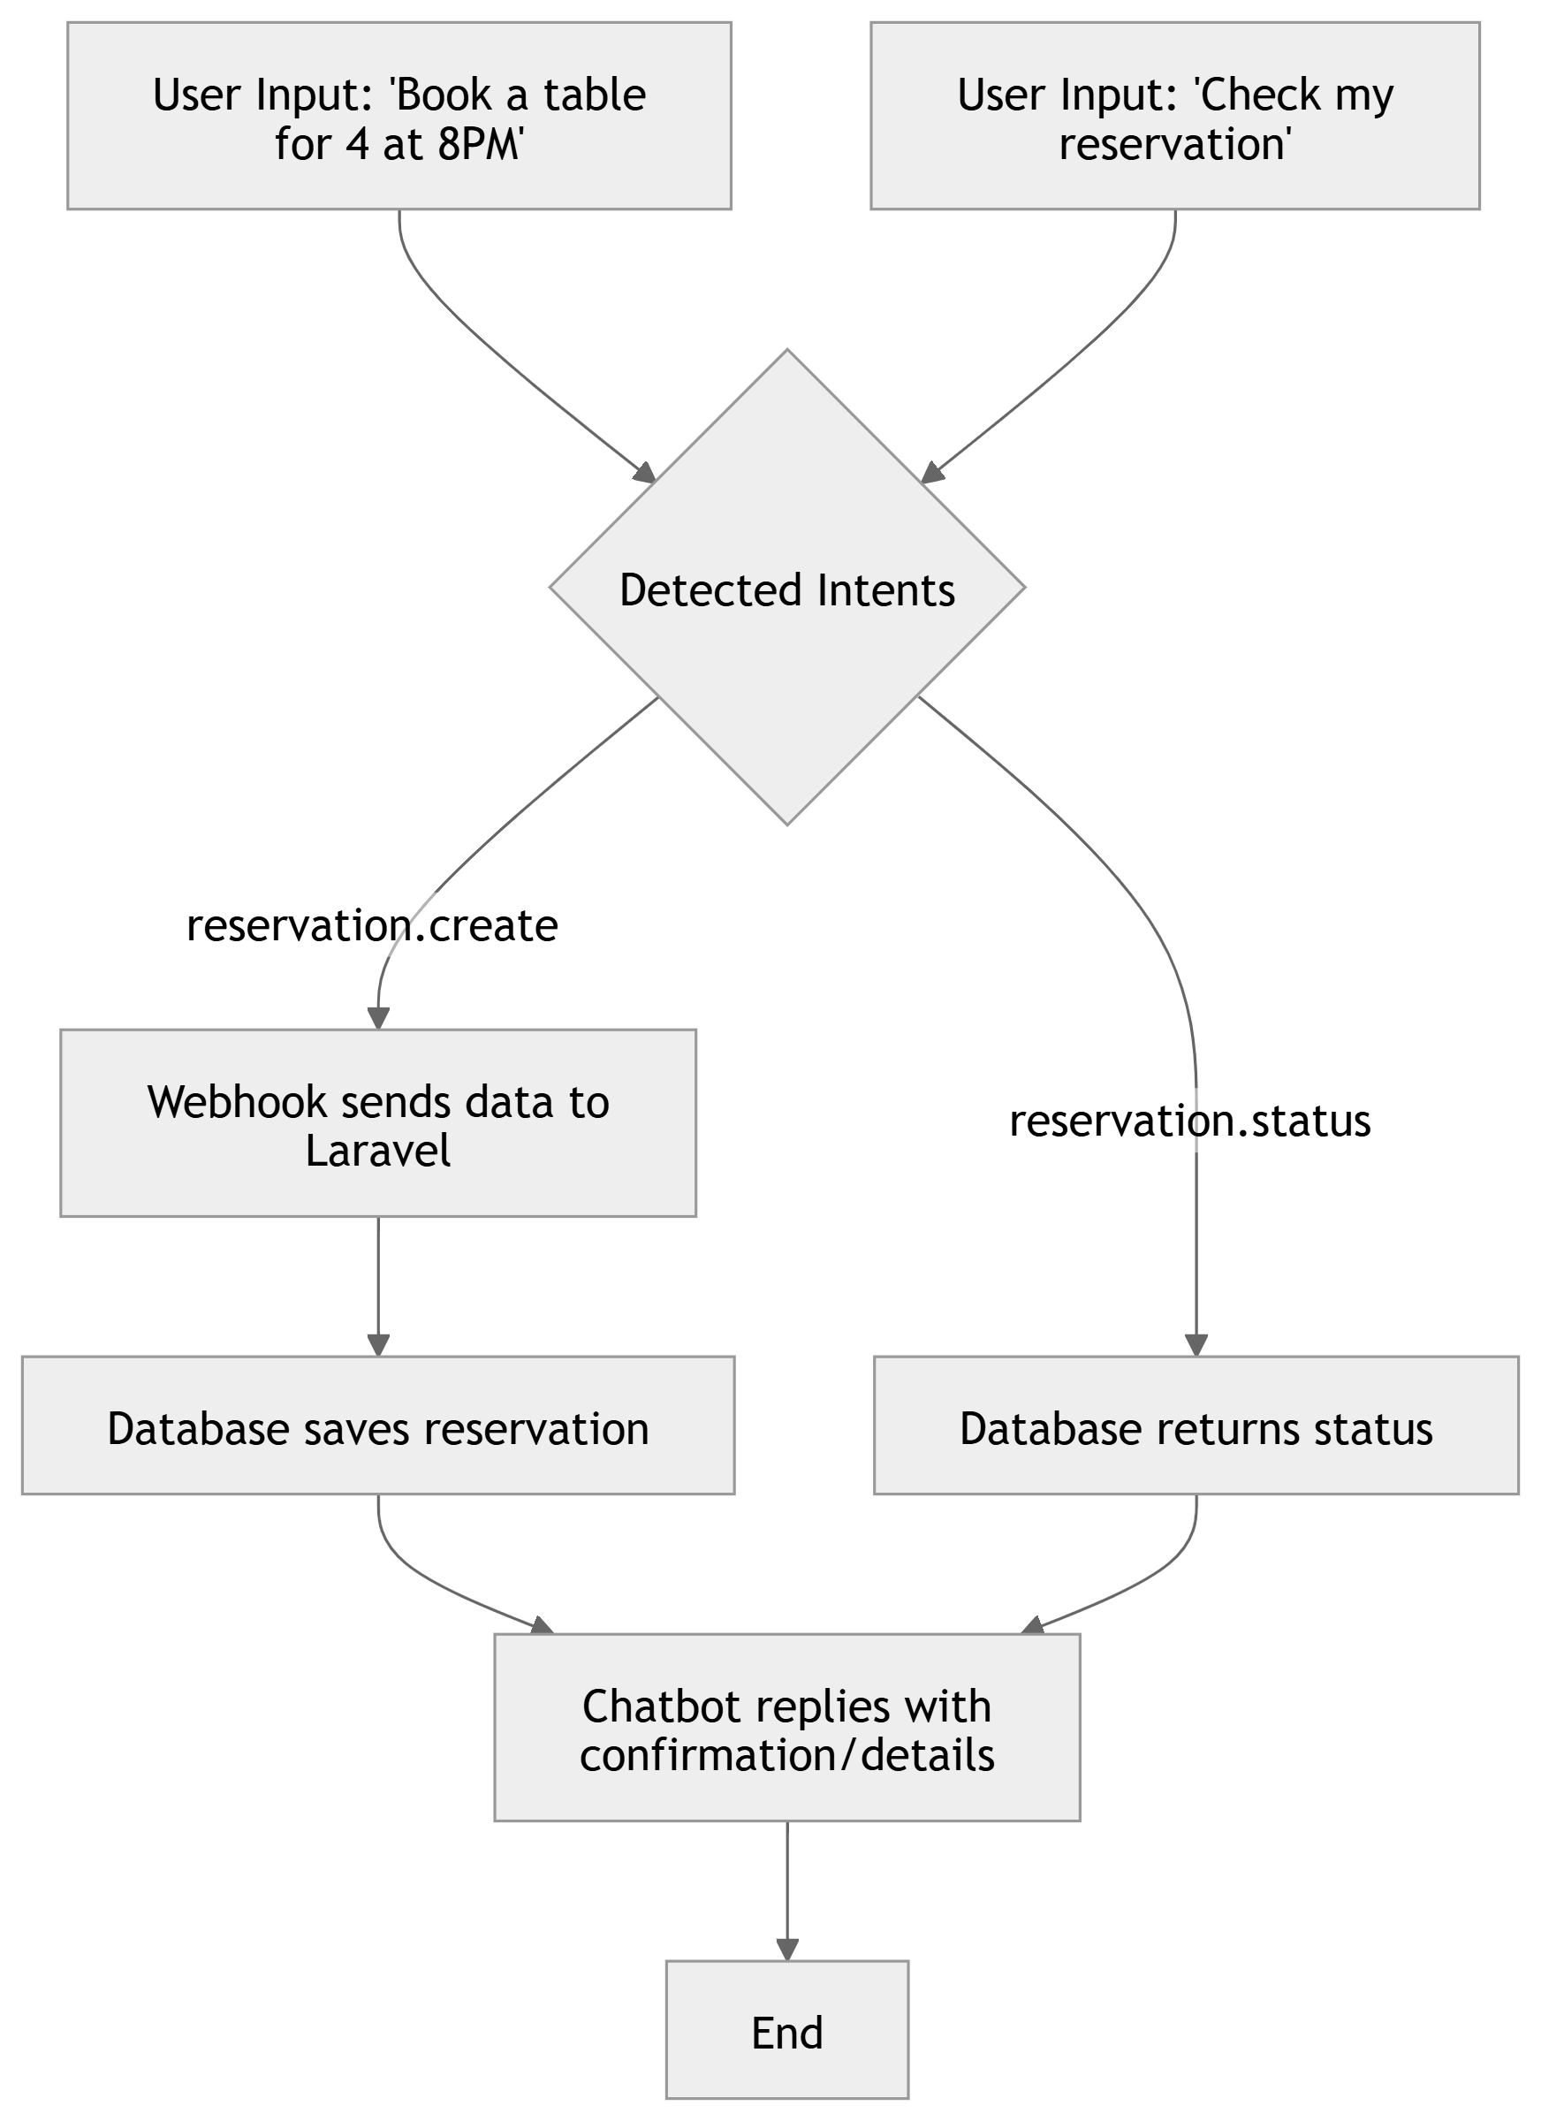
Dialogflow Intents (Reservation Management Flow)

Slide 13
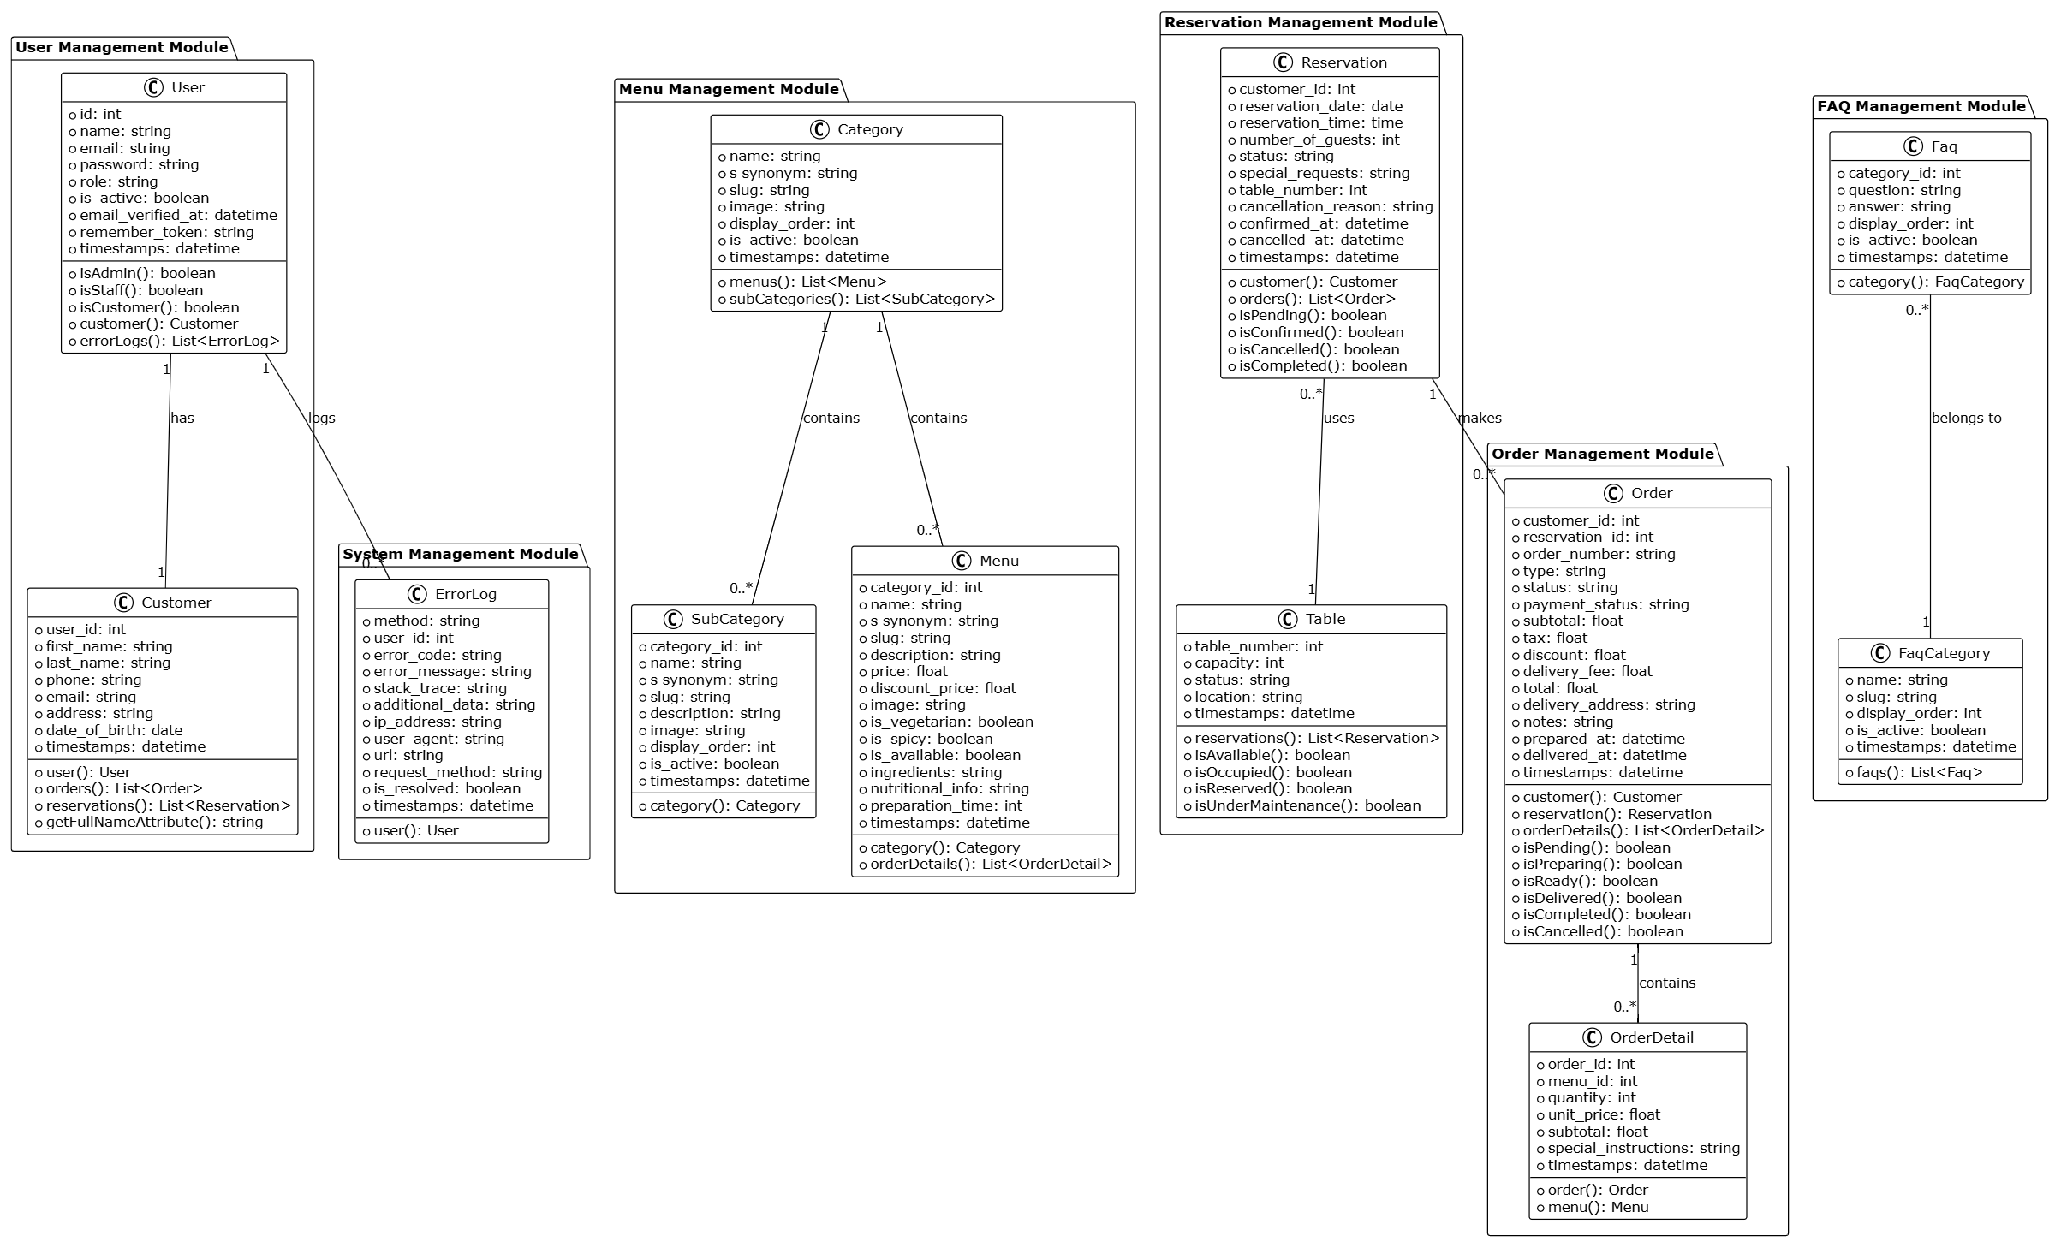
Class Diagram

Slide 14
Interface Design
User Portal
Admin Portal
Chatbot

Slide 15
Work Plan
Phase | Duration | Key Activities
Requirement Gathering | Nov 2024 | Project idea finalization, requirement specification
System Design | Dec 2024 | Use case diagrams, architecture, database & UI designs
Development | Jan – Feb 2025 | Backend APIs in Laravel, Dialogflow chatbot integration
Integration | Mar 2025 | Linking chatbot with backend, UI & portal functionality
Testing & Validation | Mar – Apr 2025 | Functional testing, test cases, bug fixing
Documentation | April 2025 | Final SRS, report writing, PPT preparation

Slide 16
Learning & Reflection
Technical Learnings
Integrated Dialogflow NLP with Laravel backend
Personal Growth
Designed and consumed RESTful APIs
Developed role-based portals (User/Admin)
Implemented intent & entity handling in Dialogflow
Created secure, modular database structures using MySQL
Strengthened project planning and time management
Learned debugging and issue resolution in real apps
Enhanced communication and documentation skills
Gained confidence in full-stack development

Slide 17
Conclusion & Q/A
Summary
EatzAI is a smart restaurant chatbot system powered by Dialogflow NLP and a Laravel backend.
It automates food ordering, table reservations, menu viewing, and FAQs through natural language interaction.
Admin and user portals allow seamless backend management and tracking.
Impact
Enhances customer experience through real-time communication.
Reduces staff workload by automating common queries and actions.
Demonstrates the integration of AI with traditional backend systems.

Slide 18
Thank You

