Slide 1
EV Charging Demand Forecasting & Analytics
PowerGrid EV Analytics
Project Scope
Analytical Approach
UK EV Charging Data | 2022–2024
Statistical and machine-learning forecasting models evaluated against unseen test data to identify the best-performing approach for operational planning.
Data Period
Sessions Analysed
1 Jan 2022 – 31 Dec 2024
294,024 charging sessions
Daily Observations
Models Compared
1,096 daily data points
SARIMA vs. XGBoost

Slide 2


PROJECT FOUNDATION
Objective & Dataset
Research Objectives
Dataset Overview
1
Forecast daily EV charging demand
294K
Develop reliable daily-level energy demand predictions across multiple time horizons.
Charging Sessions
2
Compare forecasting approaches
Total sessions recorded across the full three-year coverage period.
Benchmark a statistical baseline (SARIMA) against a machine-learning model (XGBoost).
1,096
3
Generate multi-horizon forecasts
Daily Observations
Produce 30-day, 90-day, and 365-day forward-looking demand estimates.
One observation per calendar day from 1 Jan 2022 to 31 Dec 2024.
Primary Variable
energy_kwh — daily total charging energy consumed across all sessions.
Coverage
Three full calendar years (2022, 2023, 2024), providing a rich seasonal and trend signal for modelling.

Slide 3
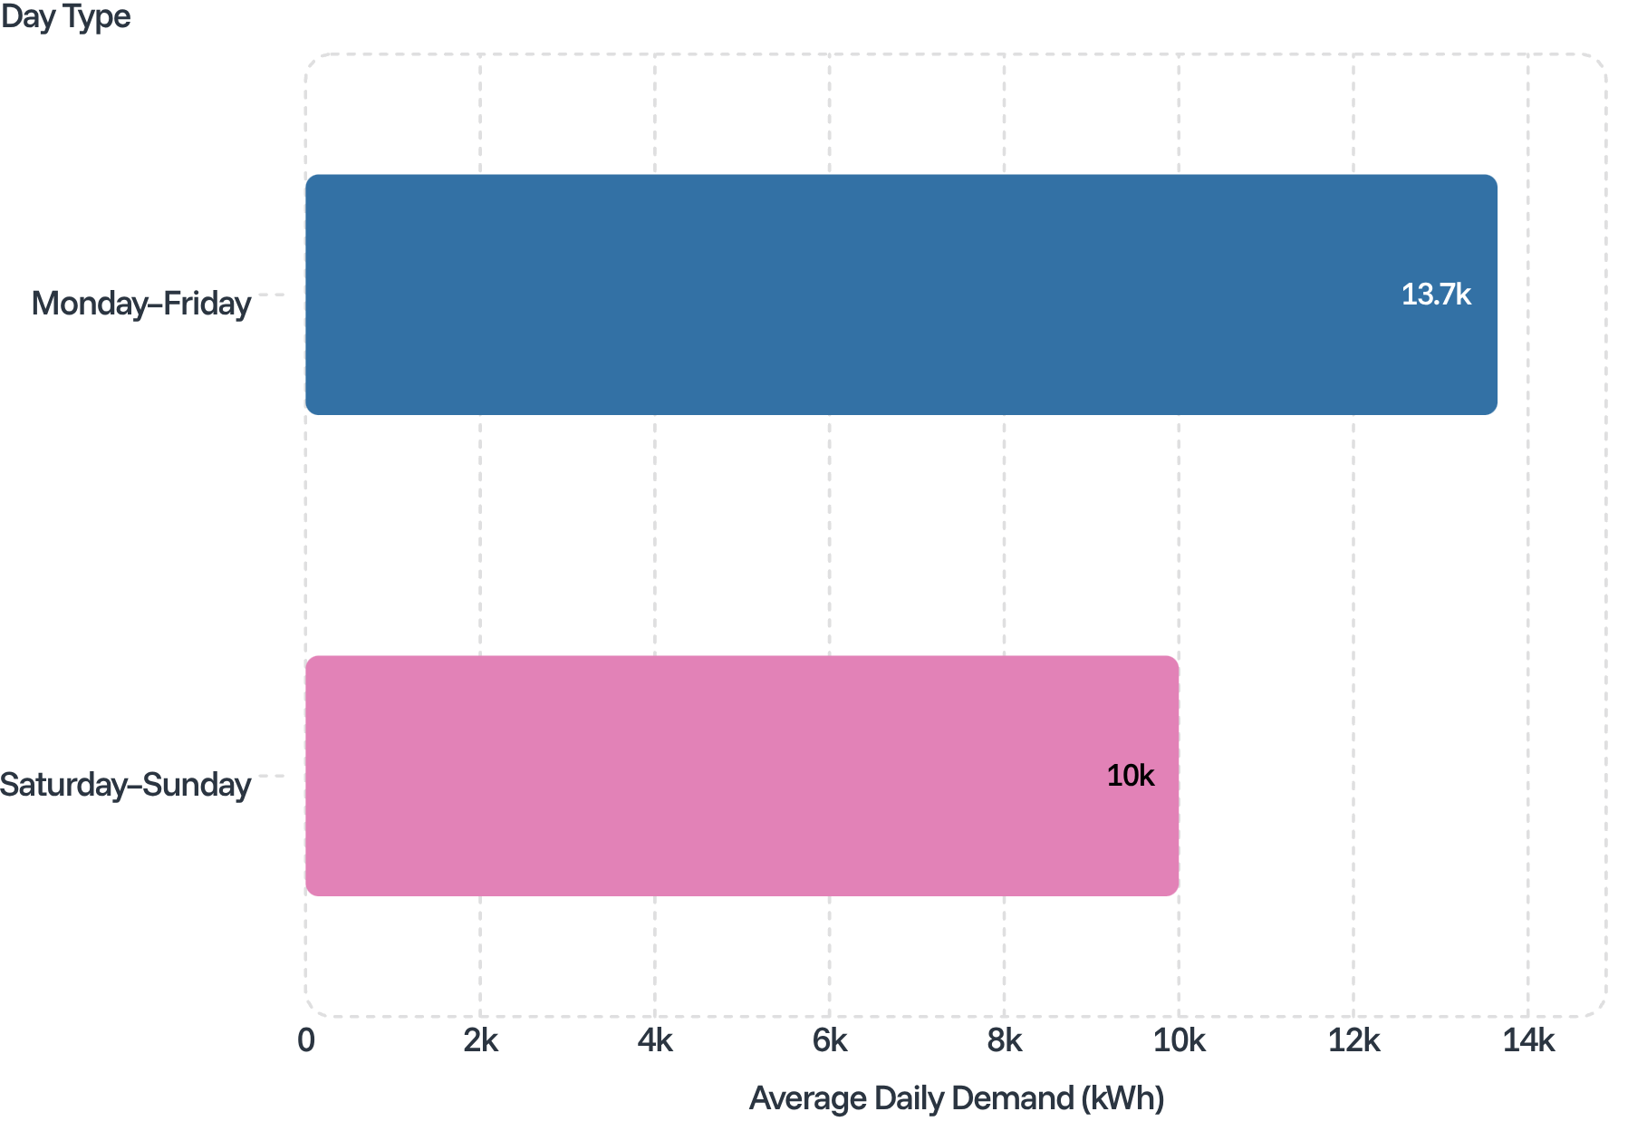


EXPLORATORY ANALYSIS
Charging Demand Trends & Seasonality
Key Findings
Year-on-Year Growth
Weekly Seasonality
Strong and consistent growth in daily charging demand across 2022, 2023, and 2024, reflecting rapid network utilisation growth.
A clear and repeating weekly cycle is present in the data, with demand consistently higher on weekdays than weekends.
Weekday vs. Weekend
Day-Level Variation
Daily demand fluctuates around the upward trend, confirming the need for models that capture both seasonality and trend simultaneously.
Mon–Fri: ~13.6–13.7 thousand kWh/day
Sat–Sun: ~10 thousand kWh/day
Weekday demand averages 13,650 kWh/day versus 10,000 kWh/day at weekends — a ~37% uplift on working days.

Slide 4
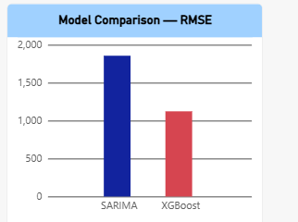
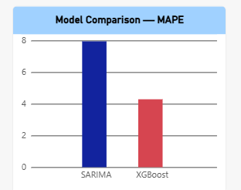


MODEL EVALUATION
Forecasting Model Comparison
Both models were evaluated on the final unseen 90-day test period. Lower RMSE and MAPE values indicate superior forecasting accuracy.
RMSE Comparison (lower is better)
MAPE Comparison (lower is better)
SARIMA(1,1,1)(1,1,1,7) — Statistical Baseline
XGBoost — Machine Learning Model
RMSE: 1,856.88 kWh
MAPE: 7.95%
RMSE: 1,123.90 kWh
MAPE: 4.29%
Root mean squared error on the 90-day unseen test set.
Mean absolute percentage error — roughly 1 in 12 units off on average.
39.5% lower RMSE than SARIMA on the same test period.
46% lower MAPE — leveraging engineered temporal and lag features.
Conclusion: XGBoost outperformed SARIMA on both RMSE and MAPE across the unseen 90-day test period and was selected as the preferred model for future demand forecasting.

Slide 5
FORWARD FORECAST
XGBoost Future Demand Forecast
Predicted Average Daily Demand by Horizon
Key Interpretation
Forecast Horizon | Avg. Predicted Daily Demand (kWh)
30 days | 21,334.91
90 days | 21,148.30
365 days | 21,310.52
~21.3 MWh/day Stable Baseline
Forecasted demand is approximately 21.3 MWh/day across all three horizons, reflecting continued but stabilising growth from the 2022–2024 trajectory.
Long-Horizon Stability
The 365-day forecast remains relatively stable rather than projecting accelerating growth, and should be interpreted as a baseline planning forecast rather than a highly dynamic long-term prediction.
All three horizons converge near 21.3 MWh/day, indicating a stable forward demand baseline.
Horizon-Appropriate Use
The 30-day forecast is most reliable for short-term operational planning; the 365-day forecast is best suited to strategic infrastructure capacity decisions.
30-Day Horizon
90-Day Horizon
365-Day Horizon
21,334.91 kWh/day
Short-term operational planning
21,148.30 kWh/day
Medium-term resource scheduling
21,310.52 kWh/day
Strategic capacity planning

Slide 6





CONCLUSIONS
Business Insights & Recommendations
Business Insights
Recommendations
Infrastructure Expansion
Use demand forecasts to support evidence-based charging infrastructure expansion decisions.
Increasing Demand
EV charging demand increased substantially between 2022 and 2024, indicating growing utilisation of the charging network and the need for proactive infrastructure planning.
Peak Demand Monitoring
Monitor weekday peak demand and station-level utilisation to identify capacity constraints early.
Weekly Demand Pattern
Maintenance Scheduling
Weekday charging demand is significantly higher than weekend demand (~13.6–13.7 vs. ~10 thousand kWh/day), creating a predictable and exploitable weekly cycle.
Schedule maintenance during lower-demand periods (weekends) where operationally possible.
Model Retraining
Continuously retrain the XGBoost model as new charging data becomes available; monitor performance via RMSE and MAPE.
Forecast-Based Planning
The XGBoost model provides a data-driven estimate of future charging demand (~21.3 MWh/day) for both operational and infrastructure planning purposes.
Planning Horizon Selection
Use the 30-day forecast for short-term operations and longer horizons for strategic capacity planning.
Conclusion: XGBoost achieved better forecasting performance than SARIMA on the unseen 90-day test period (RMSE 1,123.90 kWh vs. 1,856.88 kWh; MAPE 4.29% vs. 7.95%) and was selected as the preferred model for future EV charging demand forecasting.

