Slide 1
EV Charging Revenue & Price Sensitivity Analysis
Historical performance, revenue forecasting and pricing scenario analysis | 2022–2024 actuals + 2025 forecast
PYTHON
STATISTICAL ANALYSIS
FORECASTING
POWER BI

Slide 2
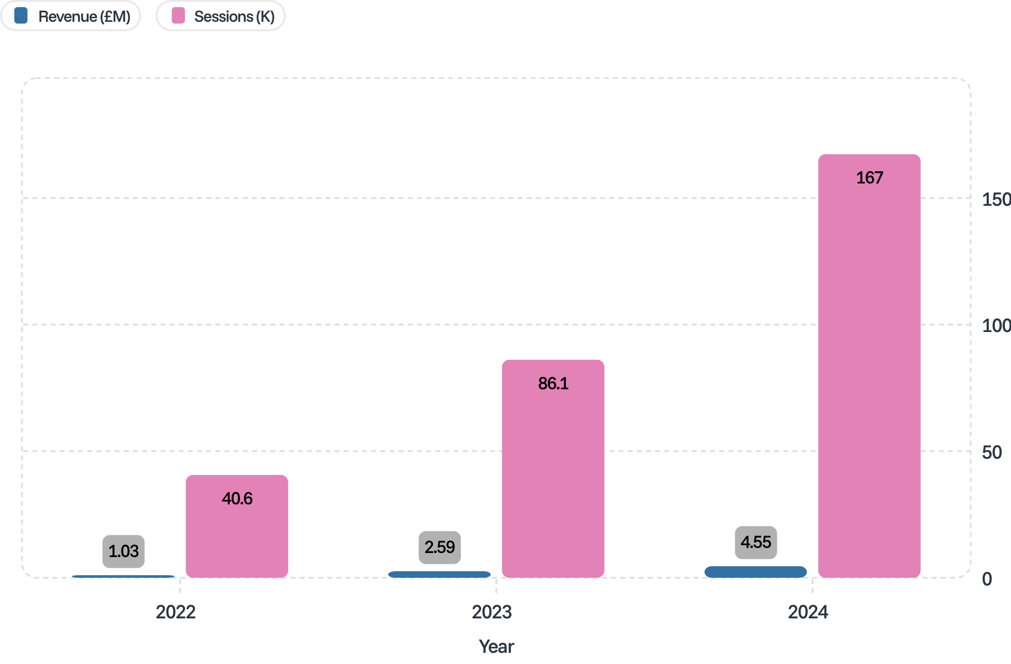
Revenue Performance: 2022–2024
2022
£1.03M revenue
40,640 sessions
2023
£2.59M revenue
86,132 sessions
+151.5% growth
2024
£4.55M revenue
167,252 sessions
+76.0% growth
Revenue and session volume both grew substantially from 2022 to 2024, with revenue growth moderating from 151.5% to 76.0%.
Revenue more than quadrupled over three years. Session volume growth tracked revenue expansion, indicating demand-driven expansion.

Slide 3


Pricing & Demand Relationship
Price per kWh (Weighted Average)
Why the Elasticity Cannot Be Trusted
Aggregated monthly data conflates multiple growth drivers. The p-value of 0.854 indicates no statistical evidence of a reliable price-demand relationship at this level of aggregation.
Observed demand variation is strongly influenced by:
2022
2023
£0.51 / kWh
£0.64 / kWh
2024
Underlying market expansion (EV adoption curves)
Network infrastructure rollout
Seasonal and time-of-day patterns
Station and charger-type mix changes
£0.59 / kWh
Regression Output
These confounders dominate the price signal in monthly aggregate data, making it impossible to isolate pricing effects with this dataset structure.
Price Elasticity
+0.75 — positive coefficient, counterintuitive direction
A p-value of 0.854 means pricing effects cannot be reliably distinguished from noise. Do not interpret the +0.75 elasticity as causal.
p-value = 0.854
Not statistically significant — fails conventional thresholds (0.05 / 0.10)
R² = 0.997
High model fit driven by underlying trend, not price signal

Slide 4
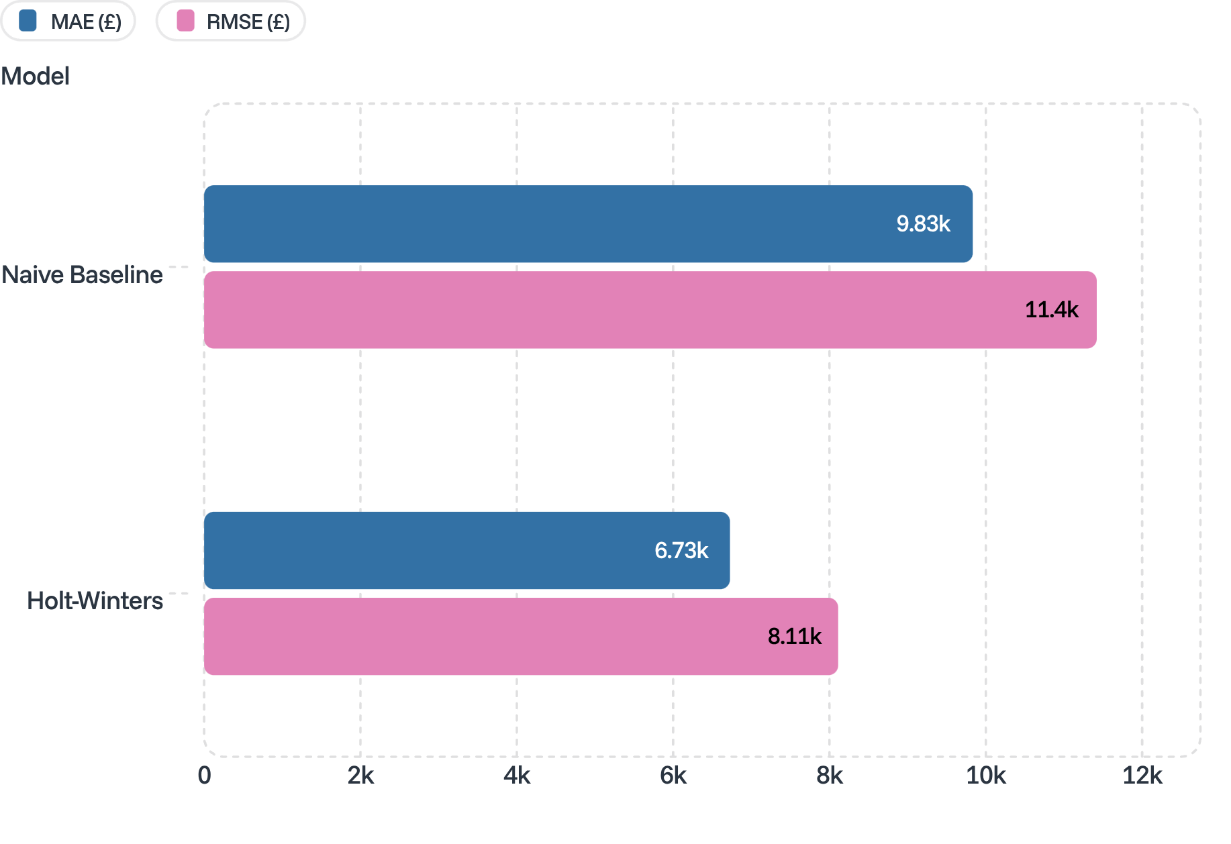
Revenue Forecasting: Holt-Winters Model
Model Error Comparison — Test Period (Jul–Dec 2024)
Training & Validation Setup
Training Period
January 2022 – June 2024
Test Period
July 2024 – December 2024
2025 Forecast
Annual Total
Monthly Avg
£6.43M
£536K
Monthly Range
£509.7K – £545.6K
31.6%
MAE Reduction
£9,833 → £6,727
Holt-Winters exponential smoothing outperformed naive baseline on both error metrics, validated on a held-out test set.
29.0%
RMSE Reduction
£11,419 → £8,111

Slide 5

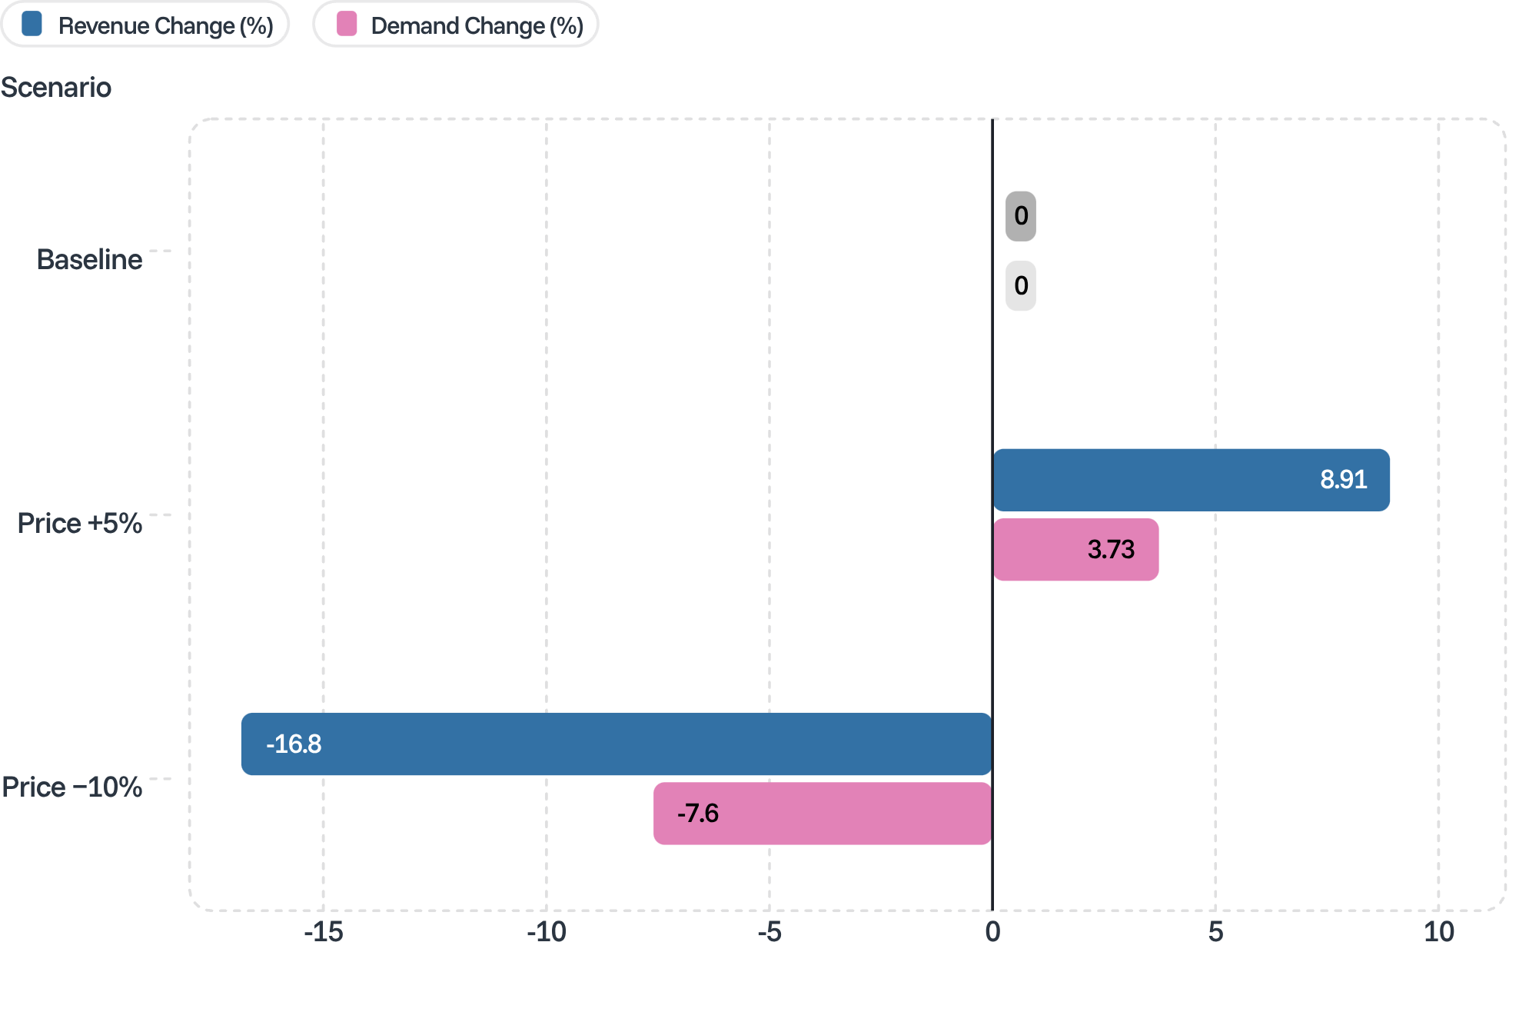

Pricing Scenario Analysis
These are illustrative model-based scenarios only. The estimated elasticity (+0.75) was not statistically significant (p = 0.854). Do not interpret as causal predictions or pricing recommendations.
Scenario Detail
Baseline (0% change)
Revenue: 0.00% | Demand: 0.00%
Price +5%
Revenue: +8.91% | Demand: +3.73%
Price −10%
Revenue: −16.84% | Demand: −7.60%
Demand estimates derived from elasticity coefficient (+0.75). Statistical non-significance means confidence intervals are wide and direction unreliable.
Illustrative revenue and demand changes under three pricing scenarios based on the estimated (non-significant) elasticity coefficient.

Slide 6

Key Insights & Next Steps
Summary Findings
Portfolio KPIs
1
Revenue Expansion
Metric | Value
Total Revenue (2022–2024) | £8.17M
Total Energy Delivered | 13.81M kWh
Total Sessions | 294,024
2025 Forecast Revenue | £6.43M
EV charging revenue grew from £1.03M (2022) to £4.55M (2024), driven by session volume growth — not price increases.
2
Demand Growth
Charging sessions increased 312% over three years, indicating strong underlying market expansion.
3
Forecast Accuracy
Next Analytical Opportunity
Holt-Winters exponential smoothing reduced forecast error by ~30% versus naive baseline on the held-out test period.
Session-level pricing analysis with controls for station, charger type, user type, time of day, and seasonality — to isolate pricing effects that aggregate monthly data cannot reveal.
4
Price Sensitivity Limitation
Monthly aggregated data is insufficient to establish a statistically reliable price-demand relationship (p = 0.854).
This approach would provide the granularity needed to produce statistically defensible elasticity estimates and inform evidence-based pricing strategy.

