Slide 1
Image Forgery Detection Using Deep Learning
Team No : 9
Members of Group Ch. Joy Suhas
J. Sri Chakri
G. Shyam Chetan

Slide 2
OUTLINE
What is Image forgery
What is Forged image detecion
Classification of Forged Images
(Authentic or Fake)
Why Deep Learning?
What is Deep Learning?
ELA (Error Level Analysis)
CASIA_ATID Data set
Algorithm Details
Conclusion

Slide 3
Image forgery
Image Forgery refers to the manipulation of digital images to alter their content or appearance. This can be done for various purposes, such as misinformation, fraud, or entertainment. The alterations can range from simple changes to complex modifications that are difficult to detect with the naked eye.

Slide 4
Types of image forgery
Copy-Move Forgery:
A part of the image is copied and pasted within the same image.
Splicing:
Parts of different images are combined to create a new image.
Retouching:
Modifying an image to enhance or diminish certain features.
Recoloring:
Changing the color properties of parts of an image.
Removal:
Deleting objects or people from an image.

Slide 5
What is FORGED IMAGE DETECTION?
Forged image detection is the process of identifying and analyzing images to determine if they have been manipulated.
It is crucial for maintaining the authenticity and integrity of digital media in fields like journalism, forensics, and social media.
Used in various domains such as verifying the authenticity of news photos, preventing digital fraud, enhancing security in digital forensics, and maintaining trust in social media content.

Slide 6




Deep Learning
Neural Networks
Feature Learning
Large Data Sets
Hierarchical Representation

Slide 7
What is Deep learning?
The term "deep" in deep learning refers to the use of multiple layers in the neural network architecture. These deep neural networks, also known as deep models, consist of interconnected layers of artificial neurons or nodes. Each layer receives input data, performs computations, and passes the output to the next layer, gradually extracting higher-level features from the input data as it progresses through the network. The final layer produces the model's output or prediction.

Slide 8
Why deep learning
Automatic Feature Extraction: Deep learning models, especially CNNs, automatically learn and extract relevant features from ELA images without manual intervention.
High Accuracy: These models have demonstrated superior accuracy in identifying complex patterns and subtle anomalies indicative of forgeries.
Scalability: Deep learning can efficiently process large volumes of images, making it scalable for real-world applications.
Consistency and Robustness: They provide consistent results and are robust to various types of image manipulations and quality variations.
Real-Time Processing: Optimized deep learning models can analyze images in real-time, offering immediate feedback on authenticity.

Slide 9
Methodology
1
2
3
4
Image Acquisition
Preprocessing
Feature Extraction
Classification
Including resizing, noise reduction, and color space conversion.
The process of obtaining the image that needs to be analyzed for forgery.
To distinguish between authentic and forged images.
Using deep learning algorithms to classify the image as real or fake.

Slide 10
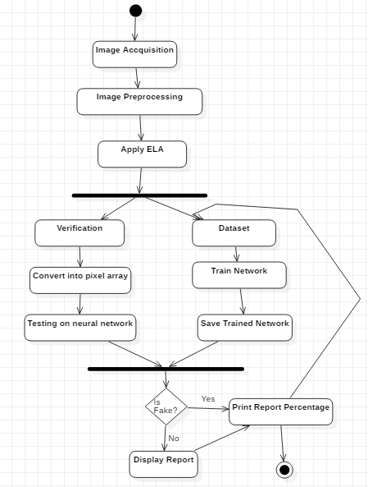

Slide 11
Dataset preparation
We have made a custom dataset using a self made dataset called ATID dataset which are randow photos clicked on phone and made into the dataset
For forged image we have edited some of the photos in adobe photoshop, canva etc.
Publicly available dataset called CASIA dataset from kaggle was used along with these
Around 12000 images were processed

Slide 12
Error level analysis(ela)
Purpose: ELA is a technique used to identify areas within an image that have different levels of compression, which can indicate potential tampering or forgery.
Method: It works by re-saving a compressed image (like JPEG) and then comparing the error levels between the original and the re-saved image.
Error Visualization: The difference in error levels is visualized as a new image where areas with different compression levels appear with varying intensities.
Tampering Indication: In a uniformly compressed image, error levels should be consistent across the entire image. Inconsistencies can suggest that certain parts of the image have been edited or pasted from different sources.

Slide 13
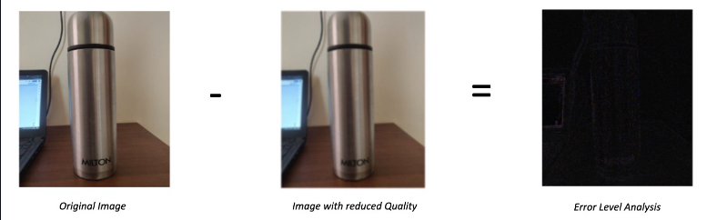
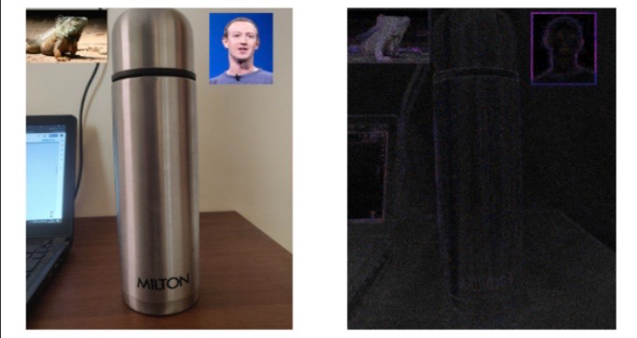

Slide 14
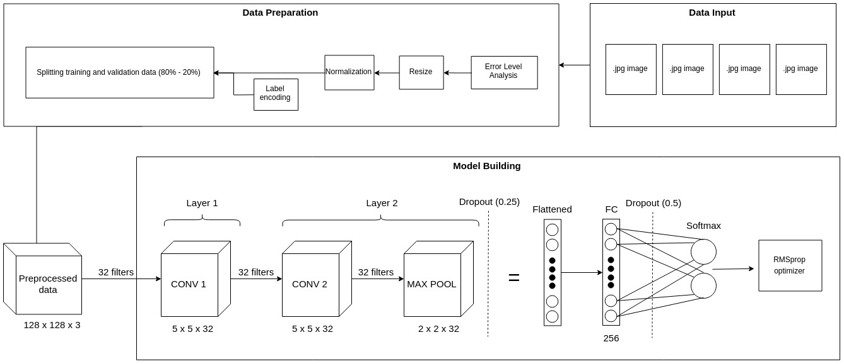

Slide 15
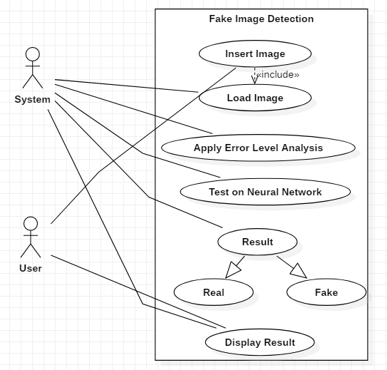

Slide 16
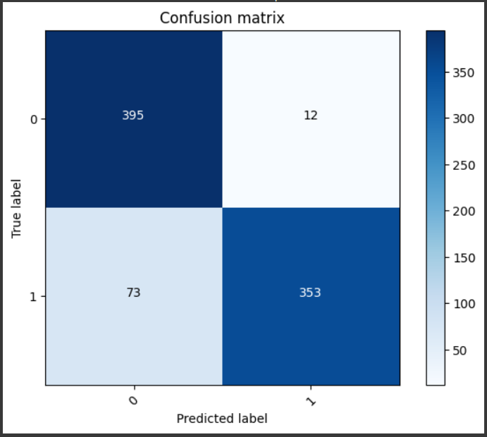

Slide 17
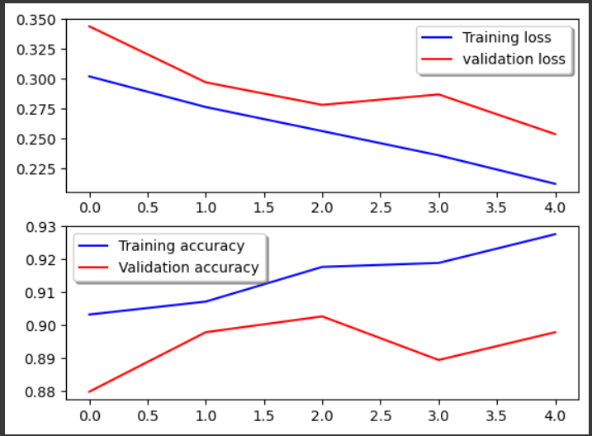

Slide 18
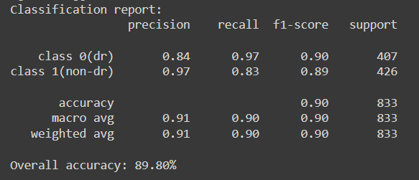

Slide 19





Slide 20
references
Image Forgery Detection using Deep Learning: A Survey
A Deep Learning Approach To Universal Image Manipulation Detection Using A New Convolutional Layer
Forged Face Detection using ELA and Deep Learning Techniques
Pixel Based Image Forgery Detection Using Deep Learning

Slide 21
Future scope
Integrating metadata analysis with deep learning in image forgery detection holds immense potential. By combining metadata (timestamps, geolocation, device info) with advanced algorithms, we can enhance detection accuracy and provide traceability. This approach promises robust security in digital media authentication and forensic investigations, revolutionizing the fight against digital image forgery.

Slide 22
Thank you

