Slide 1

Taking Aim at Student Learning
Connecting Learning Outcomes to Your Goals
Sarah Hansen, Director of Assessment and Strategic Initiatives, VPSS
Suzanne Fox, Graduate Assistant

Slide 2
Outline
Define assessment, student learning assessment, and learning
Describe the relationship between student learning assessment and Division of Student Services goals and values
Define student learning outcomes (SLOs) and describe their format and desired characteristics
Where to go from here
Questions
Brief Assessment

Slide 3
At the end of this session, you will be able to:
Define student learning outcomes (SLOs) and describe their format and desired characteristics
Describe how assessment can help you in your work
Write an effective student learning outcome using the SWiBAT format

Slide 4
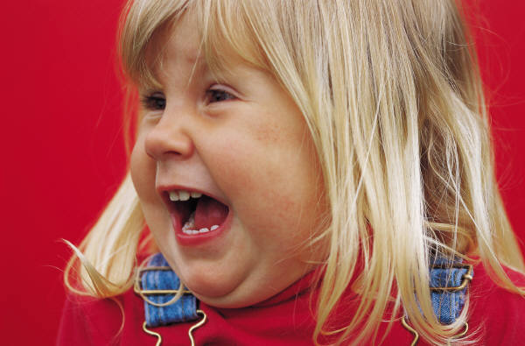

Who gets excited when you hear the word “assessment”?

Slide 5
Are we excited when we talk about the ways students grow as a result of our programs and services?
Assessment is a means to these ends.

Slide 6
What is assessment?
“Any effort to gather, analyze, and interpret evidence that describes institutional, departmental, divisional, or agency effectiveness” (Upcraft & Schuh, 1996, p. 18)
What We Can Assess
Who Uses Our Programs & Services
Student Satisfaction
Student Cultures & Campus Environ-ments
Student Needs
Cost Effective-ness
Comparison to National Standards
Comparison to Other Institutions
Student Learning

Slide 7
What do we mean by learning?
Cognitive
(knowledge)
Psycho-Motor
(skills)
Affective
(attitude)
DOMAINS OF LEARNING

Slide 8

What are student learning outcomes (SLOs)?
Goals that describe “the knowledge, skills, attitudes, and habits of mind that students take with them from a learning experience” (Suskie, 2009, p. 75)
What should students be able to do as a result of the programs and services we provide?
EXPERIENCE
Time 1
Time 2

Slide 9
Prioritizing SLOs
Determine which SLOs are nice and which SLOs are needed
Your program or service works in concert with others in the department – it does not need to do it all
Aim for 3-5 SLOs per program or service

Slide 10
Connecting outcomes to the Big Picture
University Mission
Division Mission
Departmental Goals
Departmental Objectives
Outcomes for programs
General
to
Specific
Align Upward

Slide 11
Connecting outcomes to the Big Picture: Example
“To educate students for success and fulfillment in a diverse world…”
“To support student success…through educationally purposeful activities”
“OSL provides diverse social, cultural, and educational programs…”
“Students participating in Dance Marathon will list at least 3 types of family support funded by DM.”

Slide 12
It’s all nice, but what’s really essential?
What really has to happen for you to know that program or service did its job?
What must occur for you to know that the time and energy devoted to that program or service was well spent?

Slide 13
Format of SLOs
SWiBAT: Students will be able to ________.
Examples:
Students will be able to successfully discuss accommodation needs with their instructors (Student Disability Services)
Students who work as intramural officials will be able to demonstrate appropriate conflict resolution skills in an emotional environment (Recreational Services)
Students who participate in The Path will be able to identify at least two academic support resources on campus (Residence Life)

Slide 14
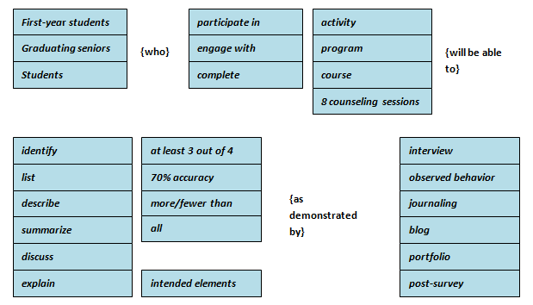
Format of SLOs
Keeling & Associates, 2007
Notes:
Suzanne
A slightly more complex version
Have audience members translate what they brainstormed during the last activity into learning outcomes; Each person share one to workshop together

Slide 15
Desired characteristics of SLOs
Align with department, division, and institution goals
Describe a behavior that is:
meaningful,
specific,
measureable, and
attainable
Describe a single behavior
Describe knowledge, skills, attitudes, and habits of mind (i.e., learning)

Slide 16

Common “trip ups”
Using “action words” that are hard to measure (appreciate, be aware of, understand)
Multiple outcomes in one
SLOs that aren’t really about learning

Slide 17
Fixing SLOs
Students will be able to…
…appreciate the benefits of exercise
…value exercise as a stress reduction tool
…identify at least 3 benefits of exercise
Students will be able to…
…access resources at The University of Iowa
…develop and apply effective problem solving skills that would enable one to adequately navigate through the proper resources within the university
…identity the university resource most pertinent to their concern

Slide 18
A note about new programs
Begin with the end in mind: What is your goal?
What should a student know or be able to do to respond to that goal? (Outcomes)
Next, what content will support these outcomes? (Content)
After that, what methods will effectively deliver this content? (Methods)
Finally, how will we know if students have achieved the outcomes (Assessment)

Slide 19
Where to go from here
Provide learning experience
Compare established/
actual learning outcomes
Use findings to improve learning
Establish learning outcomes

Slide 20
Where to go from here
Resources:
Next workshop: Focus Groups, Surveys, and Rubrics, Oh My! Choosing an Assessment Method
Wednesday, March 2, 9:00 a.m.-10:00 a.m. (245 IMU) or
Friday, March 11, 1:00 p.m.-2:00 p.m. (245 IMU)
Soon-to-be-updated website: http://student-services.uiowa.edu/staff/dssstaff.php
One-on-one consultations

Slide 21
Where to go from here
Assessment Coordinators:
Student Health Service/Health Iowa: Kathy Prediger and Tanya Villhauer
University Counseling Service: Paula Keeton and Eva Schoen
Recreational Services: Mike Widen and Wayne Fett
University Life Centers/Office of Student Life: Bill Nelson and Kelly Jo Karnes
Women's Resource and Action Center: Laurie Haag
University Housing: Kate Fitzgerald
Student Disability Services: Jo Dillon

