Slide 1

Focus Groups, Surveys, and Rubrics, Oh My!
Choosing an Assessment Method
Sarah Hansen, Director of Assessment, VPSS
Suzanne Fox, Graduate Assistant

Slide 2

Outline
Review steps to assessing student learning
Describe considerations in choosing an assessment method
Describe 3 assessment methods:
Rubrics
Surveys
Focus Groups
Discuss specific methods you might choose, based on your outcome(s)
Questions
Assessment

Slide 3
At the end of the session, you will be able to…
Identify at least 1 opportunity for embedded assessment in your workplace
Define direct and indirect measures of learning
List at least 2 strengths for each assessment method discussed in the workshop
Describe at least 1 thing you learned about each assessment method discussed in the workshop

Slide 4
Steps to assessing student learning
Identify learning outcomes (goals describing what students should know, think, or be able to do as a result of an experience)
Provide the opportunity for students to gain learning outcomes
Gather, analyze, and interpret evidence
to determine whether or not learning
occurred
Use evidence to improve student learning
Suskie (2009)
The gathering component is the focus of today’s workshop

Slide 5
Which of the following is an indirect measure of learning?
A survey asking students to list at least 3 conflict resolution strategies
A survey question that asks students to rate their level of confidence in their ability to resolve conflict on a scale from 1 (not at all confident) to 5 (very confident)
A rubric rating how well a resident assistant applied strategies for resolving conflict in a role play during training
A focus group in which resident assistants discuss the following question: what did you learn from the workshop on conflict resolution?

Slide 6
Data can be…
Qualitative or quantitative
Qualitative data describe things in terms of categorizations or qualities (e.g., gender)
Quantitative data can be counted or expressed numerically (e.g., age)
Direct or indirect measures of learning
Direct measures require students to display learning
Indirect measures ask students or others to reflect on student learning (Bresciani, Zelna, & Anderson, 2004)

Slide 7
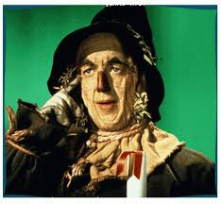
Considerations in choosing a method
Think about how you’ll need to use the information
What types of information will be useful in helping you know what you need to change?
Think about who will use the assessment information
What kind(s) of data to they respond to?

Slide 8
Another way to look at it….
There are naturally occurring assessment methods (e.g., things that are or can be embedded within a program or experience such as reflection papers, essays, portfolios, role plays, observed behaviors, student interactions)
There are methods designed solely as a means to evaluate

Slide 9
The BEST assessment method is the one that gives you useful and useable data.
If you have a great survey, but no one completes it, what do you have?

Slide 10
Strike while the iron is hot…
Give strong consideration to capturing assessment data at the time
Once they leave…

Slide 11
There are many assessment tools to choose from, including:
Rubrics
Surveys
Focus groups
Interviews
Observations
Document analysis
Portfolios
We will focus on these 3 today

Slide 12
What do you really mean? Consider your criteria
Example learning outcome: Students will be able to demonstrate excellent oral communication when presenting their agendas to the student senate
Example criteria:
Speaks in a clear voice
Uses culturally appropriate eye contact
Is dressed appropriately
Maintains appropriate posture
Is well organized
Uses appropriate and meaningful
visual aids
Bresciani, Zelna, & Anderson (2004)
Criteria help us know when a learning outcome has been met by describing what meeting that outcome entails or looks like.

Slide 13
Rubrics

Slide 14
What are rubrics?
A detailed set of criteria for defining the standards for evaluating performance
Are criterion-referenced, not norm-referenced (i.e., collaborative learning, not competitive learning)
Can vary in complexity from simple checklists to detailed components with detailed scales
May use existing rubrics, or develop a rubric based on discipline or best-practice standards

Slide 15
Example rubric design – checklist
Students will be able to demonstrate excellent oral communication when presenting their agendas to the student senate.
Speaks in a clear voice Y
Uses culturally appropriate eye contact Y
Is dressed appropriately N
Maintains appropriate posture Y
Is well organized Y
Uses appropriate and meaningful visual aids Y
Pays attention to the length of allotted time N
Etc.

Slide 16
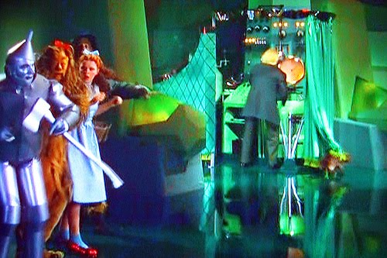
Rubrics can be very helpful if shared with students to “pull back the curtain” and expose what we want them to learn

Slide 17
Example rubric design – levels of performance
Post-Event Debrief Conversation with Student Organization Advisor for outcome on sustaining collaborative relationships within Riverfest:
 | Does not meet | Meets | Exceeds
Exec. Team focuses on bettering collaborative partnerships | ✓
Non-blaming language used throughout event implementation | ✓
Committee members took responsibility for remedying problems |  | ✓
Levels of performance – you decide what these are
Criteria

Slide 18
Example rubric design – levels of performance + descriptions
Students will be able to articulate central aspects of creating a healthy, balanced lifestyle.
 | Does not meet | Meets | Exceeds
Importance of physical activity | Thinks being “active” is sending text messages | Can state basic physical activity guidelines | Can outline an effective physical activity plan based on personal needs
Includes nutrition as a foundation | Thinks Red Bull is a food group | Can describe the basic components of MyPyramid | Can identify better and best ways to meet nutrition guidelines
Criteria C | Description | Description | Description

Slide 19

7 steps to rubric development
Identify the outcome you are assessing
Articulate what meeting that outcome looks like
Identify how you will gather the information (e.g., reflective writing, observation)
Choose type of rubric (check here)
List the criteria (rows)
List levels of achievement (columns)
Pilot and revise as needed

Slide 20
Surveys

Slide 21

Tips for dealing with survey fatigue
Perks
Contacts
Convenience
Ask only the essential
Follow up

Slide 22
Tips for writing survey questions
Avoid jargon – keep it simple
Avoid asking things that respondents will have a difficult time recalling
Distinguish between undecided and neutral (but be prepared…)
Ensure that response categories are mutually exclusive
Avoid double-barreled questions (i.e., 2 questions in 1)
Pilot your questions with students
Bresciani, Zelna, & Anderson (2004); Dillman (2007)

Slide 23
Writing survey questions to get at learning (direct measures)
General statements that learning has occurred (measuring student perception of learning)
As a result of participating in MAC, I understand how to use the group intervention technique in a bystander situation.
Demonstration of specific learning
List one example of how you could use the “group intervention technique” with the following scenario (included).

Slide 24
Writing survey questions to get at learning (direct measures)
General statements that learning has occurred (measuring student perception of learning)
As a result of meeting with the health educator, I have an understanding of my barriers to behavior change.
Demonstration of specific learning
List two barriers to behavior change you identified during your meeting with the health educator.

Slide 25
Writing survey questions to get at learning (direct measures)
General statements that learning has occurred (measuring student perception of learning)
As a result of participating in this workshop, I will be able to use assertive behaviors in communicating with my roommate.
Demonstration of specific learning
Evaluator in this case is an RA who observes the student’s behavior on the floor. Using a rubric, the RA assesses the level of the student response.

Slide 26
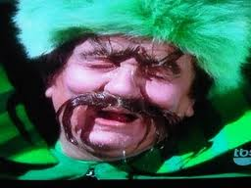
National surveys – overwhelmed with data?
Identify why you want to use them before ever taking a next step
Recognize you will never use all the information, so it’s best to identify specific items you will track and use beforehand (it’s ok not to use it all!)
Extensive data can be overwhelming – use what you previously identified, rather than worrying
about all of it
If you can’t connect the survey to specific
outcomes, or guarantee that you’ll use the
data, pass.

Slide 27
Focus Groups

Slide 28
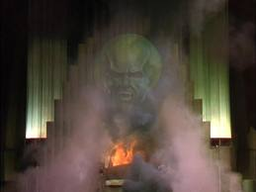
Myths about focus groups
They are low-cost and quick
They require professional moderators
They require special facilities
They must consist of strangers
They will not work for sensitive
topics
Morgan (1998)

Slide 29
Tips for recruiting for focus groups
May benefit from nonrandom sampling (see handout)
Emphasize that the focus group will be interesting and worthwhile
Make the contacts personal
Build on existing relationships
If possible, offer incentives
Make participation as convenient as possible
Typical group size is 6 to 10
Follow up
2 weeks before – make initial contact
1 week before – send a confirmation
Day before – send a reminder
Morgan (1998)

Slide 30
Flow of focus group questions
Question Category | Purpose
Opening | To get participants acquainted and feeling connected
Introductory | To introduce the topic of discussion
Transition | To facilitate the transition to key questions
Key | To obtain insight on areas of central concern
Ending | To bring closure to the discussion
Krueger (1998)

Slide 31
Tips for writing focus group questions
Assume nothing
Why do you like being a major in this department?
Improved: Do you like being a major in this department? (then, a follow-up)
Be neutral
Do long wait times for appointments discourage you from going to your academic advisor?
Improved: What has been your experience in making appointments with your academic advisor?

Slide 32
Tips for writing focus group questions
Ask one question at a time
How is the library collection in your major? Do you have trouble finding source materials?
Improved: What has been your experience in finding resource materials at the library?
Avoid slang
How do you like using the CL?
Improved: Please tell me about using the department’s computer lab.
Schuh (n.d.)

Slide 33
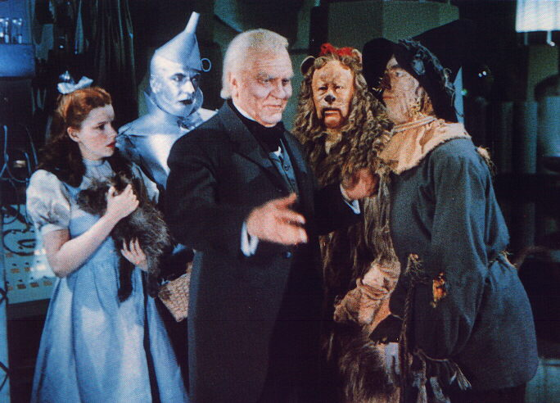
Tips for conducting focus groups
Record the discussion
Speak clearly
Use a conversational manner
Show interest
Control your reactions
Be flexible, but stay on track
Be comfortable with silence
Probe/clarify as needed
Take notes
Divide responsibilities
Bresciani, Zelna, & Anderson (2004); Krueger (1998)

Slide 34
Which of the following is an indirect measure of learning?
A survey asking students to list at least 3 conflict resolution strategies
A survey question that asks students to rate their level of confidence in their ability to resolve conflict on a scale from 1 (not at all confident) to 5 (very confident)
A rubric rating how well a resident assistant applied strategies for resolving conflict in a role play during training
A focus group in which resident assistants discuss the following question: what did you learn from the workshop on conflict resolution?

Slide 36
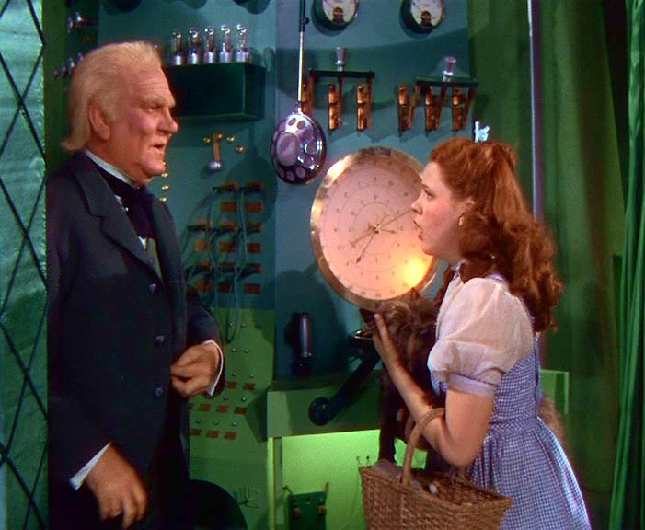
Questions?

