Slide 1
SVP Equipment

Slide 2
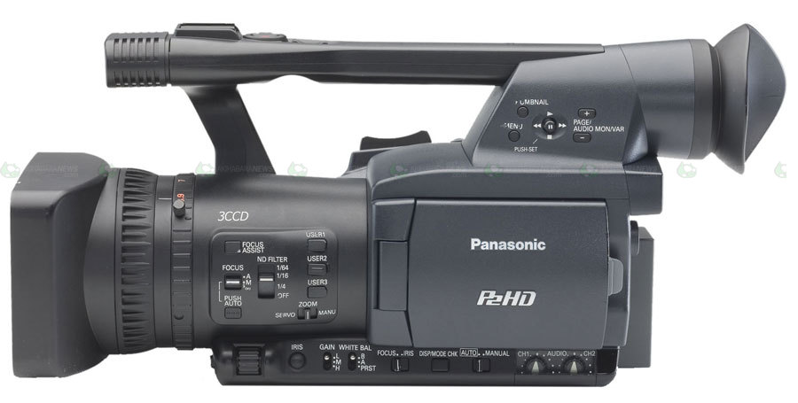
HPX

Slide 3
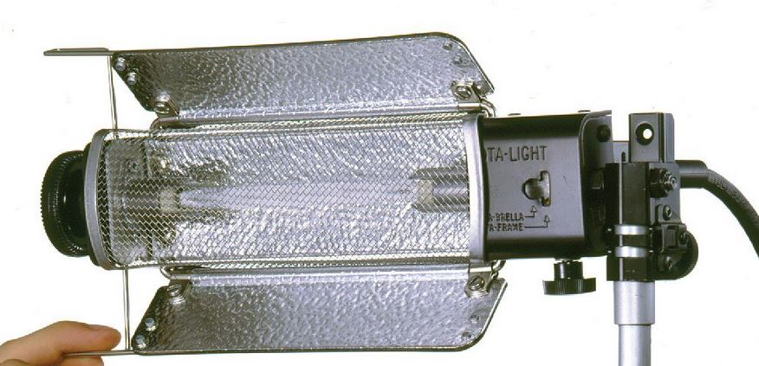
Tota Lights

Slide 4
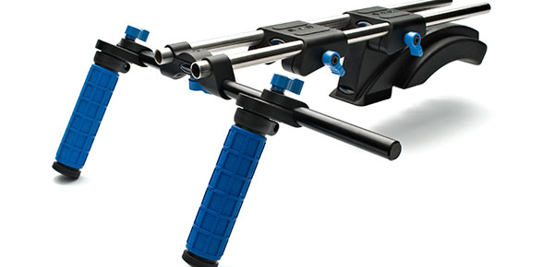
Shoulder Mount

Slide 5
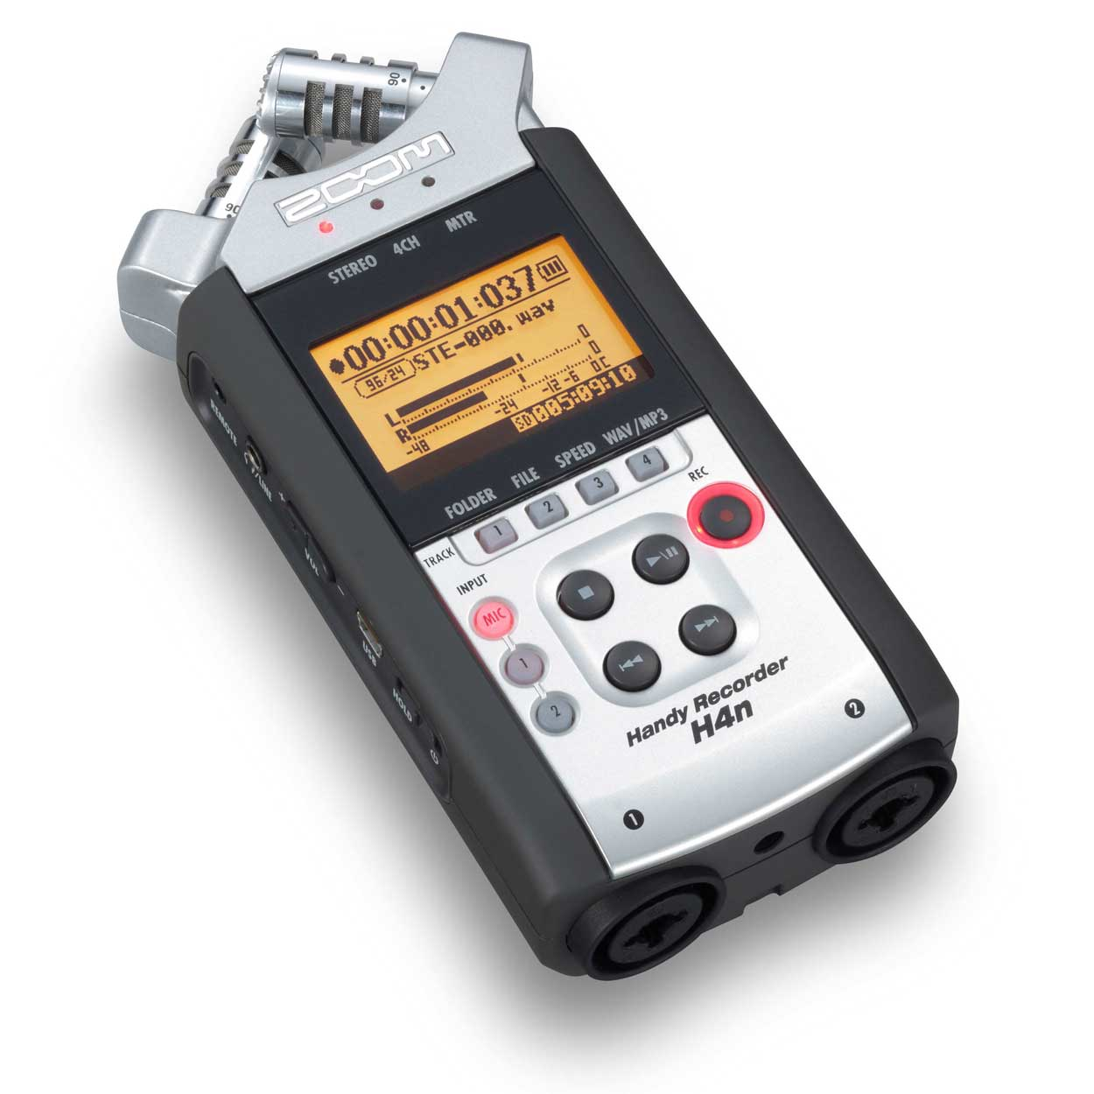
H4N

Slide 6
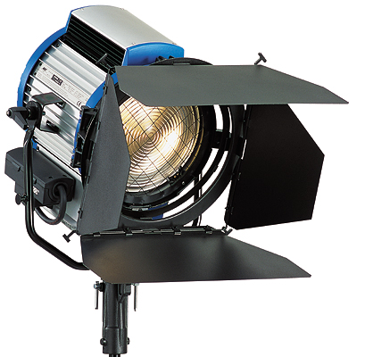
Arri Lights

Slide 7
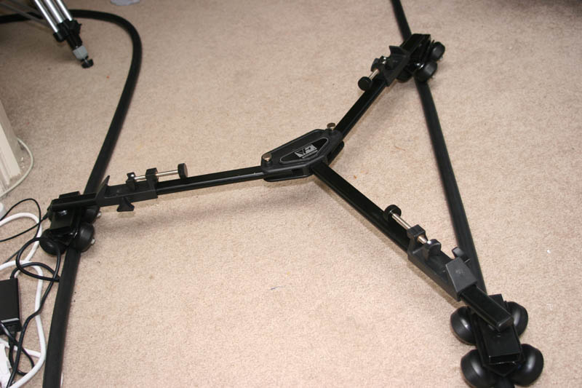
Track & Dolly

Slide 8
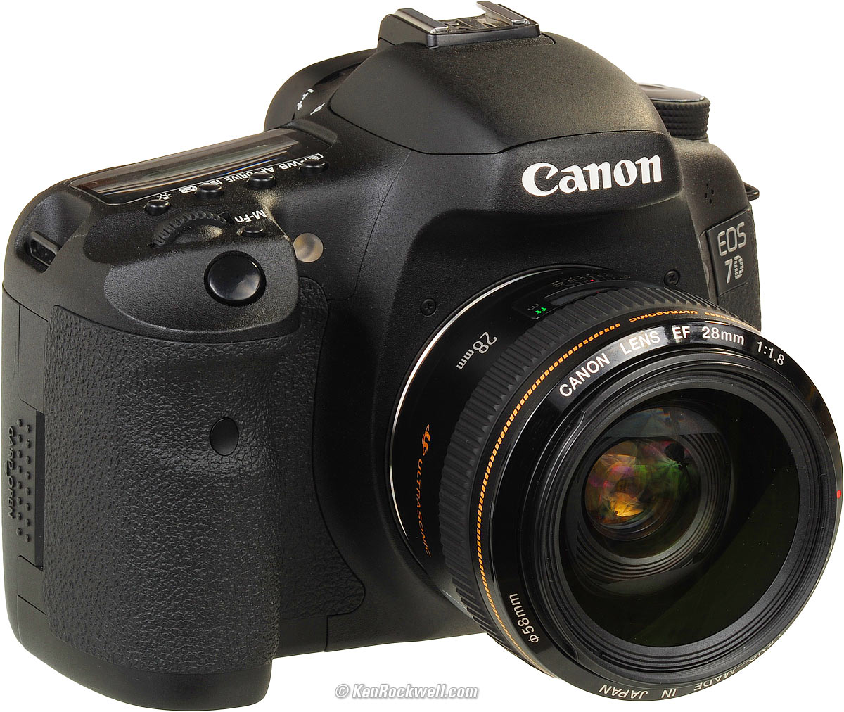
Canon 7D

Slide 9
Canon 7D cont…
Aperture
Shutter Speed
Color Temperature
ISO
Picture Style
Lens Length

Slide 10
Aperture
What’s an f-stop?
Represented in increments:
f1.2, f1.4, f2.0, f3.5, f4.0, f5.0…f22
How does it affect depth of field?

Slide 11
Shutter Speed
The rate in which the shutter opens and closes
Represented as fraction:
1/30, 1/50, 1/60, 1/90…1/2500

Slide 12
Color Temperature
Cold to Warm
Kelvin Scale
2300 to 7500

Slide 13
ISO
‘Film’ Sensitivity
Film Stocks have ISO or ASA ratings.
7D is rated at a 320 ISO.
100, 160, 240, 320, 500, 640…6400

Slide 14
Picture Style
Adjust
Saturation

Slide 15
Lens Length
Depth of Field
Prime vs Zoom
24mm, 50mm, Kit Lens

