Slide 1
UISG ELECTIONS 2012
APPROVED CANDIDATE MEETING

Slide 2

THE BASICS
Positions Available:
39 Senator Positions
73 Individuals Running
President and Vice President of UISG
2 Executive Tickets
#Party and I Party

Slide 3
FINAL SCHEDULE
Monday, March 26th- 12:01 AM, Campaigning begins
Thursday, March 29th- UISG Presidential Debate at 7:00pm (Chemistry Building w128)
However, may be moved a bit later…
Monday, April 2nd- UISG Vice-Presidential Debate at 7:00pm (Chemistry Building w128)
Wednesday, April 4th- Voting Begins at 12:01am (ISIS)
Thursday, April 5th- Voting Ends at 5:00 pm (ISIS)
Thursday, April 5th- All campaign materials and paperwork must be submitted to the Student Elections Board Desk by 5:00 pm (Suite 260 IMU). Failure to submit required forms will disqualify candidates.
Friday, April 6th- Ballots and submitted paperwork are verified by the Student Elections Board. Election results announced- 5:00 pm (Hubbard Commons)

Slide 4
CAMPAIGN PROCEDURE
Prior to the distribution of any individual campaign material through any medium, all candidates must give to the SEBC (Suite 260C Desk A2, IMU) a copy of said material and a completed campaign material approval form.
Available on UISG Website Tonight

Slide 5
CAMPAIGN PROCEDURE
Campaigning shall include, but is not limited to:
Posters or flyers
Buttons, balloons, or stickers
Speeches
Newspaper, radio, television, or electronic advertisements
Clothing, hats, or other apparel
Listserv emails
Facebook (Groups, Statuses, Messages, etc)
-Submit me a copy of your party’s platform, do not have to submit separate form if re-posting information from your platform
Tweets
-Same policy
Other websites
Anything that displays the approval or opposition of a candidate

Slide 6
CAMPAIGN PROCEDURE
However, personal correspondence needs no prior approval by the SEB.
Personal correspondence shall be defined as any form of person-to-person communication, not copied in mass or numerously duplicated, and not in violation of rules set forth in the University of Iowa Student Elections code.
This does not include Facebook messages, private groups, tweets at people, etc.

Slide 7
CAMPAIGN PROCEDURE
ALL campaign materials, including electronic campaign material, MUST BE REMOVED from public areas within 48 hours of the conclusion of the election unless under the regulation of Cambus, University Housing, the University Box Office or any other Academic/Non- Academic buildings and spaces, or be fined.

Slide 8
CAMPAIGN SPENDING
The maximum campaign-spending limit for a full slate of two (2) at-large senatorial candidates and President/Vice president is $3,000.00;
Any Senate candidates (whether affiliated with a presidential ticket or running independently) have a maximum spending limit of $300, including In Kind donations.
Candidates are required to keep track of all expenditures. A Campaign Finance Record will be available to candidates online at the SEBC website, located at (uisg.uiowa.edu), and all expenditures must be recorded on the financial record. This record and all campaign receipts are due to the SEBC at the conclusion of the voting period (THURSDAY, APRIL 5TH 5:00 PM)

Slide 9
CAMPAIGN SPENDING
Donations of materials by outside sources must have their value reported to the SEBC on the Campaign Financial Record as “In Kind” reports.
declared at its present fair market value.
Donated materials and/or services, including previously owned material must be declared whether sought or offered.
A candidate is allowed to accept a discount for materials and/or services rendered however, the candidate is required to declare the expense at its fair market value.

Slide 10
PROHIBITED PRACTICES
THE FOLLOWING PRACTICES ARE PROHBITED…
organization to discuss meeting with said group within the campaign period.
Claiming the endorsement of any organization without an approved Student Organization Form or letter of endorsement.
-Available on Website tonight
Any campaigning in the student government office (Suite 260B IMU).
Verbal or physical harassment or intimidation of other party candidates or adherents

Slide 11
CAMPAIGN PROCEDURE
Furthermore, it shall be the duty of the candidates to police their own campaign.
If you have questions about what is considered proper campaign material, please contact me before disseminating it

Slide 12
COMPLAINTS
Any individual, including candidates, may file complaints.
Complaint forms may be obtained online at the UISG website tonight
Complaints must be filed in writing and submitted to the SEBC drop box, located at the SEBC desk (Suite 260C Desk A2, IMU). Oral and electronic complaints will not be accepted.

Slide 13
COMPLAINTS CONT’D
Complaints must contain the following:
Name of the candidate and/or party who committed the alleged violation.
Brief description of the alleged violation, including date and time of the
incident and reference to the relevant provision(s) of the SEBC Code, UISG
By-Laws, or other provisions prescribing guidelines for elections.
Printed name of person filing complaint.
Signature of person filing complaint.
Any applicable evidence should also be attached to the complaint.
Complaints may be submitted before and throughout the campaign period, but no complaints will be accepted after 12:00 PM the day following the final day of voting, notwithstanding complaints alleging violations of removal of campaign material after the close of campaign period.
Complaints must be filed within 24 hours of the time the violation occurred. This time period shall be tolled for the hours the SEBC office is closed

Slide 14
PENALTIES
Penalties include, but are not limited to monetary fines and disqualification
A detailed list of infractions and monetary fines will be available on the USIG website tonight

Slide 15
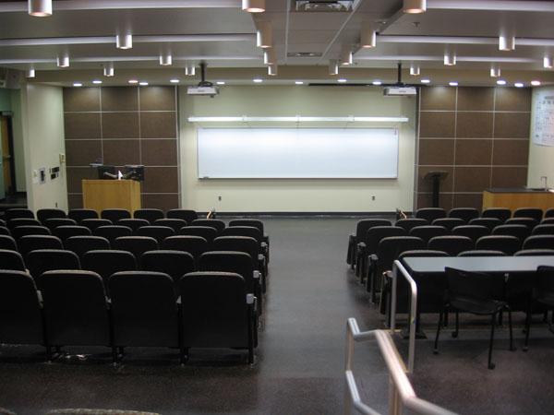
THE DEBATES
Thursday, March 29th- UISG Presidential Debate at 7:00pm (Chemistry Building w128)
Monday, April 2nd-
UISG Vice-Presidential
Debate at 7:00pm
(Chemistry Building w128)

Slide 16
THE DEBATES
The debate will be conducted with fairness, candor and decorum, and supported by facts and arguments founded in reason.
Moderator from The Daily Iowan, press will be present
Not mandatory, but all are encouraged to attend
The SEBC, with input from the current UISG president should she/he choose, shall prepare questions for the debates. However, all current undergraduate students may submit debate questions for consideration at least 24 hours prior to the debate
Email them to me, patrick-grim@uiowa.edu

Slide 17
ELECTION DAY PROCEDURE
Online polls open Wednesday, April 4th- at 12:01am on ISIS
Thursday, April 5th- Voting Ends at 5:00 pm (ISIS)
Campaigning on Election Day
Candidates are not responsible for any material that has been distributed through the University Box Office, the Cambus office, University Housing or any other Academic/Non-Academic buildings and spaces.

Slide 18
ELECTION DAY PROCEDURE
The following acts are prohibited on Election Day:
bribing voters.
Interfering or attempting to interfere with a voter when marking a ballot (…their computers)
Inducing voters to show or state who he or she voted for

Slide 19
POLLING
On-Line Polling
On-line polling will be the only available forum for voting in student body elections
The tabulation of votes will be carried out by the SEBC. Presidential Election will be conducted using Instant Run-Off Voting. Senatorial elections will be conducted using a plurality vote. The final results will be certified and announced by the SEBC Director.
In the case of a tie there will be a run-off election between the tied candidates. The election will be conducted online by the SEBC.
There will be an addition campaign period for the tied candidates, to be established and monitored by the SEBC.

Slide 20
THE BALLOTS
Your name will be listed as written on your petition unless you tell me otherwise
Please make changes accordingly on sign in sheet or notify me via email of desired change
Only name will be listed, party in parentheses for those who are affiliated
Distributing individual information is your responsibility

Slide 21
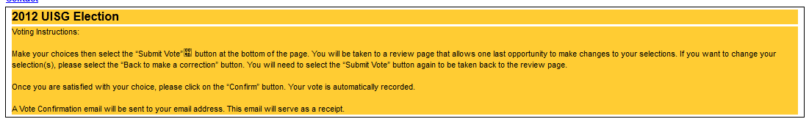
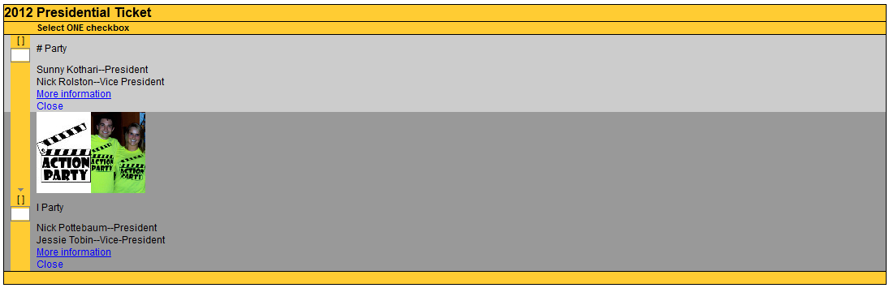
EXAMPLE BALLOTS

Slide 22
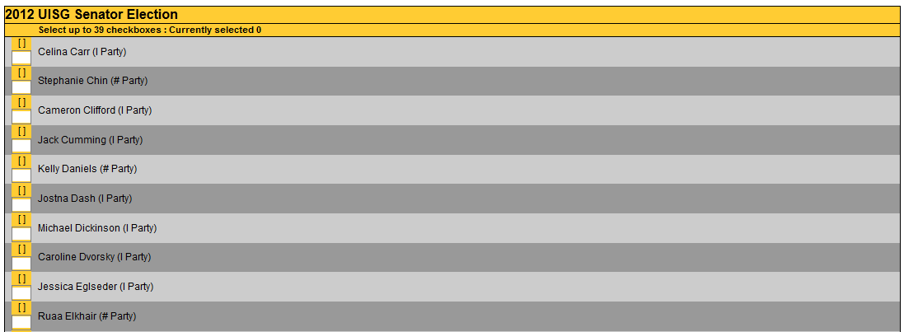
EXAMPLE BALLOTS
Rotating Alpha order by last name
Every time a ballot is opened, initial letter order shifts
39 Selections, no party ticket option

Slide 23
CONCLUSION
Thursday, April 5th- All campaign materials and paperwork must be submitted to the Student Elections Board Desk by 5:00 pm (Suite 260 IMU). Failure to submit required forms will disqualify candidates.
Friday, April 6th- Ballots and submitted paperwork are verified by the Student Elections Board. Election results announced- 5:00 pm (Hubbard Commons)

Slide 24
CONCLUSION
REVISED 2012 STUDENT GOVERNMENT ELECTIONS CODE AVAILABLE ON WEBSITE TONIGHT
Potential Time Change for Debate
If you have questions of any sort, please do not hesitate to contact me via email (patrick-grim@uiowa.edu, or my cell 847-239-2658)

Slide 25
Questions?
QUESTIONS?

