Slide 1

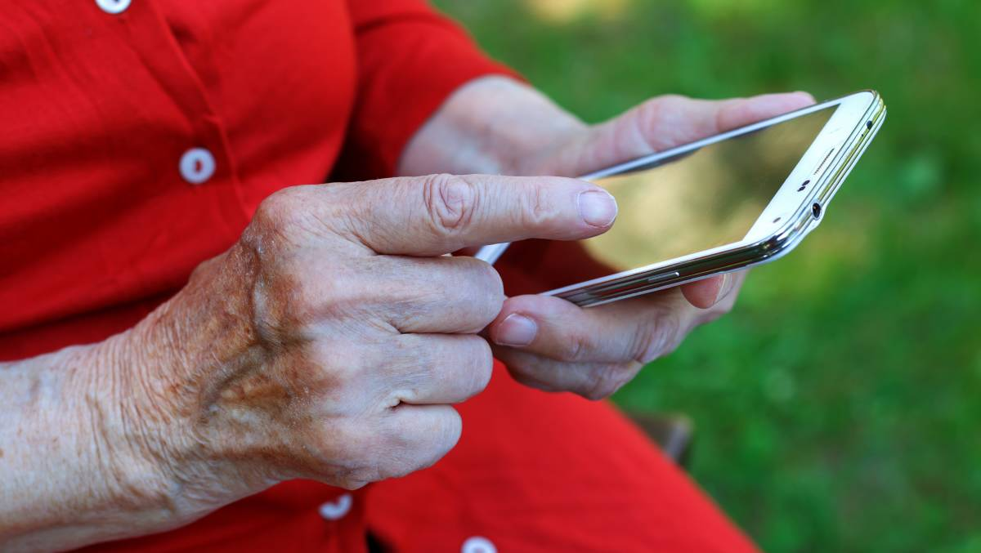
Personal Safety App System for Vulnerable People
This project is about creating an app that allows vulnerable individuals to send distress signals using a combination of software and hardware components. Features including location sharing, an SOS button, and audio/video recording.

Slide 2
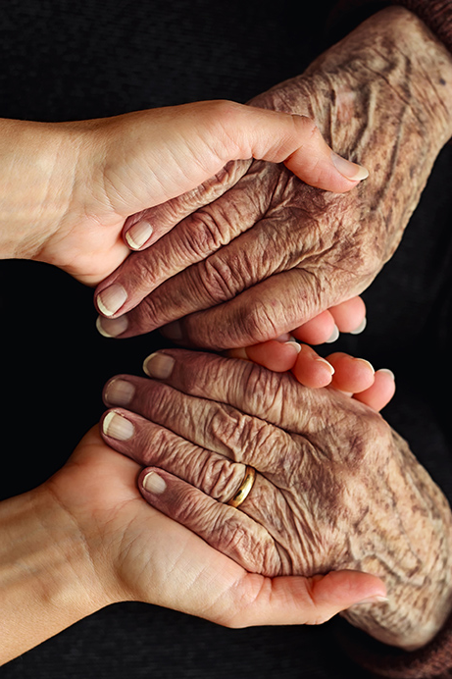
Importance of Developing an Android App for Distress Signals
1
Immediate Support🆘
2
Better Accessibility🔍
Distress signal app provides a quick and easy way for individuals to seek help during emergency circumstances.
Elderly people no longer have to worry about the absence of emergency help contacts and support, as everything can be taken care of from their Smartphone.
3
Peace of Mind🧘
Using distress signal app, people can now move around with greater confidence and less stress knowing that help is always within reach at the click of a button.

Slide 3
The Software Components of the App
User Interface
Integration of APIs 🖥
Android Studio is used to design the user interface (UI) with user-friendly elements, including buttons for distress signals, location sharing, and audio/video recording.
Implement user authentication and user profile management to allow users to add trusted contacts.
Integrating multiple APIs such as Google Maps and Firebase Database for additional features such as location tracking and voice/video calling.

Slide 4
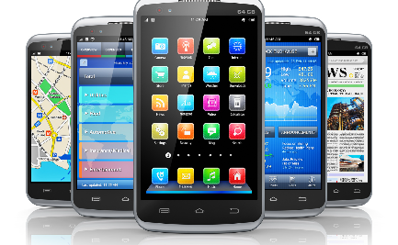
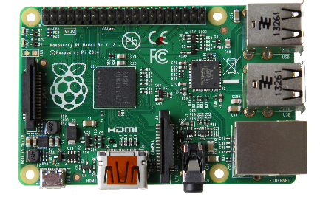
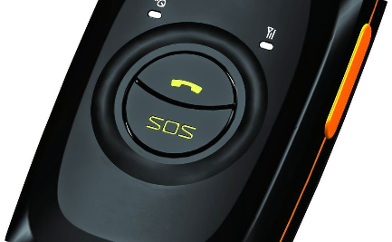
Hardware Components Required
Smartphones
The app requires a smartphone for the user to receive and send emergency signals from.
Raspberry Pi
The module incorporates sensors that can be used for tracking, and assist in location sharing, enabling the user to send their location and distress signals in real-time.
GPS Tracker
The GPS tracker is incorporated with Raspberry Pi and enables sending coordinates and auto location sharing for ensuring timely help.

Slide 5
Features of the App
1
Location Sharing 📍
Users can send their real-time location to emergency contacts, allowing them to track the location of the person in distress and offer help.
SOS Button 🆘
2
The app allows users to press the SOS button, which sends emergency signals via SMS, along with location information to trusted emergency contacts chosen by the user.
3
Audio/Video Recording 🎥🎤
During the distress call, the app records audio and video clips which can help first responders have a better understanding of the situation, allowing them to take timely actions.

