Slide 1

Pitch Deck
MindHaven
Explore Now
01

Slide 2


Ingoude Company
Home
Service
About Us
Contact
A
Automated
U
Unified
THEME
R
Resourceful
A
Accessible
02

Slide 3
Ingoude Company
Home
Service
About Us
Contact
AURA FOR ADHD
Theme Connection:
AURA (Automated, Unified, Resourceful, Accessible) → for ADHD, this means automating focus aids, unifying support systems, making resource management easier, and ensuring accessibility in learning & work.
Automated: Automates focus reminders, breaks, and environment adjustments.
Unified: Combines multiple ADHD aids (timers, reminders, sensory control) into one system.
Resourceful: Optimizes energy & time usage by tracking focus patterns.
Accessible: Customizable for individual needs & easy to use on mobile or desktop.
03

Slide 4
Time Blindness: They underestimate time passing, causing missed deadlines.
Task Initiation Struggles: They delay starting unpleasant or overwhelming tasks.
Sensory Overload: Busy/noisy environments quickly drain focus.
Forgetfulness: Important steps, tasks, or meetings slip their mind.
Problem Statement
Inconsistent Energy: They work in bursts, followed by burnout.
Gap: Existing tools focus on only one aspect (e.g., timers)
instead of a unified, automated support system.
People with ADHD face challenges that hinder academic and workplace performance:

Slide 5
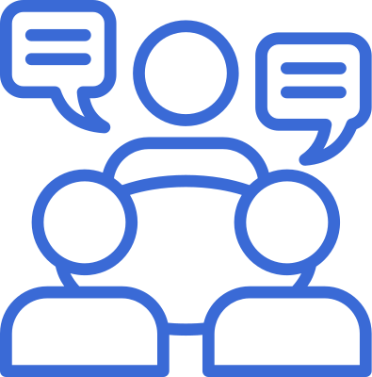

A cross-platform ADHD support system that:
Uses AI to detect loss of focus via webcam and inactivity tracking.
Provides automated reminders for deadlines and micro-breaks.
Has Pomodoro mode for structured work/rest cycles.
Integrates sound & light control (IoT devices like smart bulbs) to create focus-friendly environments.
Tracks energy levels & suggests task scheduling during high-energy periods.
Proposed Solution

Slide 6
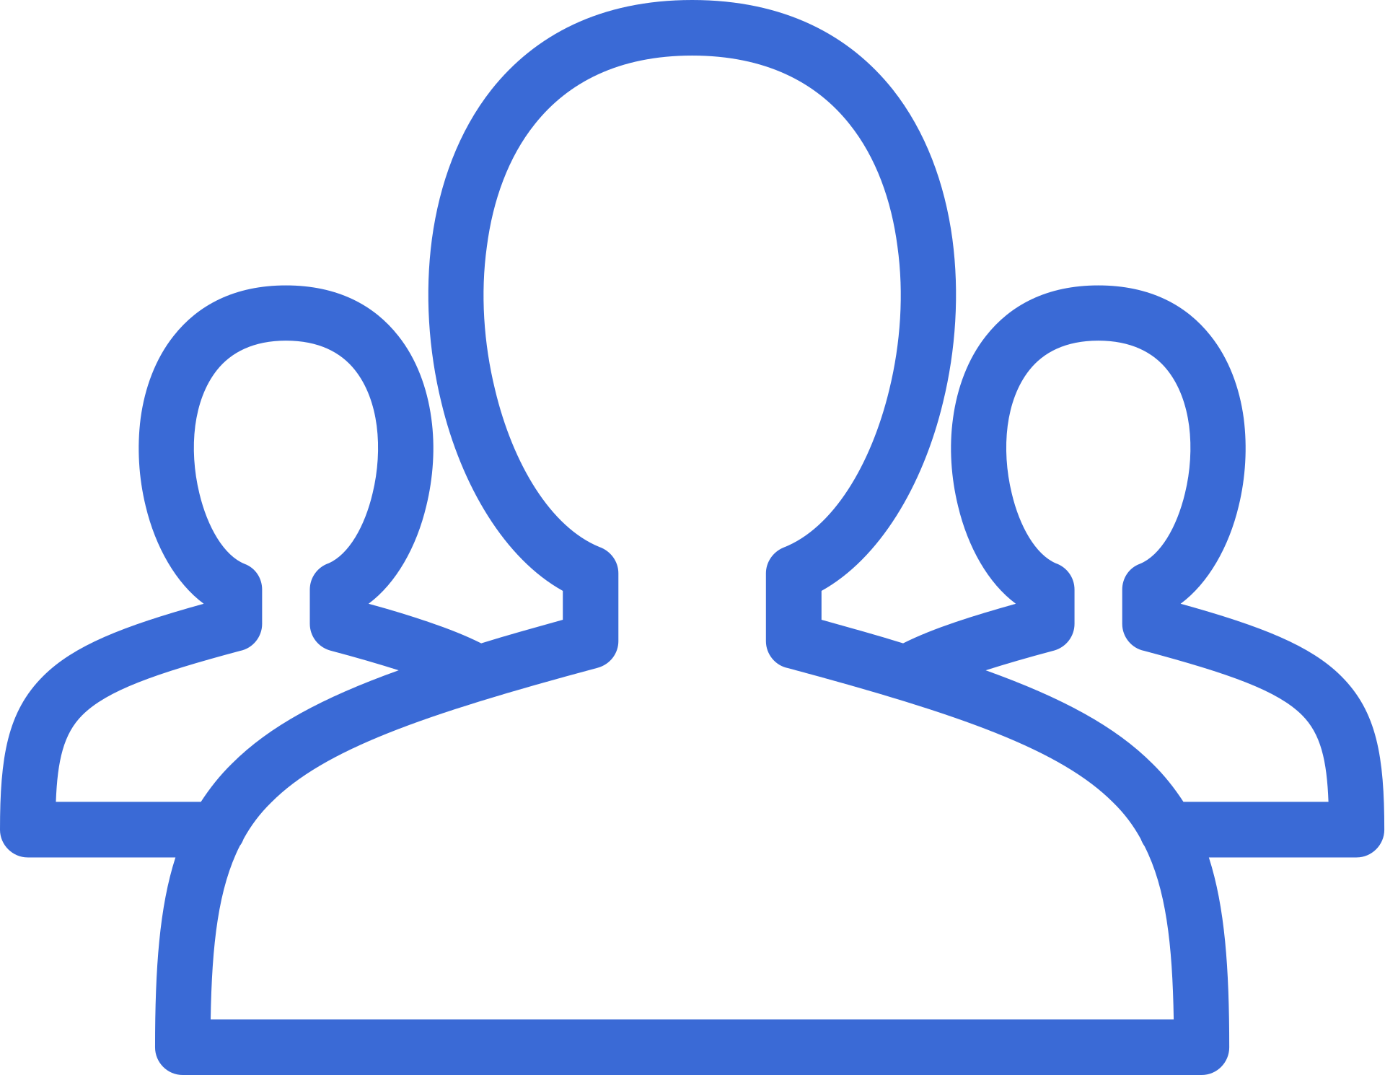
Ingoude Company
Home
Service
About Us
Contact
Service 01
Service 05
HOW IT WORKS
User sets tasks & deadlines.
Data analytics show focus patterns over time.
Service 02
Webcam + AI detects if user is distracted for > 2 mins.
Service 04
Service 03
IoT devices adjust environment (dim lights, white noise on).
Smart reminders appear (pop-up, voice, or phone notification).
06

Slide 7
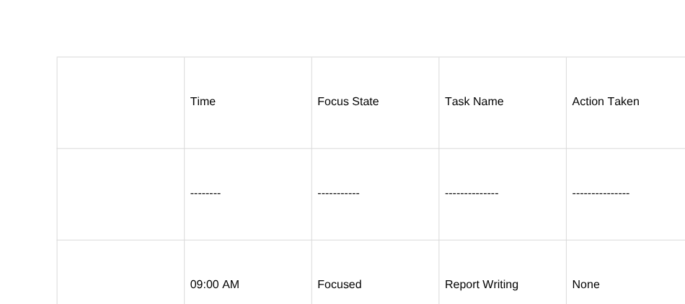
Ingoude Company
Prototype Demo Plan
1. *Simulate focus tracking* → Use OpenCV to detect if user is away or not looking at screen.
2. *Pop-up reminders* → Simple desktop notification when focus lost.
3. *Pomodoro timer* → Work/rest cycle visible on dashboard.
4. *Mock IoT control* → Simulate “light dimming” in the UI.
5. *Analytics chart* → Show mock data of productive hours & distraction times.
Learn More
08

Slide 8

*Key Features
Service 01
Service 02
Service 03
All-in-One:* Combines timers, focus tracking, and sensory environment control
Customizable:* Every ADHD brain is different — settings are flexible.
Data Insights:* Users see when they focus best & schedule tasks accordingly.
Service 04
Accessible: Works on any basic laptop, mobile app optional.
07

Slide 9

Ingoude Company
Home
Service
About Us
Contact
Thank
You
10

