Slide 1
MemSys: Interval Tree Powered Memory Management System
DONE BY :
AVANTHIK C CB.SC.U4CYS24109
MANUKRISHNA JP CB.SC.U4CYS24132
SREEHARI PRADEESH CB.SC.U4CYS24150
A AL AMEEN CB.SC.U4CYS24163
YUG AGARWAL CB.SC.U4CYS24167

Slide 2
Problem Statement
Memory Allocation Conflicts
In operating systems, multiple processes request memory simultaneously.
Problems that may occur:
Two processes may request overlapping memory regions
Manual tracking becomes inefficient
Requirement for fast conflict detection
Goal of the project:
A system that allocates memory safely
Detects overlapping intervals instantly
Visualizes memory allocation in real time

Slide 3
What is an Interval Tree?
Interval Tree
An Interval Tree is a Binary Search Tree designed to store intervals.
Each node stores ; Interval [low, high]
max value (maximum high value in subtree)
Purpose:
Efficiently detect overlapping intervals
Application:
Operating systems
Computational geometry
Scheduling systems
Database indexing

Slide 4
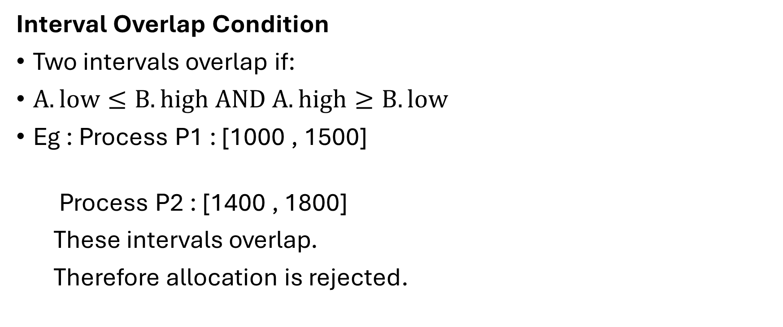
Interval Overlap Condition
Interval Overlap Condition
Two intervals overlap if:
$A.low≤B.high AND A.high≥B.low$
Eg : Process P1 : [1000 , 1500]
Process P2 : [1400 , 1800]
These intervals overlap.
Therefore allocation is rejected.

Slide 5
System Architecture
Components
Frontend
HTML
CSS
JavaScript
Backend
Flask API
Handles requests from UI
Communicates with C++ using subprocess calls
Core Logic
C++ Interval Tree
Performs fast overlap detection
Data Storage
Database stores allocated memory intervals
Ensures persistent records

Slide 6
Backend & Database Storage
The backend is built using Flask (Python) which connects the frontend and the C++ interval tree.
Backend responsibilities:
Receive memory allocation requests from the UI
Call the C++ interval tree to check for overlaps
Store successful allocations in a database using Python
Return the result to the frontend
Database Stores
Process ID , Start Address , End Address , Allocation Size
Purpose
Maintain persistent records
Allow easy retrieval of allocations

Slide 7
Project Workflow
How the System Works
User enters:
Start address
Offset (size)
Process ID
Request sent to Flask API
Flask calls C++ interval tree
Tree checks for overlap
Result returned to UI
If no conflict → allocation succeeds
If conflict → request rejected

Slide 8
Time Complexity
Operation | Complexity
Insert | O(log n)
Delete | O(log n)
Overlap Search | O(log n)
Worst case can be O(n) since tree is not self-balancing.

Slide 9
Features of MemSys
Interval Tree based overlap detection
Real time memory visualization
Process based memory allocation
Persistent state storage using database
Easy free memory operation
Conflict detection with exact process information

Slide 10
Conclusion
C++ (core logic) + Flask (backend) + Database + Web UI create a complete system.
MemSys demonstrates how Data Structures solve real-world problems.
Interval Trees efficiently detect overlapping memory regions
Combining C++ + Flask + Web UI creates a practical system
Shows how DSA concepts integrate into full stack applications

