Slide 1

StockProX: Efficient Order Matching System using Treaps
SUBMITTED BY:
YASHWANTHI B.K (CB.SC.U4CYS24161)
BHAVADARINI M (CB.SC.U4CYS24111)
A RIDHUSREE(CB.SC.U4CYS24101)
NIRANJANA GIRISH(CB.SC.U4CYS24134)
YASWIN ILLAKIYA R (CB.SC.U4CYS24162)

Slide 2









Problem Statement
Modern financial markets face an extraordinary challenge: processing millions of transactional requests in real-time while maintaining fairness, accuracy, and performance. The core problem requires building an efficient system to manage and process a large number of transactional requests in a dynamic marketplace.
Hierarchical Organization
Priority Management
Organize buy and sell orders in a structured, searchable manner based on price levels
Prioritize requests based on defined criteria such as price and timestamp
Automatic Matching
Historical Insights
Automatically process compatible requests when buy price meets or exceeds sell price
Maintain comprehensive records for analytics, auditing, and compliance purposes
This problem directly mirrors real-world stock exchanges where thousands of buy and sell orders arrive continuously, requiring millisecond-level processing to maintain market integrity.

Slide 3




Motivation: The Need for Speed
Modern financial markets have evolved into high-frequency environments where microseconds determine profitability. Stock exchanges process millions of orders per second, cryptocurrency markets operate 24/7 with volatile price movements, and online marketplaces require instant transaction confirmation.
Poor data structure selection causes cascading delays and inefficiency throughout the system. In trading contexts, even millisecond delays can result in missed opportunities, unfair pricing, and regulatory violations. Efficient algorithms are not merely desirable—they are required to maintain market fairness, prevent arbitrage opportunities, and ensure all participants receive equitable treatment.
Stock Exchanges
Cryptocurrency Markets
Online Marketplaces
NYSE, NASDAQ process 1M+ orders per second during peak trading hours
Binance, Coinbase handle continuous trading across global time zones
eBay, Amazon require real-time inventory and pricing synchronization

Slide 4

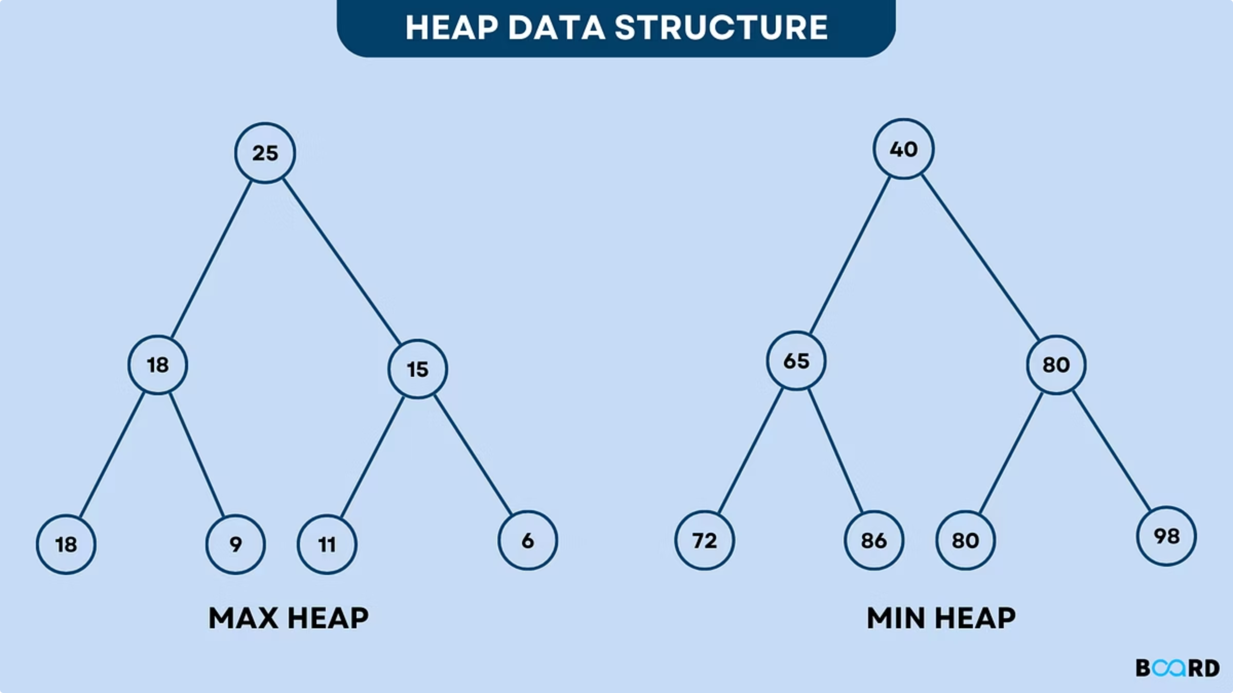
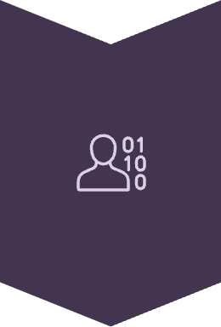


Core Data Structures
This project combines multiple data structures to achieve both ordering and priority handling capabilities. Each structure contributes unique properties that address specific aspects of the order matching problem.
Binary Search Trees
Organize orders by price in sorted order, enabling efficient range queries and ordered traversal
Heaps
Quickly access highest-priority orders using max-heap for buys and min-heap for sells
Treaps
Combine BST ordering with heap priority for balanced, efficient dynamic data management

Slide 5
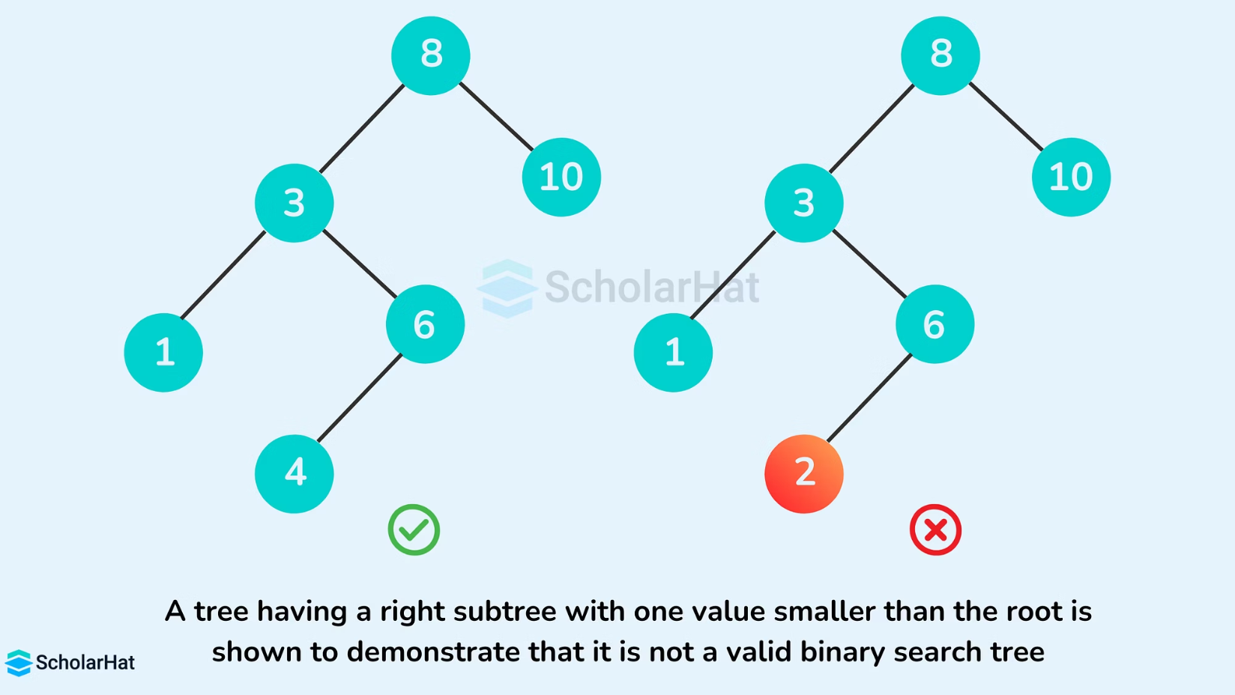
Binary Search Trees
Definition & Properties
Application to Order Matching
A Binary Search Tree (BST) is a hierarchical data structure where each node contains a key, and relationships follow specific ordering rules:
In StockProX, BSTs organize buy and sell orders by price level, creating natural price-time priority queues. Buy orders are stored in descending order while sell orders use ascending order, enabling efficient identification of matching price points.
Left subtree contains values smaller than the root
Right subtree contains values larger than the root
In-order traversal produces sorted sequence
The BST provides efficient searching, insertion, and deletion operations with average time complexity of O(log n) for balanced trees. However, worst-case complexity degrades to O(n) if the tree becomes unbalanced through sequential insertions.

Slide 6


Heaps: Priority Management Structures
Max Heap
Largest element positioned at the root node, with all children smaller than parent. Ideal for finding highest buy price in order matching systems.
Min Heap
Smallest element positioned at the root node, with all children larger than parent. Perfect for identifying lowest sell price in trading platforms.
Heaps are specialized tree structures that maintain the heap property through efficient insertion and extraction operations. They guarantee O(1) access to the highest or lowest priority element and O(log n) for insertion and deletion. In real-time systems, heaps enable priority scheduling, task management, and quick identification of optimal matching candidates without full tree traversal.

Slide 7





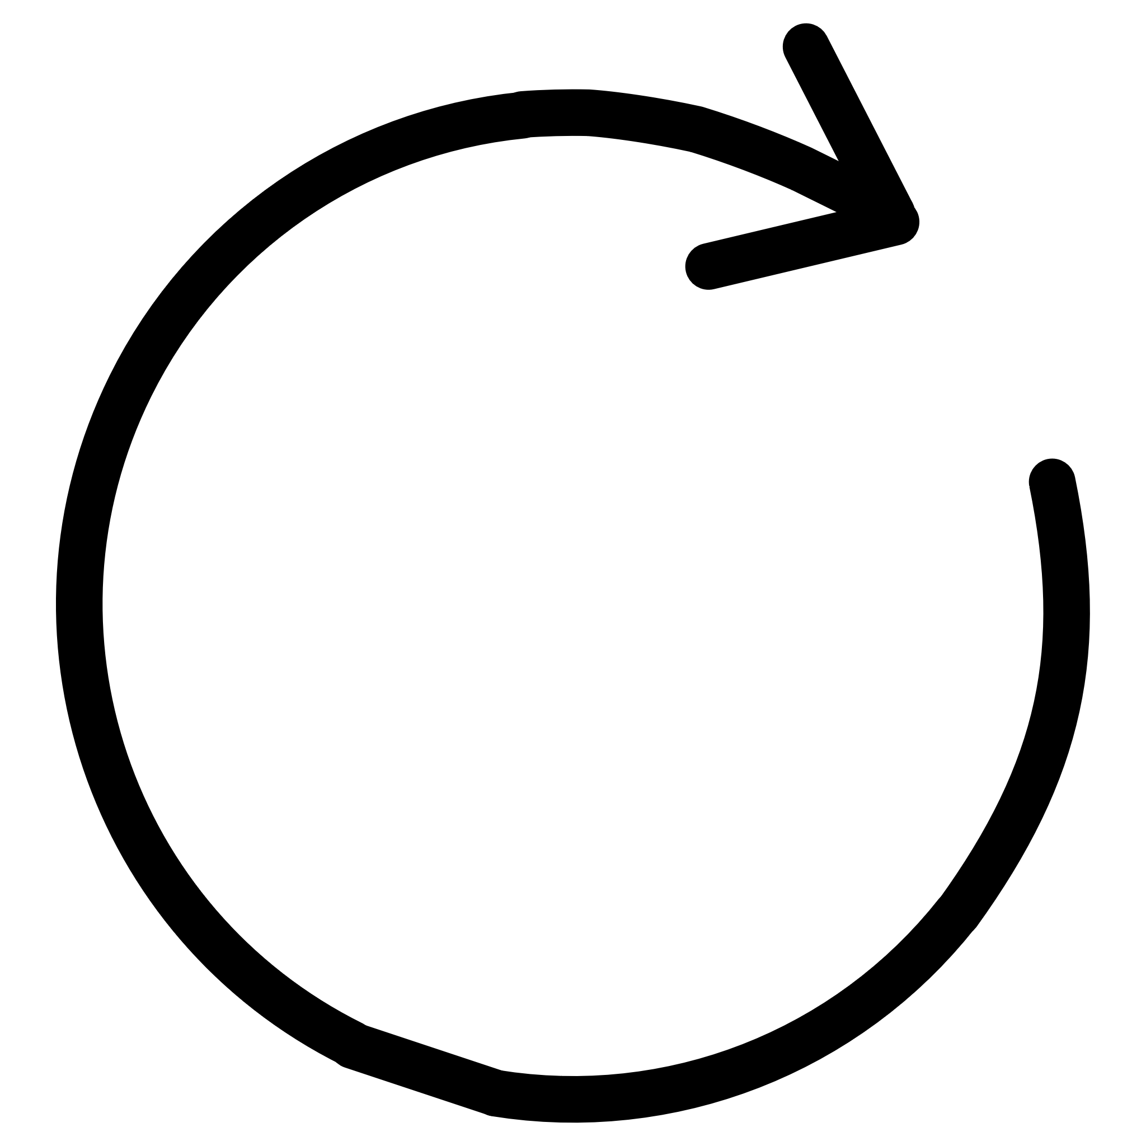
Treaps: The Hybrid Solution
A Treap is a hybrid data structure that combines Binary Search Tree ordering with Heap priority management, creating a self-balancing structure that maintains efficiency for dynamic data.
BST Property
Heap Property
Automatic Balancing
Nodes ordered by key (price), with left subtree smaller and right subtree larger than current node
Nodes ordered by priority (timestamp), with parent having higher priority than children
Tree rotations maintain balance when heap property is violated during insertions
Node Structure
Advantages
struct Node { double price; // BST key long timestamp; // Heap priority int quantity; Node* left; Node* right; };
Expected O(log n) time complexity
Self-balancing without complex logic
Combines ordering with priority
Efficient for dynamic data

Slide 8




Why Treaps? Technical Advantages
Combined Capabilities
Automatic Balance
Simultaneously maintains ordering by price and priority by timestamp, eliminating need for separate data structures
Randomized priorities ensure tree remains balanced with high probability, preventing degeneration into linked list
Dynamic Efficiency
Real-Time Ready
Faster than simple BST for datasets with frequent insertions and deletions, maintaining consistent performance
Suitable for real-time systems requiring millisecond-level response times and consistent worst-case behavior
Real-World Applications
Treaps excel in order books for trading platforms, database indexing systems requiring dynamic updates, memory allocation systems with variable block sizes, and event simulation systems processing time-ordered events with priority weighting.

Slide 9

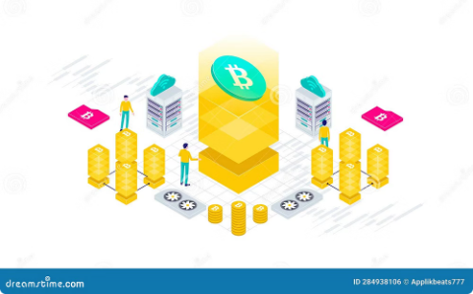
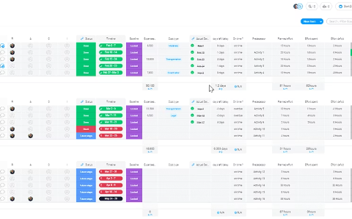
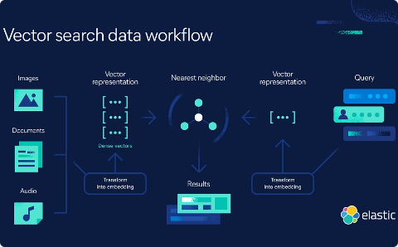
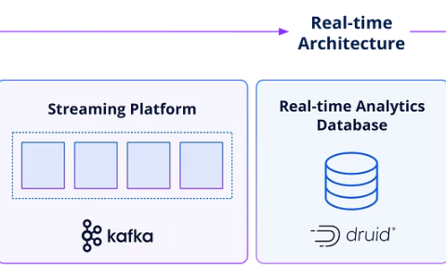

Real-World Applications Beyond Trading
Stock Exchanges
Cryptocurrency Markets
Priority Scheduling
Database Indexing
NYSE, NASDAQ, and other exchanges use treap-like structures for order books, matching millions of trades daily with sub-millisecond latency
Binance, Coinbase, and crypto exchanges leverage priority queues for matching engine, handling continuous 24/7 trading across global markets
Operating systems and real-time systems use heap-based structures for task scheduling, ensuring highest-priority processes execute first
Modern databases employ tree-heap hybrids for maintaining B-tree indexes with efficient insertion, deletion, and range query performance
Data Processing
Event Simulation
Stream processing systems and event-driven architectures use priority queues to manage time-sensitive data with guaranteed ordering
Discrete-event simulation frameworks process future events in chronological order while respecting priority rules for event handling

Slide 10
System Architecture & Results
Frontend Layer
Backend API
HTML/CSS for structure and styling
JavaScript for dynamic interactions
Responsive design for multiple devices
Node.js runtime environment
Express framework for routing
RESTful endpoints for order management
Database Layer
Matching Engine
MongoDB for document storage
Historical trade records
User account management
Treap-inspired data structures
BST + Heap hybrid logic
Real-time order processing
Order Matching Algorithm
01
02
03
Get Highest Buy
Get Lowest Sell
Compare Prices
Extract maximum price from buy order heap
Extract minimum price from sell order heap
Check if buy price ≥ sell price
04
05
Execute Trade
Update Orders
Process transaction and update quantities
Remove completed orders, maintain balance
Example Scenario
Buy Orders
Sell Orders
120 → qty 2
100 → qty 5
90 → qty 8
80 → qty 3
95 → qty 4
110 → qty 1
Matching Result: 120 matches with 80, 100 matches with 95, 90 matches with remaining orders. System always matches best available prices first, ensuring optimal execution for both buyers and sellers.
Features & Future Improvements
Current Features
Future Enhancements
Efficient order matching
Multi-stock support
API-based architecture
Real-time processing
Historical database
Real-time market data integration
WebSocket live updates
Portfolio tracking
Trading dashboards
AI-based analysis
Conclusion: This project demonstrates how advanced data structures—Treaps, BSTs, and Heaps—combine to design an efficient transaction processing system. The implementation successfully simulates core functionality of a real trading engine, processing orders with O(log n) expected time complexity while maintaining price-time priority.
Thank You

