Slide 1
ChronosLocker
Secure Digital Evidence Management System
Ensuring Integrity and Trust in Digital Forensics
TEAM MEMBERS
Thrishwant G-CB.SC.U4CYS24152
Karnasula Jaya Sai Venkatesh-CB.SC.U4CYS24125
Hithesh Y-CB.SC.U4CYS24121
Nivriti S-CB.SC.U4CYS24135
Sathya Prathmesh K J-CB.SC.U4CYS24149

Slide 2
Problem Statement
Evidence Tampering
Chain of Custody
Digital evidence can be altered or modified without detection, compromising investigation integrity
Maintaining verifiable custody records is difficult across multiple investigators and systems
Integrity Verification
Transparent Systems
Investigators require cryptographic proof that evidence remains unmodified from collection to presentation
Existing evidence management systems lack transparent, verifiable verification mechanisms

Slide 3




Project Objective
Secure Storage
Hash Detection
Build a secure digital evidence storage system with tamper-proof integrity guarantees
Detect tampering using cryptographic hash functions and hash chain verification
Transparent Tracking
Trustworthy Forensics
Provide transparent, auditable evidence tracking from collection to courtroom
Ensure trustworthy forensic investigations through verifiable integrity checks

Slide 4

System Architecture
Investigator Upload (REST API)
SQLite Storage & Dashboard
C++ Backend (Crow)
The system follows a layered architecture with clear separation between presentation, application logic, and data storage layers.

Slide 5
Core Components
1
2
C++ Backend Server
SQLite Database
High-performance server implementation using Crow framework for handling concurrent evidence submissions and hash calculations
chronos.db file stores evidence metadata, cryptographic hashes, timestamps, and investigator credentials securely
3
4
Web Dashboard
index.html provides intuitive interface for investigators to view evidence records and verify system integrity

Slide 6

Evidence Integrity Mechanism
Original File
SHA-256 Hash 1
SHA-256 Hash 2
Root Hash
Each evidence file generates a unique cryptographic hash using SHA-256. These individual hashes chain together to create a Merkle tree structure, culminating in a single Root Hash that represents the complete integrity state of the entire evidence collection.

Slide 7
System Workflow
Upload Evidence
Generate Hash
Store in DB
Update Root Hash
The workflow ensures every piece of evidence undergoes cryptographic verification before storage. The Root Hash updates automatically with each new submission, maintaining real-time integrity tracking across the entire evidence repository.

Slide 8
Threat Model
Evidence Tampering
Integrity Attacks
Data Manipulation
Unauthorized modification of evidence files after collection
Attempts to bypass or disable hash verification mechanisms
Altering database records or hash values to conceal modifications
Detection Mechanism: Any modification to evidence triggers hash mismatch during verification. The Root Hash becomes invalid, immediately alerting investigators to potential tampering. Hash chaining ensures even single-file changes propagate through the entire integrity tree.

Slide 9
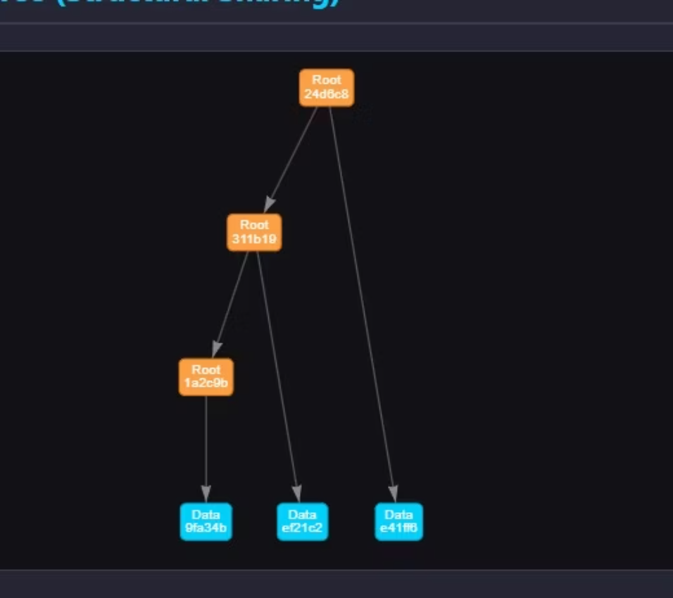
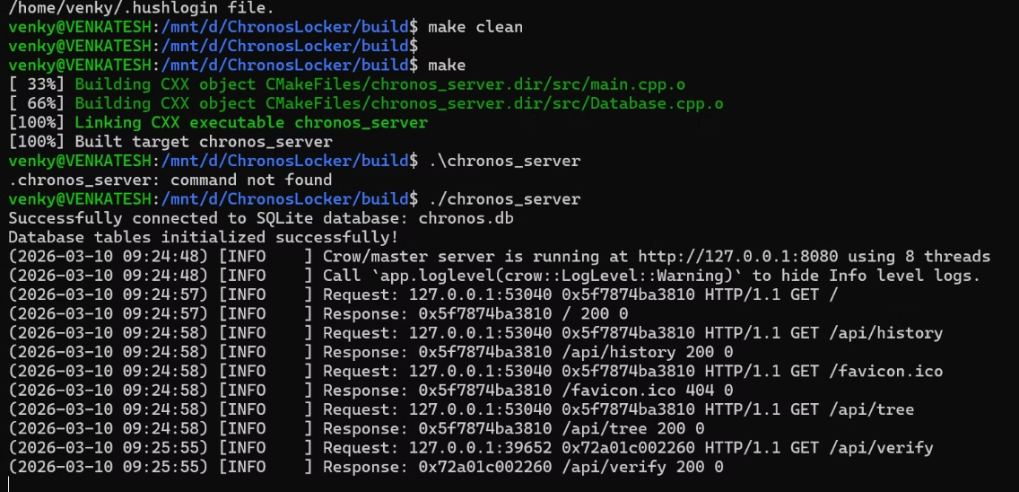
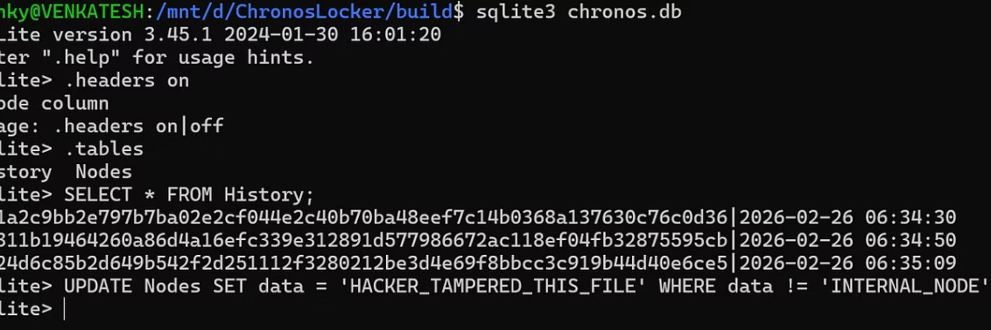
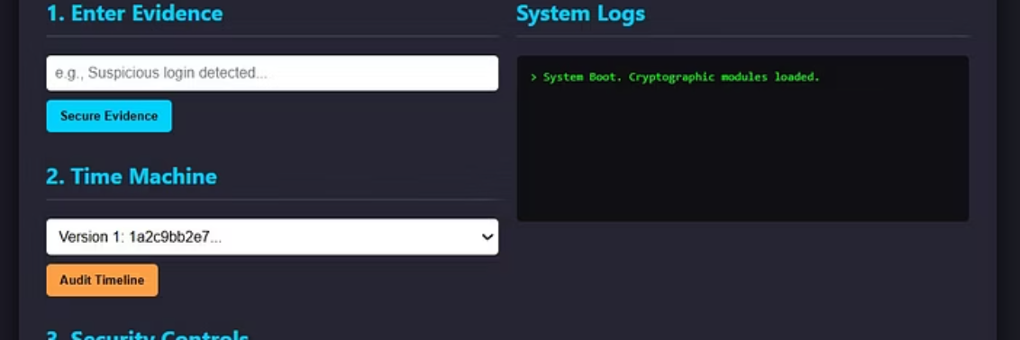
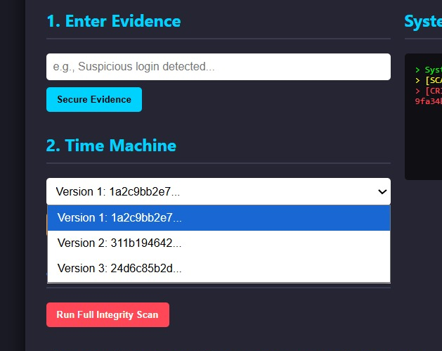
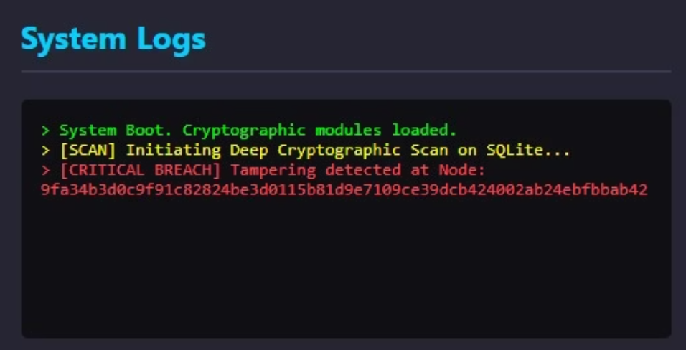
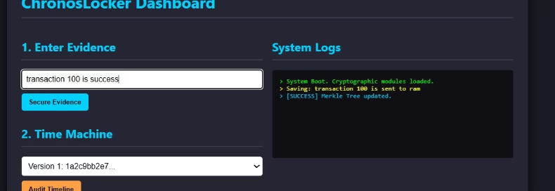
System Demonstration
3)Merkle Tree Data Structure
Visualization showing the
relationship between Root and Data
nodes.
4)Real-time detection of Node tampering within
SQLite environment
1)Compiling and launching the chronos_server using CMake and executing the binary.
5)ChronosLocker Dashboard – Central Management Console for integrity auditing
and version control and Executing a SQL UPDATE statement to tamper with data
nodes within chronos.db
2)Data is entered

Slide 10
Conclusion & Future Improvements
01
02
03
Current Achievements
Transparency Benefits
Distributed Storage
ChronosLocker ensures evidence integrity through cryptographic hashing and provides tamper detection capabilities for forensic investigations
The system improves transparency and auditability in forensic workflows with verifiable chain of custody
Future version will support replication across multiple nodes for redundancy and high availability
04
05
Blockchain Integration
Enhanced Security
Proposed implementation using blockchain for immutable evidence logging and timestamp verification
Planned addition of multi-factor authentication and hardware security modules for key management

