Slide 1





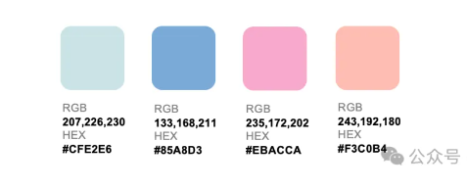
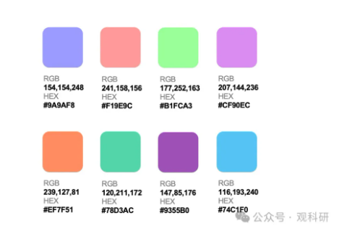
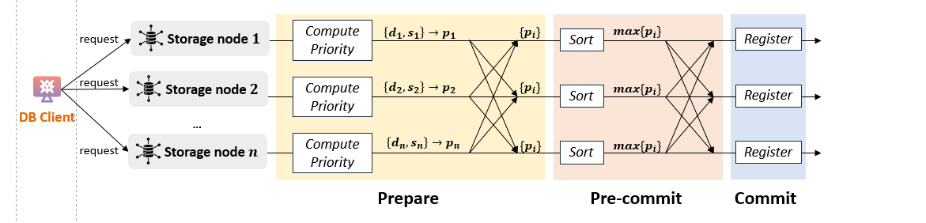
❷ Batching
❸ Storer Discovery
① Retrieval
Data Owner
❶ Uploading
定位
定位
定位
Storage Workflow
Gateway
❹ Dispatching
Storage Provider
Satellite
定位
Query Workflow
④ Return
② Transmission
Log on Ledger
③ Verification
Ledger
measurement baseline store & query
Storage Workflow
Query Workflow
Log on Ledger
❷ Batching
❹ Sending data and proof
② Fetching data and proof
Data Owner
❶ Uploading
Gateway
❸ Storer selecting
Satellites
Storage Provider
④ Return
① Retrieval
③ Verification
Ledger
Notes:
一版

Slide 2
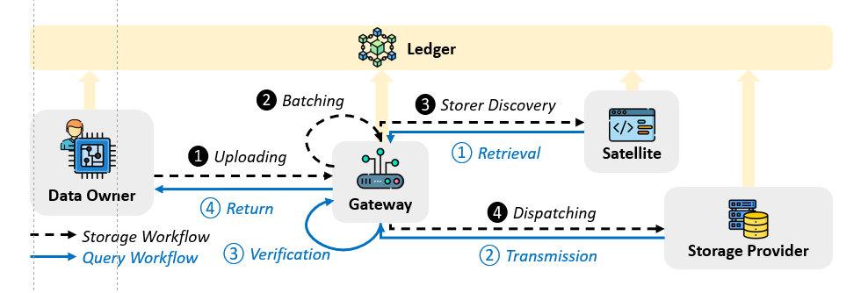


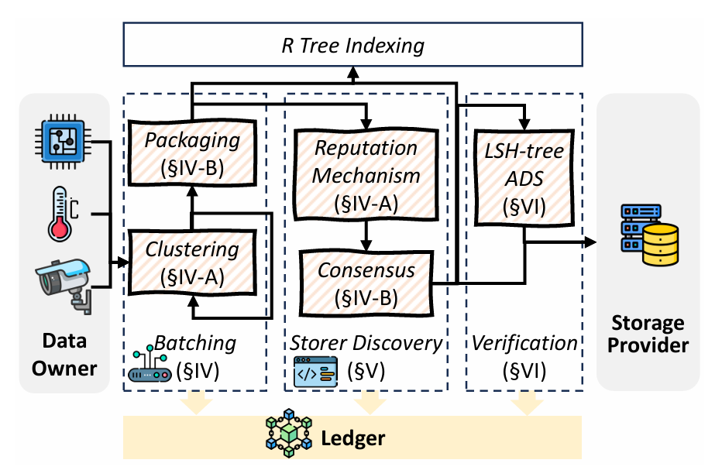
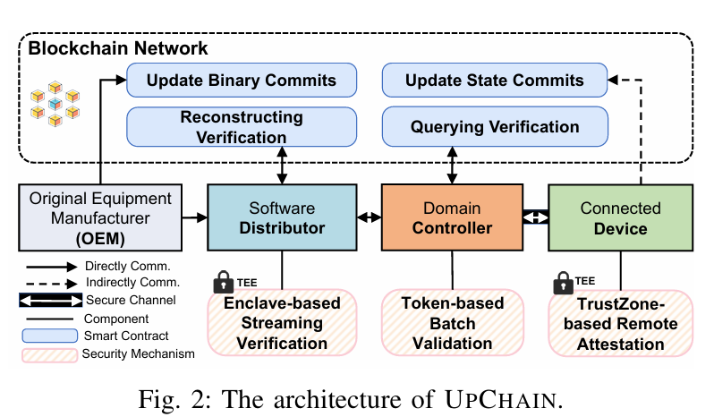

Data Owner
R Tree Indexing
Storage Provider
Data
Batching
Storer Selection
Data
Verification
Packaging (§IV-B)
Consensus-based Node Selection
(§V)
LSH Tree-based Verification
(§VI)
Dynamic
DAG
(§IV-A)
Ledger
Data Owner
R Tree Indexing
Storage Provider
R Tree Indexing
Batching
(§IV)
Storer Discovery (§V)
Verification
(§VI)
Packaging (§IV-B)
Data Owner
Batching
(§IV)
Storer Discovery (§V)
Verification (§VI)
Storage Provider
Node Selection
(§V)
LSH-tree
ADS
(§VI)
Packaging (§IV-B)
Reputation Mechanism (§IV-A)
LSH-tree ADS
(§VI)
Clustering
(§IV-A)
Clustering (§IV-A)
Node Selection
(§V-B)
Hyperledger Fabric
Hyperledger Fabric

Slide 3
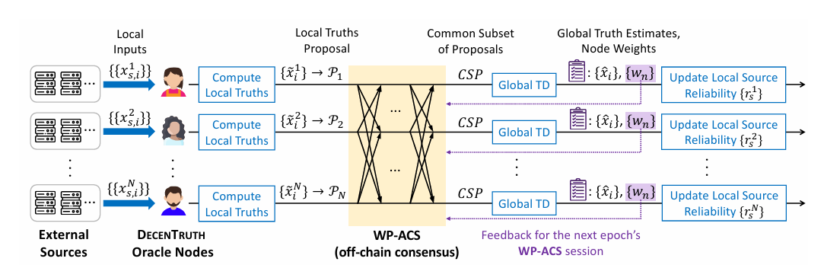
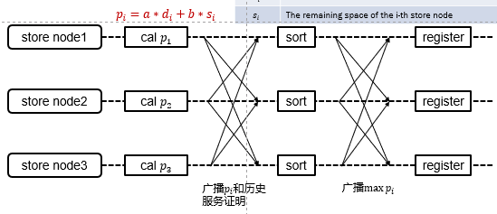








共识算法
Prepare
Pre-commit
Commit
request
Storage node $1$
Compute Priority
$$\left\{d_{1},s_{1}\right\}→p_{1}$$
$$\{p_{i}\}$$
Sort
$$max\{p_{i}\}$$
Register
request
Storage node $2$
Compute Priority
$$\left\{d_{2},s_{2}\right\}→p_{2}$$
$$\{p_{i}\}$$
$$max\{p_{i}\}$$
Sort
Register
Gateway
...
request
Storage node $n$
Compute Priority
$$\left\{d_{n},s_{n}\right\}→p_{n}$$
$$\{p_{i}\}$$
Sort
$$max\{p_{i}\}$$
Register
One-round consensus

Slide 4


共识算法
request
Storage node $1$
Node Selector
Node Selector
best storage node
request
Storage node $2$
Node Selector
Node Selector
best storage node
Node Selector
Gateway
...
request
Storage node $n$
Node Selector
Node Selector
best storage node
First-round consensus
Second-round consensus

Slide 5
same bit
a | c | d | f | e | d
different bit
LSH
b | f | e | d | a | c
f | e | b | c | a | d
LSH
LSH
e | f | c | b | e | a
e | f | c | b | e | d
e | f | c | b | e | b
LSH
LSH
LSH
0 | ... | 0 | 0 | 0
0 | ... | 0 | 0 | 1
0 | ... | 0 | 1 | 0
0 | ... | 0 | 1 | 1
0 | ... | 1 | 0 | 0
0 | ... | 1 | 1 | 0
0 | ... | 1 | 0 | 1

Slide 6
c | a | d | d | f | a
LSH
b | f | e | d | a | c
b | f | e | d | a | d
LSH
LSH
e | f | c | b | e | a
e | f | c | b | e | d
e | f | c | b | e | b
e | f | c | b | e | f
LSH
LSH
LSH
LSH
0 | ... | 0 | 0 | 0
0 | ... | 0 | 0 | 1
0 | ... | 0 | 1 | 0
0 | ... | 0 | 1 | 1
0 | ... | 1 | 0 | 0
0 | ... | 1 | 1 | 0
0 | ... | 1 | 0 | 1

Slide 7
hash root
o | h | l | n | j | y
hash
b | a | f | v | k | i
b | a | f | e | k | a
data
0 | 9 | 3 | 0 | 2 | 3
0 | 9 | 3 | 1 | 2 | 4

Slide 8
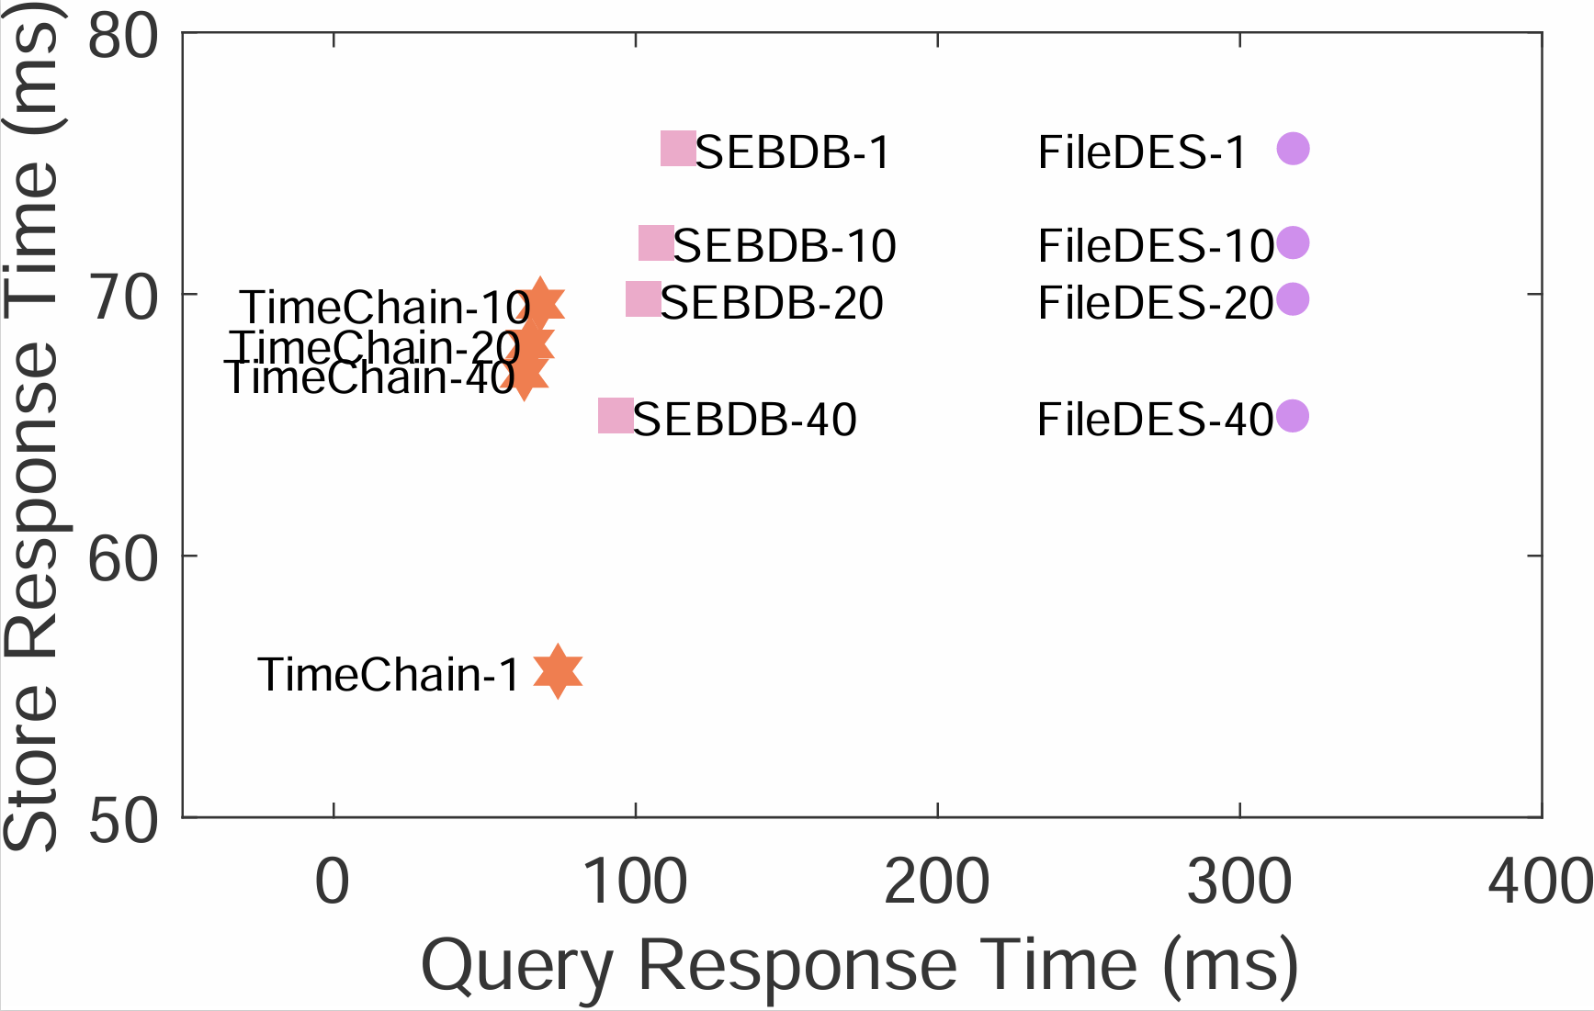
better
better
better
[249,215,192]/255;
[254,192,239]/255;
[223,192,254]/255;
better

Slide 9
❷ Batching
❸ Storer Discovery
① Retrieval
Data Owner
❶ Uploading
定位
定位
定位
Storage Workflow
Gateway
❹ Dispatching
Storage Provider
Satellite
定位
Query Workflow
④ Return
② Transmission
Log on Ledger
③ Verification
Ledger
measurement baseline store & query
Storage Workflow
Query Workflow
Log on Ledger
❹ Sending data and proof
❷ Batching
② Fetching data and proof
Data Owner
locator
❸ Storer selecting
Satellites
Storage Provider
❶ Uploading
Gateway
locator
locator
④ Return
locator
① Retrieval
③ Verification
Ledger
Notes:
一版

Slide 10
Data Owner
R Tree Indexing
Storage Provider
Data
Batching
Storer Selection
Data
Verification
Packaging (§IV-B)
Consensus-based Node Selection
(§V)
LSH Tree-based Verification
(§VI)
Dynamic
DAG
(§IV-A)
Ledger
Data Owner
R Tree Indexing
Storage Provider
R Tree Indexing
Batching
(§IV)
Storer Discovery (§V)
Verification
(§VI)
Packaging (§IV-B)
Data Owner
Batching
(§IV)
Storer Discovery (§V)
Verification (§VI)
Storage Provider
Node Selection
(§V)
LSH-tree
ADS
(§VI)
Packaging (§IV-B)
Reputation Mechanism (§IV-A)
LSH-tree ADS
(§VI)
Clustering
(§IV-A)
Clustering (§IV-A)
Node Selection
(§V-B)
Hyperledger Fabric
Hyperledger Fabric

Slide 11
Data Owner
R Tree Indexing
Storage Provider
Data Batching
Storer Selection
Data Verification
Packaging
(§4.2)
Consensus-based Node Selection
(§5)
LSH Tree-based Verification
(§6)
Adaptive UWG
(§4.1)
Ledger
Data Owner
R Tree Indexing
Storage Provider
R Tree Indexing
Batching
(§IV)
Storer Discovery (§V)
Verification
(§VI)
Packaging (§IV-B)
Data Owner
Batching
(§IV)
Storer Discovery (§V)
Verification (§VI)
Storage Provider
Node Selection
(§V)
LSH-tree
ADS
(§VI)
Packaging (§IV-B)
Reputation Mechanism (§IV-A)
LSH-tree ADS
(§VI)
Clustering
(§IV-A)
Clustering (§IV-A)
Node Selection
(§V-B)
Hyperledger Fabric
Hyperledger Fabric

Slide 12










Prepare
Pre-commit
Commit
$$\left\{d_{1},s_{1}\right\}→p_{1}$$
$$top_{n}\{p_{i}\}$$
request
node $1$
Compute Priority
$$\{p_{i}\}$$
Sort
Register
$$\left\{d_{2},s_{2}\right\}→p_{2}$$
$$top_{n}\{p_{i}\}$$
request
node $2$
Compute Priority
$$\{p_{i}\}$$
Sort
Register
Gateway
...
$$\left\{d_{n},s_{n}\right\}→p_{n}$$
$$top_{n}\{p_{i}\}$$
request
node $n$
Compute Priority
$$\{p_{i}\}$$
Sort
Register
Store nodes
One-round consensus

Slide 13
共识算法
request
Storage node $1$
Node Selector
Node Selector
best storage node
request
Storage node $2$
Node Selector
Node Selector
best storage node
Node Selector
Gateway
...
request
Storage node $n$
Node Selector
Node Selector
best storage node
First-round consensus
Second-round consensus

Slide 14
same bit
a | c | d | f | e | d
different bit
LSH
b | f | e | d | a | c
f | e | b | c | a | d
LSH
LSH
e | f | c | b | e | a
e | f | c | b | e | d
e | f | c | b | e | b
LSH
LSH
LSH
0 | ... | 0 | 0 | 0
0 | ... | 0 | 0 | 1
0 | ... | 0 | 1 | 0
0 | ... | 0 | 1 | 1
0 | ... | 1 | 0 | 0
0 | ... | 1 | 1 | 0
0 | ... | 1 | 0 | 1

Slide 15
same bit
different bit
c | a | d | d | f | a
LSH
b | f | e | d | a | c
b | f | e | d | a | d
LSH
LSH
e | f | c | b | e | a
e | f | c | b | e | d
e | f | c | b | e | b
e | f | c | b | e | f
LSH
LSH
LSH
LSH
0 | ... | 0 | 0 | 0
0 | ... | 0 | 0 | 1
0 | ... | 0 | 1 | 0
0 | ... | 0 | 1 | 1
0 | ... | 1 | 0 | 0
0 | ... | 1 | 1 | 0
0 | ... | 1 | 0 | 1

Slide 16
hash root
o | h | l | n | j | y
hash
b | a | f | v | k | i
b | a | f | e | k | a
data
0 | 9 | 3 | 0 | 2 | 3
0 | 9 | 3 | 1 | 2 | 4

Slide 17
better
better
better
[249,215,192]/255;
[254,192,239]/255;
[223,192,254]/255;
better

Slide 18
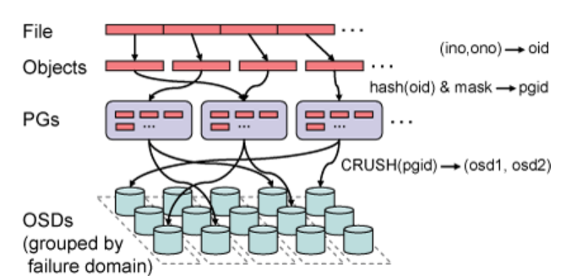
文件
对象
hash
PGs
...
...
...
CRUSH
存储单元

Slide 19
❷ Batching
❸ Storer Discovery
① Retrieval
Data Owner
❶ Uploading
定位
定位
定位
Storage Workflow
Gateway
❹ Dispatching
Storage Provider
Satellite
定位
Query Workflow
④ Return
② Transmission
Log on Ledger
③ Verification
Ledger
measurement baseline store & query
存储工作流
查询工作流
账本记录
❹ 发送数据和完整性证明
❷ 聚合
② 获取数据和完整性证明
数据
拥有方
网关
❸ 选择
存储节点
卫星节点
存储节点
❶ 上传
④ 返回
① 检索
③ 验证
区块链账本
Notes:
一版

Slide 20
用户
卫星节点
存储节点
存储节点
存储节点

Slide 21
用户
存储节点
存储节点
存储节点

Slide 22
扩展节点
key | value
726f6d
分支节点
0 | 1 | 2 | 3 | 4 | 5 | 6 | 7 | 8 | 9 | a | b | c | d | e | f | value
 |  |  |  |  |  |  |  |  |  |  |  |  |  |  |  | 0xabc
叶子节点
扩展节点
key | value
16e65 | “dog”
key | value
56c753 | 0xaa

Slide 23
第一章
绪论
第二章
相关工作
第三章
基于区块链存储系统的测量与研究
问题一
范围查询跨越多个批处理单元
问题二
存储节点选择不当
问题三
完整性证明数据量大
第四章
面向链下存储的自适应聚合机制
第五章
基于共识协议的节点选择机制
第六章
基于LSH树的
验证机制
第七章
实验结果与分析
第八章
总结与展望

Slide 24
数据拥有方
R树索引
存储节点
数据聚合
存储方选择
数据验证
数据封装
基于共识
的节点选择
基于LSH树的验证机制
自适应图
区块链账本
Data Owner
R Tree Indexing
Storage Provider
R Tree Indexing
Batching
(§IV)
Storer Discovery (§V)
Verification
(§VI)
Packaging (§IV-B)
Data Owner
Batching
(§IV)
Storer Discovery (§V)
Verification (§VI)
Storage Provider
Node Selection
(§V)
LSH-tree
ADS
(§VI)
Packaging (§IV-B)
Reputation Mechanism (§IV-A)
LSH-tree ADS
(§VI)
Clustering
(§IV-A)
Clustering (§IV-A)
Node Selection
(§V-B)
Hyperledger Fabric
Hyperledger Fabric

Slide 25
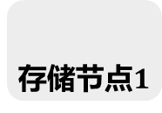
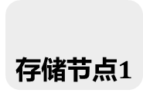

决定提案
广播
准备
预提交
提交
存储节点$1$
是否通过决策？
一致意见>2f+1?
决策
记录
请求
决策节点
决策
存储节点$1$
是否通过决策？
一致意见>2f+1?
记录
网关
...
存储节点$1$
是否通过决策？
一致意见>2f+1?
决策
记录
节点选择
共识

Slide 26








准备
预提交
提交
存储节点$1$
计算得分
$$\left\{d_{1},s_{1}\right\}→p_{1}$$
$$\{p_{i}\}$$
排序
$$max\{p_{i}\}$$
请求
记录
请求
存储节点$1$
计算得分
$$\left\{d_{2},s_{2}\right\}→p_{2}$$
$$\{p_{i}\}$$
排序
$$max\{p_{i}\}$$
记录
网关
...
存储节点$1$
计算得分
$$\left\{d_{n},s_{n}\right\}→p_{n}$$
$$\{p_{i}\}$$
排序
$$max\{p_{i}\}$$
请求
记录
共识

Slide 27
相同bit
a | c | d | f | e | d
不同bit
b | f | e | d | a | c
f | e | b | c | a | d
e | f | c | b | e | a
e | f | c | b | e | d
e | f | c | b | e | b
d | ... | e | a | c
d | ... | e | a | d
d | ... | e | b | c
d | ... | e | b | d
d | ... | e | e | c
d | ... | e | e | d
d | ... | e | f | a
0 | ... | 0 | 0 | 0
0 | ... | 0 | 0 | 1
0 | ... | 0 | 1 | 0
0 | ... | 0 | 1 | 1
0 | ... | 1 | 0 | 0
0 | ... | 1 | 1 | 0
0 | ... | 1 | 0 | 1

Slide 28
相同bit
c | a | d | d | f | a
不同bit
b | f | e | d | a | c
b | f | e | d | a | d
e | f | c | b | e | a
e | f | c | b | e | d
e | f | c | b | e | b
e | f | c | b | e | f
d | ... | e | a | c
d | ... | e | a | d
d | ... | e | b | c
d | ... | e | b | d
d | ... | e | e | c
d | ... | e | e | d
d | ... | e | f | a
0 | ... | 0 | 0 | 0
0 | ... | 0 | 0 | 1
0 | ... | 0 | 1 | 0
0 | ... | 0 | 1 | 1
0 | ... | 1 | 0 | 0
0 | ... | 1 | 1 | 0
0 | ... | 1 | 0 | 1

Slide 29
Hash1-8
传统哈希
Hash1234
Hash5678
传统哈希
传统哈希
Hash12
Hash34
Hash56
Hash78
传统哈希
传统哈希
传统哈希
传统哈希
Hash1
Hash2
Hash3
Hash4
Hash5
Hash6
Hash7
Hash8
传统哈希
交易1
交易2
交易3
交易4
交易5
交易6
交易7
交易8

Slide 30
Hash1-8
局部敏感哈希
Hash1234
Hash5678
局部敏感哈希
局部敏感哈希
Hash12
Hash34
Hash56
Hash78
局部敏感哈希
局部敏感哈希
局部敏感哈希
局部敏感哈希
Hash1
Hash2
Hash3
Hash4
Hash5
Hash6
Hash7
Hash8
局部敏感哈希
交易1
交易2
交易3
交易4
交易5
交易6
交易7
交易8

Slide 31
哈希根
o | h | l | n | j | y
哈希
b | a | f | v | k | i
b | a | f | e | k | a
数据
0 | 9 | 3 | 0 | 2 | 3
0 | 9 | 3 | 1 | 2 | 4

Slide 32
区块数据
块级索引
区块i-1
区块i
区块n
前置哈希
区块高度
时间戳
...
交易j:[...,donate,Jack,Education,100]
交易j+1:[...,transfer,Education,Jack,school1,1000]
交易j+2:[...,distribute,Education,Jack,school1,Tom,50]
(区块号，交易号，时间戳)
表级索引
块间索引
donate | 1001100...01
transfer | 1101100...01
... | ...
区块1 | 100...
区块2 | 010...
... | ...

