Slide 1





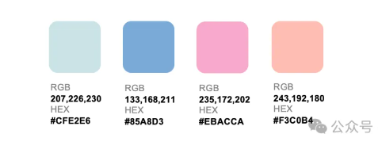
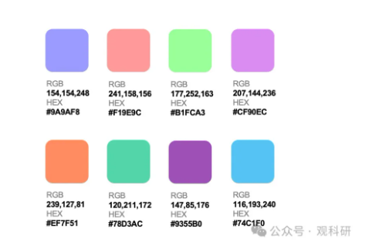
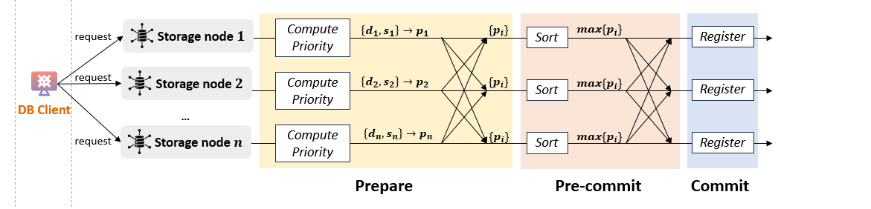
❷ Batching
❸ Storer Discovery
① Retrieval
Data Owner
❶ Uploading
定位
定位
定位
Storage Workflow
Gateway
❹ Dispatching
Storage Provider
Satellite
定位
Query Workflow
④ Return
② Transmission
Log on Ledger
③ Verification
Ledger
measurement baseline store & query
Storage Workflow
Query Workflow
Log on Ledger
❷ Batching
❹ Sending data and proof
② Fetching data and proof
Data Owner
❶ Uploading
Gateway
❸ Storer selecting
Satellites
Storage Provider
④ Return
① Retrieval
③ Verification
Ledger
Notes:
一版

Slide 2
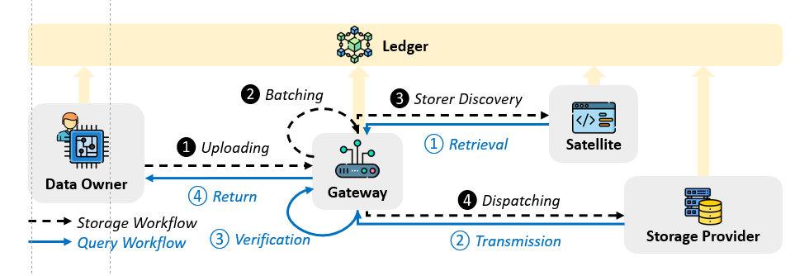


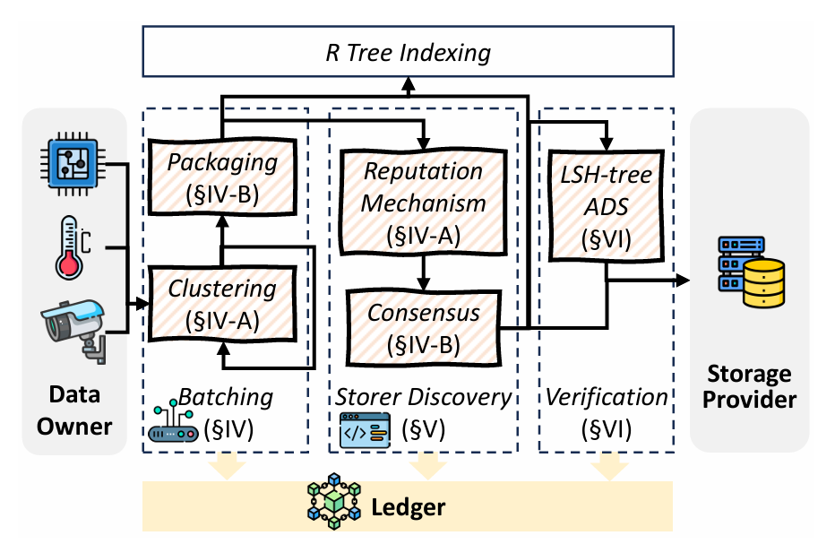
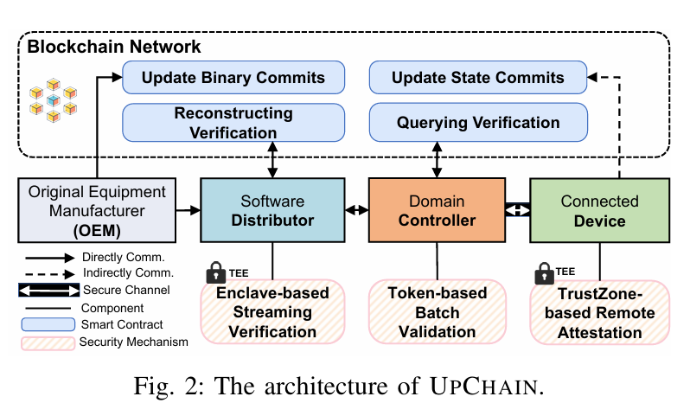

Data Owner
R Tree Indexing
Storage Provider
Data
Batching
Storer Selection
Data
Verification
Packaging (§IV-B)
Consensus-based Node Selection
(§V)
LSH Tree-based Verification
(§VI)
Dynamic
DAG
(§IV-A)
Ledger
Data Owner
R Tree Indexing
Storage Provider
R Tree Indexing
Batching
(§IV)
Storer Discovery (§V)
Verification
(§VI)
Packaging (§IV-B)
Data Owner
Batching
(§IV)
Storer Discovery (§V)
Verification (§VI)
Storage Provider
Node Selection
(§V)
LSH-tree
ADS
(§VI)
Packaging (§IV-B)
Reputation Mechanism (§IV-A)
LSH-tree ADS
(§VI)
Clustering
(§IV-A)
Clustering (§IV-A)
Node Selection
(§V-B)
Hyperledger Fabric
Hyperledger Fabric

Slide 3
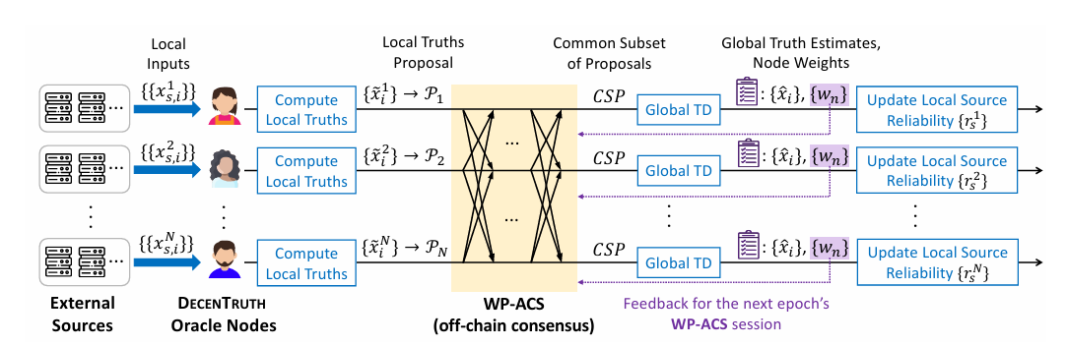
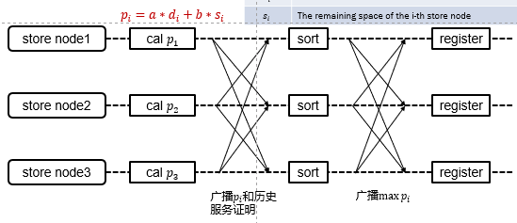








共识算法
Prepare
Pre-commit
Commit
request
Storage node $1$
Compute Priority
$$\left\{d_{1},s_{1}\right\}→p_{1}$$
$$\{p_{i}\}$$
Sort
$$max\{p_{i}\}$$
Register
request
Storage node $2$
Compute Priority
$$\left\{d_{2},s_{2}\right\}→p_{2}$$
$$\{p_{i}\}$$
$$max\{p_{i}\}$$
Sort
Register
Gateway
...
request
Storage node $n$
Compute Priority
$$\left\{d_{n},s_{n}\right\}→p_{n}$$
$$\{p_{i}\}$$
Sort
$$max\{p_{i}\}$$
Register
One-round consensus

Slide 4


共识算法
request
Storage node $1$
Node Selector
Node Selector
best storage node
request
Storage node $2$
Node Selector
Node Selector
best storage node
Node Selector
Gateway
...
request
Storage node $n$
Node Selector
Node Selector
best storage node
First-round consensus
Second-round consensus

Slide 5
same bit
a | c | d | f | e | d
different bit
LSH
b | f | e | d | a | c
f | e | b | c | a | d
LSH
LSH
e | f | c | b | e | a
e | f | c | b | e | d
e | f | c | b | e | b
LSH
LSH
LSH
0 | ... | 0 | 0 | 0
0 | ... | 0 | 0 | 1
0 | ... | 0 | 1 | 0
0 | ... | 0 | 1 | 1
0 | ... | 1 | 0 | 0
0 | ... | 1 | 1 | 0
0 | ... | 1 | 0 | 1

Slide 6
c | a | d | d | f | a
LSH
b | f | e | d | a | c
b | f | e | d | a | d
LSH
LSH
e | f | c | b | e | a
e | f | c | b | e | d
e | f | c | b | e | b
e | f | c | b | e | f
LSH
LSH
LSH
LSH
0 | ... | 0 | 0 | 0
0 | ... | 0 | 0 | 1
0 | ... | 0 | 1 | 0
0 | ... | 0 | 1 | 1
0 | ... | 1 | 0 | 0
0 | ... | 1 | 1 | 0
0 | ... | 1 | 0 | 1

Slide 7
hash root
o | h | l | n | j | y
hash
b | a | f | v | k | i
b | a | f | e | k | a
data
0 | 9 | 3 | 0 | 2 | 3
0 | 9 | 3 | 1 | 2 | 4

Slide 8
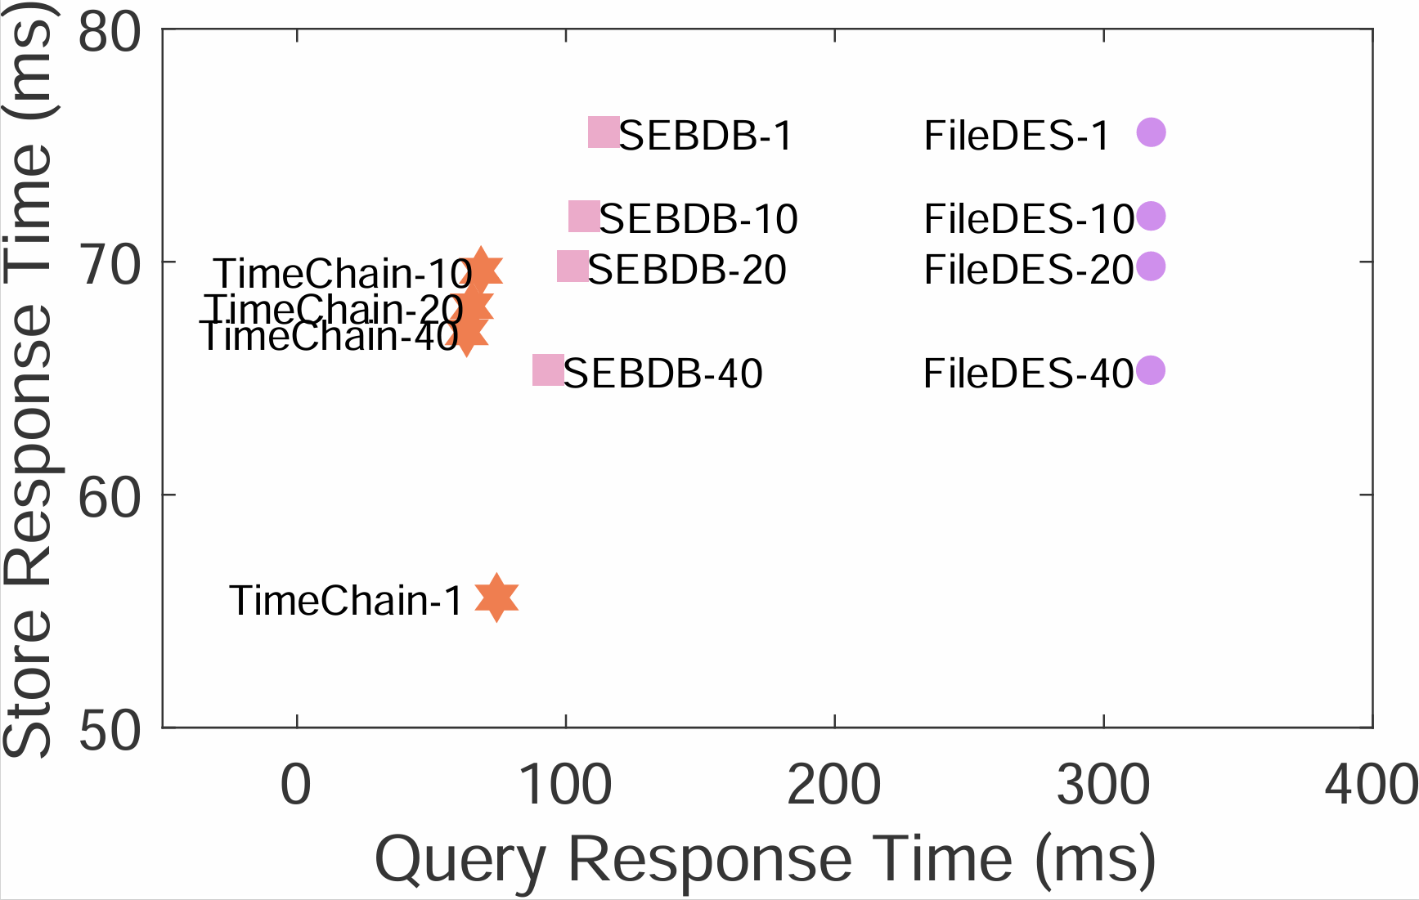
better
better
better
[249,215,192]/255;
[254,192,239]/255;
[223,192,254]/255;
better

Slide 9





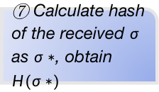
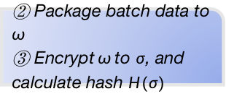
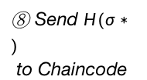
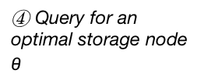


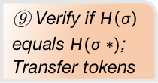
User
Blockchain Network
④ Query for an optimal storage node $θ$
Storage node Selection
Query
Recorder
Hash Verification
DB Client
⑤ Stake $H\left(σ\right)$ and tokens
① Forward data store request
⑥ Send $σ$ to storage node
Storage node $θ$
⑧ Send $H(σ∗)$
to Chaincode
measurement baseline store & query
Smart contract
Internal operations
Data flow
Point to action set
② Package batch data to $ω$
③ Encrypt$ω$to $σ$, and calculate hash $H(σ)$
⑩ Record storage operations, storage node and root hash
⑦ Calculate hash of the received $σ$ as $σ∗$, obtain $H(σ∗)$
⑨ Verify if $H\left(σ\right)$ equals $H(σ∗)$;
Transfer tokens
Storage Workflow
Query Workflow
Log on Ledger
❷ Batching
❸ Storer Discovery
Satellite
定位
① Retrieval
Data Owner
❶ Uploading
Gateway
❹ Dispatching
Storage Provider
④ Return
② Transmission
③ Verification
Ledger
Notes:
一版

Slide 10
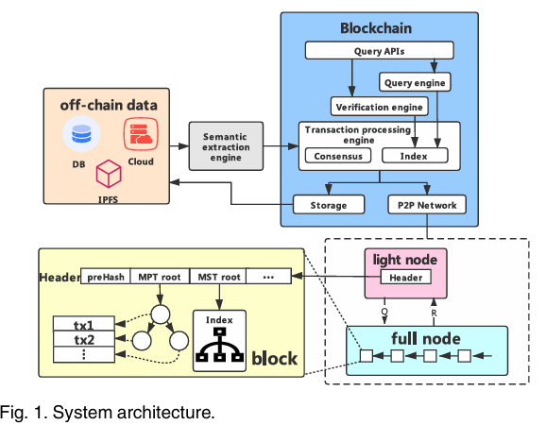
TimeChain
Smart Contract
API
User Client
Node selection
(§.4)
Access Control
Batch data selection (§.5)
Smart Contract (§.4)
R tree
Verification (§.6)
Query Engine (§.5)
Store nodes
Data transmission
Verification (§.6)
Remote Storage Server

Slide 11
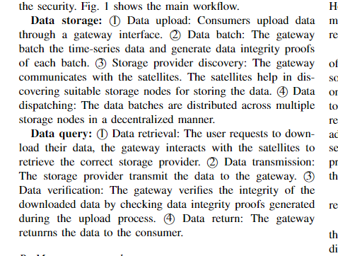
User
Blockchain Network
④ Query for an optimal storage node $θ$
Storage node Selection
Query
Recorder
Hash Verification
DB Client
⑤ Stake $H\left(σ\right)$ and tokens
measurement baseline store & query
① Forward data store request
⑥ Send $σ$ to storage node
Storage node $θ$
⑧ Send $H(σ∗)$
to Chaincode
Smart contract
Internal operations
Data flow
Point to action set
② Package batch data to $ω$
③ Encrypt$ω$to $σ$, and calculate hash $H(σ)$
⑩ Record storage operations, storage node and root hash
⑦ Calculate hash of the received $σ$ as $σ∗$, obtain $H(σ∗)$
⑨ Verify if $H\left(σ\right)$ equals $H(σ∗)$;
Transfer tokens
❷ Batching
Satellite
Data Owner
❸ Storer Discovery
Gateway
❶ Uploading
① Retrieval
④ Return
❹ Dispatching
Storage Provider
③ Verification
② Transmission
Query Workflow
Storage Workflow
Notes:
一版

Slide 12
User
sensor
gateway
DB Client
Hyperledger fabric chaincode
sensor
Choose store node
sensor
质押批数据hash与coin
Store node
Verify the equality of the Two hash value
Receive data from DB Client
Calculate hash of batch data
Send hash to Chaincode
measurement baseline store
User
Blockchain Network
④ Query for an optimal storage node $θ$
Storage node Selection
Query
Recorder
Hash Verification
DB Client
⑤ Stake $H\left(σ\right)$ and tokens
① Forward data store request
⑥ Send $σ$ to storage node
Storage node $θ$
⑧ Send $H(σ∗)$
to Chaincode
Smart contract
Internal operations
Data flow
Point to action set
② Package batch data to $ω$
③ Encrypt$ω$to $σ$, and calculate hash $H(σ)$
⑩ Record storage operations, storage node and root hash
⑦ Calculate hash of the received $σ$ as $σ∗$, obtain $H(σ∗)$
⑨ Verify if $H\left(σ\right)$ equals $H(σ∗)$;
Transfer tokens
Notes:
一版

Slide 13

共识算法
request
Storage node $1$
Compute Priority
$$\left\{d_{1},s_{1}\right\}→p_{1}$$
$$\{p_{i}\}$$
Sort
$$max\{p_{i}\}$$
Register
request
Storage node $2$
Compute Priority
$$\left\{d_{2},s_{2}\right\}→p_{2}$$
$$\{p_{i}\}$$
$$max\{p_{i}\}$$
Sort
Register
DB Client
...
request
Storage node $n$
Compute Priority
$$\left\{d_{n},s_{n}\right\}→p_{n}$$
$$\{p_{i}\}$$
Sort
$$max\{p_{i}\}$$
Register
Prepare
Pre-commit
Commit

Slide 14
User
sensor
gateway
DB Client
Hyperledger fabric chaincode
sensor
Choose store node
sensor
质押批数据hash与coin
Store node
Verify the equality of the Two hash value
Receive data from DB Client
Calculate hash of batch data
Send hash to Chaincode
measurement baseline query
User
Blockchain Network
④ Query the storage node and root hash
Query
Recorder
⑧ Return data
DB Client
① Forward data query request
⑥ Fetch the encrypted data 𝝈
Storage node $θ$
Smart contract
Internal operations
Data flow
Point to action set
② Query R tree and get the index of the corresponding transaction
⑦ decrypted the encrypyted data 𝝈
⑤ Find the payload of the corresponding tansaction,
get root hash, storage node
Notes:
一版

Slide 15


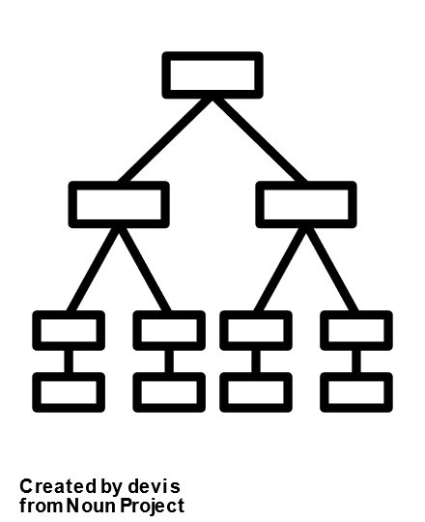

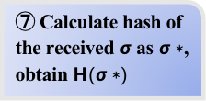
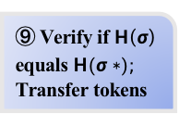






User
sensor
gateway
DB Client
Hyperledger fabric chaincode
sensor
Choose store node
sensor
质押批数据hash与coin
Store node
Verify the equality of the Two hash value
Receive data from DB Client
Calculate hash of batch data
Send hash to Chaincode
measurement baseline store
User
Blockchain network
④ Query for an apt storage node
obtain $θ$
Storage node Selection
Record for Query
Hash Verification
⑧ Send $H(σ∗)$
to Chaincode
⑤ Stake $H\left(σ\right)$ and tokens
① Forward data
_{B+ tree}
_{Merkle tree}
⑥ Send $σ$ to storage node
_{DB client}
Storage node $θ$
Smart contract
Internal operations
Data flow
Point to action set
② Package batch data to $ω$ and calculate Merkle root hash
③ Encrypt$ω$to $σ$, and calculate hash of $σ$ , obtain $H(σ)$
⑩Record storage operations,storage node and root hash
⑨ Verify if $H\left(σ\right)$ equals $H(σ∗)$;
Transfer tokens
⑦ Calculate hash of the received $σ$ as $σ∗$, obtain $H(σ∗)$
Notes:
一版

Slide 16



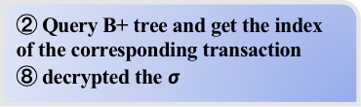
User
sensor
gateway
DB Client
Hyperledger fabric chaincode
sensor
Choose store node
sensor
质押批数据hash与coin
Store node
Verify the equality of the Two hash value
Receive data from DB Client
Calculate hash of batch data
Send hash to Chaincode
measurement baseline query
User
Blockchain network
③ Query blockchain and get the payload
⑤ Return the root hash, storage node
Record for Query
⑨ Return data
⑦ Send the encrypted data $σ$ to client
Storage node $θ$
① Fetch data query
_{B+ tree}
_{DB client}
⑥ Query the $θ$ to get the encrypted data
Smart contract
Internal operations
Data flow
Point to action set
② Query B+ tree and get the index of the corresponding transaction
⑧ decrypted the $σ$
④ Find the payload of the corresponding tansaction,
get root hash, storage node
Notes:
一版

Slide 17
Storage node Selection
⑩Record storage operations,storage node and root hash

Slide 18
LSH
low similarity
LSH
LSH
LSH
LSH
LSH
LSH
LSH
LSH
LSH
000000
000001
000010
000011
000100
000000
000001
000010
000011
000100
local sensitive hash tree
local sensitive hash tree with tail merging

Slide 19
LSH-tree
hash root
o | h | l | n | j | y
hash
b | a | f | v | k | i
b | a | f | e | k | a
data
0 | 9 | 3 | 0 | 2 | 3
0 | 9 | 3 | 1 | 2 | 4

Slide 20
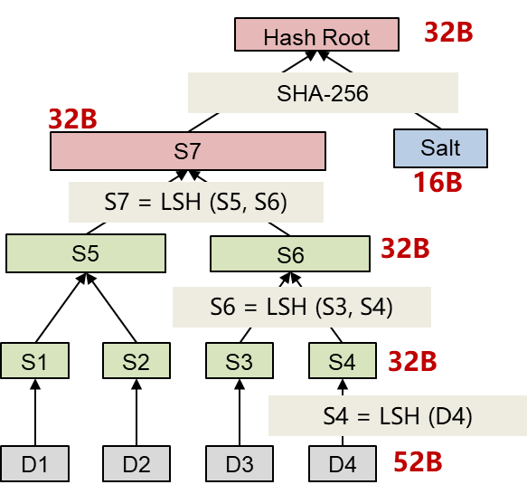

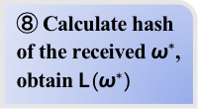
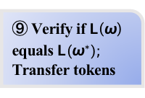
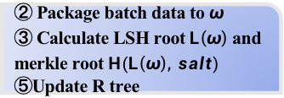


timechain store
User
Blockchain network
④ Query for an apt storage node, obtain $θ$
Storage node Selection
Record for Query
Hash Verification
⑥ Stake$L\left(ω\right)$ ，$R\left(L\left(ω\right), salt\right)$ and tokens
① Forward data
_{R tree}
_{LSH tree}
⑦ Send $ω$ and $L(ω)$to storage node
_{DB client}
Storage node $θ$
Smart contract
Internal operations
Data flow
Point to action set
② Package batch data to $ω$
③ Calculate LSH root$L\left(ω\right)$and merkle root$H(L\left(ω\right), salt)$
⑤Update R tree
⑩Record storage operations, storage node and root hash
⑨ Verify if $L\left(ω\right)$ equals $L(ω^{∗})$;
Transfer tokens
⑧ Calculate hash of the received $ω^{∗}$, obtain $L(ω^{∗})$
Notes:
一版

Slide 21


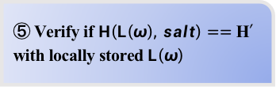

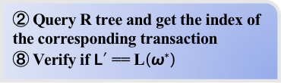
timechain query
User
Blockchain network
⑦ Fetch LSH root$L′$
Record for Query
⑨ Return data
④ Fetch merkle root $H′$
⑥ Send data$ω^{∗}$ and $L\left(ω^{∗}\right)$ to client
Storage node $θ$
① Fetch data query
_{R tree}
_{DB client}
③ Send request of$ω$and $salt$
Smart contract
Internal operations
Data flow
Point to action set
② Query R tree and get the index of the corresponding transaction
⑧ Verify if $L′$ == L$\left(ω^{∗}\right)$
⑤ Verify if $H\left(L\left(ω\right), salt\right)==$ H$′$ with locally stored $L\left(ω\right)$
Notes:
一版

Slide 22





共识算法
Storage node 1
Compute Priority
$$\left\{d_{1},s_{1}\right\}→p_{1}$$
$$\{p_{i}\}$$
Sort
$$max\{p_{i}\}$$
Register
request
request
Storage node 2
Compute Priority
$$\left\{d_{2},s_{2}\right\}→p_{2}$$
$$\{p_{i}\}$$
Sort
$$max\{p_{i}\}$$
Register
_{DB client}
...
request
Storage node n
Compute Priority
$$\left\{d_{1},s_{1}\right\}→p_{1}$$
$$\{p_{i}\}$$
Sort
$$max\{p_{i}\}$$
Register
Prepare
Pre-commit
Commit

Slide 23




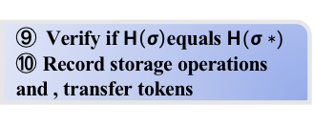
User
sensor
gateway
DB Client
Hyperledger fabric chaincode
sensor
Choose store node
sensor
质押批数据hash与coin
Store node
Verify the equality of the Two hash value
Receive data from DB Client
Calculate hash of batch data
Send hash to Chaincode
User
Blockchain network
④ Query for an apt storage node, obtain $θ$
Storage node Selection
Hash Verification
⑤ Stake $H\left(σ\right)$ and tokens
⑧ Send $H(σ∗)$
to Chaincode
① Forward data
_{DB client}
⑥ Send $σ$ to storage node
Storage node $θ$
Smart contract
Internal operations
Data flow
Point to action set
② Package batch data to $ω$
③ Encrypt$ω$to $σ$, and calculate hash of $σ$ , obtain $H(σ)$
⑨ Verify if $H\left(σ\right)$equals $H(σ∗)$
⑩ Record storage operations and , transfer tokens
⑦ Calculate hash of the received $σ$ as $σ∗$, obtain $H(σ∗)$
Notes:
一版

Slide 24





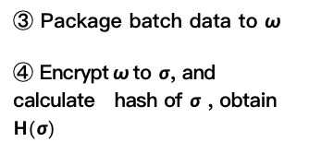



User
sensor
gateway
DB Client
Hyperledger fabric chaincode
sensor
Choose store node
sensor
质押批数据hash与coin
Store node
Verify the equality of the Two hash value
Receive data from DB Client
Calculate hash of batch data
Send hash to Chaincode
Blockchain network
Chaincode:Storage node Selection
(11) Return the verification result
Chaincode:Hash Verification
⑤ Query for remaining storage space and reputation
⑥ Return an apt storage node
⑩ Send $H(σ∗)$
to Chaincode
⑦ Stake $H\left(σ\right)$and coin
User
Storage node
⑧ Send $σ$ to storage node
⑨ Calculate hash of the received $σ$ as $σ∗$, obtain $H(σ∗)$
_{sensor1}
_{sensor2}
_{sensor3}
_{gateway}
_{DB client}
③ Package batch data to $ω$
④ Encrypt$ω$to $σ$, and calculate hash of $σ$ , obtain $H(σ)$
① Send data to gateway
② Forward data
Notes:
草稿

Slide 25
一些可能会忘掉的东西，暂存
网络时延建模or数据集参考
建模：https://www.juestc.uestc.edu.cn/fileDZKJDX_ZKB/journal/article/dzkjdxxbzrkxb/2012/5/PDF/2012-5-781.pdf
网络时延和距离的关系：ziviani2005improving
数据集，但是都是MB：https://ieeexplore.ieee.org/document/7590449
最后是吞吐量（而且感觉数据不太对）而不是RTT：Inside Dropbox: Understanding Personal Cloud Storage Services

