Slide 1





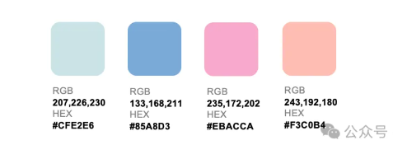
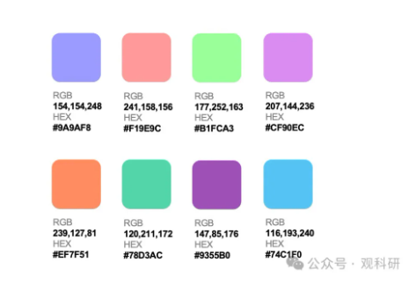
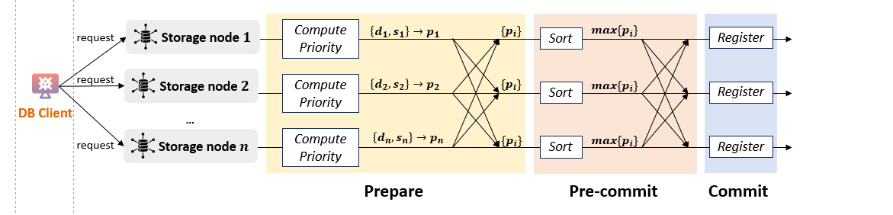
❷ Batching
❸ Storer Discovery
① Retrieval
Data Owner
❶ Uploading
定位
定位
定位
Storage Workflow
Gateway
❹ Dispatching
Storage Provider
Satellite
定位
Query Workflow
④ Return
② Transmission
Log on Ledger
③ Verification
Ledger
measurement baseline store & query
Storage Workflow
Query Workflow
Log on Ledger
❷ Batching
❹ Sending data and proof
② Fetching data and proof
Data Owner
❶ Uploading
Gateway
❸ Storer selecting
Satellites
Storage Provider
④ Return
① Retrieval
③ Verification
Ledger
Notes:
一版

Slide 2
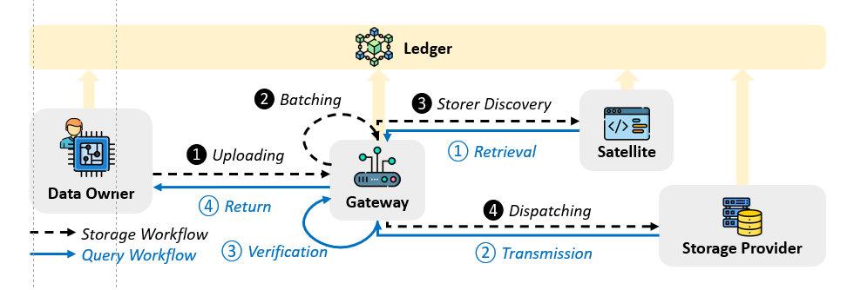


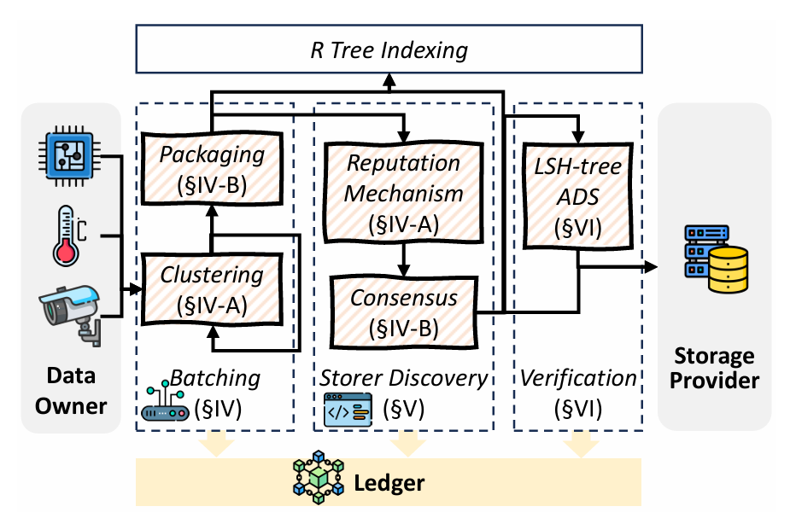
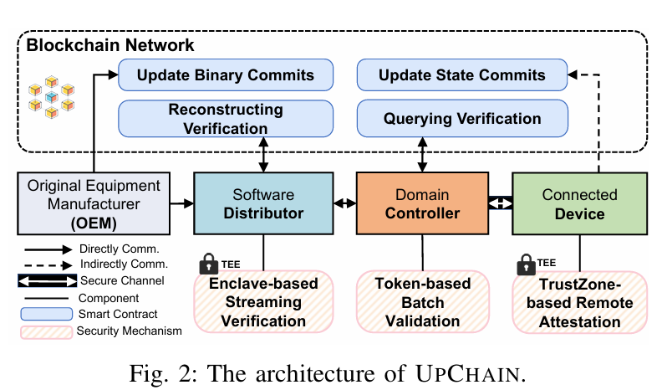

Data Owner
R Tree Indexing
Storage Provider
Data
Batching
Storer Selection
Data
Verification
Packaging (§IV-B)
Consensus-based Node Selection
(§V)
LSH Tree-based Verification
(§VI)
Dynamic
DAG
(§IV-A)
Ledger
Data Owner
R Tree Indexing
Storage Provider
R Tree Indexing
Batching
(§IV)
Storer Discovery (§V)
Verification
(§VI)
Packaging (§IV-B)
Data Owner
Batching
(§IV)
Storer Discovery (§V)
Verification (§VI)
Storage Provider
Node Selection
(§V)
LSH-tree
ADS
(§VI)
Packaging (§IV-B)
Reputation Mechanism (§IV-A)
LSH-tree ADS
(§VI)
Clustering
(§IV-A)
Clustering (§IV-A)
Node Selection
(§V-B)
Hyperledger Fabric
Hyperledger Fabric

Slide 3
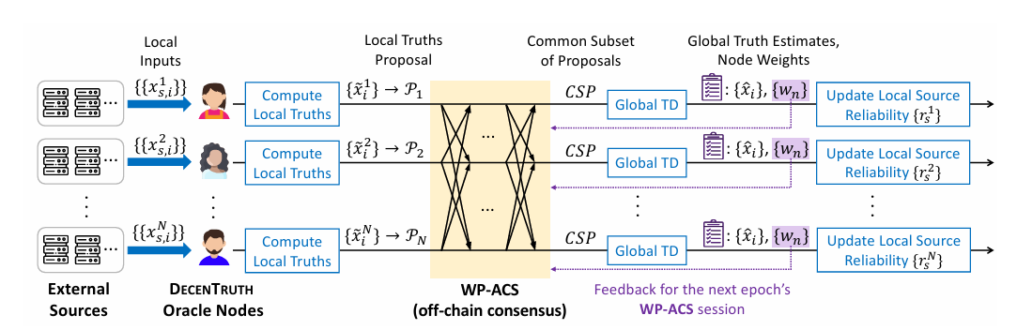
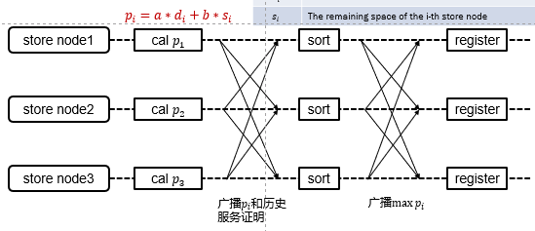








共识算法
Prepare
Pre-commit
Commit
request
Storage node $1$
Compute Priority
$$\left\{d_{1},s_{1}\right\}→p_{1}$$
$$\{p_{i}\}$$
Sort
$$max\{p_{i}\}$$
Register
request
Storage node $2$
Compute Priority
$$\left\{d_{2},s_{2}\right\}→p_{2}$$
$$\{p_{i}\}$$
$$max\{p_{i}\}$$
Sort
Register
Gateway
...
request
Storage node $n$
Compute Priority
$$\left\{d_{n},s_{n}\right\}→p_{n}$$
$$\{p_{i}\}$$
Sort
$$max\{p_{i}\}$$
Register
One-round consensus

Slide 4


共识算法
request
Storage node $1$
Node Selector
Node Selector
best storage node
request
Storage node $2$
Node Selector
Node Selector
best storage node
Node Selector
Gateway
...
request
Storage node $n$
Node Selector
Node Selector
best storage node
First-round consensus
Second-round consensus

Slide 5
same bit
a | c | d | f | e | d
different bit
LSH
b | f | e | d | a | c
f | e | b | c | a | d
LSH
LSH
e | f | c | b | e | a
e | f | c | b | e | d
e | f | c | b | e | b
LSH
LSH
LSH
0 | ... | 0 | 0 | 0
0 | ... | 0 | 0 | 1
0 | ... | 0 | 1 | 0
0 | ... | 0 | 1 | 1
0 | ... | 1 | 0 | 0
0 | ... | 1 | 1 | 0
0 | ... | 1 | 0 | 1

Slide 6
c | a | d | d | f | a
LSH
b | f | e | d | a | c
b | f | e | d | a | d
LSH
LSH
e | f | c | b | e | a
e | f | c | b | e | d
e | f | c | b | e | b
e | f | c | b | e | f
LSH
LSH
LSH
LSH
0 | ... | 0 | 0 | 0
0 | ... | 0 | 0 | 1
0 | ... | 0 | 1 | 0
0 | ... | 0 | 1 | 1
0 | ... | 1 | 0 | 0
0 | ... | 1 | 1 | 0
0 | ... | 1 | 0 | 1

Slide 7
hash root
o | h | l | n | j | y
hash
b | a | f | v | k | i
b | a | f | e | k | a
data
0 | 9 | 3 | 0 | 2 | 3
0 | 9 | 3 | 1 | 2 | 4

Slide 8
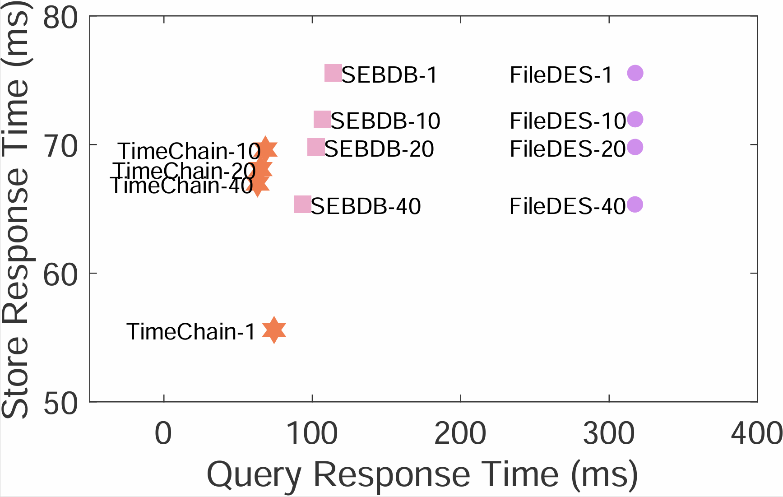
better
better
better
[249,215,192]/255;
[254,192,239]/255;
[223,192,254]/255;
better

Slide 9
❷ Batching
❸ Storer Discovery
① Retrieval
Data Owner
❶ Uploading
定位
定位
定位
Storage Workflow
Gateway
❹ Dispatching
Storage Provider
Satellite
定位
Query Workflow
④ Return
② Transmission
Log on Ledger
③ Verification
Ledger
measurement baseline store & query
Storage Workflow
Query Workflow
Log on Ledger
❹ Sending data and proof
❷ Batching
② Fetching data and proof
Data Owner
locator
❸ Storer selecting
Satellites
Storage Provider
❶ Uploading
Gateway
locator
locator
④ Return
locator
① Retrieval
③ Verification
Ledger
Notes:
一版

Slide 10
Data Owner
R Tree Indexing
Storage Provider
Data
Batching
Storer Selection
Data
Verification
Packaging (§IV-B)
Consensus-based Node Selection
(§V)
LSH Tree-based Verification
(§VI)
Dynamic
DAG
(§IV-A)
Ledger
Data Owner
R Tree Indexing
Storage Provider
R Tree Indexing
Batching
(§IV)
Storer Discovery (§V)
Verification
(§VI)
Packaging (§IV-B)
Data Owner
Batching
(§IV)
Storer Discovery (§V)
Verification (§VI)
Storage Provider
Node Selection
(§V)
LSH-tree
ADS
(§VI)
Packaging (§IV-B)
Reputation Mechanism (§IV-A)
LSH-tree ADS
(§VI)
Clustering
(§IV-A)
Clustering (§IV-A)
Node Selection
(§V-B)
Hyperledger Fabric
Hyperledger Fabric

Slide 11
Data Owner
R Tree Indexing
Storage Provider
Data Batching
Storer Selection
Data Verification
Packaging
(§4.2)
Consensus-based Node Selection
(§5)
LSH Tree-based Verification
(§6)
Adaptive UWG
(§4.1)
Ledger
Data Owner
R Tree Indexing
Storage Provider
R Tree Indexing
Batching
(§IV)
Storer Discovery (§V)
Verification
(§VI)
Packaging (§IV-B)
Data Owner
Batching
(§IV)
Storer Discovery (§V)
Verification (§VI)
Storage Provider
Node Selection
(§V)
LSH-tree
ADS
(§VI)
Packaging (§IV-B)
Reputation Mechanism (§IV-A)
LSH-tree ADS
(§VI)
Clustering
(§IV-A)
Clustering (§IV-A)
Node Selection
(§V-B)
Hyperledger Fabric
Hyperledger Fabric

Slide 12










Prepare
Pre-commit
Commit
$$\left\{d_{1},s_{1}\right\}→p_{1}$$
$$top_{n}\{p_{i}\}$$
request
node $1$
Compute Priority
$$\{p_{i}\}$$
Sort
Register
$$\left\{d_{2},s_{2}\right\}→p_{2}$$
$$top_{n}\{p_{i}\}$$
request
node $2$
Compute Priority
$$\{p_{i}\}$$
Sort
Register
Gateway
...
$$\left\{d_{n},s_{n}\right\}→p_{n}$$
$$top_{n}\{p_{i}\}$$
request
node $n$
Compute Priority
$$\{p_{i}\}$$
Sort
Register
Store nodes
One-round consensus

Slide 13
共识算法
request
Storage node $1$
Node Selector
Node Selector
best storage node
request
Storage node $2$
Node Selector
Node Selector
best storage node
Node Selector
Gateway
...
request
Storage node $n$
Node Selector
Node Selector
best storage node
First-round consensus
Second-round consensus

Slide 14
same bit
a | c | d | f | e | d
different bit
LSH
b | f | e | d | a | c
f | e | b | c | a | d
LSH
LSH
e | f | c | b | e | a
e | f | c | b | e | d
e | f | c | b | e | b
LSH
LSH
LSH
0 | ... | 0 | 0 | 0
0 | ... | 0 | 0 | 1
0 | ... | 0 | 1 | 0
0 | ... | 0 | 1 | 1
0 | ... | 1 | 0 | 0
0 | ... | 1 | 1 | 0
0 | ... | 1 | 0 | 1

Slide 15
same bit
different bit
c | a | d | d | f | a
LSH
b | f | e | d | a | c
b | f | e | d | a | d
LSH
LSH
e | f | c | b | e | a
e | f | c | b | e | d
e | f | c | b | e | b
e | f | c | b | e | f
LSH
LSH
LSH
LSH
0 | ... | 0 | 0 | 0
0 | ... | 0 | 0 | 1
0 | ... | 0 | 1 | 0
0 | ... | 0 | 1 | 1
0 | ... | 1 | 0 | 0
0 | ... | 1 | 1 | 0
0 | ... | 1 | 0 | 1

Slide 16
hash root
o | h | l | n | j | y
hash
b | a | f | v | k | i
b | a | f | e | k | a
data
0 | 9 | 3 | 0 | 2 | 3
0 | 9 | 3 | 1 | 2 | 4

Slide 17
better
better
better
[249,215,192]/255;
[254,192,239]/255;
[223,192,254]/255;
better

Slide 18
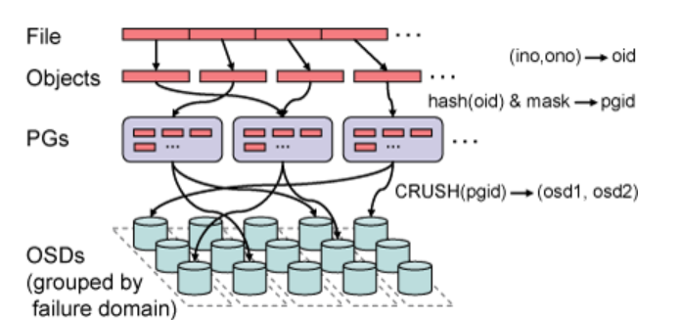
文件
对象
hash
PGs
...
...
...
CRUSH
存储单元

Slide 19
❷ Batching
❸ Storer Discovery
① Retrieval
Data Owner
❶ Uploading
定位
定位
定位
Storage Workflow
Gateway
❹ Dispatching
Storage Provider
Satellite
定位
Query Workflow
④ Return
② Transmission
Log on Ledger
③ Verification
Ledger
measurement baseline store & query
存储工作流
查询工作流
账本记录
❹ 发送数据和完整性证明
❷ 聚合
② 获取数据和完整性证明
数据
拥有方
网关
❸ 选择
存储节点
卫星节点
存储节点
❶ 上传
④ 返回
① 检索
③ 验证
区块链账本
Notes:
一版

Slide 20
数据拥有方
R树索引
存储节点
数据聚合
存储方选择
数据验证
聚合
(§-4.2)
基于共识
的节点选择
(§-5)
基于LSH树的验证机制
(§-6)
自适应图(§-4.1)
区块链账本
Data Owner
R Tree Indexing
Storage Provider
R Tree Indexing
Batching
(§IV)
Storer Discovery (§V)
Verification
(§VI)
Packaging (§IV-B)
Data Owner
Batching
(§IV)
Storer Discovery (§V)
Verification (§VI)
Storage Provider
Node Selection
(§V)
LSH-tree
ADS
(§VI)
Packaging (§IV-B)
Reputation Mechanism (§IV-A)
LSH-tree ADS
(§VI)
Clustering
(§IV-A)
Clustering (§IV-A)
Node Selection
(§V-B)
Hyperledger Fabric
Hyperledger Fabric

Slide 21



准备
预提交
提交
请求
存储节点$1$
计算得分
$$\left\{d_{1},s_{1}\right\}→p_{1}$$
$$\{p_{i}\}$$
排序
$$max\{p_{i}\}$$
记录
请求
存储节点$2$
计算得分
$$\left\{d_{2},s_{2}\right\}→p_{2}$$
$$\{p_{i}\}$$
$$max\{p_{i}\}$$
排序
记录
网关
...
请求
存储节点$n$
计算得分
$$\left\{d_{n},s_{n}\right\}→p_{n}$$
$$\{p_{i}\}$$
排序
$$max\{p_{i}\}$$
记录
一轮共识

Slide 22
相同bit
a | c | d | f | e | d
不同bit
LSH
b | f | e | d | a | c
f | e | b | c | a | d
LSH
LSH
e | f | c | b | e | a
e | f | c | b | e | d
e | f | c | b | e | b
LSH
LSH
LSH
0 | ... | 0 | 0 | 0
0 | ... | 0 | 0 | 1
0 | ... | 0 | 1 | 0
0 | ... | 0 | 1 | 1
0 | ... | 1 | 0 | 0
0 | ... | 1 | 1 | 0
0 | ... | 1 | 0 | 1

Slide 23
相同bit
c | a | d | d | f | a
不同bit
LSH
b | f | e | d | a | c
b | f | e | d | a | d
LSH
LSH
e | f | c | b | e | a
e | f | c | b | e | d
e | f | c | b | e | b
e | f | c | b | e | f
LSH
LSH
LSH
LSH
0 | ... | 0 | 0 | 0
0 | ... | 0 | 0 | 1
0 | ... | 0 | 1 | 0
0 | ... | 0 | 1 | 1
0 | ... | 1 | 0 | 0
0 | ... | 1 | 1 | 0
0 | ... | 1 | 0 | 1

Slide 24
哈希根
o | h | l | n | j | y
哈希
b | a | f | v | k | i
b | a | f | e | k | a
数据
0 | 9 | 3 | 0 | 2 | 3
0 | 9 | 3 | 1 | 2 | 4

Slide 25
区块数据
块级索引
表级索引
区块i-1
区块i
区块n
donate | 1001100...01
transfer | 1101100...01
... | ...
前置哈希
区块高度
时间戳
...
交易j:[...,donate,Jack,Education,100]
交易j+1:[...,transfer,Education,Jack,school1,1000]
交易j+2:[...,distribute,Education,Jack,school1,Tom,50]
块间索引
区块1 | 100...
区块2 | 010...
... | ...
(区块号，交易号，时间戳)

