Slide 2


Slide 3

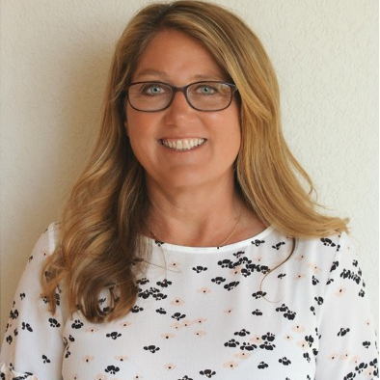
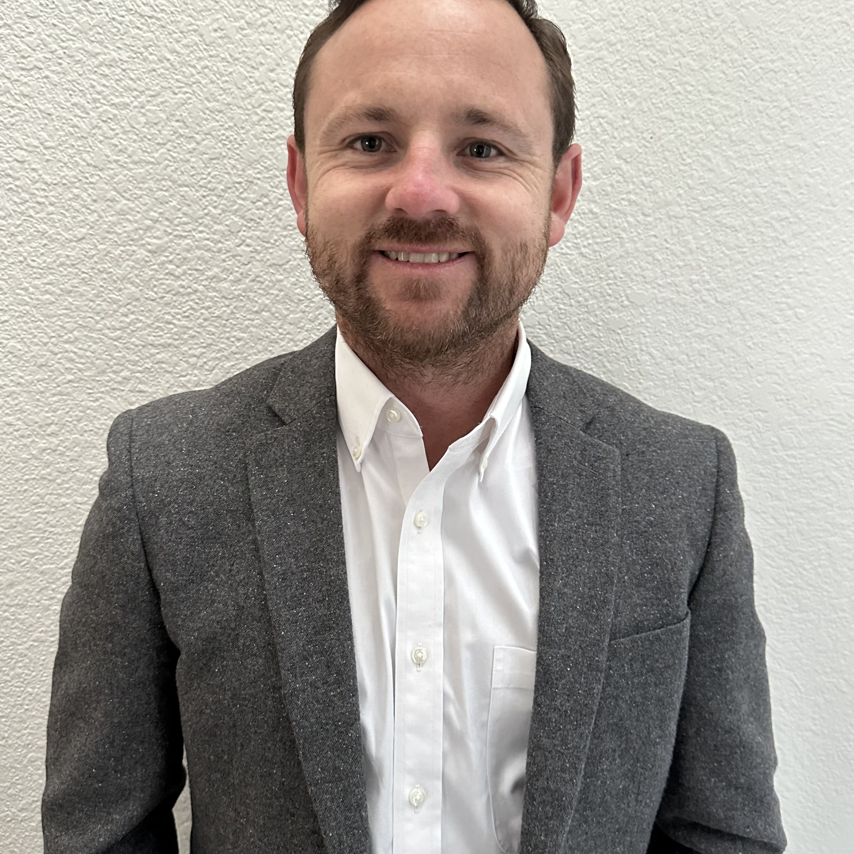
Today’s Speakers
Sally Schulte
Gina Lacy
Ryan Griffiths
Senior Product Marketing Director
Director, Professional Services
Architect, Professional Services
Notes:
Gina and Sally introduce themselves – each of us introduce ourselves independently

Slide 4
Agenda item
Agenda item
Agenda item
Agenda item
Notes:
[SALLY]
Note – comment that we will quickly cover a few new features that are relevant to the topic today

Slide 5
Poll Question
A.
Answer
B.
Answer
Question goes here
C.
Answer
D.
Answer
Notes:
[SALLY]
Attention Grab

Slide 6
Divider Slides

Slide 7

”Insert a customer
quote or headline here
in this text box”
Notes:
[Siren + Point of Persuasion #1]
The important thing to take away from this is…..consumers expect intuitive, fast, mobile-friendly experiences that align with today’s technology.

Slide 19
Headline Goes
In this box

Slide 30
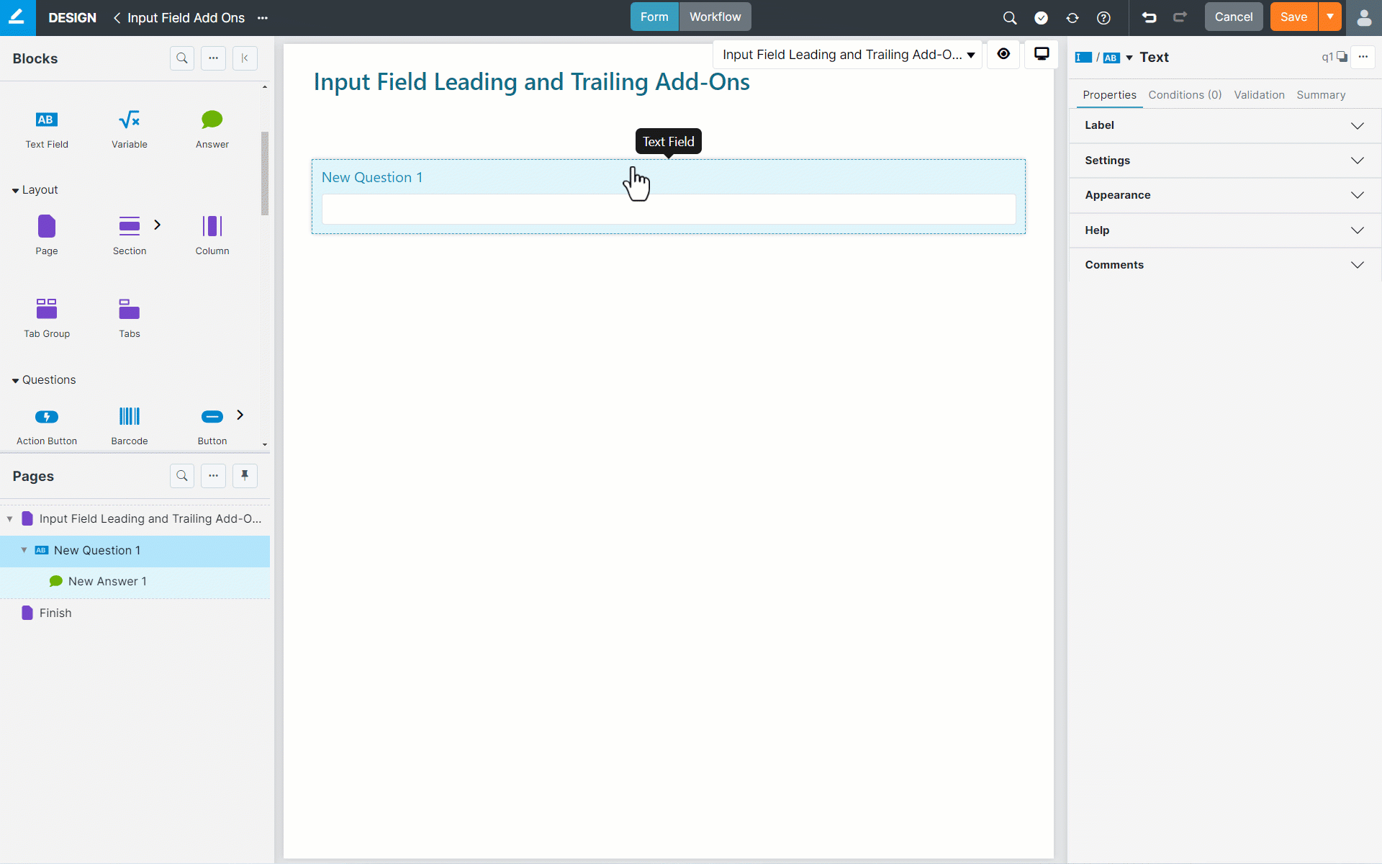

Slide 43
This Text is Placed Here as an Example

Slide 44
This Text is Placed Here as an Example

Slide 50


Thank You!
Notes:
We invite you to connect with our team to arrange a SmartIQ Discover Sesson. By collaborating, we can tailor solutions to your unique needs and embark on a journey of innovation together.

Slide 51
Icons – Business/Digital/Documents

Slide 52
Icons – Business/Digital/Documents

Slide 53
Icons – Customer Centric, Communications

Slide 54
Icons – Customer Centric, Communications

Slide 55
Icons – Data Optimization, Integration, Intelligence, Security

Slide 56
Icons – Data Optimization, Integration, Intelligence, Security

Slide 57
Icons – Cloud

Slide 58
Icons – Cloud

Slide 59


Icons – AI

Slide 60


Icons – AI

