Slide 1
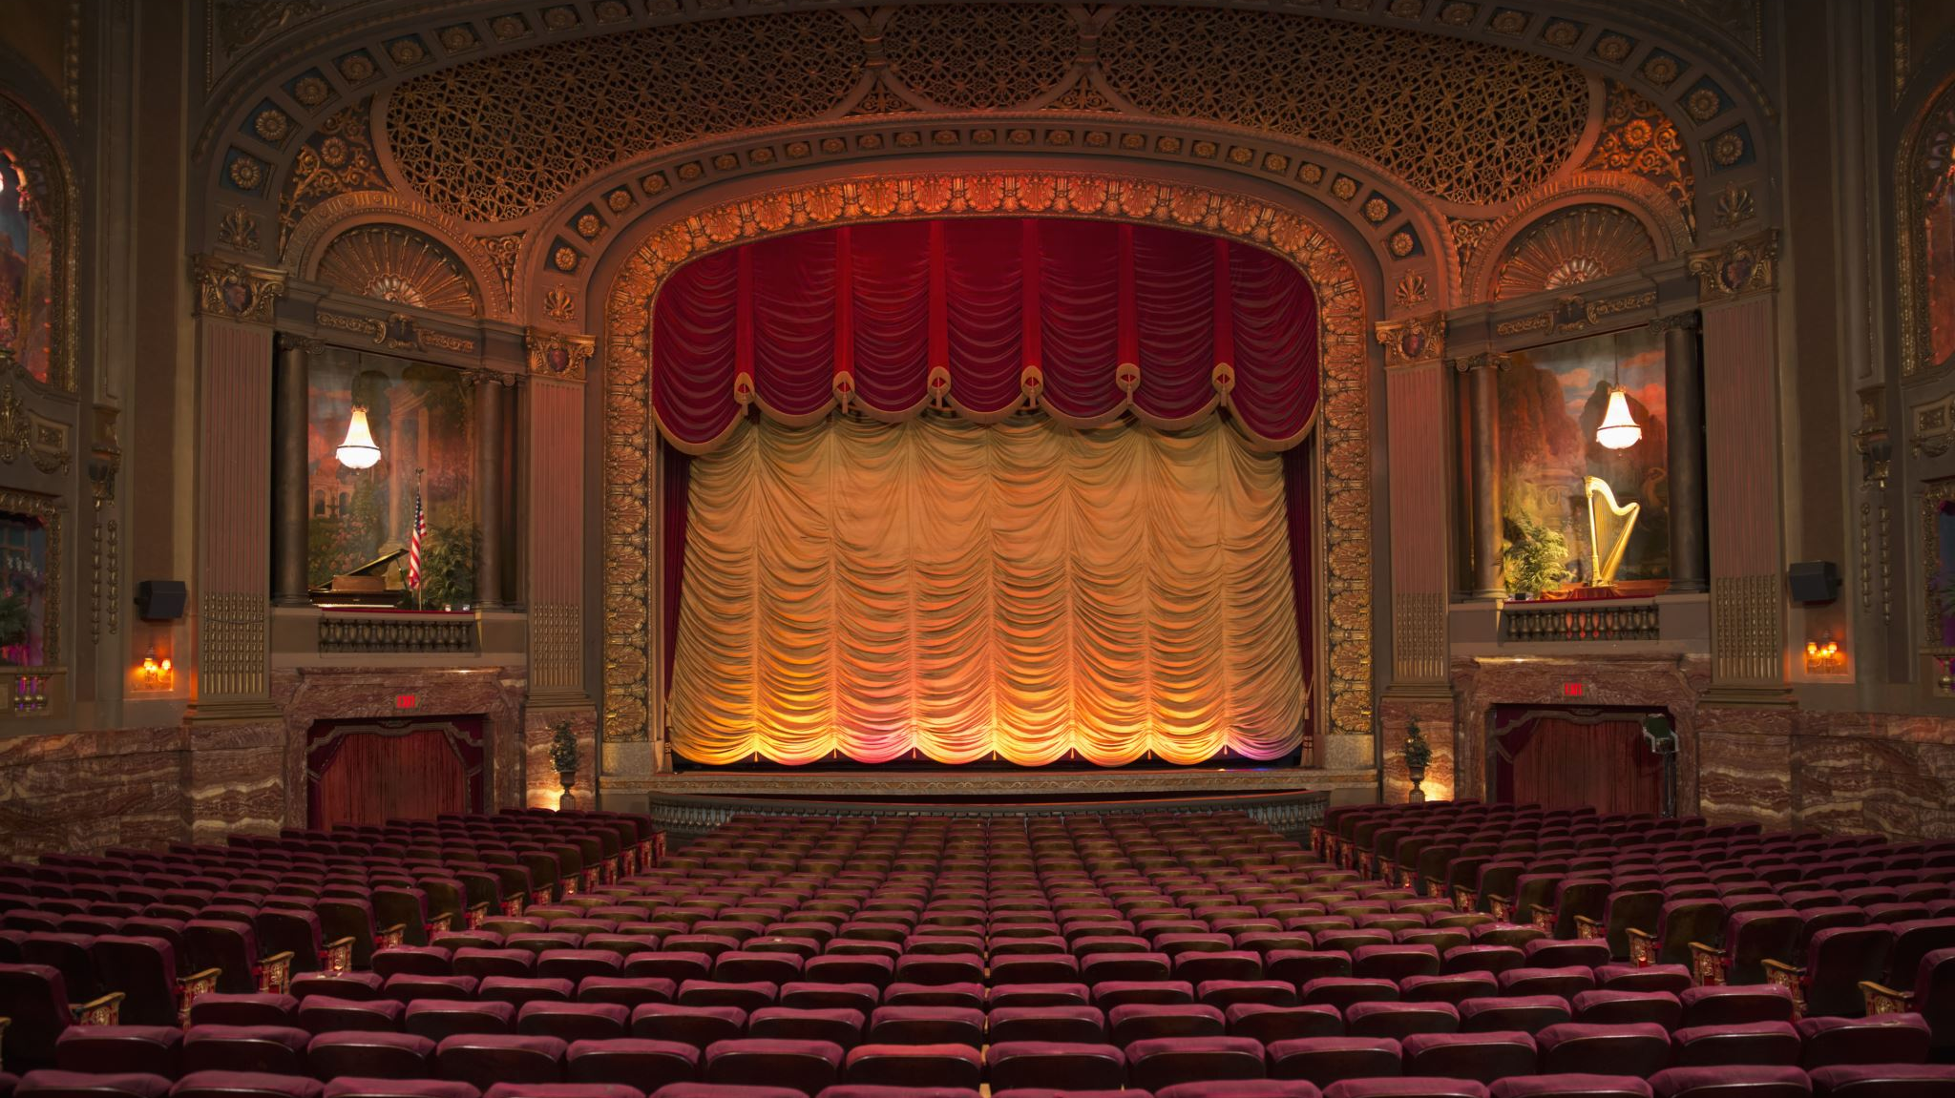
Theatre Royal Project
Presented By: Conan Hollands , Esra Kahraman & Mical Derestable

Slide 2
Contents
Introduction
Project Management
Requirements & Specification
Conclusion
Questions

Slide 3
Introduction
This application is a software engineering project to create a new booking system for The Theatre Royal.
The User Interface is text-based using the console. The application can be used for both Theatre Employees and for the General Public to use to book tickets.
Only The Theatre Employees are granted access to add and remove shows; The General Public does not have access to this feature.

Slide 4
Project Management
Management of the project was carried out by:
Conducting Research
Planning out each task
Studying the Requirements
Good Time Management

Slide 5
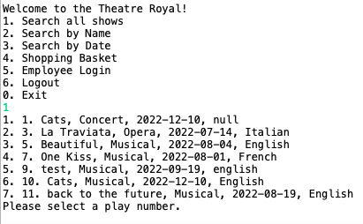
Requirement & Specification
The General Public are allowed to browse shows and search for a show or a specific date. The search result is displayed for user to see.
They can select tickets for purchase, adding them to a ‘basket’. In order to purchase a ticket, they must first register and login into the application.
Example

Slide 6
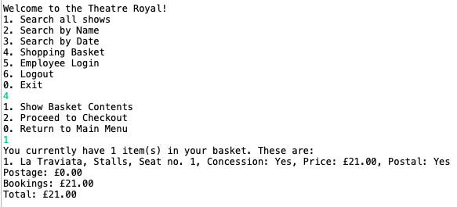
Requirement & Specification
A place order screen is shown with price total and requesting all relevant information to complete purchase.
A report with suggestions for improvements based on third-party data & reports was produced.
Customers have the option to get tickets posted or to collect at the box office. Postage has a £1 per ticket fee unless a concessionary ticket is purchased.
Example

Slide 7
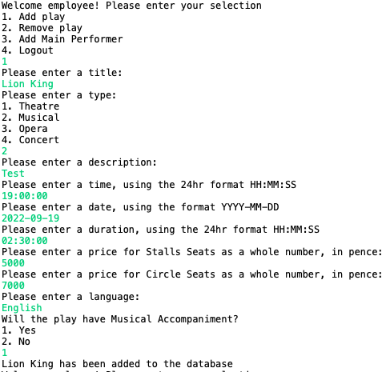
Requirement & Specification
System administrators are able to add new performances to the application.
Users can perform a new show/date search from the screen displaying the result of a previous search.
Example

Slide 8

Conclusion
All modules in the booking system was tested with valid data and invalid data and there were no issues observed at the time of testing.
The specification and requirements were completed and satisfied.
Clear and well-structured code implemented.
The application will keep records of the customers for future bookings and marketing purpose/research.
The application is user friendly.

Slide 9

Question?

