Slide 1
The Theatre Royal
Project
Technical Presentation
By Conan Hollands, Esra Kahraman, and Mical Derestable

Slide 2
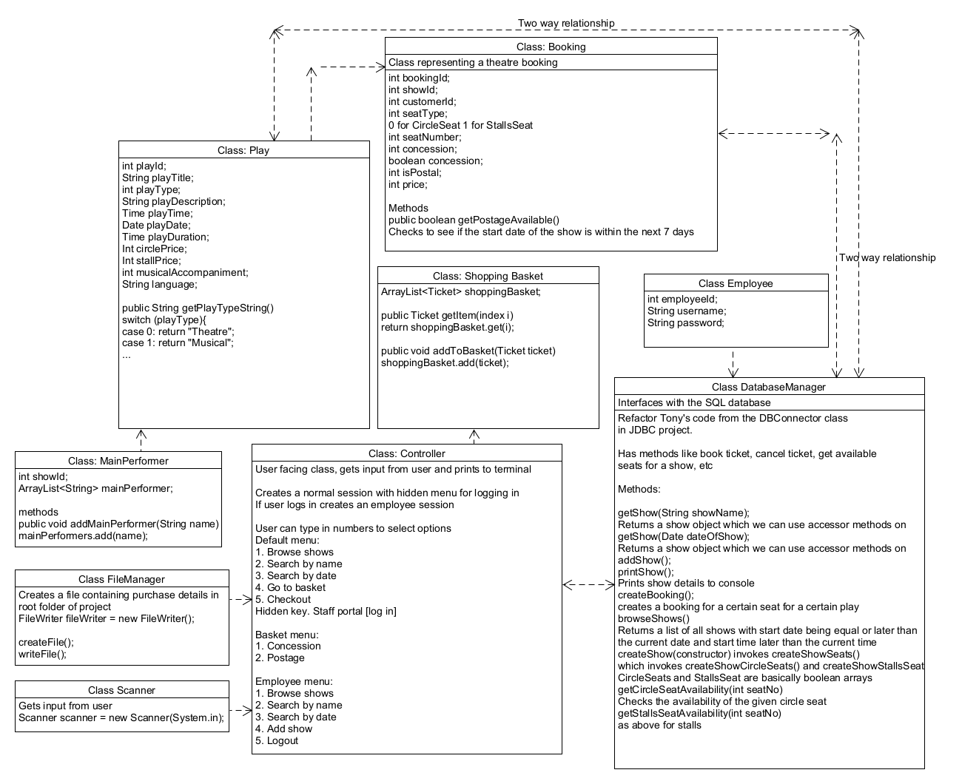
The Plan
Normalised data
Objects can be turned into row data
Row data can be turned into objects
Object-relational mapping

Slide 3
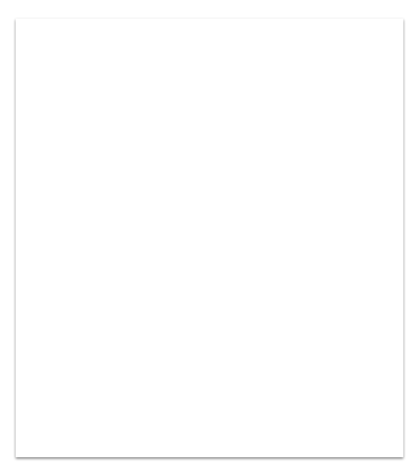
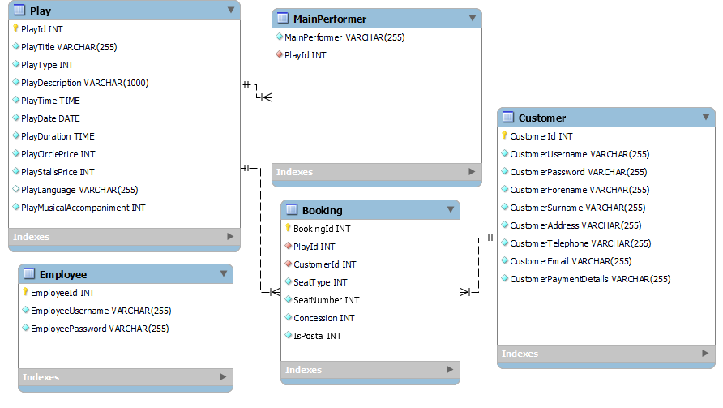
Database
Normalised
Data can be acquired by cross-referencing Id’s
Integers for Booleans and types [0 = false, playType 0 = Theatre, 1 = Musical etc]
Not-nullable default values
We later realised that non-nullable payment details meant that customers could not create accounts outside of checkout

Slide 4
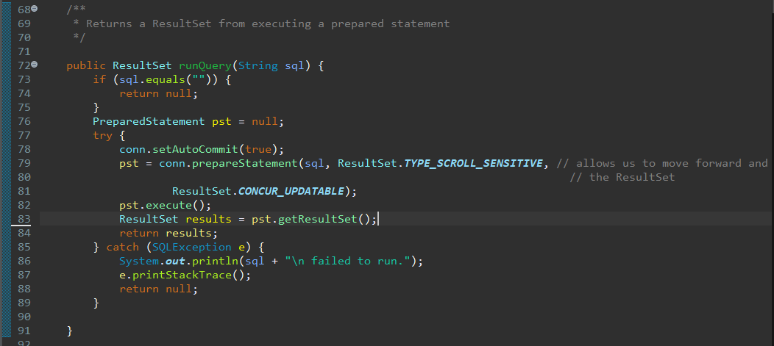
The code
The most basic element of our program is the runQuery function, which takes a string couched in SQL syntax and submits it as a query to the connected database, returning a ResultSet object which the user can operate on

Slide 5
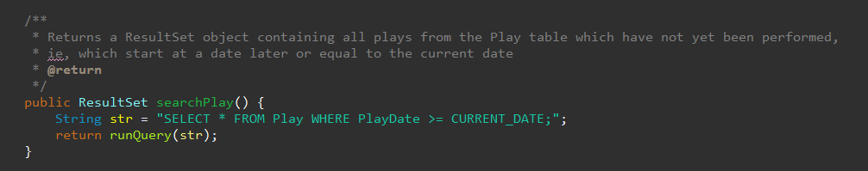
The code
We then created queries to pull rows from the database. The following example pulls all entries in the Play table which have a PlayDate equal to or later than the current one.

Slide 6
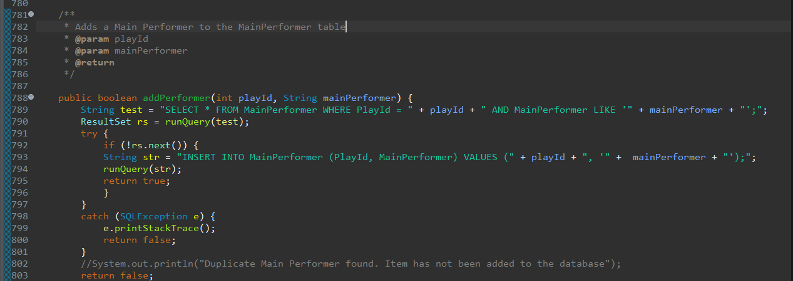
The code
Next we created functions which create rows in the database. For example, here is our addPerformer function. It adds an entry to a MainPerformers table. Each of our functions that inserts an entry into the database has input validation, precluding duplicates from being created. To accomplish this, we search for entries containing duplicate data and attempt to read them in a try/catch block.

Slide 7
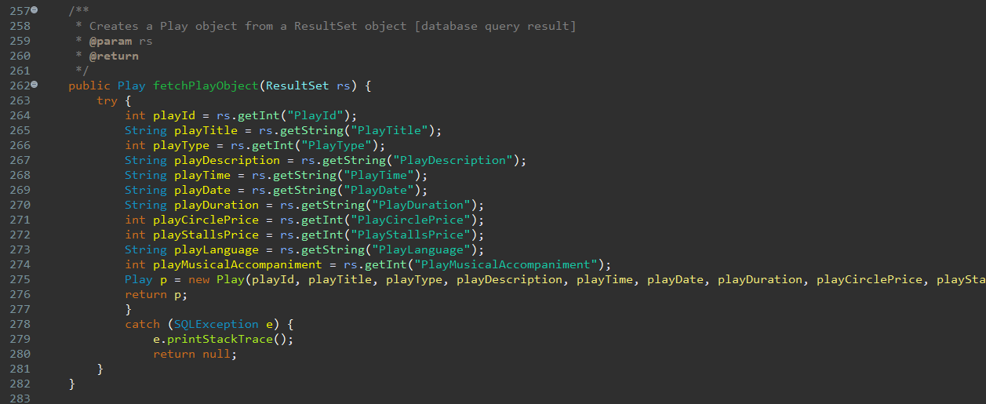
The code
Then came the fun part. We created an Object-Relational Mapping system for pulling rows from the database. We create variables from row data, and use them with a class constructor to create an instance of that row. These are our fetch methods.

Slide 8
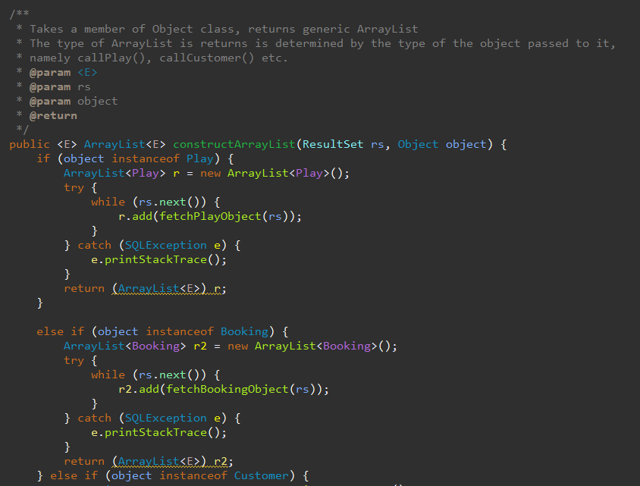
The code
Unless we’re searching for something by ID, ResultSet objects will contain more than one row of data. So we need a way to store all the rows from a ResultSet. And if one object represents one row of data, then we just need a way to store multiple objects. For this we used ArrayList<Object>.
We used generics for this, which can take and return different types of object. We pass an empty object of the relevant type, and the method will use the correct fetch method to create objects from the ResultSet argument, which are then added to an ArrayList and later returned.

Slide 9
Fetch method design note
I wanted to create a single function that could be called to create an object of whatever type was passed to it from ResultSet data. It would look like:
fetchObject(rs, callPlay())
For this I needed an array of methods. Since methods aren’t first class objects in Java, this would need a design pattern which I did not think I had time to implement. A shortcut to achieving this would be to store object fields in an array, and iterate through them according to the number of column names in a given ResultSet. Changing fields from outside a class would require them to be set to public, so perhaps not a desirable quality for a web-based application, especially considering risk to user data.

Slide 10
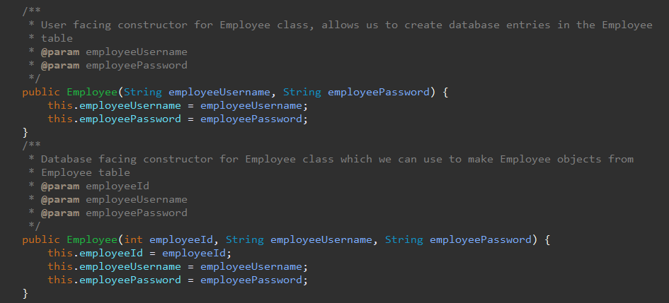
The code
Our approach required a way to manage database-generated data. For example, if a table has an ID that auto-increments, and we wanted to record that data in an object, we can’t use the same constructor we used to make it. We therefore introduced overloaded constructors for each class. Each class has a basic constructor, and an overloaded one for recording Id’s.

Slide 11
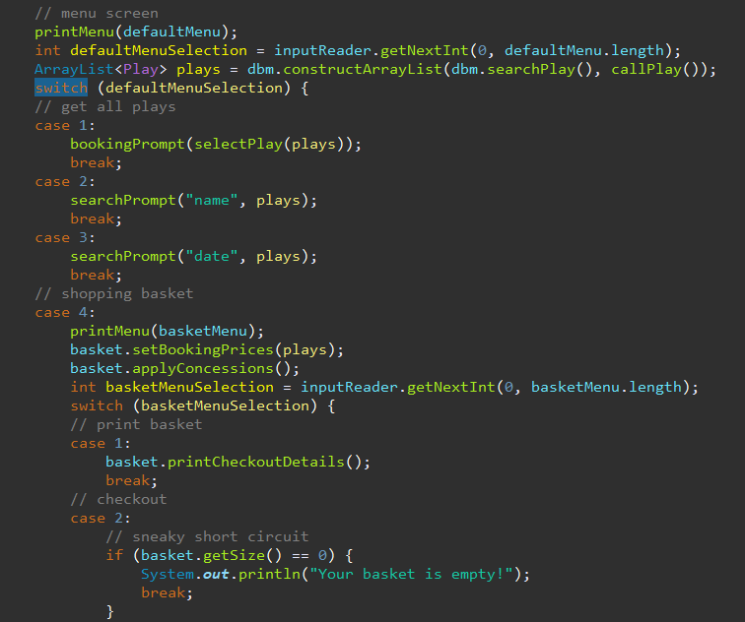
The code
When we had all of our classes set up, we began work on the Controller class to oversee how these classes interacted with each other. For our menus we used a switch-case expression, which is more or less like an if/else if/else block which behaves according to the value of the argument passed to it. In this case, ‘defaultMenuSelection’, which is a user-inputted number. Some of these cases have sub-menus, for which we used further switch-cases. Note that to use a switch-case, you must use the break keyword after each case unless you want the case to ‘cascade’ - which is, after performing the code in that case, it will move onto the next case in sequence, until there are no cases left or it encounters a break statement. In this case, break statements give us a handy way of returning to the main menu.

Slide 12
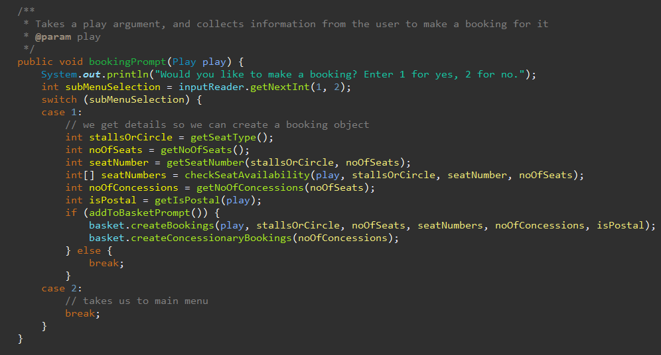
The code
Almost all of our menus and submenus are governed by functions. Many of these simply return user input after a prompt, like ‘How many seats would you like to reserve?’

Slide 13
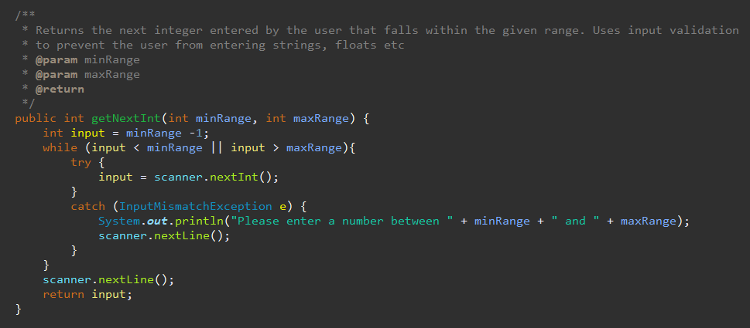
The code
All user input has input validation. The only exception to this is date and time when Employees create plays. But to implement this, all one would need to do is attempt to parse the input String as a LocalDate or LocalTime object.

Slide 14
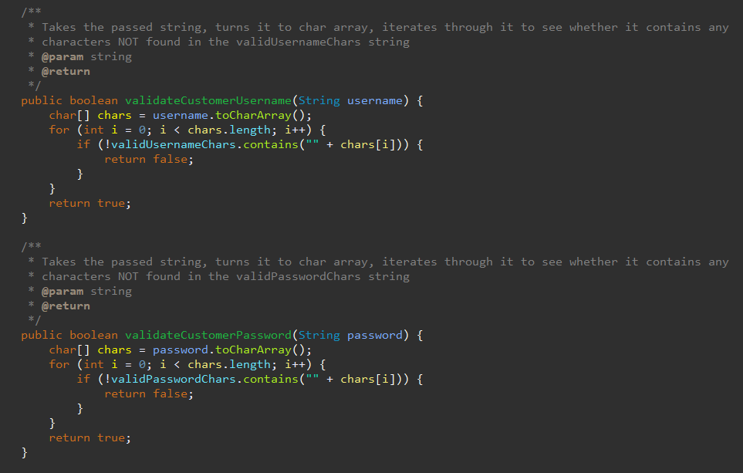
The code
Input validation for usernames and passwords. We turn proposed usernames/passwords into char Arrays, then check to see any characters aren’t in the valid characters string.

Slide 15
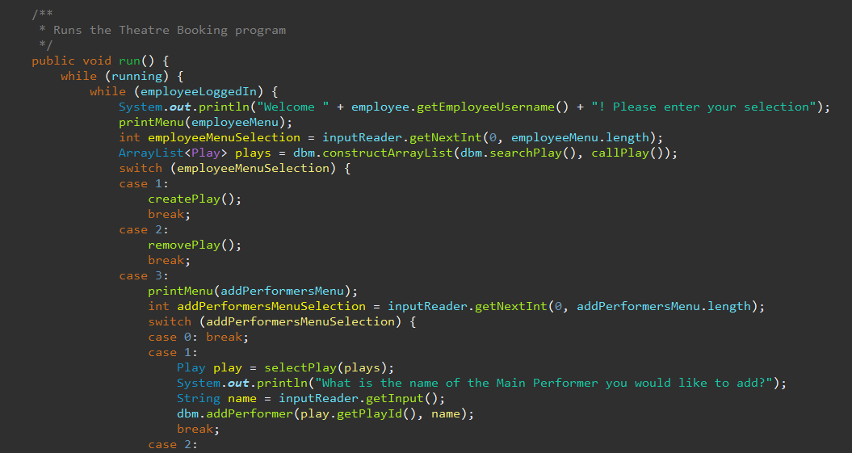
The code
Employee Menu. We situated this menu before the default menu, so that when an Employee logged in, employeeLoggedIn would be set to true and a break statement would send them back to the start of the program and this menu.

Slide 16
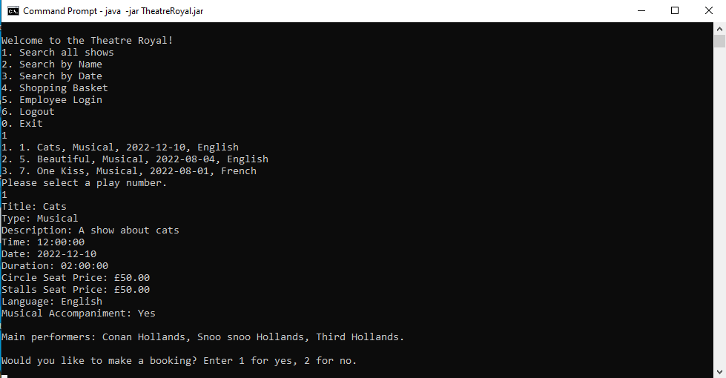
The Program
The main menu and browse all shows

Slide 17
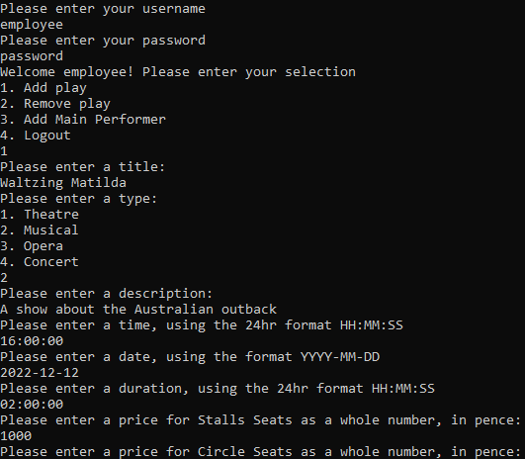
The Program
The employee menu

Slide 18
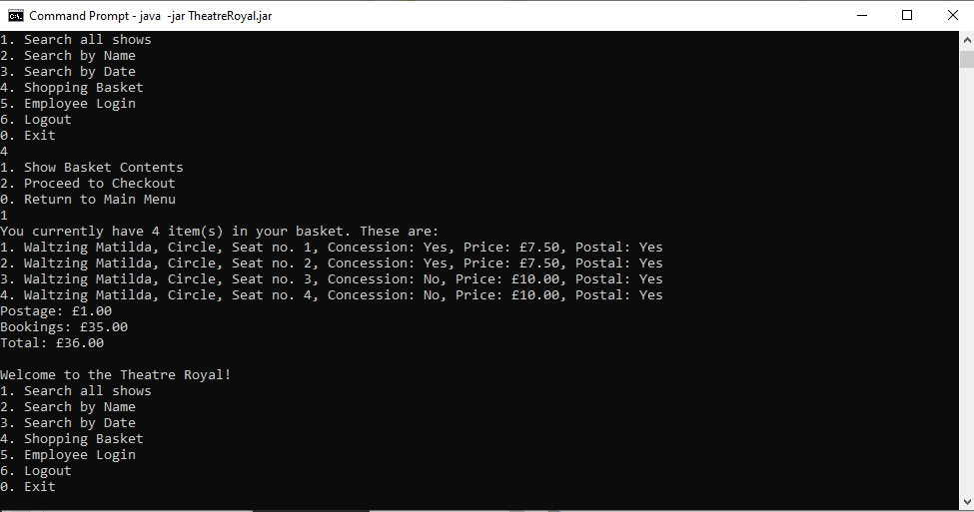
The Program
The shopping basket

Slide 19
Questions
Feel free to ask any technical questions about how the program works, or design decisions

