Slide 1
Factors involved and System interactions in Diabetes
Non Alcoholic Fatty liver disease
Beta cells, Insulin and Insulin resistance
Triglycerides levels and role of dyslipidemia
Adipose tissue, Leptin and Lipid metabolism
Paleo diet/Exercise
TNF-alpha/WBC/hs-CRP – immune systems

Slide 2
Diabetes Diagnostic Criteria
 | Fasting Plasma Glucose (FPG)
Normal | less than 100 mg/dl
Prediabetes | 100 mg/dl to 125 mg/dl
Diabetes | 126 mg/dl or higher
Result | A1C
Normal | less than 5.7%
Prediabetes | 5.7% to 6.4%
Diabetes | 6.5% or higher
Result | Oral Glucose Tolerance Test (OGTT)
Normal | less than 140 mg/dl
Prediabetes | 140 to 199 mg/dl
Diabetes | 200 mg/dl or higher

Slide 3
Diabetes Epidemiology
The increase in type 2 diabetes incidence is outpacing preventive efforts significantly (10.2991/jegh.k.191028.001 ).
Current trend
6059 cases per 100,000 individuals
2030 Projection
7079 cases per 100,000 individuals
The cost of diabetes care is at least 3.2 times greater than the average per capita healthcare expenditure, rising to 9.4 times in presence of complications (10.2991/jegh.k.191028.001 ).
Major Comorbidity (Covid-19)

Slide 4
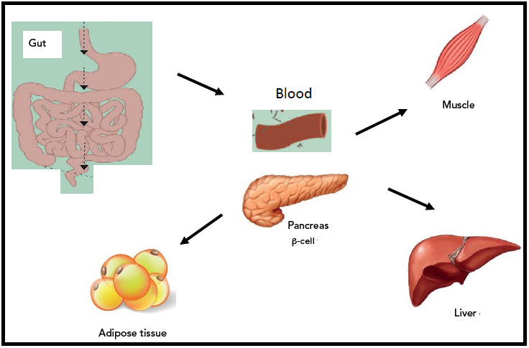
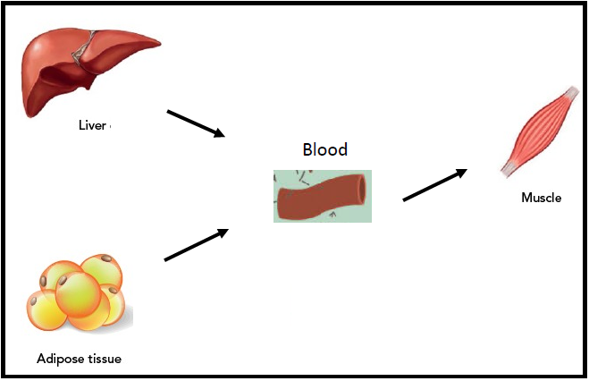
Simplified Physiology – Flow of Glucose
FED state
Fast state
Continuous Glucose
Monitor

Slide 5
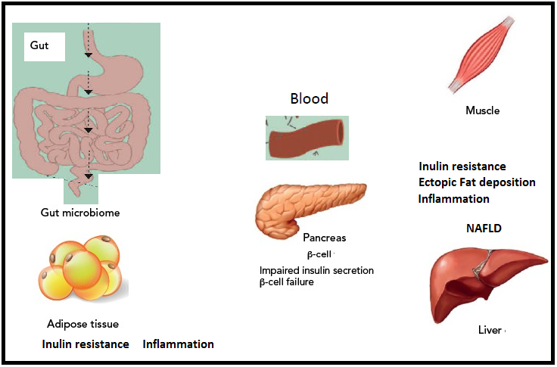
Risk Factors and Multiple paths to Diabetes

Slide 6
Importance of Datascience and AI tools in Diabetes risk prediction
Multiple risk Factors are involved
Evaluating relative impact of different risk factors among individuals both at population level and individual level
Complex Non linear interactions among different systems (Positive and negative loop interactions)
Statistical Analysis and quantitative computational modelling.
Big Data (Analysis ) for Realistic Quantitative modelling of complex systems

Slide 7
Computational Neuroscience – Sub Fields (Spiking models and Normative models)
Spiking models
Psychological models
Dynamical systems
Machine learning models
Normative models
Conductance based models
Application of chat gpt in computational psychiatry
Agent based modelling
Lecture series
https://youtu.be/PzwxxZJpb98
Prepare a magazine style article

Slide 8
Langchain
Building Agents from Large Language Models using langchain
https://learn.deeplearning.ai/langchain/lesson/1/introduction

