Slide 1
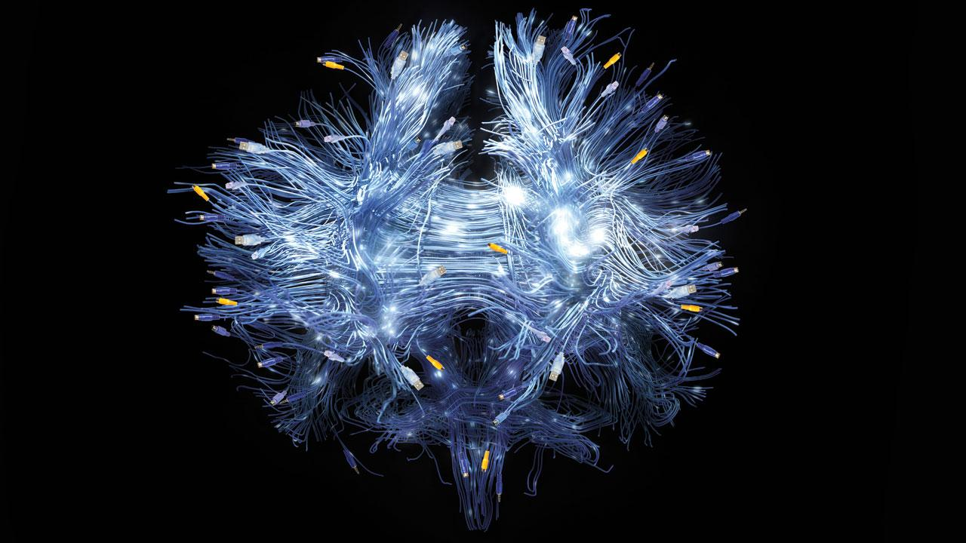
Summer School – Neural Networks with Text
Text Generation
28.09.18, Johanna Binnewitt, Valmir Etemi, Julia Kappes

Slide 3
Research Goal

Slide 4
Research Goal
Generate text by using a Machine Learning algorithm

Slide 5
Retrieve Data

Slide 6
Retrieve Data
General
Model should accept any kind of text data
You can choose text from Shakespeare to Trump to Source code to anything you like
We provide a sample data set

Slide 7
Retrieve Data
Open Data Sites
http://www.gutenberg.org/
http://qwone.com/~jason/20Newsgroups/
https://skymind.ai/wiki/open-datasets
Or just Google what you want ☺

Slide 8
Prepare Data

Slide 9
Prepare Data
Base model
We choose a Character based embedding in order to generate text
Each Character is a one-hot-encoded vector
Example:
Assume: We have a 4 letters alphabet: „H“, „E“, „L“, „O“
Goal: Predict word „Hello“, e.g.
„H“ → „ello“
„He“ → „llo“
…

Slide 10
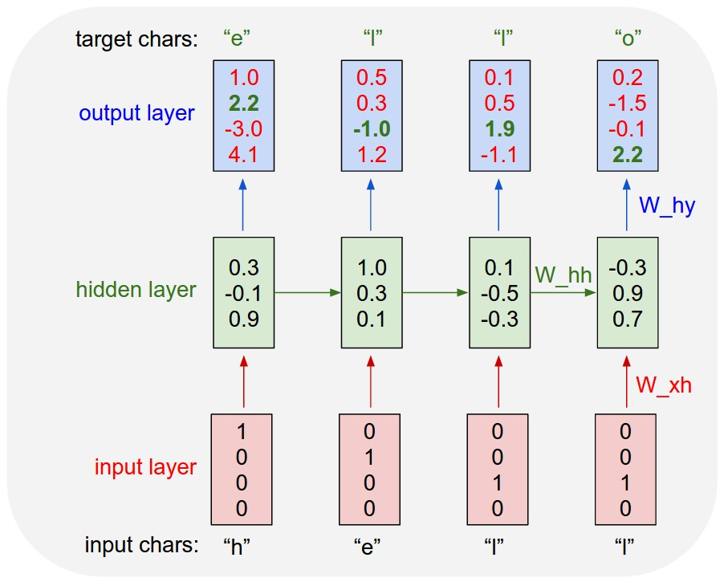
Introduction
One-Hot-Encoding
Source: http://karpathy.github.io/2015/05/21/rnn-effectiveness/

Slide 11
Model Data

Slide 12
Model Data
Recurrent Neural Network
Recurrent Neural Network (RNN) as model
RNNs have a „memory“
Takes not only input into calculation for each neuron but also the result of previous neurons
Much more like the human brain (reading, speaking, etc.)

Slide 13
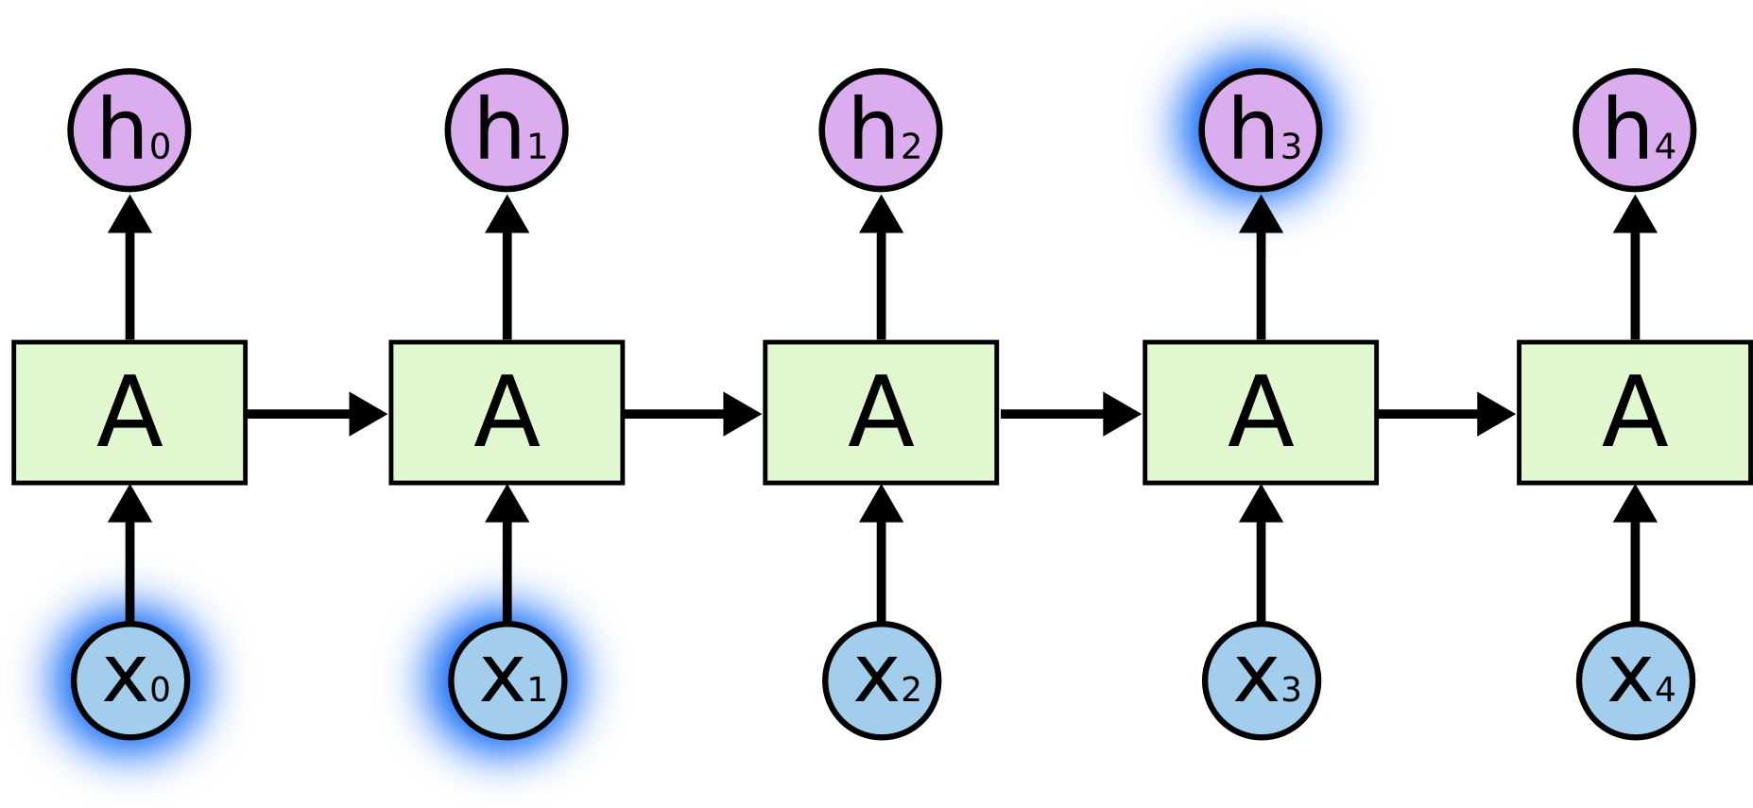
Model Data
Recurrent Neural Network – Remember previous
Source: https://colah.github.io/posts/2015-08-Understanding-LSTMs/

Slide 14
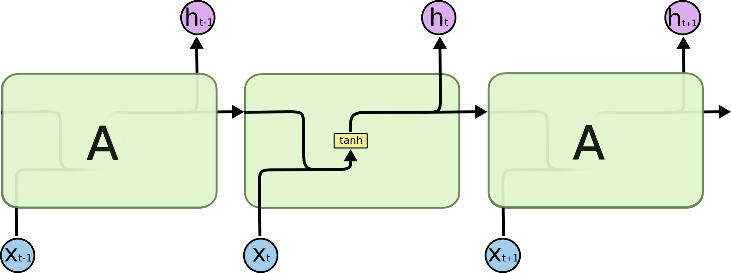
Model Data
Recurrent Neural Network – Internal Calculation

Slide 15
Model Data
Recurrent Neural Network – Example

Slide 16
Text Generation with Neural Network

Slide 17

Text Generation with Neural Network
Let‘s get our hands dirty! – again

