Slide 1
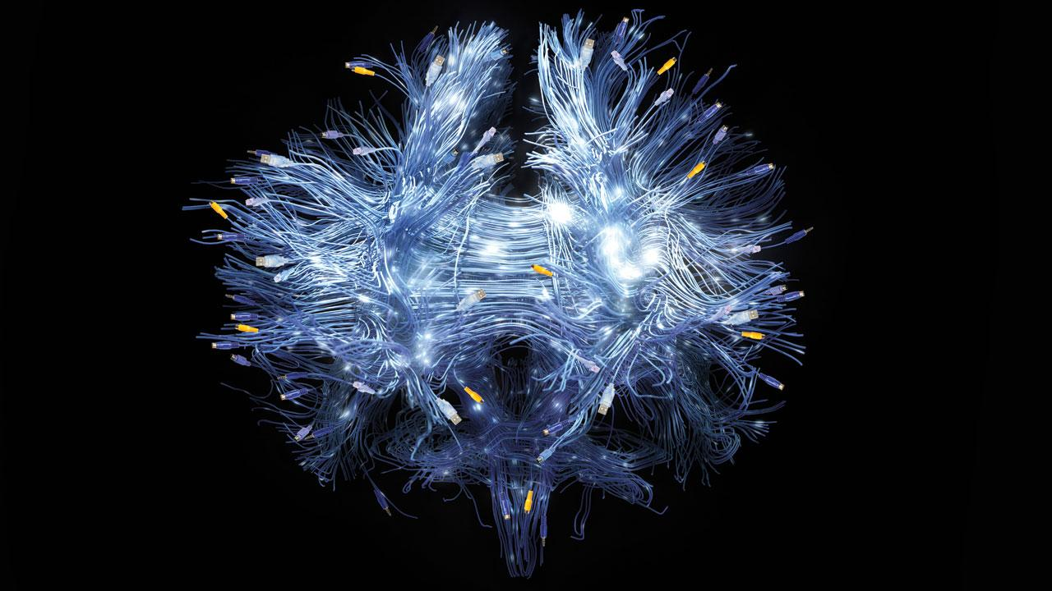
Summer School – Neural Networks with Text
28.09.18, Johanna Binnewitt, Valmir Etemi, Julia Kappes

Slide 3
Introduction

Slide 4

Introduction
What do you expect?

Slide 5
Introduction
What are we going to learn?
Neural Network Basics
How to use Neural Network Frameworks and Tools
How to use Neural Networks for Text Classification
How to use Neural Networks for Text Generation
Python ☺

Slide 6
Introduction
Which Technologies are we going to use?
Jupyter Notebook
Python
Keras

Slide 7
Organisation

Slide 8
Organisation
Schedule
Time | Friday, September 28 | Saturday, September 20
9:00 | Introduction Workshop / NN Basics | Hands on Natural Language Generation
10:30 | Coffee Break
11:00 | Tutorial Text Classification | Discussion Natural Language Generation
12:30 | Lunch Break | Closing
14:00 | Discussion Classification
14:30 | Introduction Natural Language Generation
15:30 | Coffee Break
16:00 | Hands on Natural Language Generation
17:00 | Closing

Slide 9
Data Science

Slide 10
Data Science
How do Data Scientists work?
Define Research Goal
Retrieve Data
Prepare Data
Explore Data
Model Data
Present and automate Model

Slide 11
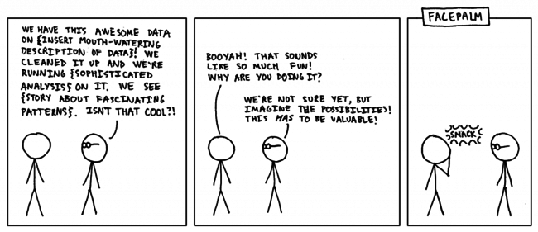
Data Science
1. Define Research Goal
https://medium.com/the-data-experience/building-a-data-pipeline-from-scratch-32b712cfb1db

Slide 12
Data Science
Retrieve Data
Use open data sites:
https://www.gutenberg.org/ (for text)
https://archive.ics.uci.edu/ml/datasets.html
Use internal data if available

Slide 13
Data Science
Prepare Data
Data cleansing (remove false, inconsistent or unnecessary data)
Data integration (enrich data with other sources)
Data transformation (Transform into suitable format)
How to transform text into a model?

Slide 14
Data Science
Explore Data
Understand retrieved data
How are variables interacting?
Use of descriptive statistics, plotting techniques and simple modeling

Slide 15
Data Science
Model Data
Build a model which suits research goal
Machine Learning models
Neural Networks
Etc.

Slide 16
Data Science
Types of Data
Structured data (e.g. SQL databases)
Semi-structured data (e.g. CSV files)
Unstructured data (e.g. text files)
Machine generated (e.g. server log files)
Natural Language
Audio, video, images
Streaming

Slide 17
Data Science
Types of Data
Structured data (e.g. SQL databases)
Semi-structured data (e.g. CSV files)
Unstructured data (e.g. text files)
Machine generated (e.g. server log files)
Natural Language
Audio, video, images
Streaming

Slide 18
Neural Network Basics

Slide 19
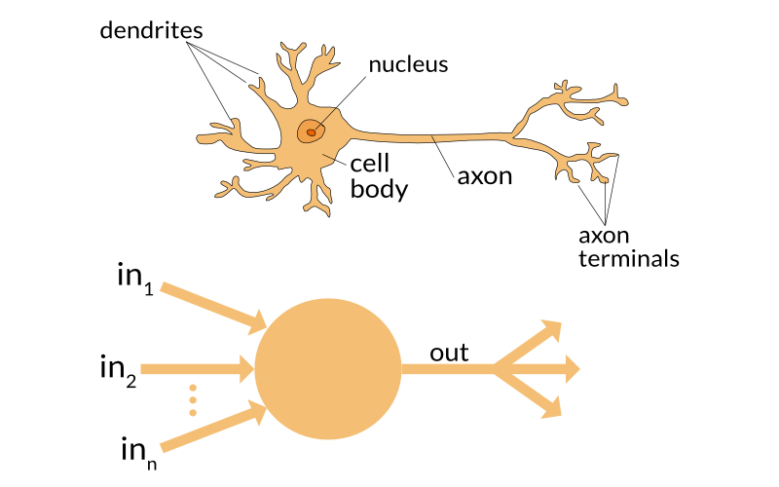
Neural Network Basics
Biological Inspiration
Source: https://towardsdatascience.com/the-differences-between-artificial-and-biological-neural-networks-a8b46db828b7

Slide 20
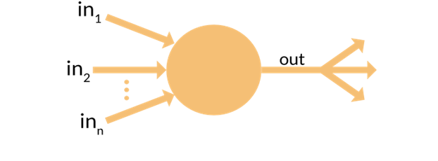
Neural Network Basics
Perceptron (1)
Input data:
Numerical values, e.g. blood values of patients:
in1 (Amount of iron) = 1
in2 (Amount of white blood cells) = 5
in3 (Something else) = 0
=> Vector: { 1, 5, 0 }
Input data consists of values and its class, e.g.
patient1 = {1, 0, 1} → Klasse 1 (krank)
patient2 = {1, 1, 1} → Klasse 0 (nicht krank)
…

Slide 21
Neural Network Basics
Perceptron (2)
Weights:
That is our model
Weights will be adjusted during the training in order to calculate the right class for the given training data.

Slide 22
Neural Network Basics
Perceptron (3)
Prediction:
The calculation is based on the dot product of the vector of the input data and the vector of the weights
Example:
Input Data: {2, 3, 2},
Weights: {0.5, -0.2, 0.1}
Calcuation:
2 * 0.5 + 3 * (-0.2) + 2 * 0.1 = 0.6

Slide 23
Neural Network Basics
Perceptron (4)
Output:
The output is the result of the dot product and an activation function.
Determines the class
Activation functions can be super simple functions, e.g. thresholds or more complex ones, e.g. Sigmoid
Example:
Result: 0.6,
Threshold: 0.5
Class → 1

Slide 24
Neural Network Basics
Perceptron (5)
Training:
If calculation of prediction outputs a wrong class, then the weights have to be adjusted in order to calcuate the correct class
Example:
Result: 0.6,
Threshold: 0.5
Target class = „0“ (Actual class „1“)
→ Error = 0 (Target) – 1 (Result) = -1

Slide 25
Neural Network Basics
Perceptron (6)
Optimizer:
Our weights have to be adjusted so that the output is less then the treshold (0.5)
Optimizer functions can also be simple, e.g. Hebbian learn rule or very complex
Example (Hebbian learn rule):
Adjust = Learning rate * Input value * Error
Adjust1 = 0.02 * 2 * (-1) = -0.04
New weight 1 = Old weight + Adjustment
0.5 – 0.04 = 0.46
Weights:
Weights before: { 0.5, -0.2, 0.1 }
Weights after: { 0.46, -0.26, 0.06 }

Slide 26
Neural Network Basics
Multi Class Problem
Previously only two classes: „0“ or „1“ (Spam, not spam, etc.)
Example for Multi Class Problem:
Image Recognition
Each picture (dog, cat, mous, etc.) equals to one class

Slide 27
Neural Network Basics
Multi Class Classification – Perceptron?
Is it possible to use perceptrons for multiple classes?
If not, what could we change to make it work?

Slide 28
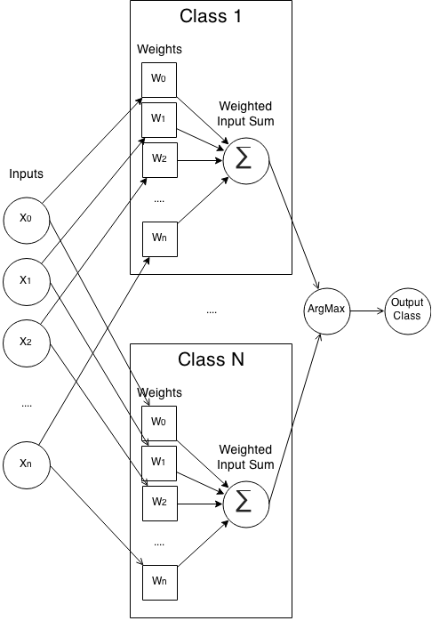
Neural Network Basics
Multi Class Classification – Perceptron! (1)

Slide 29
Neural Network Basics
Multi Class Classification – Perceptron! (2)
Calculation:
Each class is one perceptron and will be trained separately
That is, each class/perceptron has its own set of weights to train
Calculation remains the same

Slide 30
Neural Network Basics
Multi Class Classification – Perceptron! (3)
Input:
The whole input will be trained with each class weight set

Slide 31
Neural Network Basics
Multi Class Classification – Perceptron! (4)
Prediction:
Results of each class weight calculation will be compared
The class with the highest calculation is the class of prediction (ArgMax Function)

Slide 32
Neural Network Basics
Multi Class Classification – Perceptron! (5)
But how do we train now?

Slide 33
Neural Network Basics
Multi Class Classification – Perceptron! (6)
Training:
If the prediction is wrong, the weights of the predicted class have to be decreased for the particular input
Weights of correct (but not predicted) class have to be adjusted upwards

Slide 34
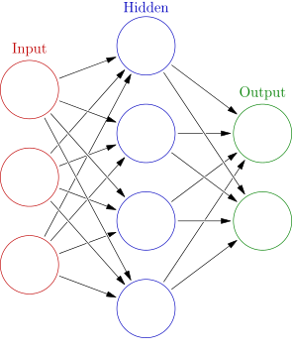
Neural Network Basics
Structure of Multi Layer Perceptrons (aka Neural Networks)
Multi Class Perceptrons have one hidden layer where all the calculations is done
For more complex problems neural networks with several layers have been developed (and nowadays called „deep“)
Source: https://en.wikipedia.org/wiki/Artificial_neural_network

Slide 35
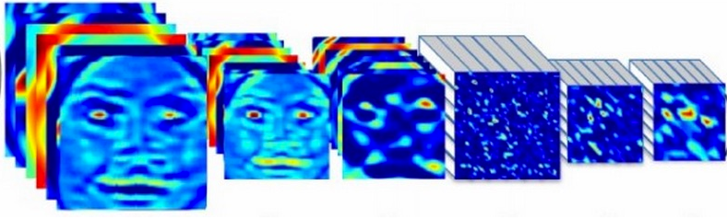

Neural Network Basics
Example for Deep Learning – Convolutional Neural Network
…
Dog?
…
Human?
…
...?
Convolution/Pooling Neurons
Fully-connected Neurons
Input

Slide 36
Neural Network Basics
Summary and terms
Input: Numerical vectors or matrices
Activation: Can be a threshold or other functions to determine if Neuron fires or not („0“ or „1“)
Learning rate: Determines how fast an algorithm should adjust to new data. A high learning rate adjusts better and faster to new data but also discards learned circumstances
Optimizer: Function to optimize model (i.e. weights)
Epochs: An epoch is a whole iteration of than one iteration of all data to have an optimal model for the given problemall input data. Algorithms need more
Batches: Sometimes data is too big to put fully into RAM. Then it needs to be processed into slices (aka batches).
Regularization: Goal is to use as less variables for a model as possible to prevent overfitting, e.g. by dropping out a fixed number of neurons

Slide 37
Tools and Frameworks

Slide 38
Tools and Frameworks
Prerequisites
Git (https://git-scm.com/downloads)
Sourcecode (https://github.com/spinfo/LSS_DLwithText)
Anaconda (https://www.anaconda.com/download/)
Keras (

Slide 39
How do I get started with DL?
...pretty good question
🤔
Notes:
39

Slide 40
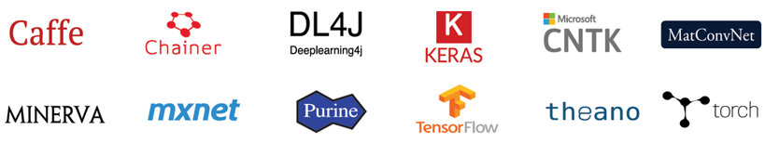
How do I get started with DL?
...pretty good question
Notes:
40

Slide 41

Best way to learn?
… DIY!

Slide 42

Tools and Frameworks
Why Keras?
Quickly train and test model
From Standard layer:
Wraps multiple frameworks
(Simplified) interface to Theano, CNTK or TensorFlow
TensorFlow is default API
Write and debug custom models and layers:

Slide 43
How do I build a Neural Network in Keras?
Pipeline
Define Network
Compile it
Fit it
Evaluate it
Make Predictions

Slide 44
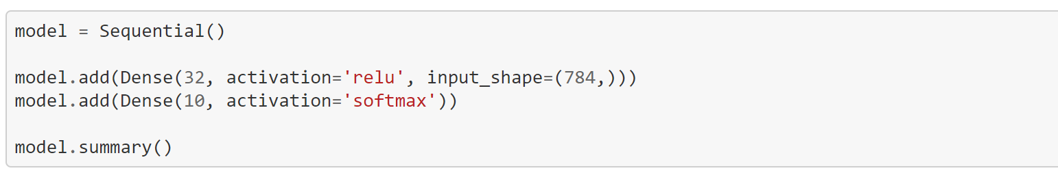
How do I build a Neural Network in Keras?
Define Network
Create an instance of the sequential class
Define sequence of layers
Add new lines (each line is a new layer)
First Layer: number of inputs (can differ depending to the network type)

Slide 45
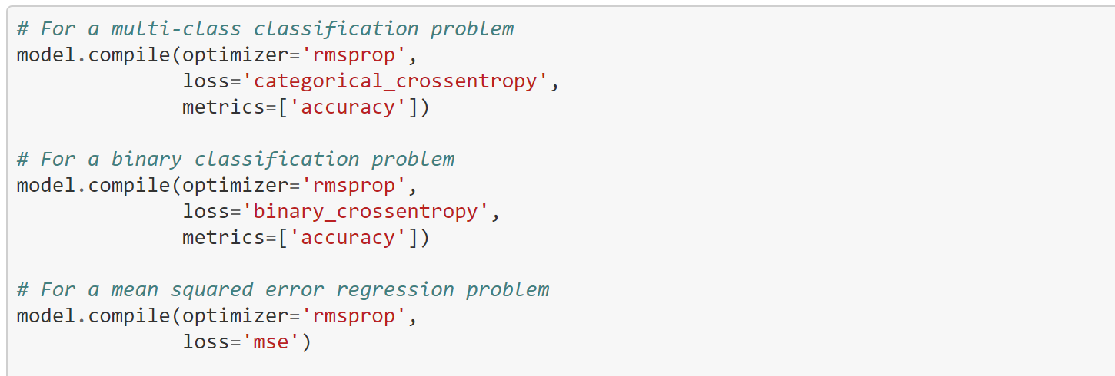
How do I build a Neural Network in Keras?
Compile it
Transforms a simple sequence of layers into a highly efficient series of matrix transforms
Intended to be executed on the GPU (depending on the configuration set)
Optimization: Train the network
Loss Function: Evaluate the network

Slide 46
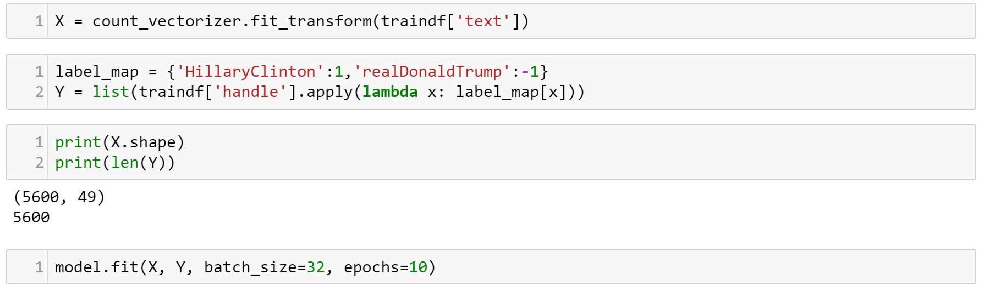
How do I build a Neural Network in Keras?
Fit Network
Adapting the weights of the training data set
Input X → Matrix of input patterns
Output Y → Array of matching output patterns

Slide 47
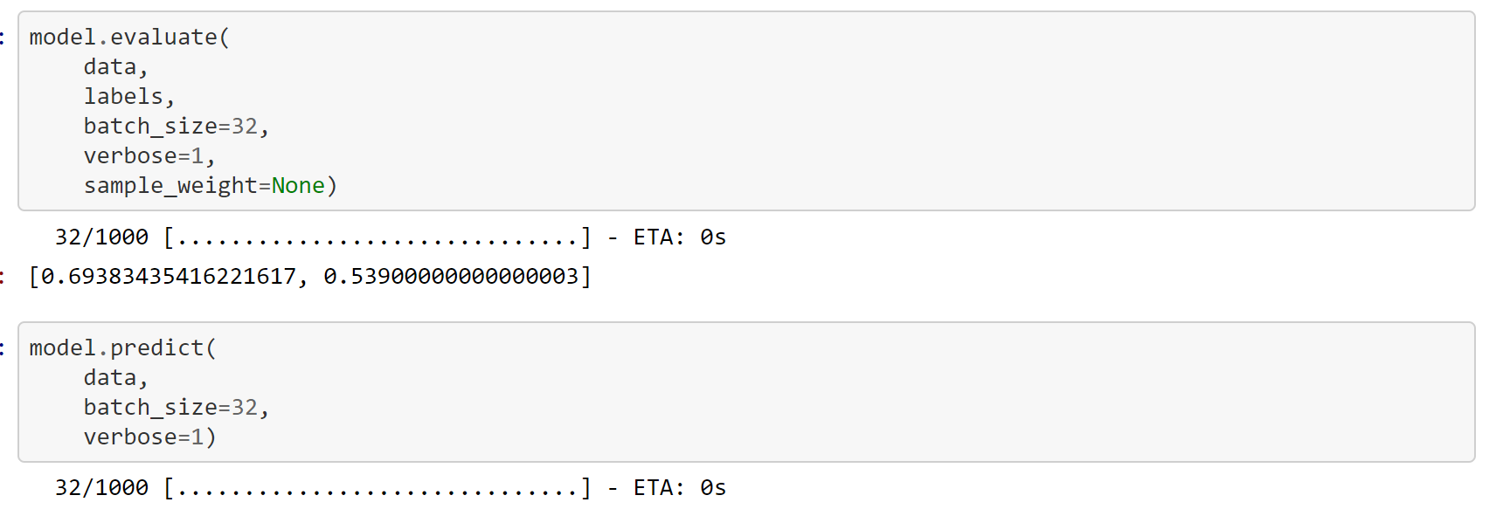
How do I build a Neural Network in Keras?
Evaluate Network and use it to make predictions
How good does model work? Evaluate it!
Input X → Matrix of input patterns (test data)
Output Y → Array of matching output patterns (test data)
Try out trained model with completely new data
What will it predict?

Slide 48
Classification with Neural Networks

Slide 49
Classification with Neural Networks
How to transform a text into a model?
Neural Networks need numerical vectors to compute output
Transformation from text to model is done via word embeddings
There are plenty algorithms for generating word embeddings

Slide 50
Classification with Neural Networks
Word embedding
Simplest word embedding is Bag of Words:
Input: “My dog has a dog name”, “My dog is cute”
Bag of Words:
Sent1: { “My” : 1, “dog” : 2, “has” : 1, “a” : 1, “name” : 1, “is” : 0, “cute” : 0 }
Sent2: { “My” : 1, “dog” : 1, “has” : 0, “a” : 0, “name” : 0, “is” : 1, “cute” : 1 }
→
Sent1: { 1, 2, 1, 1, 1, 0, 0 }
Sent1: { 1, 1, 0, 0, 0, 1, 0 }

Slide 51
Classification with Neural Networks
Word embedding
Bag of Words:
Features: Words
Values in Vector: Total Word Count in document
(other features (lemma, ngrams,..) and values (weigthed,…) are possible)
Feature Vector serves as Input Vector for Neural Network

Slide 52
Classification with Neural Networks
And the labels?
each output node of the Neural Network represents a label
the higher the output value, the more probable the label is

Slide 53

Classification with Neural Network
Let‘s get our hands dirty!

