Slide 1
HEALTH & MEDICAL DATA SCIENCE PROJECT
Maternal Health Risk
Stratification
Statistical Analysis, Exploratory Data Analysis, and
Interpretable Machine Learning on the UCI Maternal Health Risk Dataset
Mahdiyeh Mirzaei
github.com/mahdiyeh-mirzaei-v2
September 2026
n = 1,012 patients · Python · SQL · scikit-learn

Slide 2
AGENDA
01
Introduction & Data
What we'll
cover
Research question, source, and cleaning decisions
02
Exploratory Analysis
Risk groups, Blood Sugar, BP, Age & Heart Rate
A reproducible workflow from raw sensor data to an interpretable screening model.
03
SQL & Python Pipeline
Reproducible queries and preprocessing
04
Machine Learning
Logistic Regression vs. Decision Tree
05
Results & Dashboards
Metrics, feature importance, BI visuals
06
Limitations & Next Steps
Scope, caveats, and recommendations

Slide 3
INTRODUCTION
Why Maternal Risk Stratification?
Digital health systems and low-cost IoT sensors let us monitor blood pressure, glucose, temperature, and heart rate at scale. The UCI Maternal Health Risk dataset was collected from hospitals and community clinics in rural Bangladesh through such a system.
1,012
patients analyzed
6
RESEARCH QUESTION
physiological variables
How strongly do a small set of routine physiological variables distinguish Low, Mid, and High maternal risk — and can an interpretable baseline classifier identify High-Risk patients with useful sensitivity?
3
risk classes: Low / Mid / High
Maternal Health Risk Stratification
3

Slide 4
DATA & STUDY DESIGN
Data Source & Variables
UCI Maternal Health Risk dataset (Dataset 863) — Ahmed (2020), DOI 10.24432/C5DP5D. Collected via an IoT-based risk-monitoring system in rural Bangladesh; 1,014 raw observations, no missing values.
Variable | Type / Unit | Description
Age | Numeric; years | Maternal age recorded in years
SystolicBP | Numeric; mmHg | Systolic blood pressure
DiastolicBP | Numeric; mmHg | Diastolic blood pressure
BS | Numeric; mmol/L | Blood sugar (glucose) concentration
BodyTemp | Numeric; °F | Body temperature
HeartRate | Numeric; bpm | Heart rate
RiskLevel | Categorical (target) | Low Risk, Mid Risk, or High Risk
Maternal Health Risk Stratification
4

Slide 5
DATA & STUDY DESIGN
Data Cleaning & Quality Decisions
0
562
2
1,012
Missing values
Exact duplicates
Implausible Heart Rate
Final analytical sample
None found — no imputation needed.
Retained. Coarse sensor rounding can legitimately create identical rows across different patients.
Two records with HR = 7 bpm removed as sensor/entry errors — no replacement imputed.
Used consistently across every table, figure, model, and dashboard in this deck.
Final class balance: Low Risk 404 (39.9%) · Mid Risk 336 (33.2%) · High Risk 272 (26.9%)
Maternal Health Risk Stratification
5

Slide 6
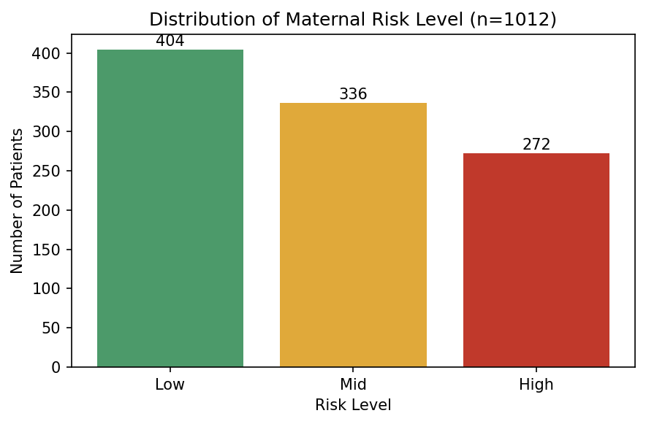
EXPLORATORY DATA ANALYSIS
Risk-Level Distribution
Group-level means
Risk | n | Age | SBP | DBP | BS | HR
Low | 404 | 26.9 | 105.8 | 72.5 | 7.22 | 73.1
Mid | 336 | 28.4 | 113.2 | 74.2 | 7.80 | 74.2
High | 272 | 36.2 | 124.2 | 85.1 | 12.12 | 76.7
High-Risk patients are older, and show meaningfully higher blood pressure and blood sugar than Low-Risk patients. Not an extreme class imbalance, but large enough that accuracy alone won't tell the full story.
Maternal Health Risk Stratification
6

Slide 7
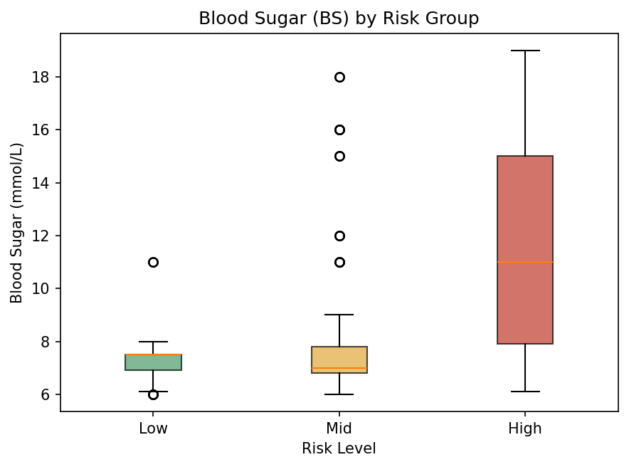
EXPLORATORY DATA ANALYSIS
Blood Sugar — The Strongest Signal
12.12 mmol/L
mean Blood Sugar in High Risk vs. 7.22 mmol/L in Low Risk
Threshold rule (BS ≥ 11 mmol/L): met by 62.5% of High-Risk patients, vs. only 1.0% of Low-Risk and 9.5% of Mid-Risk.
Standard deviation widens sharply with risk: 0.64 (Low) → 2.28 (Mid) → 4.17 (High).
This shows strong statistical association — not proof that blood sugar causes the assigned risk label.
Maternal Health Risk Stratification
7

Slide 8
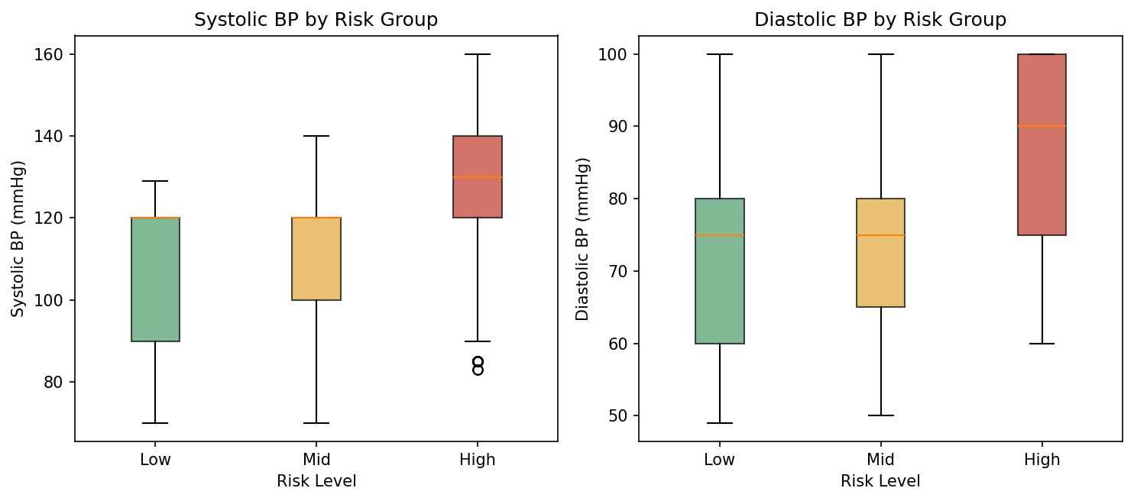
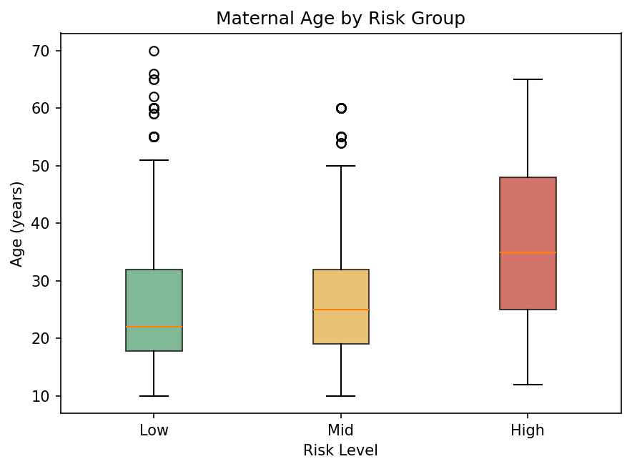
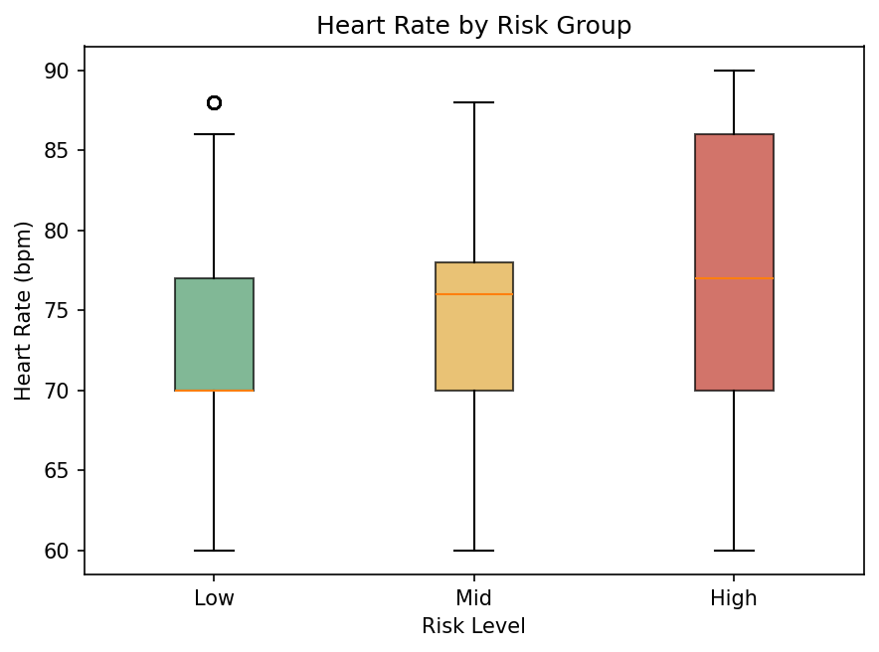
EXPLORATORY DATA ANALYSIS
Blood Pressure, Age & Heart Rate
Systolic BP rises from 105.8 mmHg (Low) to 124.2 mmHg (High); diastolic from 72.5 to 85.1 mmHg — but Low and Mid overlap substantially. Age shifts upward (26.9 → 36.2 years) yet stays heterogeneous. Heart Rate shows the weakest separation of any variable (73.1 / 74.2 / 76.7 bpm) — no single variable is a perfect classifier on its own.
Maternal Health Risk Stratification
8

Slide 9
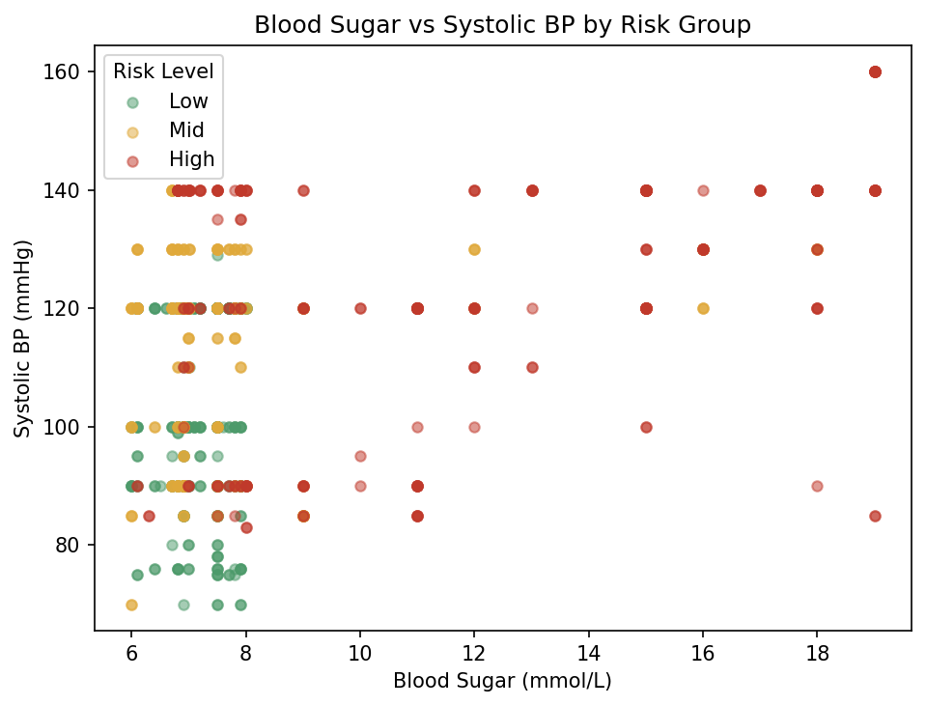
EXPLORATORY DATA ANALYSIS
Joint Relationship: Blood Sugar × Systolic BP
High-Risk points concentrate toward higher values of both Blood Sugar and Systolic BP.
No clean boundary separates the classes — a bivariate view still leaves overlap.
The RiskLevel label may itself be partly derived from BP/BS thresholds, so a model built on these features may partly reproduce the labeling rule rather than discover new clinical mechanisms.
Maternal Health Risk Stratification
9

Slide 10
METHODS
Reproducible Analytical Pipeline
Implemented in Python, supplemented by a SQLite SQL layer — same 1,012-row dataset, two ways.
1
Load UTF-8 CSV & normalize categorical labels
6
80/20 stratified train/test split (random_state=42)
2
Audit missingness, duplicates, implausible values
7
Fit StandardScaler on training data only
3
Remove only the 2 implausible HeartRate rows
8
Train multinomial Logistic Regression + Decision Tree
4
Compute descriptive statistics by RiskLevel
9
Evaluate via confusion matrices, precision/recall/F1
5
Produce distribution, boxplot & scatter figures
10
Select final model: High-Risk Recall, then macro F1
Maternal Health Risk Stratification
10

Slide 11
SQL ANALYSIS
Reproducibility with SQLite
Nine documented queries reproduce the class distribution, group summaries, and threshold checks directly against the cleaned 1,012-row table — no pandas required.
Threshold finding (Q3a)
-- Group summaries: mean of every clinical variable by RiskLevel
SELECT
RiskLevel,
COUNT(*) AS n,
ROUND(AVG(Age), 1) AS avg_age,
ROUND(AVG(SystolicBP), 1) AS avg_systolic_bp,
ROUND(AVG(BS), 2) AS avg_blood_sugar
FROM maternal_health
GROUP BY RiskLevel
ORDER BY
CASE RiskLevel
WHEN 'low risk' THEN 1
WHEN 'mid risk' THEN 2
WHEN 'high risk' THEN 3 END;
Risk | n | BS ≥ 11 mmol/L
Low | 404 | 1.0%
Mid | 336 | 9.5%
High | 272 | 62.5%
SQLite has no native STDDEV or MEDIAN — both are reconstructed with window functions and √(E[X²]−E[X]²), matching the Python descriptive statistics exactly.
Maternal Health Risk Stratification
11

Slide 12
MACHINE LEARNING
Leakage-Safe Split & Logistic Regression
FEATURES = ["Age","SystolicBP","DiastolicBP",
"BS","BodyTemp","HeartRate"]
X_train, X_test, y_train, y_test = train_test_split(
X, y, test_size=0.2,
random_state=42, stratify=y
)
# Fit scaler on TRAIN ONLY to avoid leakage
scaler = StandardScaler().fit(X_train)
X_train_s = scaler.transform(X_train)
X_test_s = scaler.transform(X_test)
logreg = LogisticRegression(max_iter=2000,
random_state=42)
logreg.fit(X_train_s, y_train)
Multinomial Logistic Regression
80/20 stratified split preserves the Low/Mid/High proportions in both sets (test n = 203, including 55 High-Risk cases).
Softmax over per-class linear scores zₖ = β₀ₖ + β₁ₖx₁ + ... + βₚₖxₚ converts scores to class probabilities.
Standardization matters here because predictors are on very different scales (mmHg vs. mmol/L vs. °F).
Result: 0.586 accuracy, 0.584 macro F1, 0.782 High-Risk Recall.
Maternal Health Risk Stratification
12

Slide 13
MACHINE LEARNING
Shallow, Interpretable Decision Tree
Decision Tree (depth = 4)
tree = DecisionTreeClassifier(
max_depth=4,
min_samples_leaf=15,
random_state=42
)
tree.fit(X_train, y_train) # no scaling needed
y_pred = tree.predict(X_test)
# Select final model: High-Risk Recall first,
# macro F1 as tie-breaker
if tree_metrics["high_risk_recall"] >= \
lr_metrics["high_risk_recall"]:
final_model = tree
Kept intentionally shallow (depth 4, min leaf 15) to stay interpretable and limit overfitting on a modest sample.
Each split reduces Gini impurity — the tree can be read top-to-bottom as an explicit set of threshold rules.
Chosen as the final model: it outperformed Logistic Regression on all four reported metrics.
Result: 0.680 accuracy, 0.670 macro F1, 0.836 High-Risk Recall, 0.920 High-Risk Precision.
Gini(t) = 1 − Σ pₖ²
Maternal Health Risk Stratification
13

Slide 14
RESULTS
Model Comparison on the Held-Out Test Set
Model | Accuracy | Macro F1 | High Recall | High Precision
Logistic Regression | 0.586 | 0.584 | 0.782 | 0.768
Decision Tree — selected | 0.680 | 0.670 | 0.836 | 0.920
Maternal Health Risk Stratification
14

Slide 15
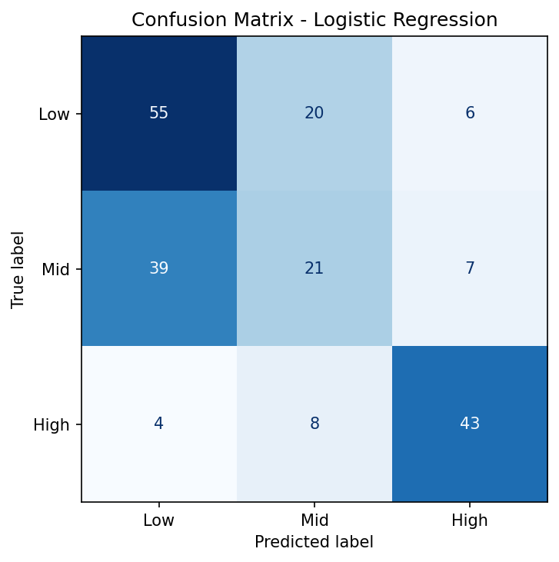
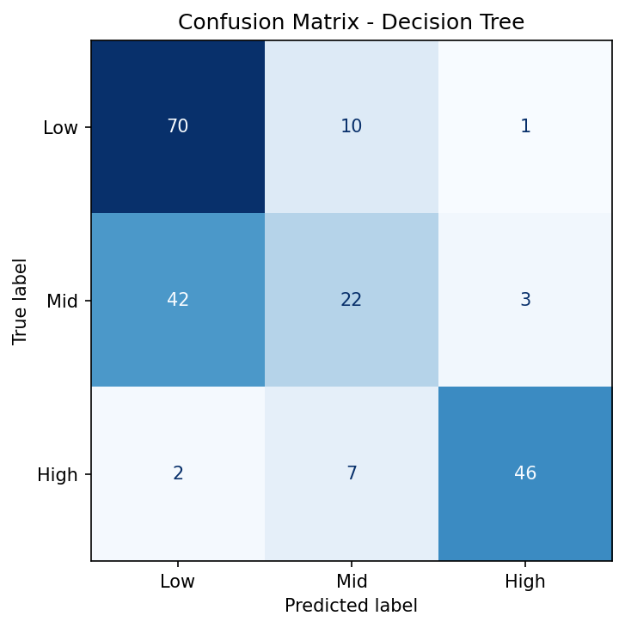
RESULTS
Class-Wise Performance & Confusion Matrices
Decision Tree, per class
Class | Precision | Recall | F1
Low Risk | 0.614 | 0.864 | 0.718
Mid Risk | 0.564 | 0.328 | 0.415
High Risk | 0.920 | 0.836 | 0.876
Main error: 42 of 65 Mid-Risk cases predicted as Low Risk — the Low/Mid boundary, not High-Risk detection, is the model's weak spot. Still, 9 of 55 true High-Risk cases were missed.
Maternal Health Risk Stratification
15

Slide 16
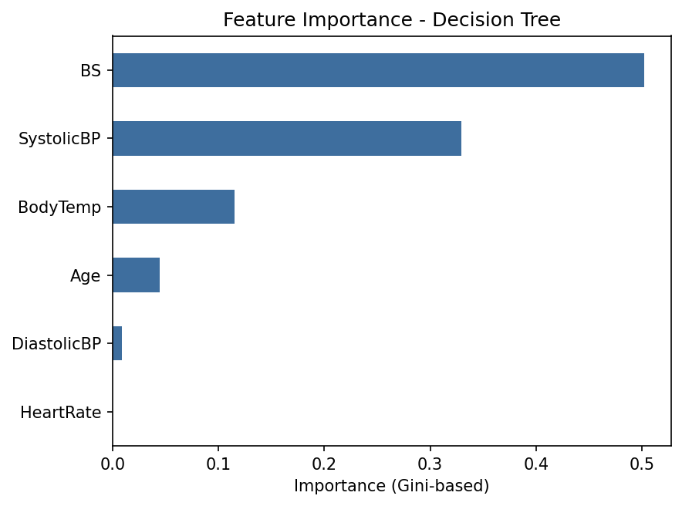
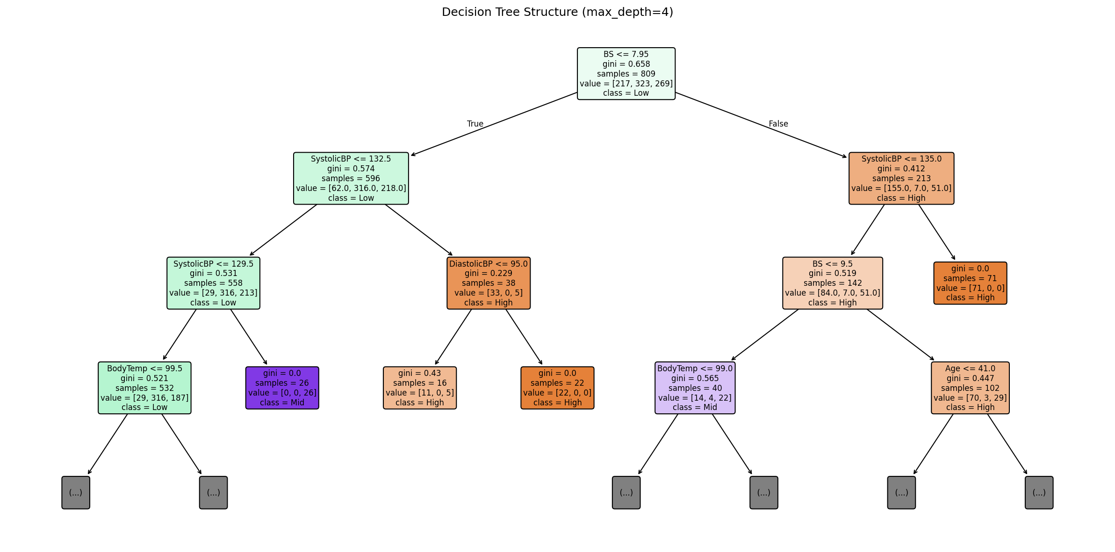
FEATURE INTERPRETATION
What Drives the Model?
Blood Sugar (~50%) and Systolic BP (~33%) account for the large majority of the tree's splitting power — fully consistent with the descriptive EDA. Diastolic BP, Age, and Heart Rate contribute far less. Importance reflects impurity reduction, not a causal effect.
Maternal Health Risk Stratification
16

Slide 17
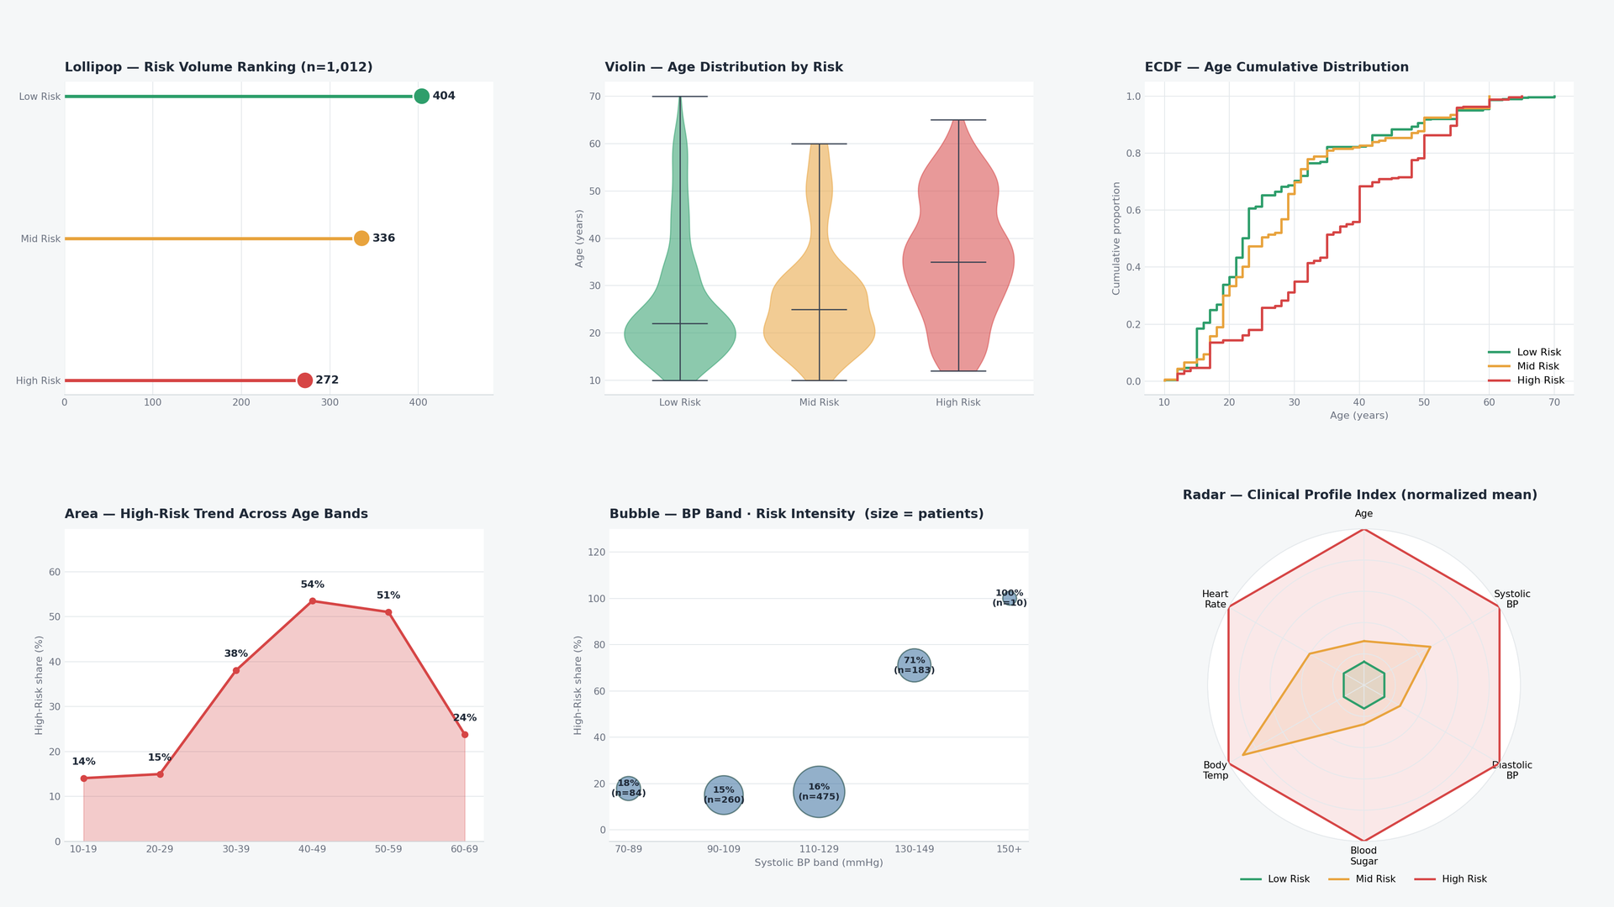
ANALYTICAL DASHBOARD
Overview Dashboard
Maternal Health Risk Stratification
17

Slide 18
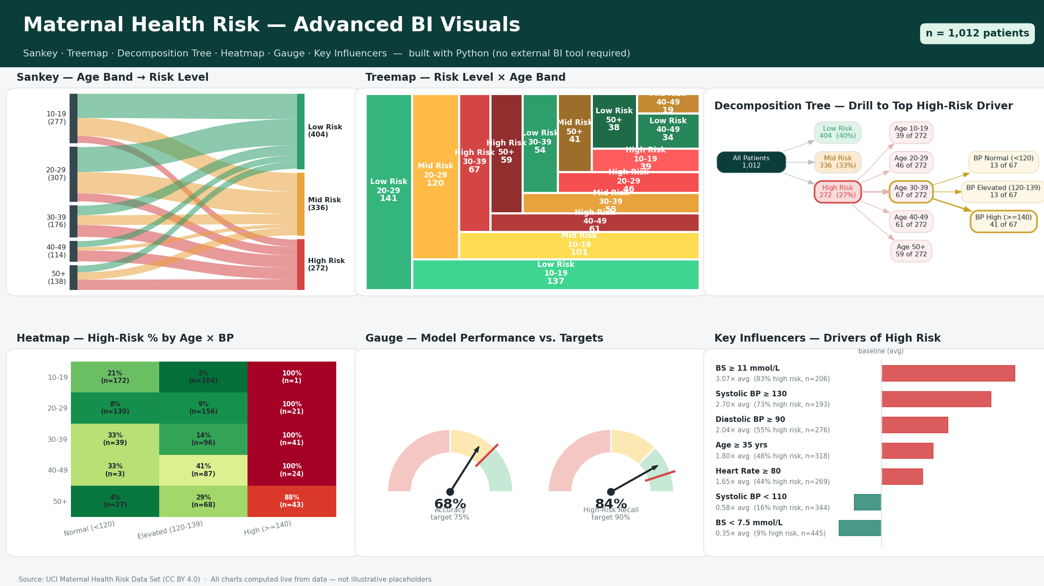
ANALYTICAL DASHBOARD
Advanced BI Visuals
Sankey · Treemap · Decomposition Tree · Heatmap · Gauge · Key Influencers — built with Python, no external BI tool required.
Maternal Health Risk Stratification
18

Slide 19
DISCUSSION
Limitations
Geographic scope
Limited predictors
Rural Bangladesh only — may not generalize to other health systems.
Only 6 fields; no gestational age, obstetric history, labs, or comorbidities.
Duplicate rows
Possible label dependence
562 exact duplicates from coarse rounding reduce effective sample diversity.
RiskLevel may already be partly derived from BP/BS thresholds.
No external validation
Small High-Risk test set
Evaluated on one held-out split, not an independent cohort.
Only 55 High-Risk cases in the test split — recall estimates carry sampling variability.
Maternal Health Risk Stratification
19

Slide 20
CONCLUSION
A Transparent Baseline, Not a
Clinical Decision Tool
Blood Sugar and blood pressure emerged as the dominant, consistent drivers across statistics, SQL, and machine learning alike. The shallow Decision Tree reached 0.836 High-Risk Recall and 0.920 High-Risk Precision — a strong screening pattern for an interpretable baseline. Future work should add clinically validated outcomes, larger and more diverse cohorts, cost-sensitive evaluation, and external validation before any real-world use.
THANK YOU
Mahdiyeh Mirzaei
github.com/mahdiyeh-mirzaei-v2
Educational research project — results are not intended for clinical diagnosis or decision-making.
Maternal Health Risk Stratification
20

