Slide 1

STUDY
An app for helping BU students with finding their place to study
Notes:
1

Slide 2

How does STUDY BU Work? What does it do?
*
STUDY BU’s simple layout allows for ease of access when looking around the BU campus for spots to study in. The user is first greeted by a welcome screen and our lovely mascot, Rhett, and they are then taken to a page containing checkboxes that allow the user to filter out certain study space categories, so that they can tailor their own BU study space map to their preferences.
Each marker on the map designates both a BU study location, and, when tapped by the user, a list of location-specific information is shown (Hours of operation, study spots within that location, general descriptions)
Icon that shows up on the Android home screen after downloading the app:

Slide 3
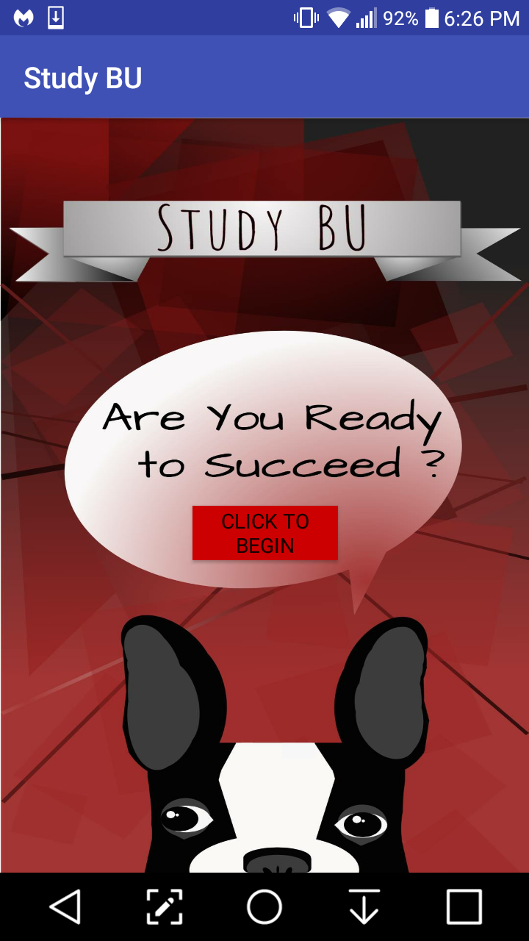
Front and Back End Walkthrough
*
Front End
What’s Happening?
The user is shown the title screen and is taken to the location filter screen once the “Click to Begin” button is pressed.
All previous screens, including this title page, may be returned to via the built in Android back button.

Slide 4
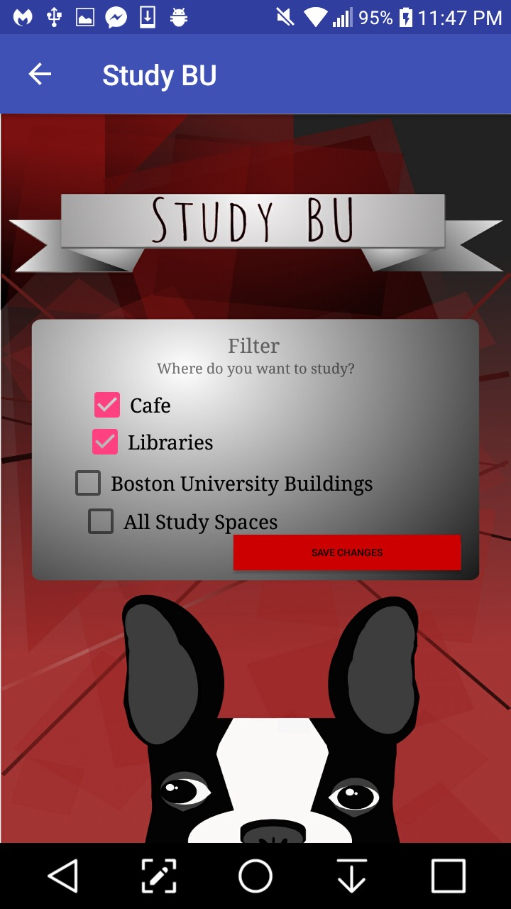
Front and Back End Walkthrough
*
Front End
What’s Happening?
The user is given the option via checkboxes to filter out certain “types” of study spaces so that they can choose to display spots according to their preferences.
In the back end, these checkboxes set booleans to true or false depending on the user’s input, and the state of these booleans are added to the intent and are passed to the map activity, and this determines whether or not the display functions for the markers with the same respective “types” are set to be on or off. If checked, they display, otherwise, they don’t.

Slide 5
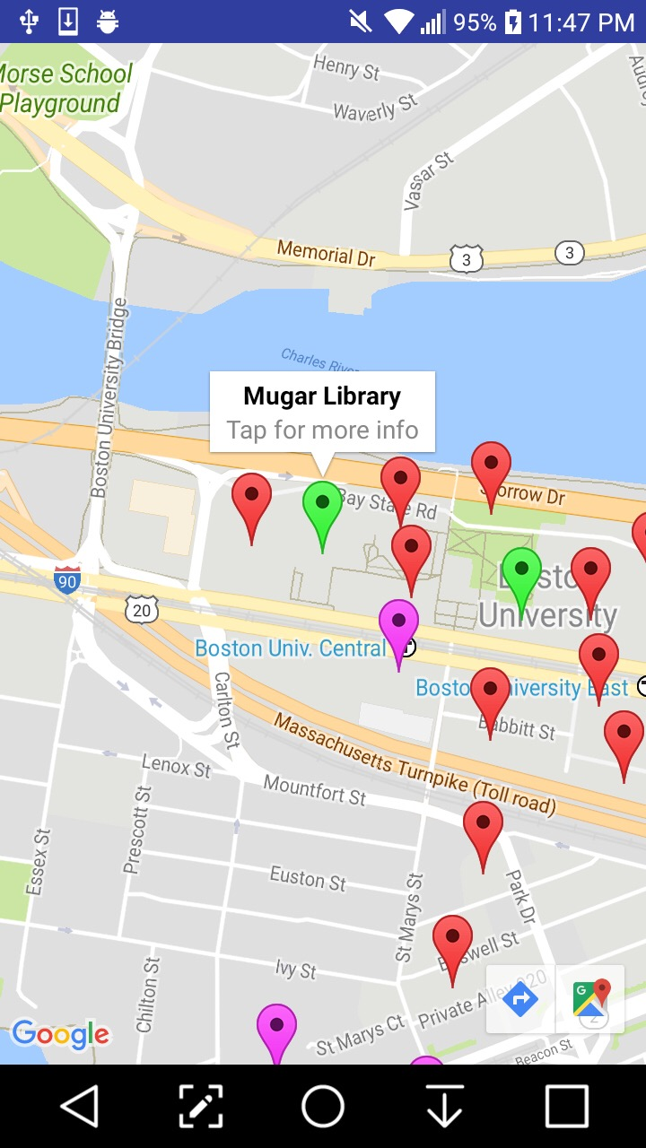
Front and Back End Walkthrough
*
Front End
What’s Happening?
After hitting “Save Changes” on the previous screen, the user is shown a map screen, displaying their current location as a blue dot, and all the various study spots around BU’s campus according to the filter options they chose.
When the map portion is first opened, you are asked whether or not you’d like to share your location. If not, then the default center of the map is set to Mugar Library.
Upon tapping a study spot marker, the name of that overarching study spot (as in the main building, which may itself contain sub-spots) is shown, along with the option to tap the dialog box in order to see the details and sub-spots of that location.
The geo-locations of these markers are hardcoded into the app using longitude and latitude values found via Google Maps. The separate objects and their respective data fields are also hardcoded in, as opposed to being pulled from, say, Yelp API, or through Google Maps.
Magenta – Cafes/Storefronts, Green – Libraries, Red – BU buildings.

Slide 6
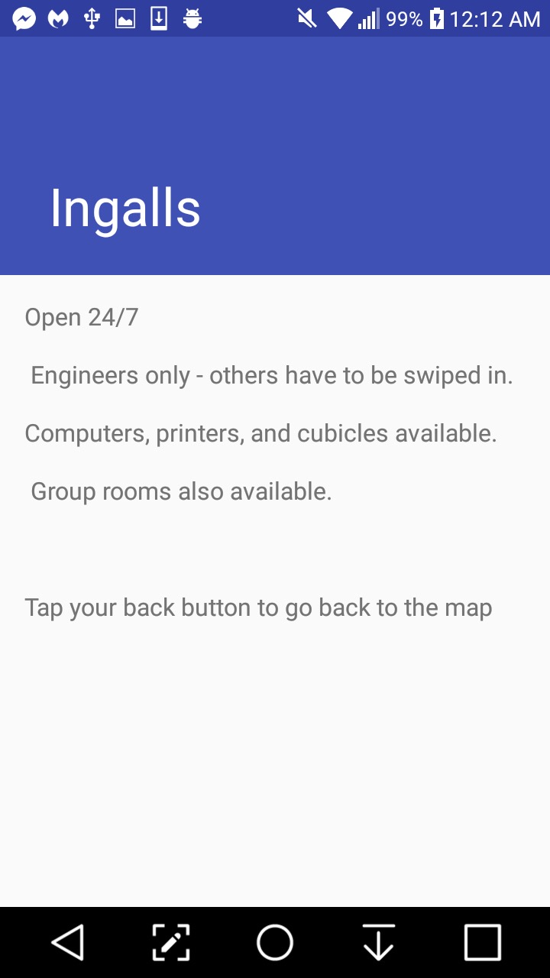
Front and Back End Walkthrough
*
Front End
What’s Happening?
Upon tapping the dialog box for a primary location, the user is then taken to a separate screen which displays more detailed information for that location, such as hours, available study materials, and other info particular to that location (for example, the Ingalls study spot details that it’s Engineers only). In order to go back to the map screen, the user may use their built-in back button on their Android device.
These details are hardcoded in as large strings, and each location has its own unique details string that it displays.
Each marker is given an ID (int value) and this ID is passed to the scrolling activity which allows you to scroll through the information.

