Slide 1
数据库

Slide 2
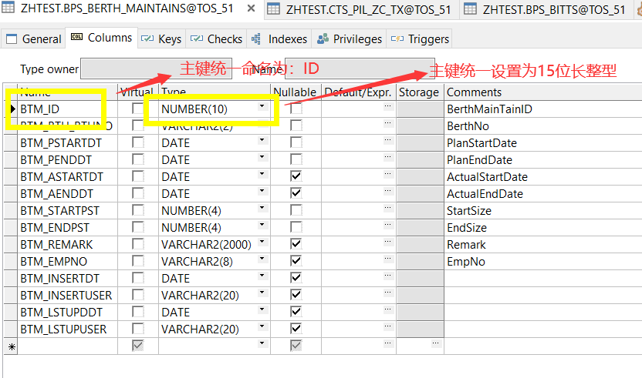
规范数据库设计

Slide 3
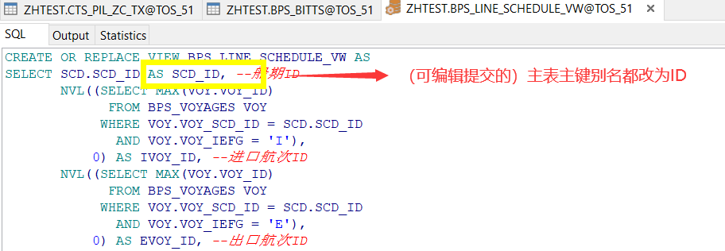
规范数据库设计

Slide 4
配置

Slide 5
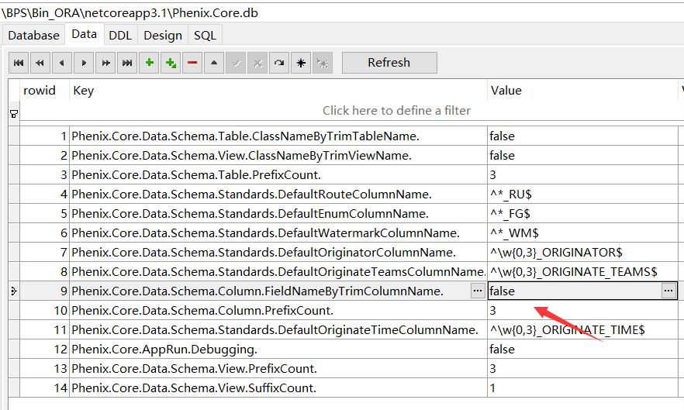
字段映射规则改为保留前缀（如果剔除前缀后无法分辨字段的话）

Slide 6
实体

Slide 7
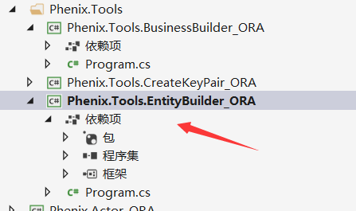
用Phenix.Tools.EntityBuilder批量生成实体代码

Slide 8
读

Slide 9
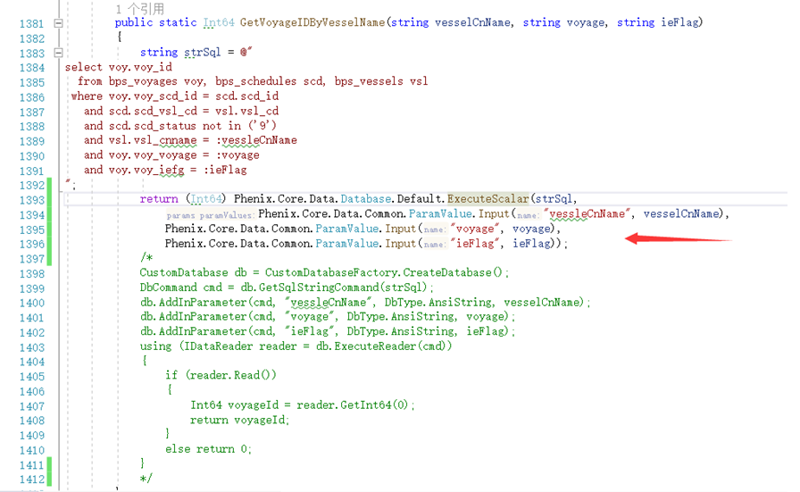
return (Int64) Phenix.Core.Data.Database.Default.ExecuteScalar(strSql,
Phenix.Core.Data.Common.ParamValue.Input("vessleCnName", vesselCnName),
Phenix.Core.Data.Common.ParamValue.Input("voyage", voyage),
Phenix.Core.Data.Common.ParamValue.Input("ieFlag", ieFlag));

Slide 10
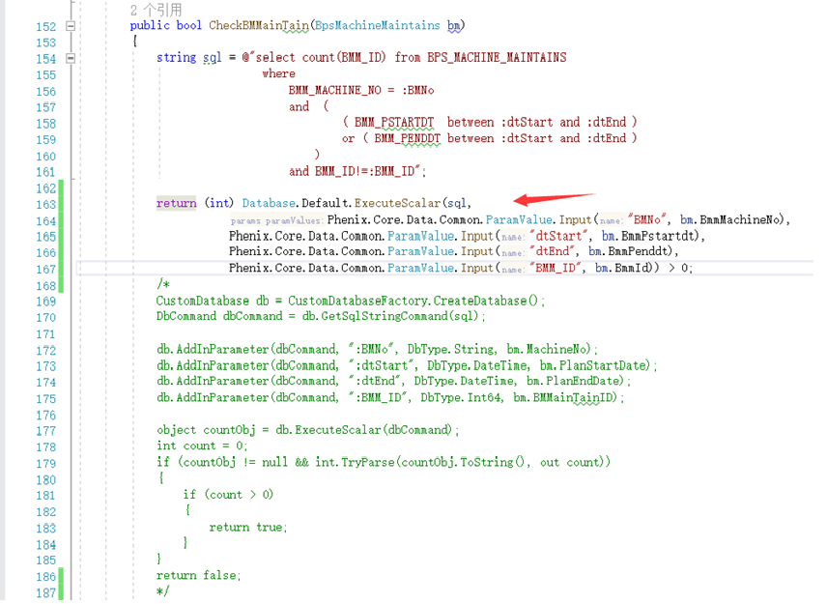
return (int) Database.Default.ExecuteScalar(sql,
Phenix.Core.Data.Common.ParamValue.Input("BMNo", bm.BmmMachineNo),
Phenix.Core.Data.Common.ParamValue.Input("dtStart", bm.BmmPstartdt),
Phenix.Core.Data.Common.ParamValue.Input("dtEnd", bm.BmmPenddt),
Phenix.Core.Data.Common.ParamValue.Input("BMM_ID", bm.BmmId)) > 0;

Slide 11
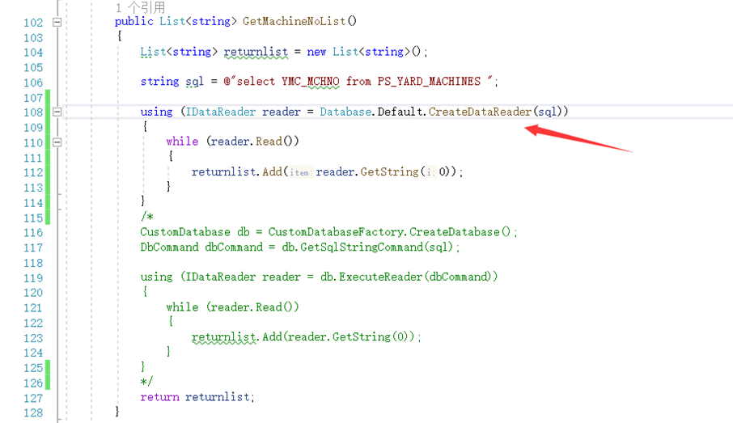
using (IDataReader reader = Database.Default.CreateDataReader(sql))
{
while (reader.Read())
{
returnlist.Add(reader.GetString(0));
}
}

Slide 12
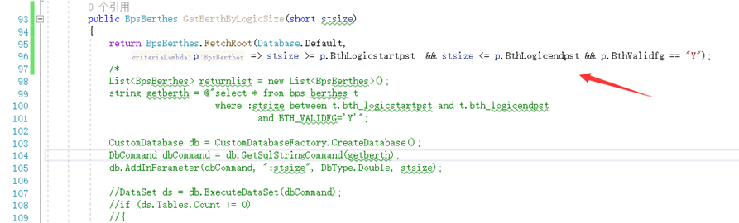
return BpsBerthes.FetchRoot(Database.Default,
p => stsize >= p.BthLogicstartpst && stsize <= p.BthLogicendpst && p.BthValidfg == "Y");

Slide 13
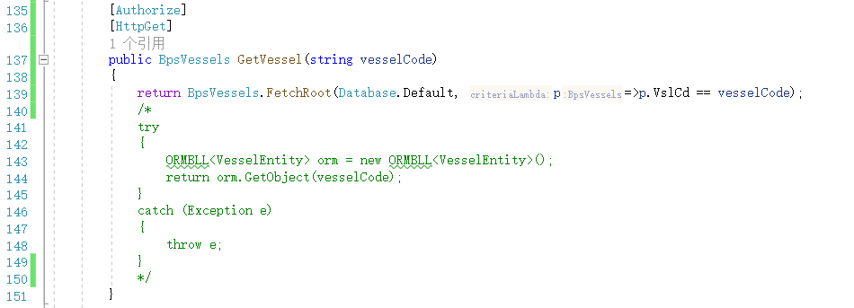
return BpsVessels.FetchRoot(Database.Default, p => p.VslCd == vesselCode);

Slide 14
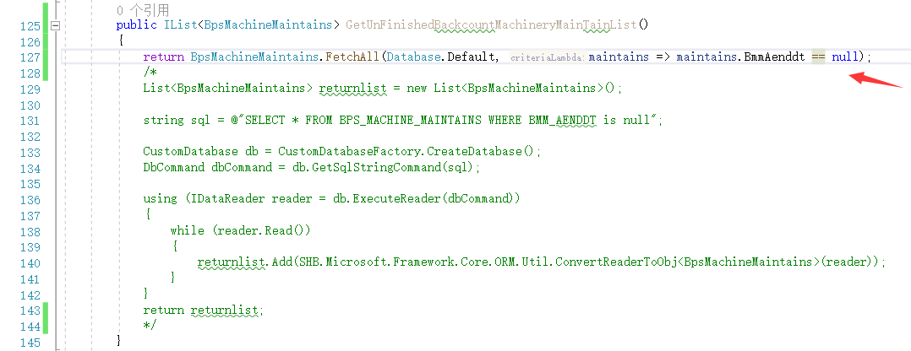
return BpsMachineMaintains.FetchAll(Database.Default, maintains => maintains.BmmAenddt == null);

Slide 15
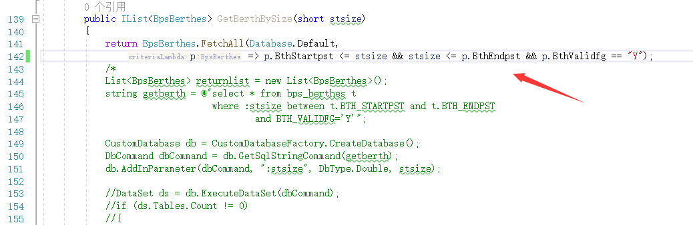
return BpsBerthes.FetchAll(Database.Default,
p => p.BthStartpst <= stsize && stsize <= p.BthEndpst && p.BthValidfg == "Y");

Slide 16
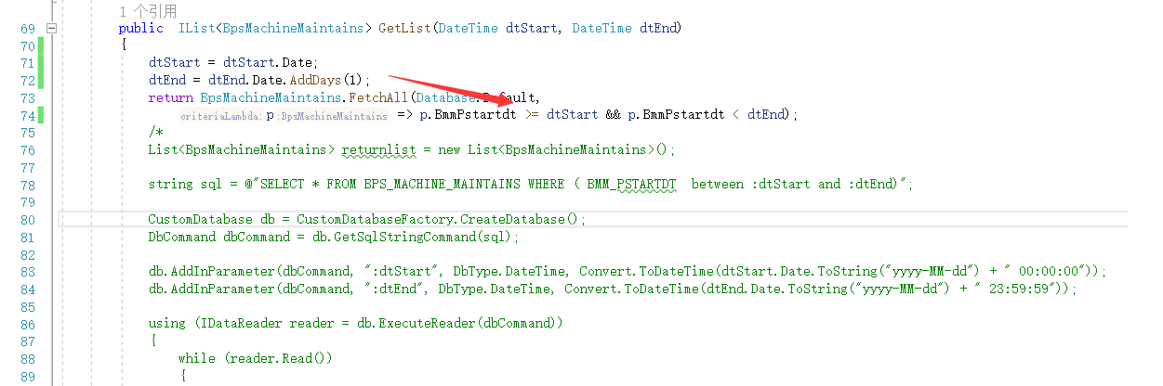
dtStart = dtStart.Date;
dtEnd = dtEnd.Date.AddDays(1);
return BpsMachineMaintains.FetchAll(Database.Default,
p => p.BmmPstartdt >= dtStart && p.BmmPstartdt < dtEnd);

Slide 17
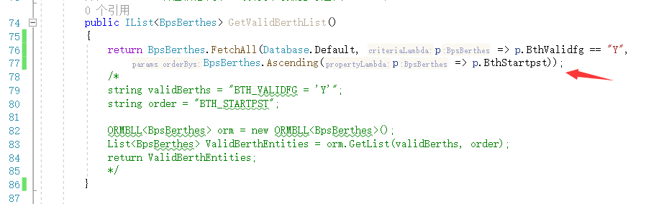
return BpsBerthes.FetchAll(Database.Default, p => p.BthValidfg == "Y",
BpsBerthes.Ascending(p => p.BthStartpst));

Slide 18
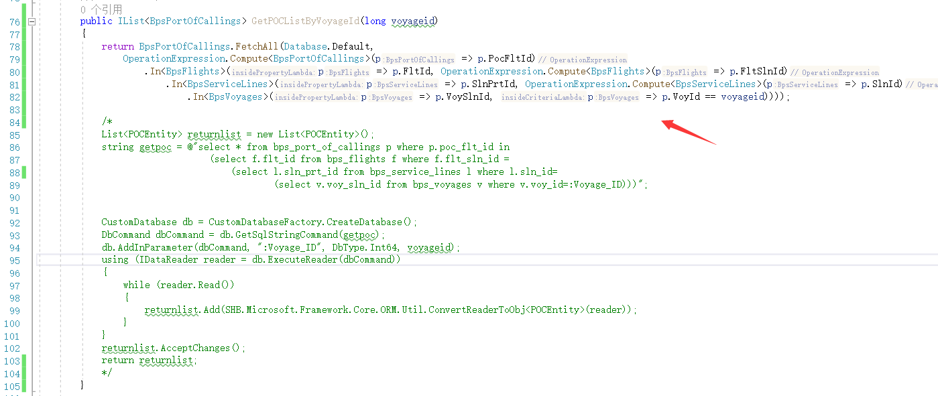
return BpsPortOfCallings.FetchAll(Database.Default,
OperationExpression.Compute<BpsPortOfCallings>(p => p.PocFltId)
.In<BpsFlights>(p => p.FltId, OperationExpression.Compute<BpsFlights>(p => p.FltSlnId)
.In<BpsServiceLines>(p => p.SlnPrtId, OperationExpression.Compute<BpsServiceLines>(p => p.SlnId)
.In<BpsVoyages>(p => p.VoySlnId, p => p.VoyId == voyageid))));

Slide 19
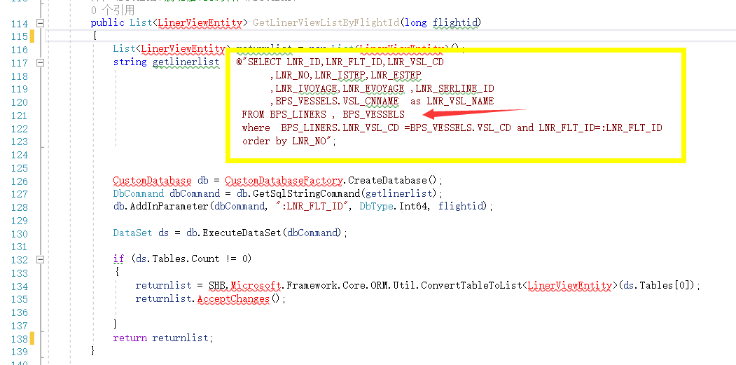
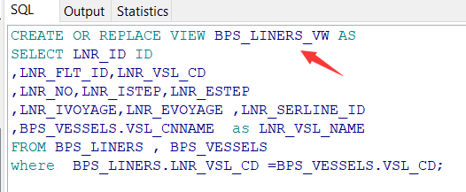
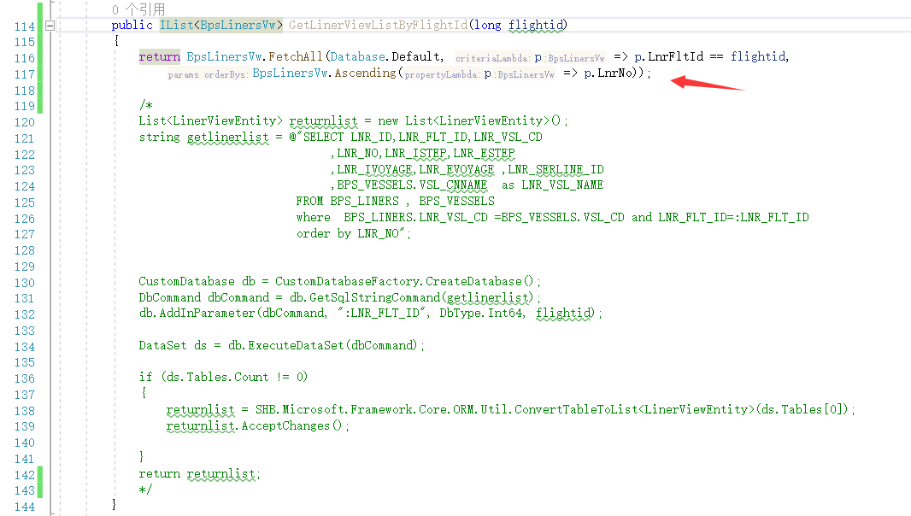
1
2
3
return BpsLinersVw.FetchAll(Database.Default, p => p.LnrFltId == flightid,
BpsLinersVw.Ascending(p => p.LnrNo));

Slide 20
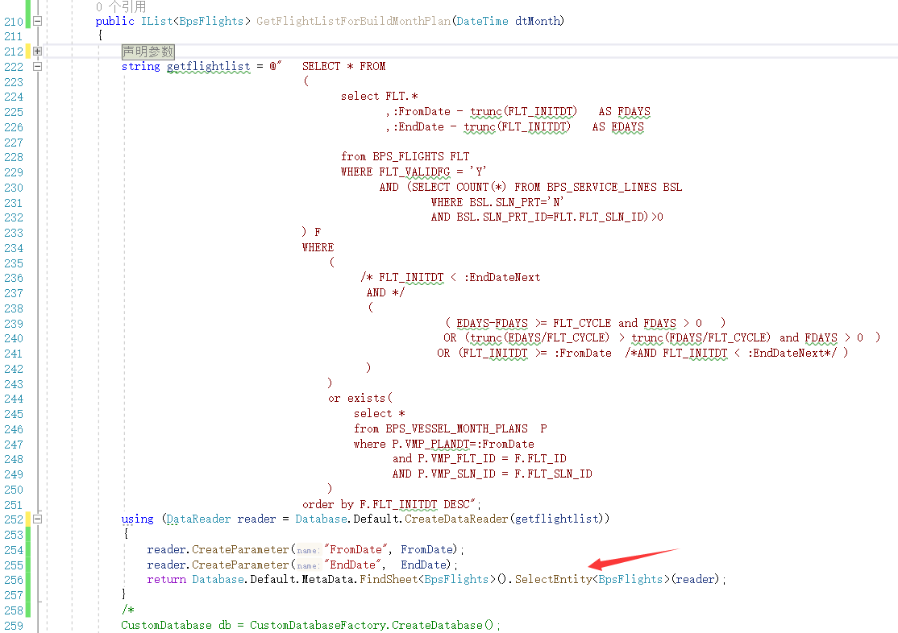
using (DataReader reader = Database.Default.CreateDataReader(getflightlist))
{
reader.CreateParameter("FromDate", FromDate);
reader.CreateParameter("EndDate", EndDate);
return Database.Default.MetaData.FindSheet<BpsFlights>().SelectEntity<BpsFlights>(reader);
}

Slide 21
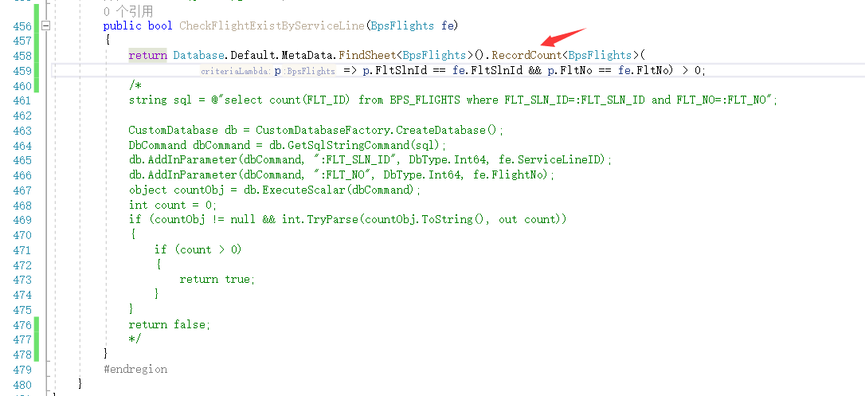
return Database.Default.MetaData.FindSheet<BpsFlights>().RecordCount<BpsFlights>(
p => p.FltSlnId == fe.FltSlnId && p.FltNo == fe.FltNo) > 0;

Slide 22
写

Slide 23
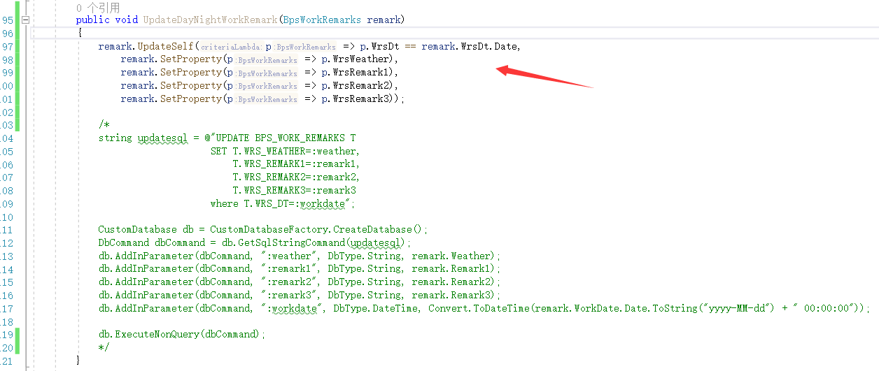
remark.UpdateSelf(p => p.WrsDt == remark.WrsDt.Date,
remark.SetProperty(p => p.WrsWeather),
remark.SetProperty(p => p.WrsRemark1),
remark.SetProperty(p => p.WrsRemark2),
remark.SetProperty(p => p.WrsRemark3));

Slide 24
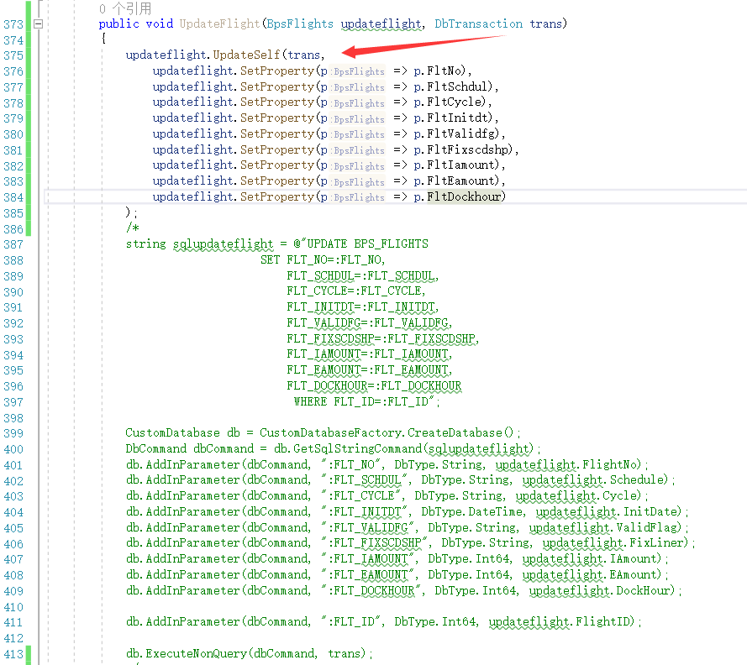
updateflight.UpdateSelf(trans,
updateflight.SetProperty(p => p.FltNo),
updateflight.SetProperty(p => p.FltSchdul),
updateflight.SetProperty(p => p.FltCycle),
updateflight.SetProperty(p => p.FltInitdt),
updateflight.SetProperty(p => p.FltValidfg),
updateflight.SetProperty(p => p.FltFixscdshp),
updateflight.SetProperty(p => p.FltIamount),
updateflight.SetProperty(p => p.FltEamount),
updateflight.SetProperty(p => p.FltDockhour)
);

Slide 25
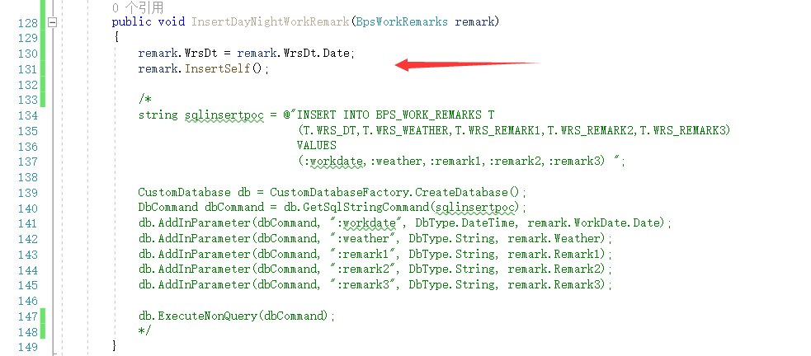
remark.InsertSelf();

Slide 26
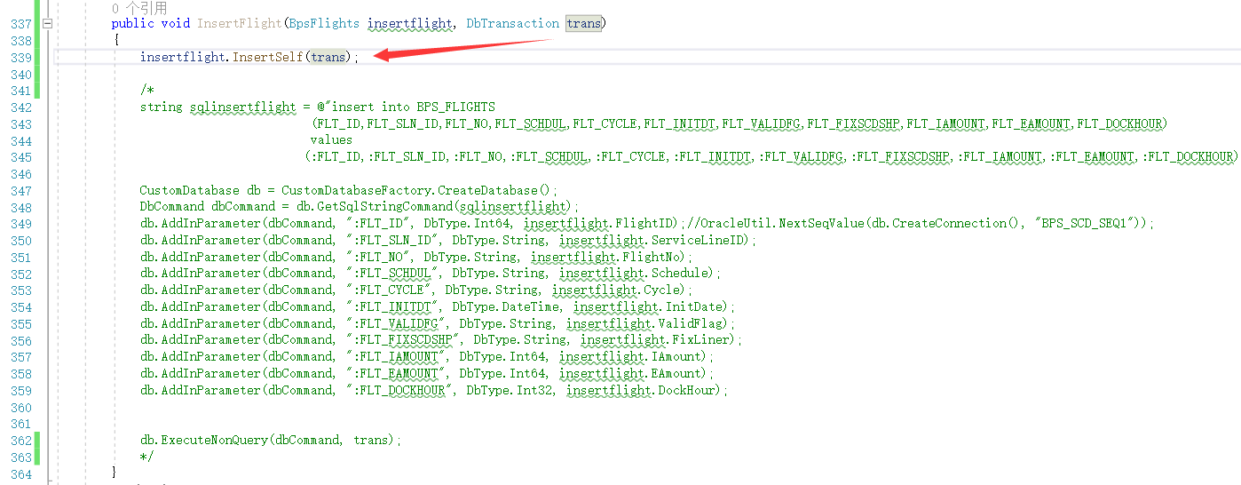
insertflight.InsertSelf(trans);

Slide 27
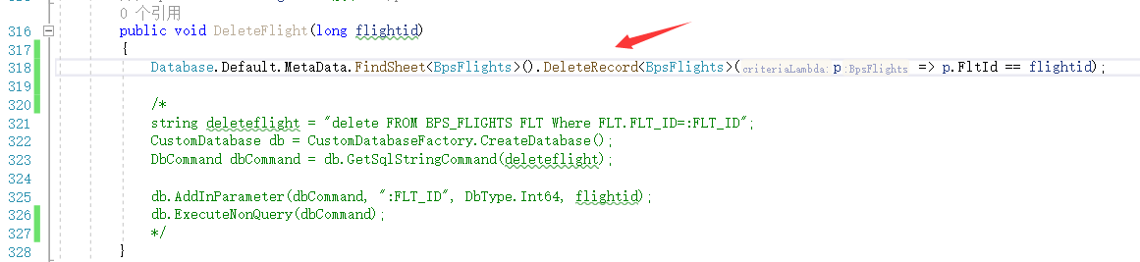
Database.Default.MetaData.FindSheet<BpsFlights>().DeleteRecord<BpsFlights>(p => p.FltId == flightid);

Slide 28
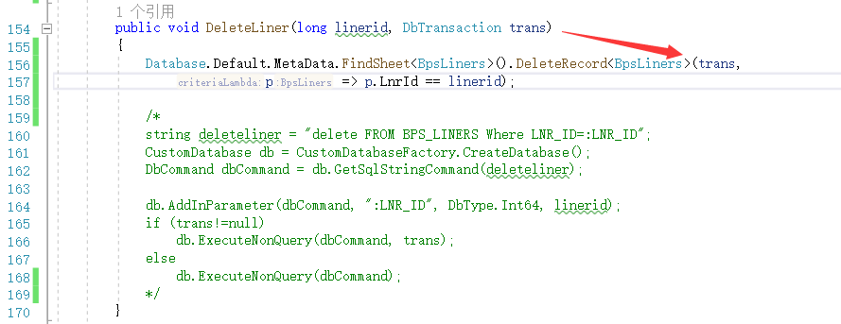
Database.Default.MetaData.FindSheet<BpsLiners>().DeleteRecord<BpsLiners>(trans,
p => p.LnrId == linerid);

Slide 29
执行

Slide 30
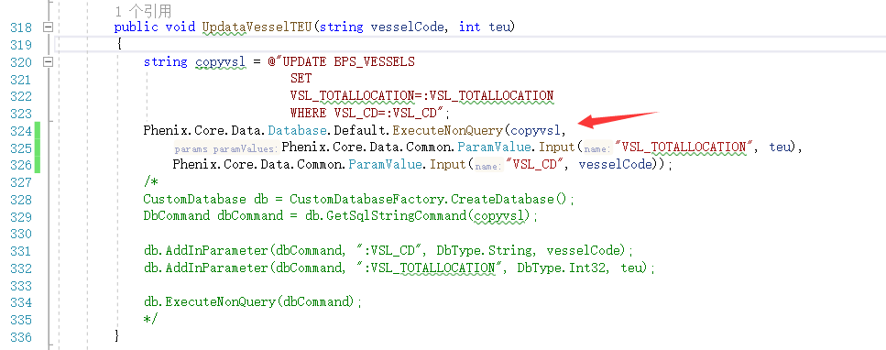
Phenix.Core.Data.Database.Default.ExecuteNonQuery(copyvsl,
Phenix.Core.Data.Common.ParamValue.Input("VSL_TOTALLOCATION", teu),
Phenix.Core.Data.Common.ParamValue.Input("VSL_CD", vesselCode));

Slide 31
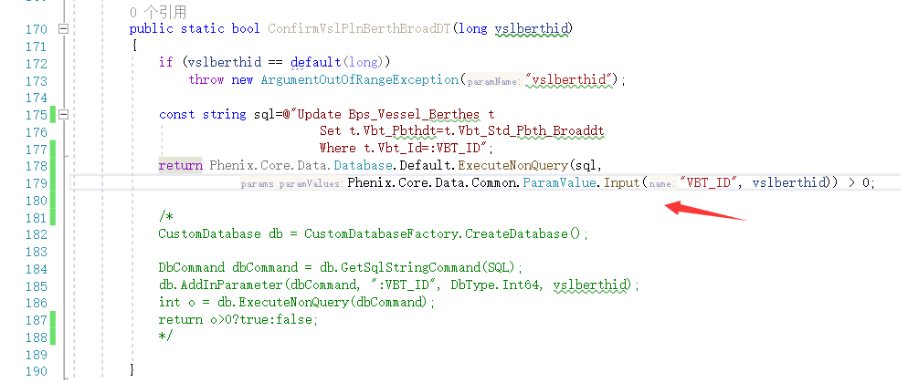
return Phenix.Core.Data.Database.Default.ExecuteNonQuery(sql,
Phenix.Core.Data.Common.ParamValue.Input("VBT_ID", vslberthid)) > 0;

Slide 32
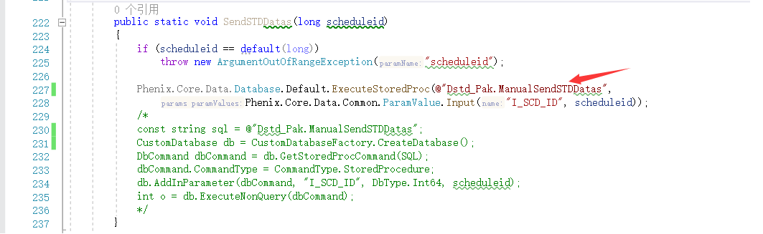
Phenix.Core.Data.Database.Default.ExecuteStoredProc(@"Dstd_Pak.ManualSendSTDDatas",
Phenix.Core.Data.Common.ParamValue.Input("I_SCD_ID", scheduleid));

Slide 33
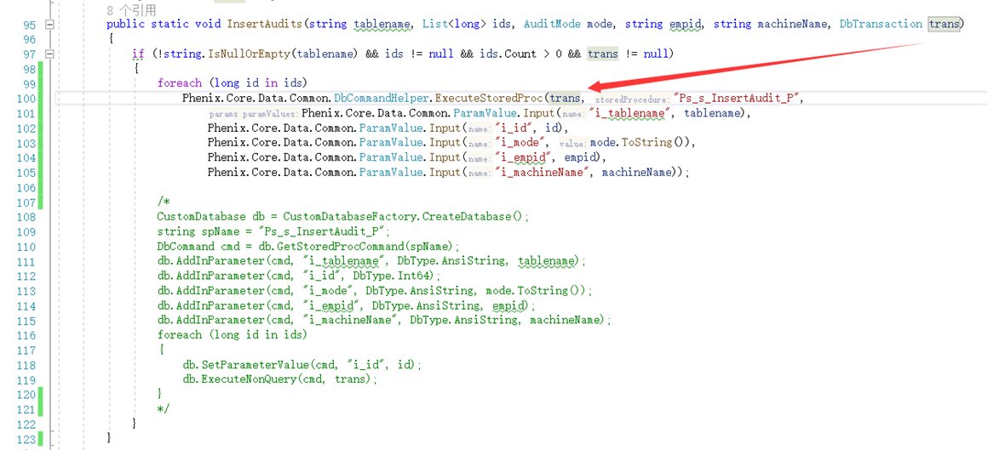
Phenix.Core.Data.Common.DbCommandHelper.ExecuteStoredProc(trans, "Ps_s_InsertAudit_P",
Phenix.Core.Data.Common.ParamValue.Input("i_tablename", tablename),
Phenix.Core.Data.Common.ParamValue.Input("i_id", id),
Phenix.Core.Data.Common.ParamValue.Input("i_mode", mode.ToString()),
Phenix.Core.Data.Common.ParamValue.Input("i_empid", empid),
Phenix.Core.Data.Common.ParamValue.Input("i_machineName", machineName));

