Slide 1
分布式云计算服务插件
Phenixヾ7 for .net core 3 & Orleans 3
https://github.com/phenixiii/Phenix.NET7

Slide 2


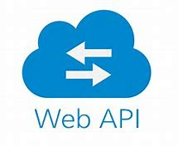







插件与宿主
（公有云/私有云+Docker/虚拟机）部署环境
代理服务
Phenix.Services.Host
WebAPI 服务容器
Orleans 服务容器
Grain
Grain
Grain
Grain
Grain
Grain
Grain
Grain
Grain

Slide 3


插件与插件
负载均衡
Grain
Grain
Grain
Grain
Grain
Grain
负载均衡
Grain
Grain
Grain
Grain

Slide 4

Demo.InspectionStation.Plugin
OperationPointGrain
ID=1号作业点
OperationPointGrain
ID=2号作业点
SetLicensePlate()
OperationPointGrain
ID=3号作业点
1号作业点
2号作业点
PUT
3号作业点
/api/inspection-station/operation-point/weighbridge
/api/inspection-station/operation-point/license-plate
/api/inspection-station/operation-point/gate

Slide 5

Demo.InspectionStation.Plugin
OperationPointGrain
ID=1号作业点
张三
OperationPointGrain
ID=2号作业点
GET
GetLicensePlate()
OperationPointGrain
ID=3号作业点
/api/inspection-station/operation-point/weighbridge
/api/inspection-station/operation-point/license-plate
/api/inspection-station/operation-point/gate

Slide 6
Demo.InspectionStation.Plugin
Center Grain
ID=张三
OperationPointGrain
ID=1号作业点
PUT
Listen({1号作业点,3号作业点})
SubscribeAsync()
/api/inspection-station/center/listen
张三
Center Grain
ID=李四
OperationPointGrain
ID=2号作业点
phAjax.subscribeMessage()
/api/message/user-message-hub
SubscribeAsync()
OperationPointGrain
ID=3号作业点

Slide 7
Demo.InspectionStation.Plugin
Center Grain
ID=张三
OperationPointGrain
ID=1号作业点
Send()
UserMessage.Send()
张三
onReceived
Center Grain
ID=李四
Send()
OperationPointGrain
ID=2号作业点
SetLicensePlate()
/api/message/user-message-hub
OperationPointGrain
ID=3号作业点
1号作业点
2号作业点
PUT
3号作业点
/api/inspection-station/operation-point/weighbridge
/api/inspection-station/operation-point/license-plate
/api/inspection-station/operation-point/gate

Slide 8
Demo.InspectionStation.Plugin
Center Grain
订阅
OperationPointGrain
消息

Slide 9
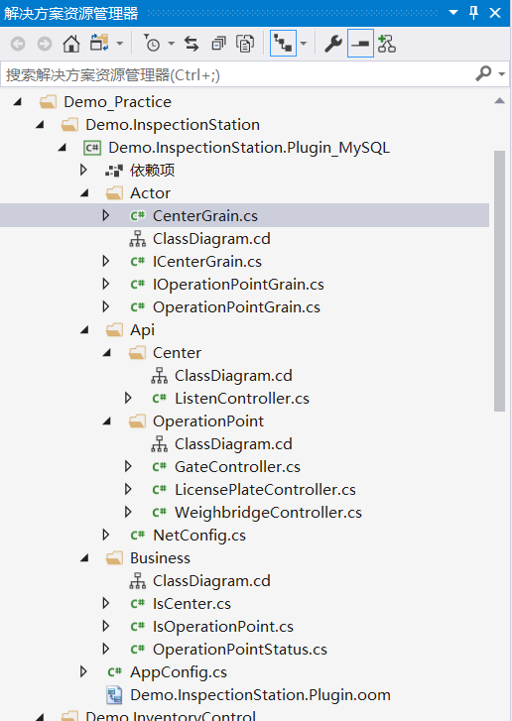
Demo.InspectionStation.Plugin
Grain

Slide 10
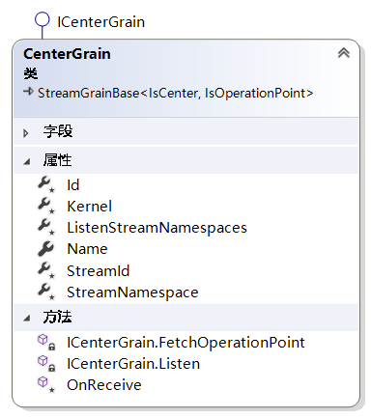
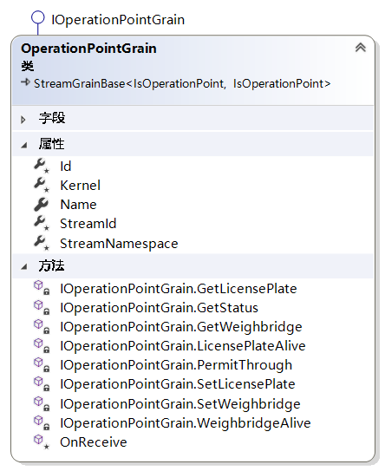
Demo.InspectionStation.Plugin

Slide 11
Demo.InspectionStation.Plugin
Kernal的实体类型
Stream的实体类型

Slide 12
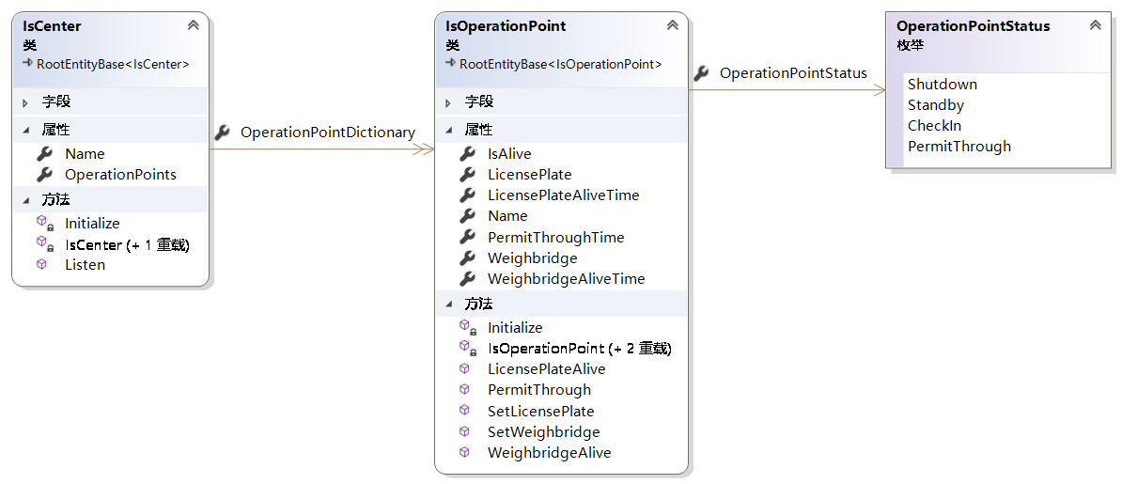
Demo.InspectionStation.Plugin
聚合关系

Slide 13
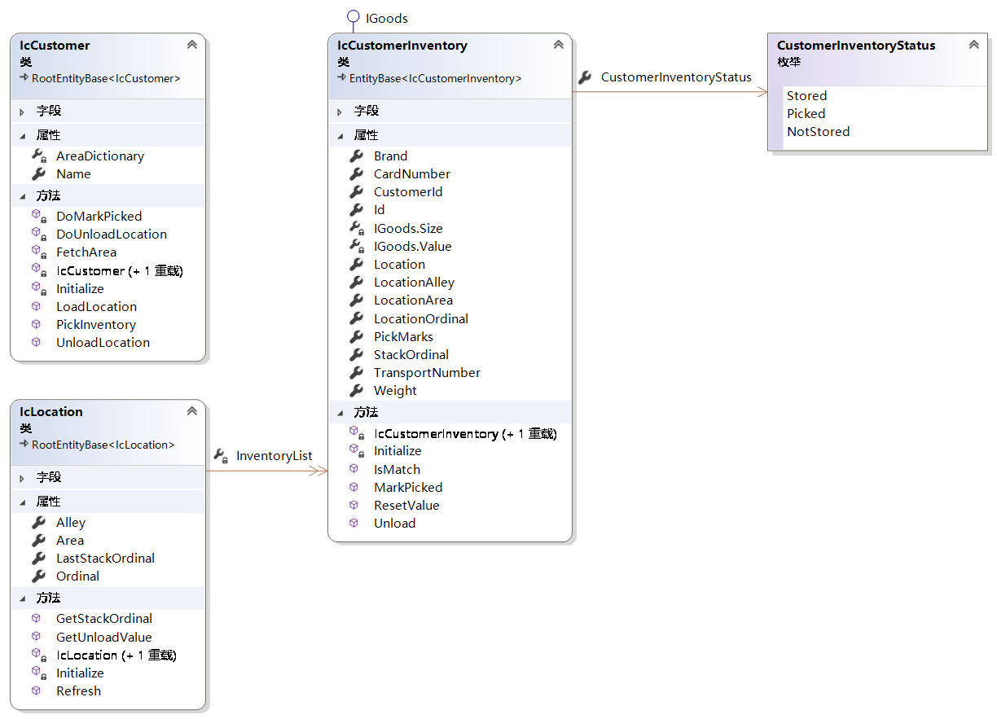
Demo.InventoryControl.Plugin
组合关系
聚合关系

Slide 14
Demo.InventoryControl.Plugin
GetStackOrdinal()
LocationGrain
ID=050101
Refresh()
CustomerGrainID=客户张
LoadLocation()
客户张
OperationPointGrain
ID=050102
CustomerGrainID=客户李
OperationPointGrain
ID=050103
OperationPointGrain
ID=050104

Slide 15
Demo.InventoryControl.Plugin
GetUnloadValue()
LocationGrain
ID=050101
Refresh()
CustomerGrainID=客户张
PickInventory()
客户张
OperationPointGrain
ID=050102
CustomerGrainID=客户李
OperationPointGrain
ID=050103
OperationPointGrain
ID=050104

Slide 16
Demo.InventoryControl.Plugin
LocationGrain
ID=050101
Refresh()
CustomerGrainID=客户张
UnloadLocation()
客户张
OperationPointGrain
ID=050102
CustomerGrainID=客户李
OperationPointGrain
ID=050103
OperationPointGrain
ID=050104

