Slide 1
Top Gun

Slide 2

Coming Attractions: Mostly Pictures
Going to Top Gun
Miramar
Where is it?
Naval Air & Movies
Purpose of Top Gun
History
Curriculum
Top Gun the Movie
Various Scenes
True or False?

Slide 3
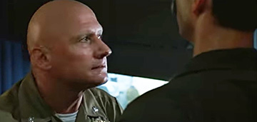
You two characters are going to Top Gun!

Slide 4
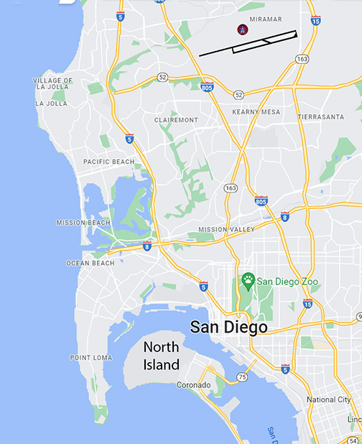
You’re going to Miramar!

Slide 5
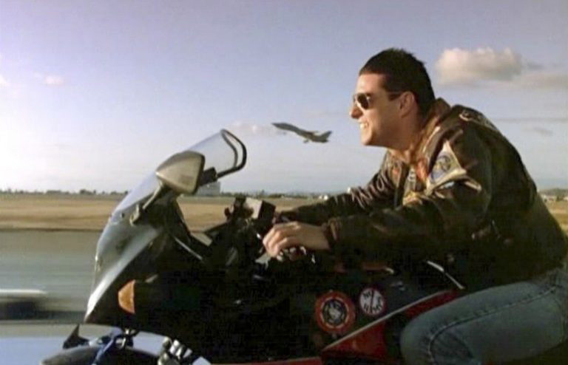
Race on Runway 26

Slide 6
Miramar vs. North Island

Slide 7
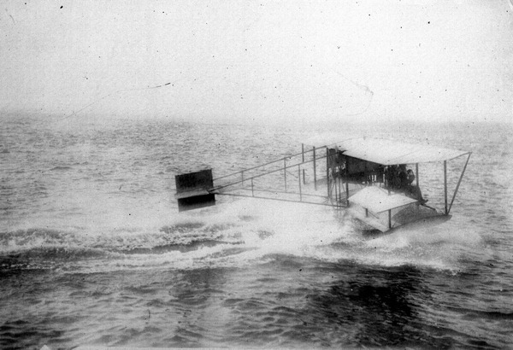
Birth of Navy Air, North Island, 1911
Curtiss A-1
Notes:
Cost $4,400
About $132,000 in today’s dollars
But only mahogany and silk
Powered bya a 75hp v-8

Slide 8
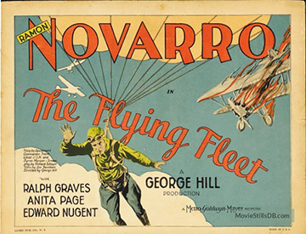
1929: Silent, Black & White

Slide 9
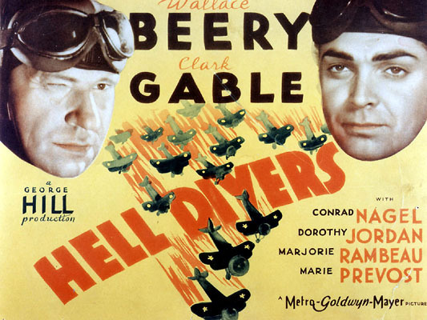
1932: Sound, Black & White

Slide 10
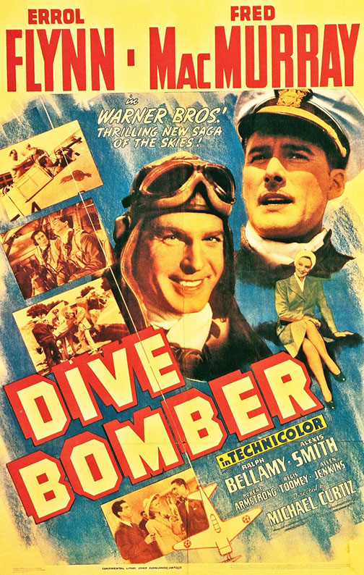
1941: Technicolor

Slide 11
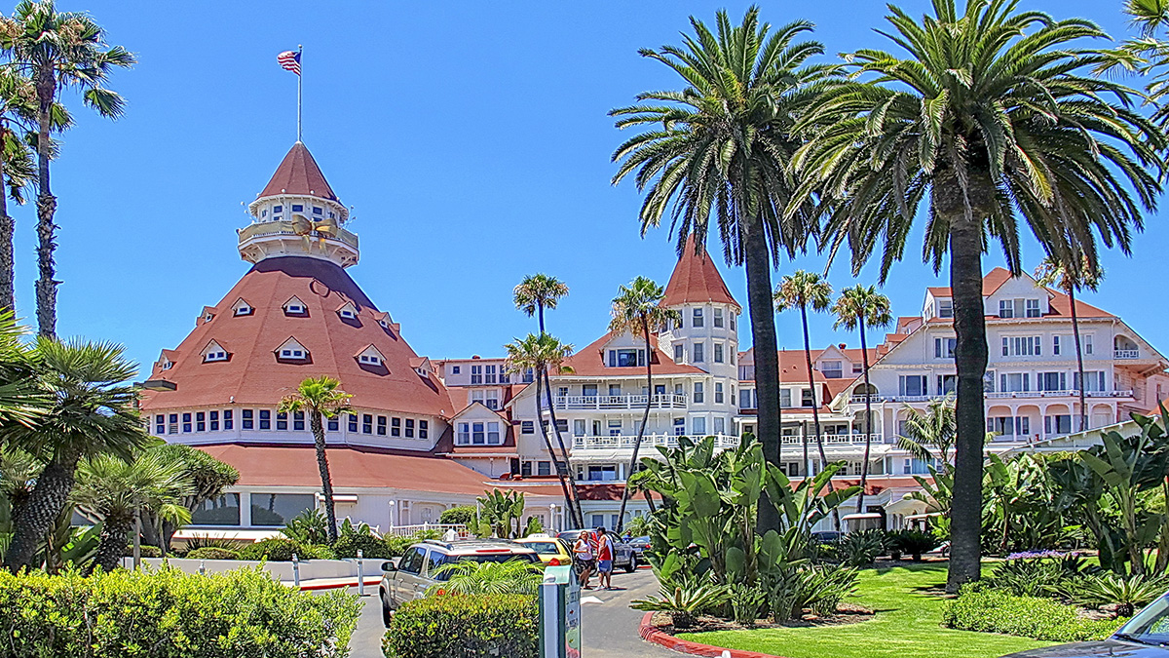
The Hotel Del

Slide 12
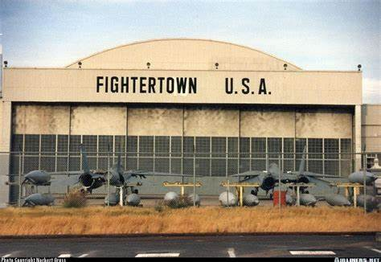
NAS Miramar,1968

Slide 13
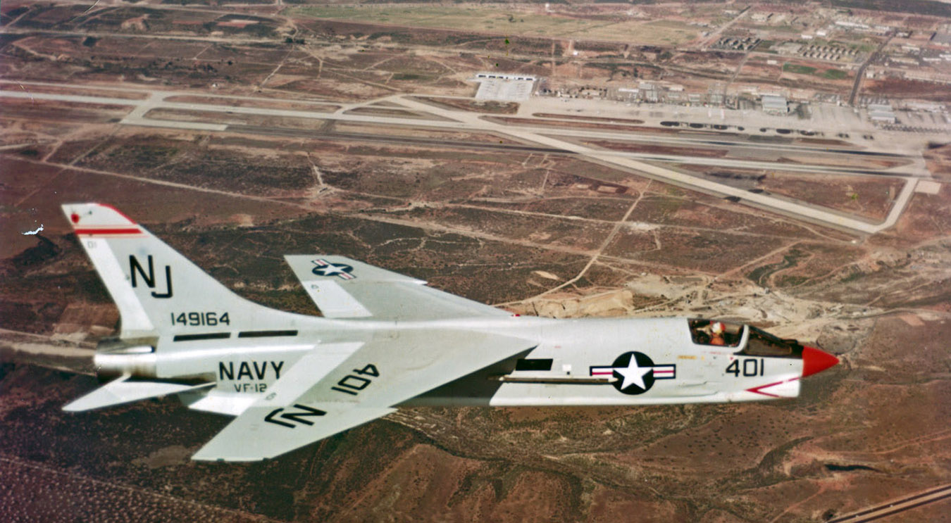
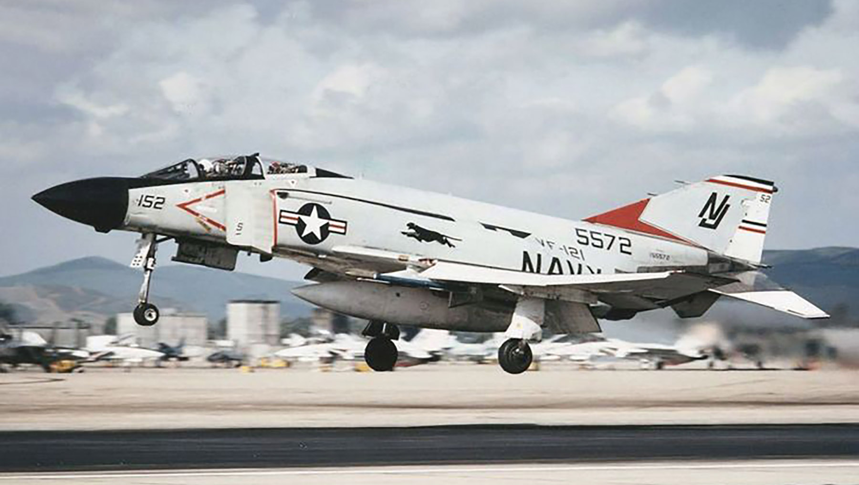
The RAG’s
VF-124
F-8 Crusader
VF-121
F-4 Phantom
Notes:
F-8 first flew in 1955; last time (U.S.) in 1970.
F-8 first fewl in 1958; last time (U.S.) in 1996.
Never flew 149164, but flew 149145 several times.

Slide 14
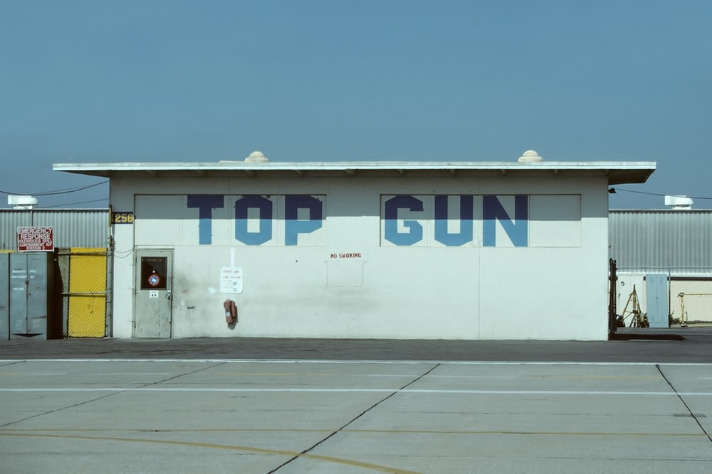
Navy Fighter Weapons School, 1969

Slide 15
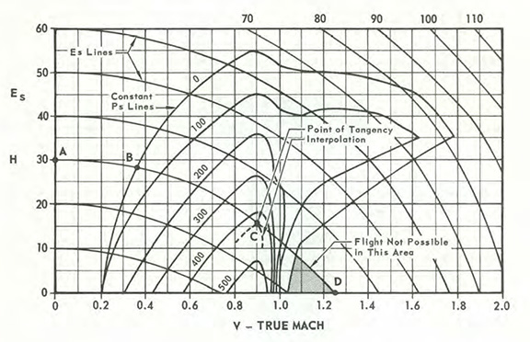
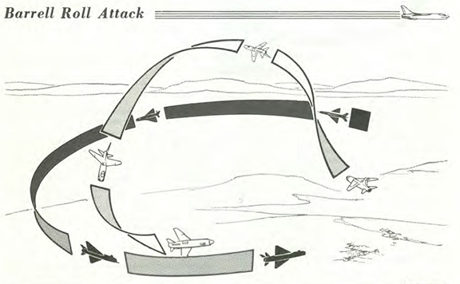
Course Content

Slide 16
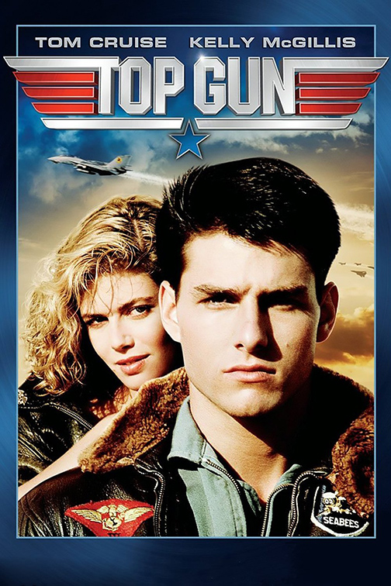
1986

Slide 17
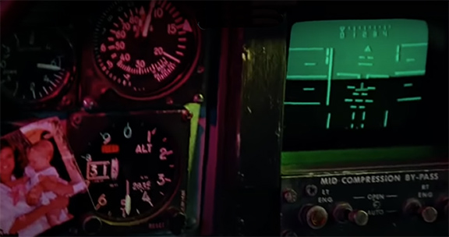
Cougar: False

Slide 18
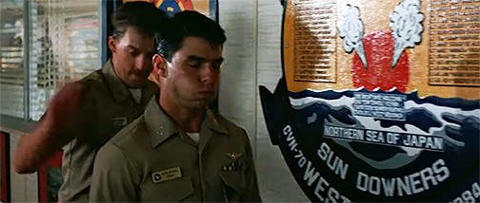
Hell of a First Day: True

Slide 19
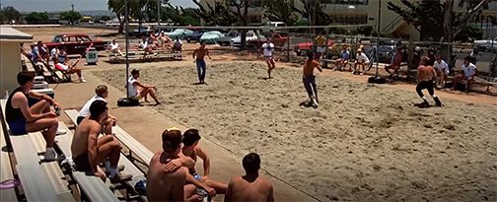
Volleyball Pit: True

Slide 20
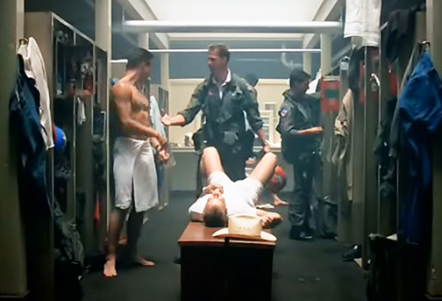
Locker Room: False

Slide 21
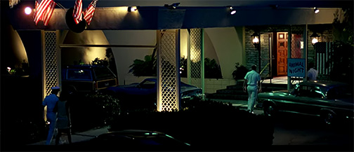
Officers’ Club: True

Slide 22
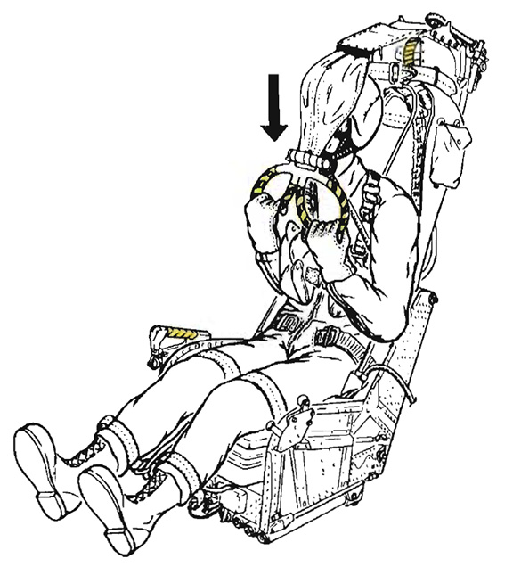
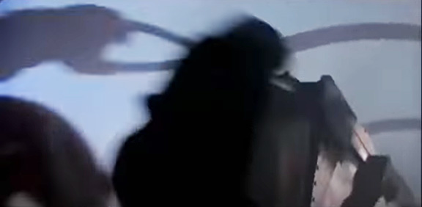
Eject! Eject!: Doubtful

Slide 23
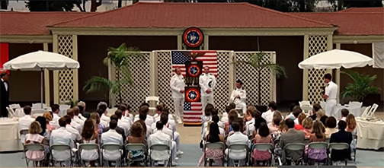
Graduation: True

Slide 24
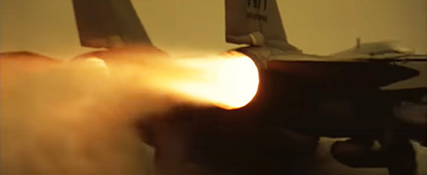
Light Burners for the Danger Zone

Slide 25
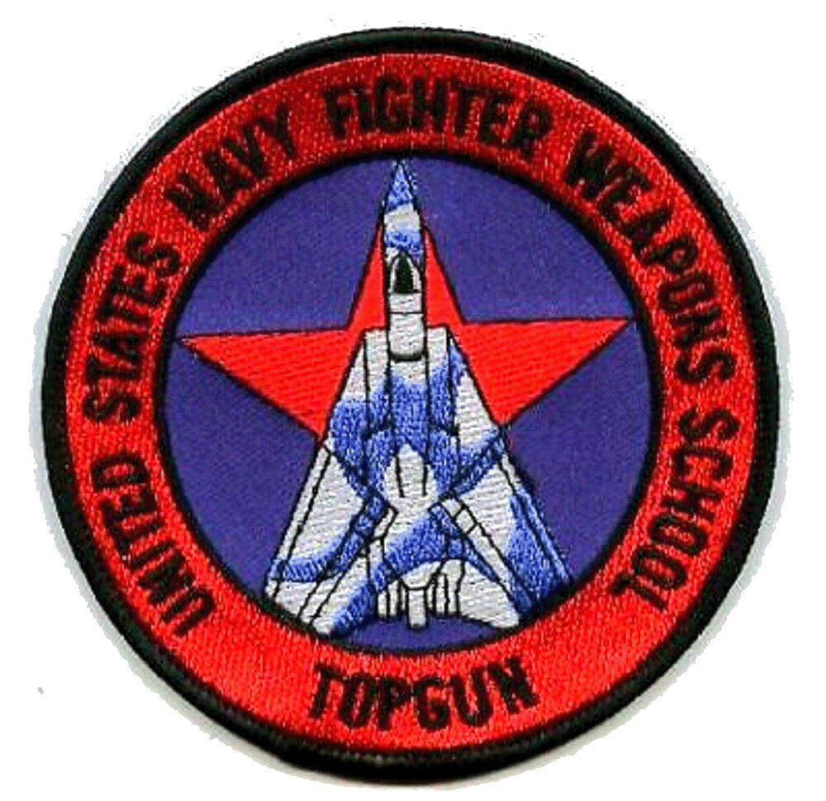
Top Gun

