Slide 1

Corpus Creation Emotion Analysis Assignment 1
Felix Bühler
Carlotta Quensel Max Wegge

Slide 2
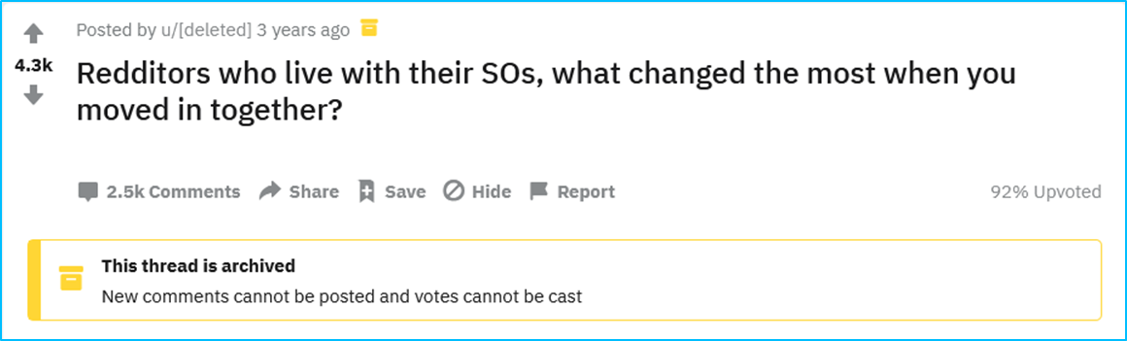
Preparation selecting a data source
topic encourages a variety of emotional responses
sufficient amount of relevant data
ca. 500 stand-alone comments
further answers/questions/ conversations, deleted users and bots were ignored
first 100 comments used for annotation

Slide 3
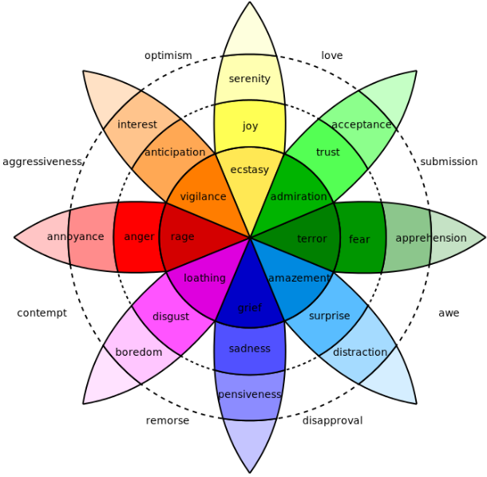
Preparation choosing an emotion model
why we decided to use this model:
eight basic emotions
combinations (e.g. joy + trust = love) open up possibilites to further analyze the data
provides different intensities for each emotion
opposing emotions exclude each other
plutchik‘s wheel of emotions

Slide 4
Preparation choosing an emotion model
why we decided to use this model:
eight basic emotions
combinations (e.g. joy + trust = love) open up possibilites to further analyze the data
provides different intensities for each emotion
opposing emotions exclude each other
problems we encountered while annotating:
plutchik‘s wheel of emotions

Slide 5
Preparation choosing an emotion model
why we decided to use this model:
eight basic emotions
combinations (e.g. joy + trust = love) open up possibilites to further analyze the data
provides different intensities for each emotion
opposing emotions exclude each other
problems we encountered while annotating:
[…] When I lived alone, I would […] have disordered eating or hours-long crying spells […]. I was forced to be a lot more honest about problems […] and I had to actually fix them. I can't present as ideal an image of myself anymore, but the person I actually am has improved. [ID 002]
plutchik‘s wheel of emotions

Slide 6
Preparation choosing an emotion model
why we decided to use this model:
eight basic emotions
combinations (e.g. joy + trust = love) open up possibilites to further analyze the data
provides different intensities for each emotion
opposing emotions exclude each other
problems we encountered while annotating:
some instances contain opposing emotions
the intensity of an emotion does not necessarily correspond to the emotion in the wheel
Hair. Hair everywhere. [ID 004]
plutchik‘s wheel of emotions

Slide 7
Preparation choosing an emotion model
why we decided to use this model:
eight basic emotions
combinations (e.g. joy + trust = love) open up possibilites to further analyze the data
provides different intensities for each emotion
opposing emotions exclude each other
problems we encountered while annotating:
some instances contain opposing emotions
the intensity of an emotion does not necessarily correspond to the emotion in the wheel
adjustments of the model:
the annotation of one emotion does not necessarily exclude its opposed emotion
the intensity of an emotion is not linked to the specific emotion in plutchik‘s wheel
plutchik‘s wheel of emotions

Slide 8
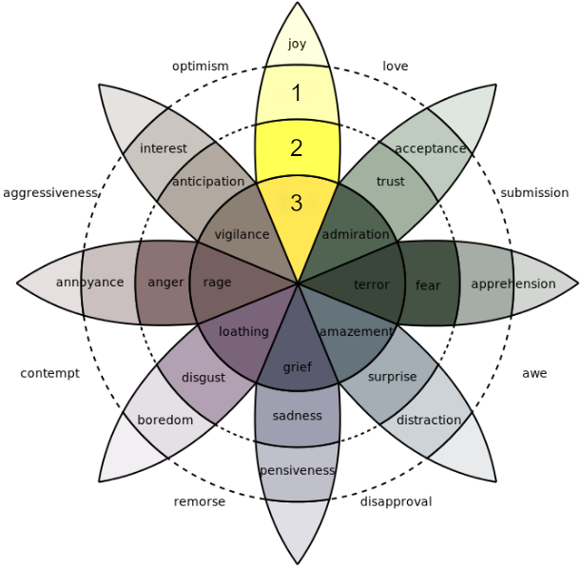
Annotation Task define annotation guidelines
for every instance, each emotion is annotated with a value between 0 and 3
the intensity of an emotion is not linked to the specific emotion in plutchik‘s wheel

Slide 9
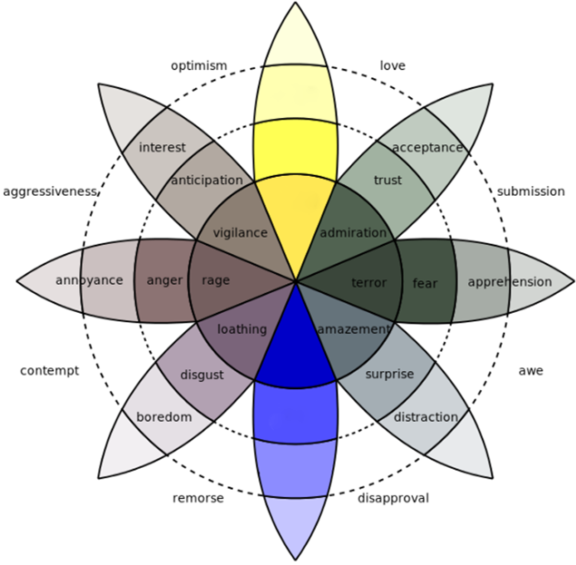
Annotation Task define annotation guidelines
for every instance, each emotion is annotated with a value between 0 and 3
the intensity of an emotion is not linked to the specific emotion in plutchik‘s wheel
the annotation of one emotion does not necessarily exclude its opposed emotion

Slide 10
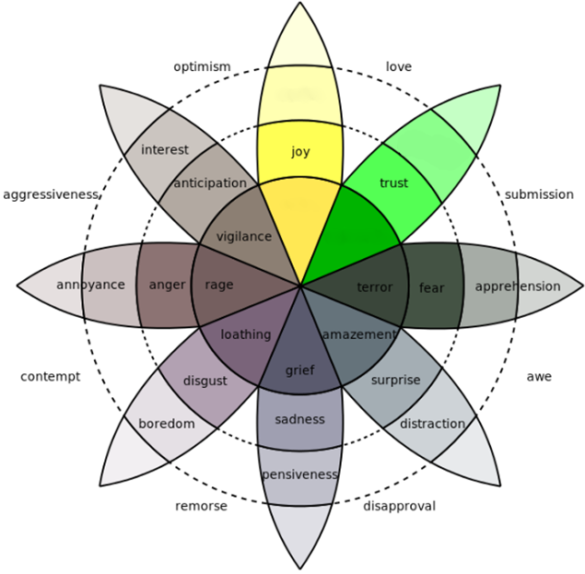
Annotation Task define annotation guidelines
for every instance, each emotion is annotated with a value between 0 and 3
the intensity of an emotion is not linked to the specific emotion in plutchik‘s wheel
the annotation of one emotion does not necessarily exclude its opposed emotion
emotions are not assigned only to trigger combinations

Slide 11
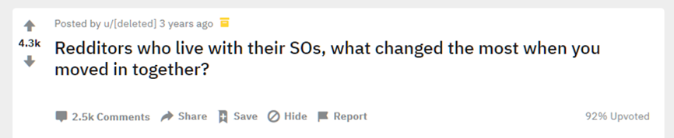
Annotation Task define annotation guidelines
for every instance, each emotion is annotated with a value between 0 and 3
the intensity of an emotion is not linked to the specific emotion in plutchik‘s wheel
the annotation of one emotion does not necessarily exclude its opposed emotion
emotions are not assigned only to trigger combinations
do not annotate emotions that are only implied by the background of the data but not present within the instance

Slide 12
Annotation Task define annotation guidelines
I remember the first time I tripped over her shoes at my place, it was adorable. A real "I'm not alone," warm and fuzzy feeling. That's gone. She's just a slob now. [ID 006]
for every instance, each emotion is annotated with a value between 0 and 3
the intensity of an emotion is not linked to the specific emotion in plutchik‘s wheel
the annotation of one emotion does not necessarily exclude its opposed emotion
emotions are not assigned only to trigger combinations
do not annotate emotions that are only implied by the background of the data but not present within the instance
every emotion that is mentioned within an instance is annotated accordingly
not only assign emotions the author experienced in the moment of writing the comment

Slide 13
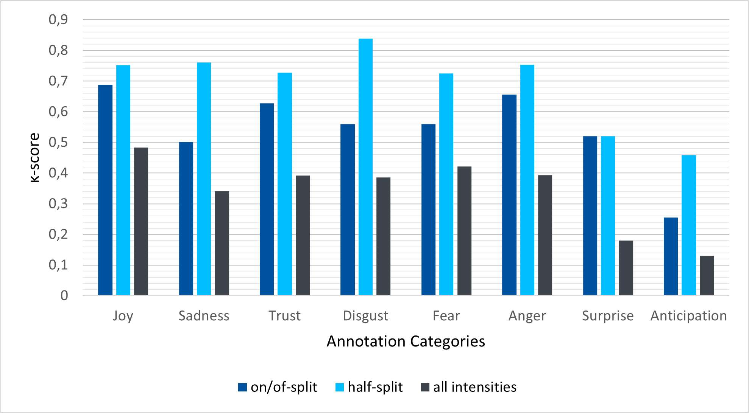
Evaluation inter-annotator agreement

Slide 14
Evaluation anter-annotator agreement
some cases where we agreed pretty strongly
some cases where we disgreed despite having defined an annotation guideline
026: wife died

Slide 15
Evaluation corpus statistics - quantitative
 | Joy | Sadness | Trust | Disgust | Fear | Anger | Surprise | Anticipation
Anticipation | 1 | 0 | 1 | 0 | 0 | 1 | 0 | 2
Surprise | 7 | 1 | 2 | 1 | 0 | 3 | 18
Anger | 1 | 2 | 1 | 1 | 0 | 18
Fear | 0 | 0 | 1 | 1 | 2
Disgust | 0 | 0 | 0 | 5
Trust | 6 | 1 | 16
Sadness | 1 | 5
Joy | 24
Co-annotation of emotions taken from the average of all annotators

Slide 16
Evaluation corpus statistics - quantitative

Slide 17
Evaluation corpus statistics - qualitative
difficulties:
irony/gags/neutrality
difficult emotions:
anticipation (vs surprise)
easy emotions:
joy, trust, anger
fear
disgust

Slide 18
Conclusion take away
emotions are very subjective and so is their annotation
there is no objective measure for scaling emotion intensity
annotation guidelines are imperative
even with guidelines defined, some instances stay debatable
annotators agree more on some emotions than on others

