Slide 1
ML-based Emotion Classification Emotion Analysis Assignment 2
Felix Bühler
Carlotta Quensel Max Wegge

Slide 2
ML feature based (SSEC-own corpus) background
goal:
automatically annotate our own corpus to compare our own annotations with the automatically generated ones
method:
feature based ML
problem:
our corpus does not include enough data do perform proper training on it (especially when considering one needs hold out data for evaluation)
solution:
use another dataset for training
the training data must meet the following criteria:
must provide enough training data
the labels must match the ones we used on our own corpus (Plutchik’s eight emotions, multi-label)
the domain should be similar
→ SSEC meets all of these criteria
research question: Can our own corpus be automatically annotated by a ML algorithm that is trained on another dataset?

Slide 3
ML feature based (SSEC-own corpus) implementation
preprocessing:
remove stopwords
use stopword list from the NLTK
keep ‘not’ as it could bear emotional meaning
punctuation marks (‘.’ , ‘:’ , ‘,’ ,…)
stemming (Lancaster stemmer, NLTK)
choice of classifier: Naive Bayes
one classifier per emotion
original instance: He who exalts himself shall be humbled; and he who humbles himself shall be exalted.Matt 23:12. #SemST
output after preprocessing: ['exalt', 'shal', 'humbl', 'humbl', 'shal', 'exalted.matt', '23:12']

Slide 4
ML feature based (SSEC-own corpus) evaluation
most informative features (learned from SSEC)
term | probability | label
wow | 0.97 (32.6 : 1) | surprise
lovewin | 0.96 (23 : 1) | joy
liberty | 0.89 (8 : 1) | not sadness
happy | 0.92 (11.8 : 1) | not fear
c | 0.92 (11.6 : 1) | surprise
rap | 0.97 (29.8 : 1) | disgust
the features for the emotions sadness (and trust) are comparably less informative
although generally advantageous, stemming/lemmatizing can have unwanted side effects

Slide 5
ML feature based (SSEC-own corpus) evaluation
 | joy | sadness | trust | disgust | anger | fear | surprise | anticipation
precision | 0.654 | 0.687 | 0.612 | 0.653 | 0.747 | 0.533 | 0.209 | 0
recall | 0.621 | 0.75 | 0.644 | 0.7 | 0.813 | 0.596 | 0.267 | 0
accuracy | 0.728 | 0.655 | 0.579 | 0.664 | 0.707 | 0.637 | 0.692 | 1
f1 | 0.637 | 0.717 | 0.628 | 0.676 | 0.779 | 0.563 | 0.235 | 0
‘Anticipation’ does not occur in the training data
evaluation on SSEC (testset)
 | joy | sadness | trust | disgust | anger | fear | surprise | anticipation
precision | 0.23 | 0.055 | 0.141 | 0.078 | 0.167 | 0 | 0.176 | 0
recall | 0.609 | 0.8 | 0.562 | 0.8 | 0.667 | 0 | 0.353 | 0
accuracy | 0.434 | 0.293 | 0.374 | 0.515 | 0.333 | 0.657 | 0.606 | 0.98
f1 | 0.333 | 0.103 | 0.225 | 0.143 | 0.267 | 0 | 0.235 | 0
evaluation on our own corpus
Accumulated accuracy: 0.101

Slide 6
Deep Learning (TEC-CrowdFlower) background
research question:
Will a NN trained on one dataset evaluate as well on the other corpus as it does on its own test set?
to use the data of each corpus for both training and testing, both coprora must meet the following criteria:
sufficient amount of (training) data
matching annotation labels
similar (or no specific) domain and data type (tweets, sentences, …)
-> TEC and CrowdFlower

Slide 7
2. research question method (architecture)
preprocessing
remove nltk-stopwords (except "not" and "but“)
lemmatizing (WordNet Lemmatizer)
stemming (Porter Stemmer)
VocSize = 400.000, Input length = 33 words
GloVe Embedding
counter class-imbalances using class_weights
reduce learning rate on plateau
Embedding (33,100)
BiLSTM (32)
Dropout (0.5)
Output (6)
architecture of the BiLSTM

Slide 8
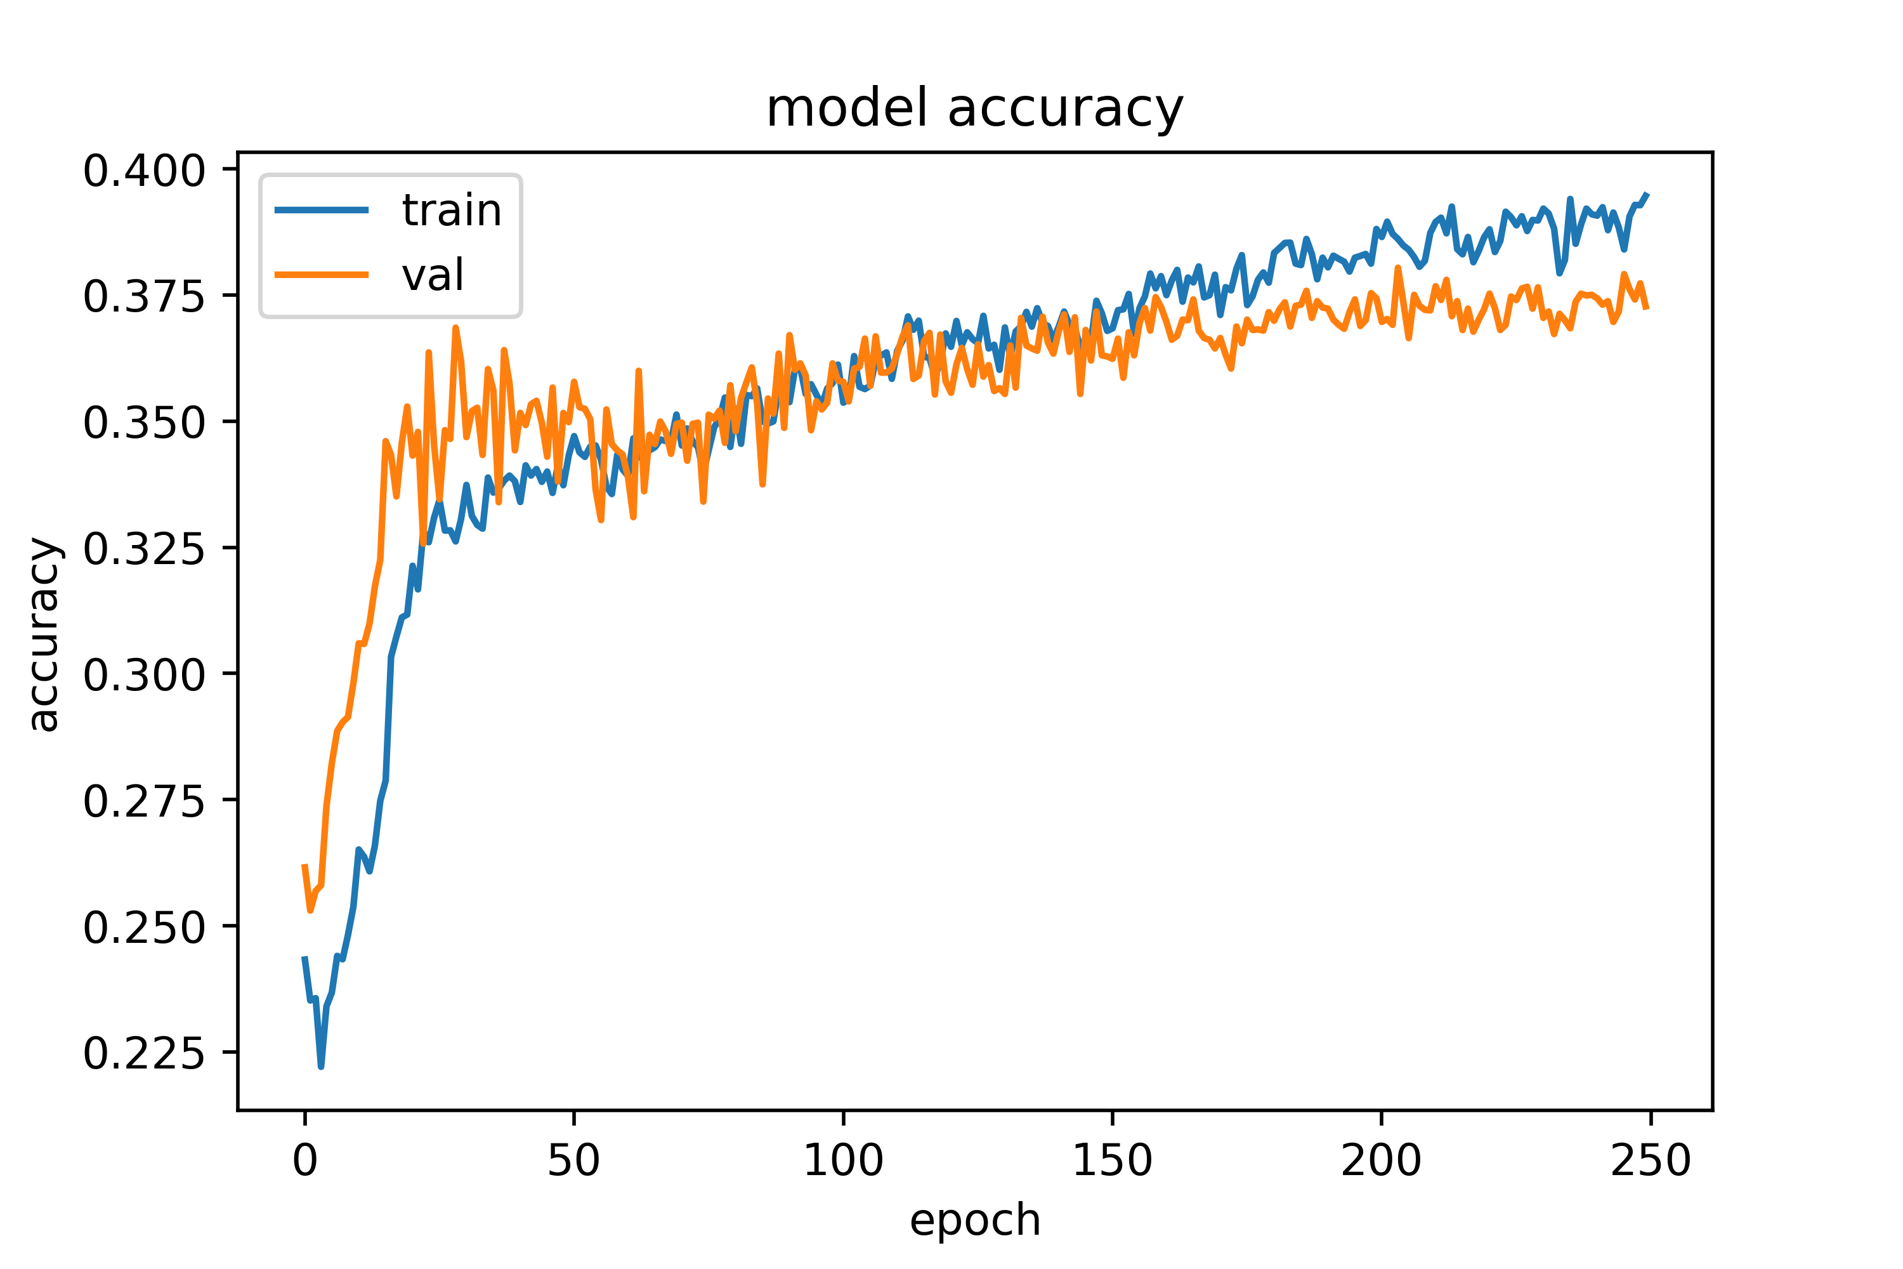
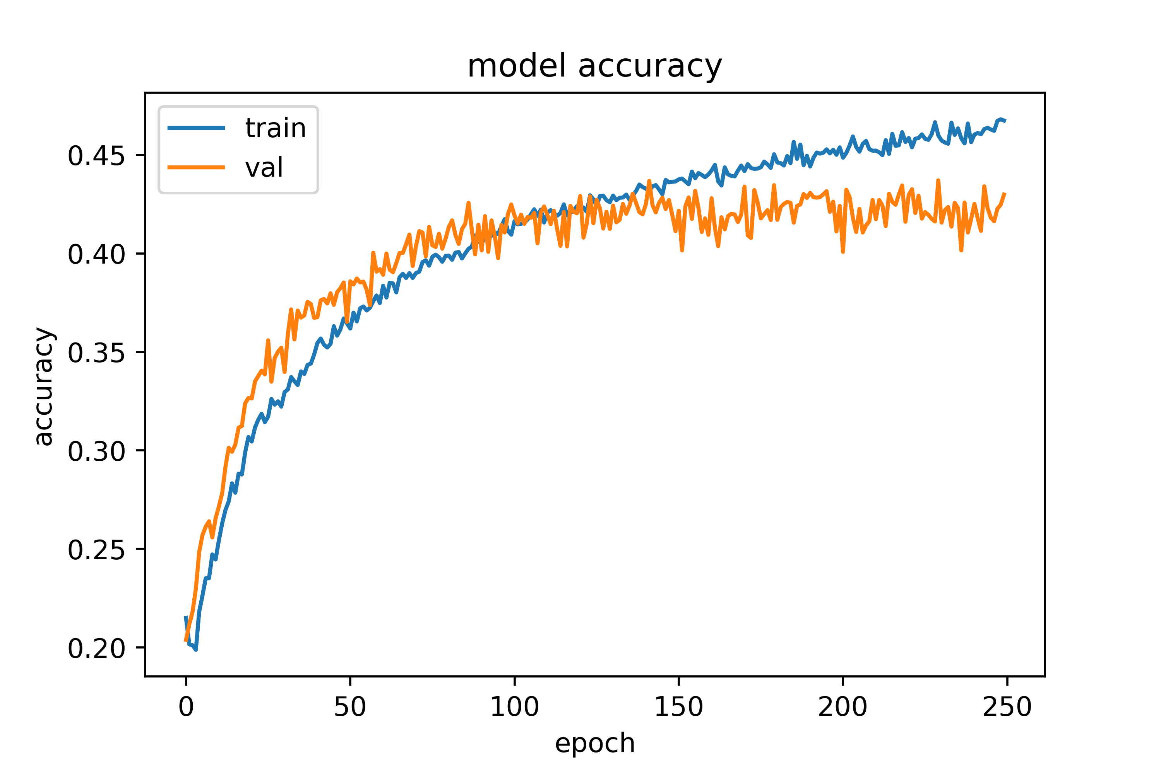
2. research question evaluation
trained on CrowdFlower evaluated on TEC
trained on TEC evaluated on CrowdFlower

Slide 9
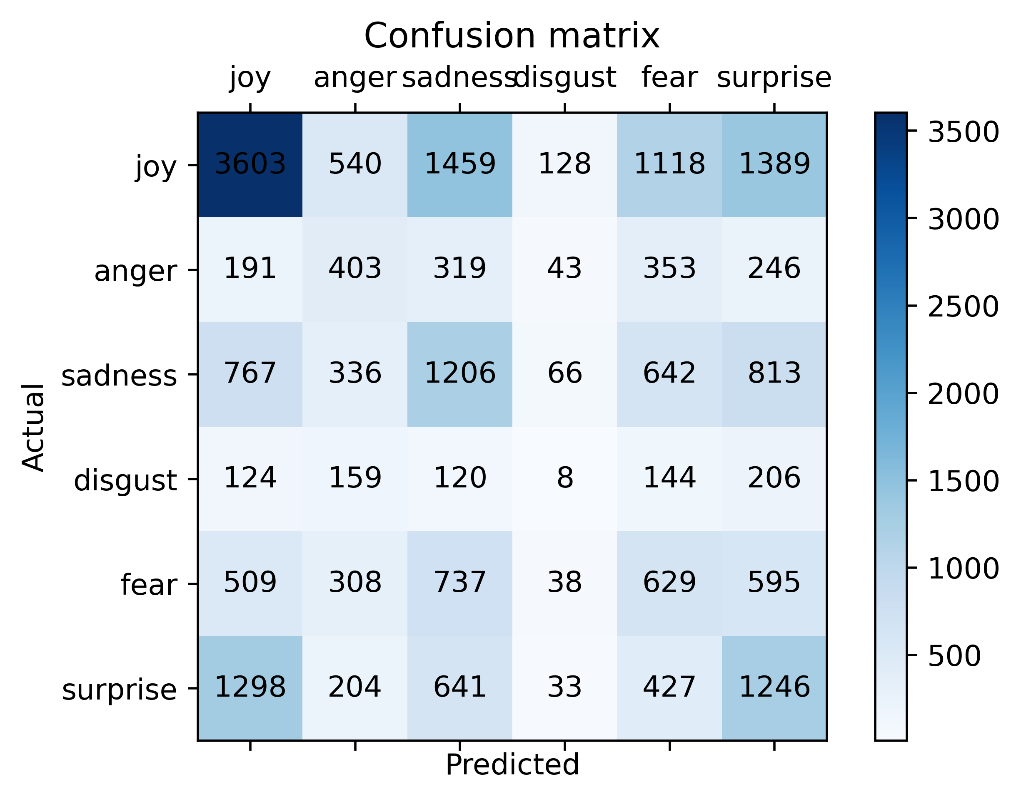
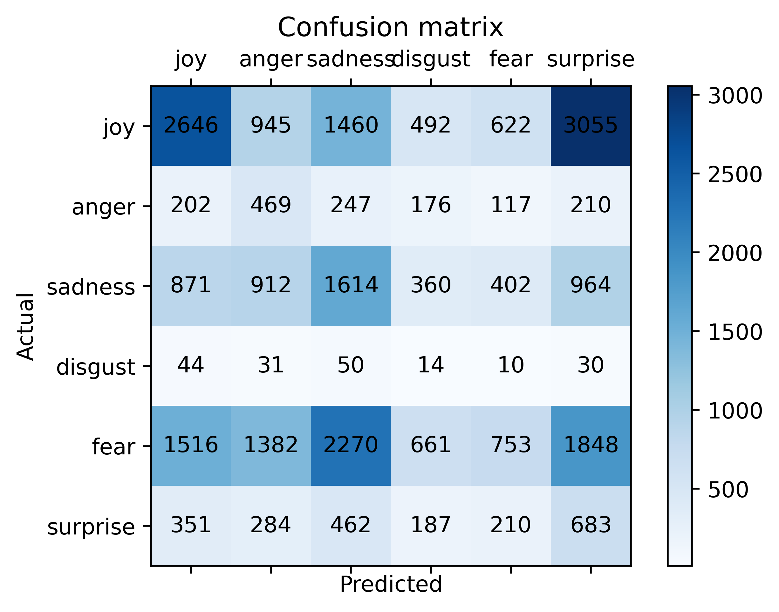
2. research question evaluation
F1 (micro): 0.337
F1 (micro):0.232
trained on CrowdFlower evaluated on TEC
trained on TEC evaluated on CrowdFlower

Slide 10
2. research question evaluation
training on TEC, predicting CrowdFlower:
dont wanna work 11-830 tomorrow but i get paid
predicted-label: sadness
true-label: sadness
sucks not being able to take days off of work or have the money to take the trip so sad
predicted-label: sadness
true-label: fear
my twitter has been hacked again
predicted-label: anger
true-label: fear
I just eat a reallyyy good ice cream!
predicted-label: surprise
true-label: joy
training on CrowdFlower, predicting TEC:
the moment when you get another follower and you cheer.
predicted-label: joy
true-label: joy
Can honestly say, don't think I've ever done so shit in an exam before
predicted-label: anger
true-label: joy
Como una expresión tan simple, una sola oración, puede llegara dañarte tanto.
predicted-label: surprise
true-label: sadness

Slide 11
Conclusion/ Take away
the performance of both ML and DL relies on (training) data
the quality of their respective training data determines the performance
to obtain better results, both datasets should be from one domain
‘balanced’ classes produce better results
feature-based relies more on observable features, DL is able to detect underlying/hidden context
feature-based ML is explainable, Deep Learning is a black box approach

Slide 12
Thank you for listening!
Questions?

