Slide 1
ML-based Emotion Role Labelling Emotion Analysis Assignment 4
Felix Bühler
Carlotta Quensel Max Wegge

Slide 2
research question data choice
Does the choice of training data influence the result of the classifier and how?
emotion roles are determined semantically but this information is partially included in the syntactic structure
label the emotion target which is often an NP (for example the person or institution, the emotion is directed at)
How will corpora with very different syntax change the trained algorithm:
GoodNewsEveryone: news headlines, which are abbreviated and include ‘ungrammatical’ telegram style sentences
Reman: complex sentences with three segments from literature
Electoral Tweets: everyday language usage from twitter users
We train and evaluate our target classifier on all three of these very different corpora

Slide 3
research question method choice
How do a naïve and a complex algorithm differ in their labelling results?
sequence labelling is harder than nominal classification and needs context information
compare a naïve approach without much context to a complex method
Hidden Markov model – takes the context of prior labels but not of tokens into account
Transformer – uses ???

Slide 4
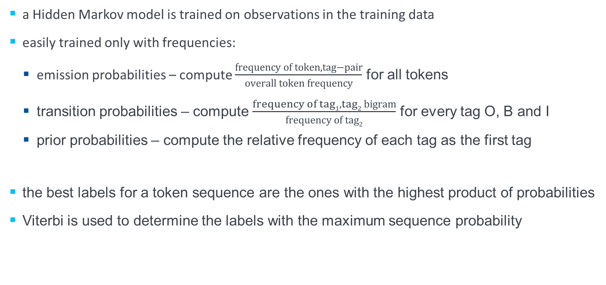
method Hidden Markov/viterbi
a Hidden Markov model is trained on observations in the training data
easily trained only with frequencies:
emission probabilities – compute $\frac{frequency of token,tag−pair}{overall token frequency}$ for all tokens
transition probabilities – compute $\frac{frequency of tag1, tag2 bigram}{frequency of tag2}$ for every tag O, B and I
prior probabilities – compute the relative frequency of each tag as the first tag
the best labels for a token sequence are the ones with the highest product of probabilities
Viterbi is used to determine the labels with the maximum sequence probability

Slide 5
method RoBERTa
Transformer
X epochs
RoBERTa Tokenizer ("O"-padding to input length 100)
RoBERTa(768)
LSTM(64)
LSTM(64)
DENSE(3)
100 (max. sentence length), 3

Slide 6
Evaluation interpretation
intersections between target and predicted sequence are evaluated as True Positive
empty intersections are evaluated as false classifications
not predicting target sequence: False Negative
predicting non-target sequence: False Positive
multiple sequences mapped onto one are evaluated as one
True Negatives (correctly predicting non-target sequence) are omitted
ID ‘gne-84‘
"Manchin knocks Barr : He should be focused on protecting the Constitution"
Target
[ "B", "O", "O", "O", "B", "I", "I", "I", "I", "I", "I", "I" ]
possible Prediction
TP
TP
possible Prediction
FP
TP
possible Prediction
FP
FN
possible Prediction
FN
TP

Slide 7
evaluation Hidden Markov
trained on Reman
trained on GNE
trained on Electoral Tweets
_{pred} ^{gold} | target | outside
target | 6335 | 11087
outside | 1099 | –
_{pred} ^{gold} | target | outside
target | 2132 | 5788
outside | 1559 | –
_{pred} ^{gold} | target | outside
target | 4365 | 11739
outside | 1026 | –
precision – 0.364
recall – 0.852
f – 0.510
precision – 0.269
recall – 0.578
f – 0.367
precision – 0.271
recall – 0.810
f – 0.406
every model is trained as stated above and evaluated on the other two corpora
the model trained on Reman has the best overall scores
literature → syntactically correct → best transition possibilities
all models predict way too many sequences (low precision)
long sequences covering multiple gold sequences distort the results

Slide 8
Thank you for listening!
Questions?
We started to hate each other. [ID 235]
Emotion Analysis | ML-based Emotion Role Labelling Felix Bühler | Max Wegge | Carlotta Quensel

