Slide 1

Corpus Creation Emotion Analysis Assignment 1
Felix Bühler
Carlotta Quensel Max Wegge

Slide 2
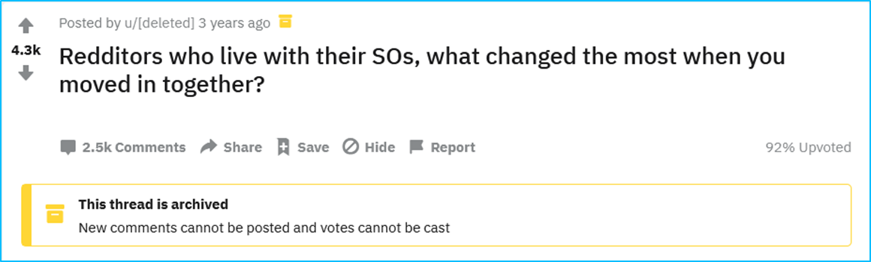
Preparation selecting a data source
topic encourages a variety of emotional responses
sufficient amount of relevant data
ca. 500 stand-alone comments
further answers/questions/ conversations, deleted users and bots were ignored
first 100 comments used for annotation

Slide 3
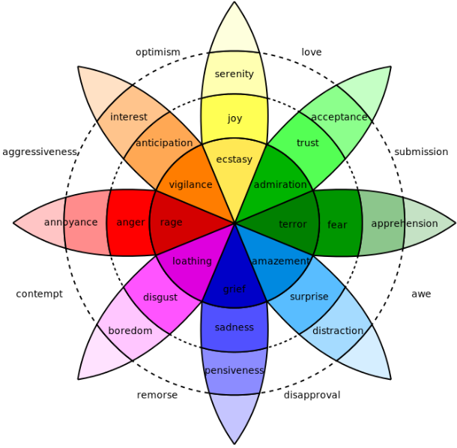
Preparation choosing an emotion model
why we decided to use this model:
eight basic emotions
combinations
different intensities
Plutchik‘s wheel of emotions

Slide 4
Preparation choosing an emotion model
problems we encountered while annotating:
instances containing opposing emotions
[…] When I lived alone, I would […] have disordered eating or hours-long crying spells […]. I was forced to be a lot more honest about problems […] and I had to actually fix them. I can't present as ideal an image of myself anymore, but the person I actually am has improved. [ID 002]

Slide 5
Preparation choosing an emotion model
problems we encountered while annotating:
instances containing opposing emotions
intensity ≠ emotion in the wheel
adjustments of the model:
opposing emotions can co-occur
Intensity scores are separate from Plutchik’s wheel
[…] When I lived alone, I would […] have disordered eating or hours-long crying spells […]. I was forced to be a lot more honest about problems […] and I had to actually fix them. I can't present as ideal an image of myself anymore, but the person I actually am has improved. [ID 002]
Hair. Hair everywhere. [ID 004]

Slide 6
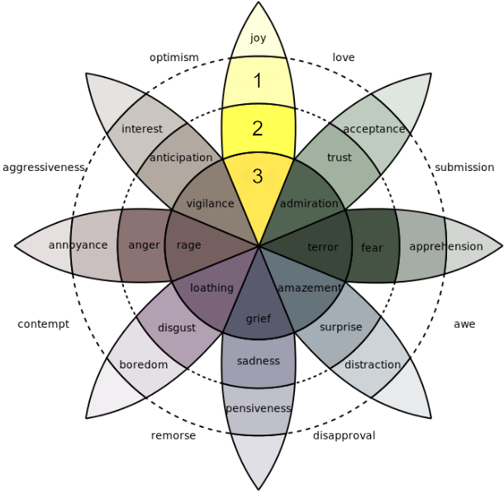
Annotation Task define annotation guidelines
for every instance, each emotion is assigned a value between 0 and 3

Slide 7
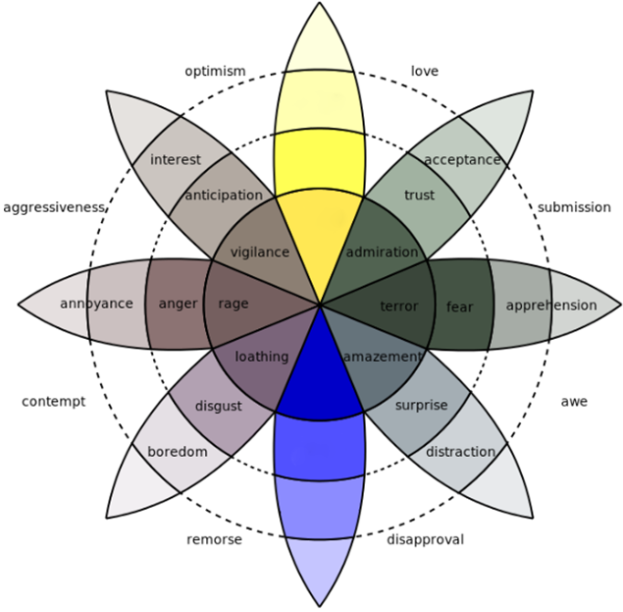
Annotation Task define annotation guidelines
for every instance, each emotion is assigned a value between 0 and 3
intensity scores are not linked to the emotion in Plutchik’s wheel
the annotation of one emotion does not exclude its opposed emotion

Slide 8
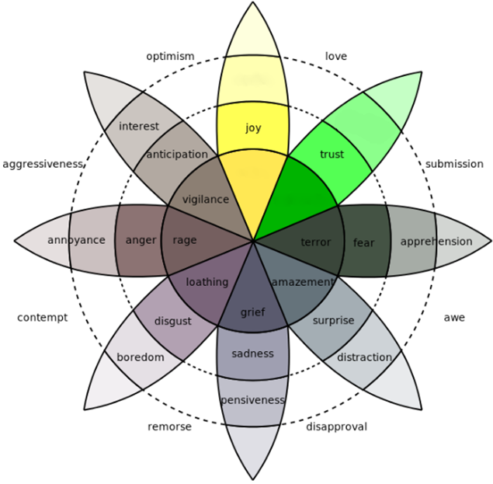
Annotation Task define annotation guidelines
for every instance, each emotion is assigned a value between 0 and 3
intensity scores are not linked to the emotion in Plutchik’s wheel
the annotation of one emotion does not exclude its opposed emotion
emotions are not assigned to trigger combinations

Slide 9
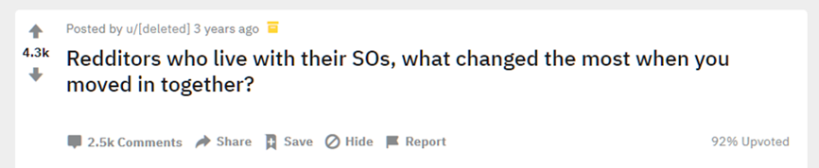
Annotation Task define annotation guidelines
for every instance, each emotion is assigned a value between 0 and 3
intensity scores are not linked to the emotion in Plutchik’s wheel
the annotation of one emotion does not exclude its opposed emotion
emotions are not assigned to trigger combinations
emotions that are only implied by the corpus domain but not present in the instance are not annotated

Slide 10
Annotation Task define annotation guidelines
I remember the first time I tripped over her shoes at my place, it was adorable. A real "I'm not alone," warm and fuzzy feeling. That's gone. She's just a slob now. [ID 006]
for every instance, each emotion is assigned a value between 0 and 3
intensity scores are not linked to the emotion in Plutchik’s wheel
the annotation of one emotion does not exclude its opposed emotion
emotions are not assigned to trigger combinations
emotions that are only implied by the corpus domain but not present in the instance are not annotated
perspective: described situations/emotions
not the author‘s experience while writing the comment

Slide 11
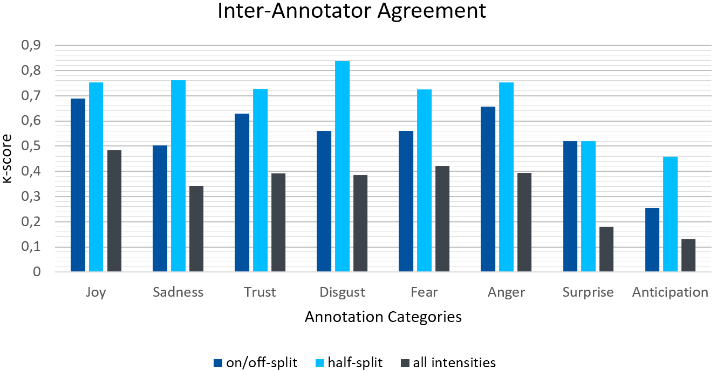
Evaluation inter-annotator agreement

Slide 12
Evaluation inter-annotator agreement
I really had to cut down on the gaming... like... drastically.
I didn't really go out much except maybe once every other week since drinking is so expensive, and I don't watch tv, so when I wasn't working or in school I would be gaming. Period. That's been my hobby for years. I would spend hours every evening like it was nothing.
Yeah, turns out that makes a woman feel hopelessly neglected and alone after a bit. Sacrifices were made. It was a huge point of contention for a while, but we are much happier now. [ID 036]
joy |  |  | sadness |  | sadness | trust |  |  | disgust |  | disgust | fear |  | fear | anger |  |  | surprise |  |  | anticipation
1 | 0 | 2 | 1 | 2 | 1 | 1 | 0 | 2 | 0 | 0 | 0 | 0 | 0 | 0 | 0 | 1 | 1 | 2 | 0 | 1 | 0 | 0 | 1
the longer a text, the more we disagreed despite the guidelines

Slide 13
Evaluation corpus statistics - quantitative
 | Joy | Sadness | Trust | Disgust | Fear | Anger | Surprise | Anticipation
Anticipation | 1 | 0 | 1 | 0 | 0 | 1 | 0 | 2
Surprise | 7 | 1 | 2 | 1 | 0 | 3 | 18
Anger | 1 | 2 | 1 | 1 | 0 | 18
Fear | 0 | 0 | 1 | 1 | 2
Disgust | 0 | 0 | 0 | 5
Trust | 6 | 1 | 16
Sadness | 1 | 5
Joy | 24
Co-annotation of emotions taken from the average of all annotators

Slide 14
Evaluation corpus statistics - quantitative
 | Felix | Carlotta | Max | Ø / Emotion
joy | 35 | 28 | 22 | 28,33
sadness | 11 | 6 | 4 | 7
trust | 21 | 23 | 16 | 20
disgust | 7 | 6 | 2 | 5
fear | 3 | 3 | 2 | 2,67
anger | 26 | 19 | 19 | 21,33
surprise | 43 | 24 | 19 | 28,67
anticipation | 10 | 15 | 3 | 9,33
Ø /Text | 1,56 | 1,24 | 0,87
Number of emotions assigned by each annotator

Slide 15
Evaluation corpus statistics - qualitative
difficulties:
irony/gags
neutrality
difficult emotions:
anticipation (vs surprise)
Not much changed.
... Until the fire nation attacked. [ID 076]
The way we organize our books. He likes them to be organized by topic or use, then grouped into subgroups and arranged alphabetically.
I like things to be arranged by topic, then arranged visually on the shelf so that they're grouped by size and the largest books are near the outside of the shelf (on both ends) moving inward to the smallest. And the heaviest books all have to be on the bottom shelf. [ID 031]

Slide 16
Evaluation corpus statistics - qualitative
easy emotions:
disgust
anger, joy, sadness
The way we organize our books. He likes them to be organized by topic or use, then grouped into subgroups and arranged alphabetically.
I like things to be arranged by topic, then arranged visually on the shelf so that they're grouped by size and the largest books are near the outside of the shelf (on both ends) moving inward to the smallest. And the heaviest books all have to be on the bottom shelf. [ID 031]

Slide 17
Conclusion take away
emotions are very subjective and so is their annotation
there is no objective measure for scaling emotion intensity
annotation guidelines are imperative
even with guidelines defined, some instances remain debatable
annotators agree more on some emotions than on others

