Slide 1
Simple Touch Prediction With Built-In IMUs Intermediate Presentation
Felix Bühler, Benedict Steuerlein
FaPra Machine Learning and Computer Vision for HCI | Pfaffenwaldring 5a | 08.01.19
Notes:
We are F and B an our subject is Simple Touch Prediction with built in IMUs

Slide 2
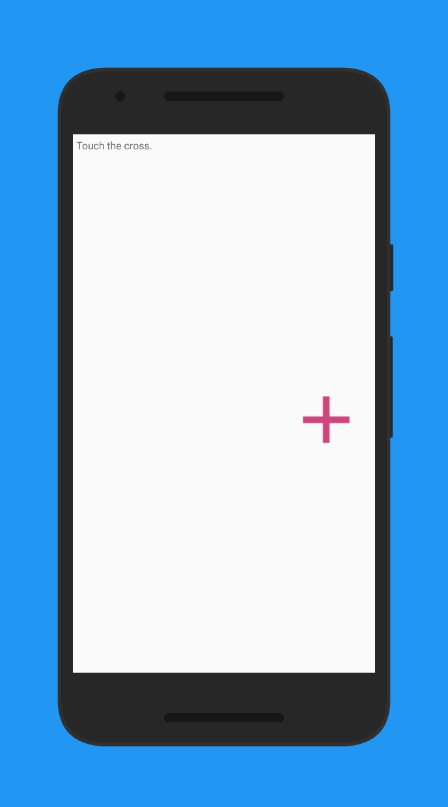
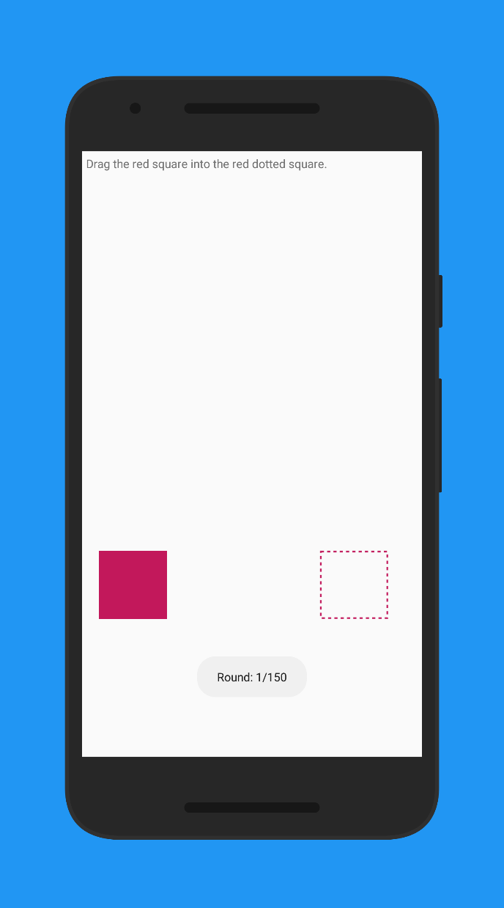
Carried out study with 18 participants
Still need 2 participants!
Current Status

Slide 3
Preprocessing
Segmentation
Remove duplicates
Sensor data alignment
Data generator
Model training
Current Status
For 18 participants on one phone:
12 GB in RAM
We will have 20 participants and four phones:
52 GB in RAM
Data generator reading hdf5 files from hard drive
Slower, but almost no RAM utilization
Limited by hardware!

Slide 4
Preprocessing
Segmentation
Remove duplicates
Sensor data alignment
Data generator
Model training
Current Status
Trained our first model
Only for Nexus 5X
18 participants (13 train – 5 test)
After 240 epochs (10 days, 5h)
Euclidean distance between actual touch and predicited touch: 63.51 mm
Hint from Sven that our loss function is calculating the mean instead of RMSE (thank you, stackoverflow)
Repeat training with correct loss function

Slide 5
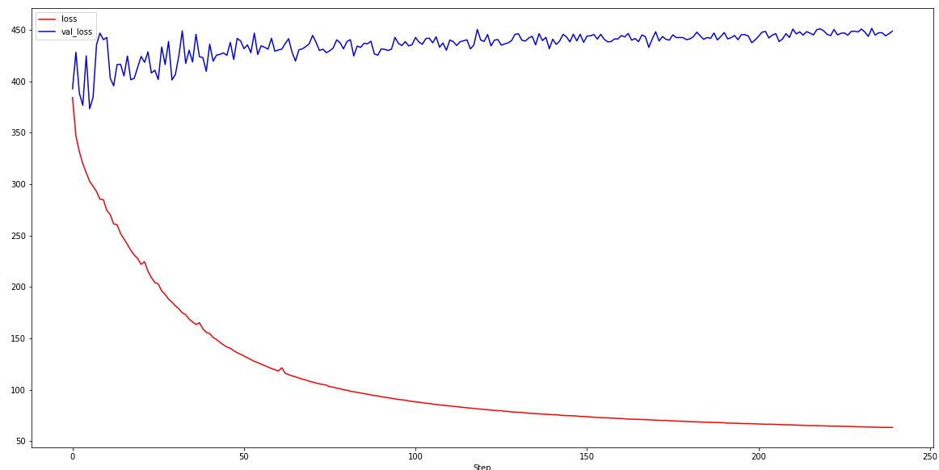
Model Accuracy
This can’t be right
Pixel
Epochs

Slide 6
Agenda
Nov
Dez
Jan 2019
Feb
Today
Discussion
11/6/2018
11/13/2018
2018
11/13/2018
Android App
11/27/2018
Data Collection Study
11/28/2018
12/11/2018
8 Tage
12/11/2018
Network Training
1/8/2019
Discussion
15 Tage
1/8/2019
1/15/2019
14 Tage
1/15/2019
Evaluation
1/29/2019
Paper Revision
29 Tage
1/29/2019
2/5/2019
8 Tage
11/27/2018
Writing Paper
2/5/2019
15 Tage
8 Tage
71 Tage
Notes:
Right no we are on schedule.
Finished implementing the study app.
From now on, we want to conduct the study

Slide 7
Currently only using window size of 150ms (50 samples) due to data.
What could be wrong?
Should we switch to classification instead of regression?
Questions

