Slide 1
Simple Touch Prediction With Built-In IMUs Intermediate Presentation
Felix Bühler, Benedict Steuerlein
FaPra Machine Learning and Computer Vision for HCI | Pfaffenwaldring 5a | 11.12.18
Notes:
We are F and B an our subject is Simple Touch Prediction with built in IMUs

Slide 2
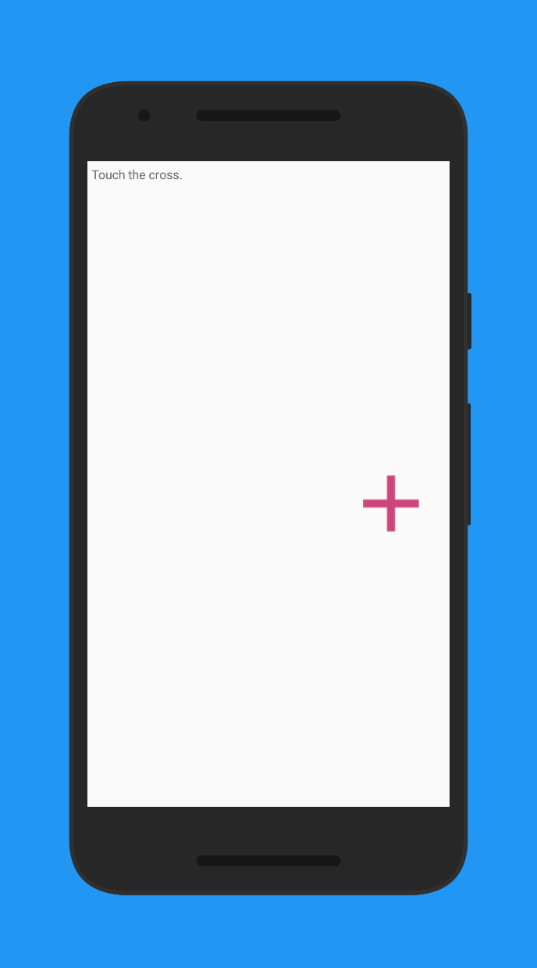
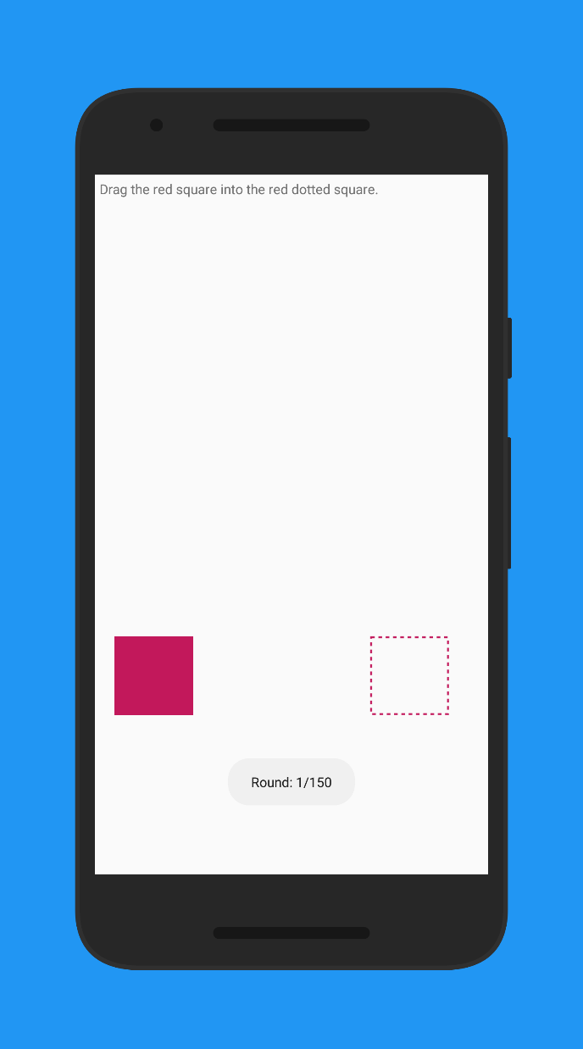
Working study app
Align crosses in a 16 x 9 grid
Fitts Task inbetween
Meanwhile record IMU
Carried out study with first participants
Current Status

Slide 3
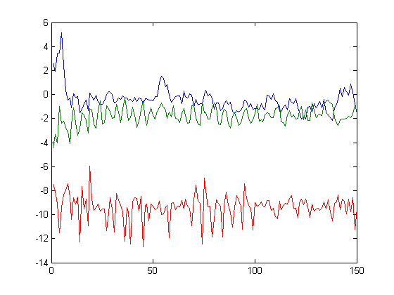
Preprocessing
Segmentation
Remove duplicates
Sensor data alignment
Current Status
[ ]
Touch
Fitts
Touch
These are the parts we are interested in!

Slide 4
Preprocessing
Segmentation
Remove duplicates
Sensor data alignment
Current Status
[ ]
Touch
Fitts
Touch
These are not!

Slide 5
Preprocessing
Segmentation
Remove duplicates
Sensor data alignment
Current Status
Touch
Touch
x
x
x
x
x
Time
Time

Slide 6
Agenda
Nov
Dez
Jan 2019
Feb
Today
Discussion
11/6/2018
11/13/2018
2018
11/13/2018
Android App
11/27/2018
Data Collection Study
11/28/2018
12/11/2018
8 Tage
12/11/2018
Network Training
1/8/2019
Discussion
15 Tage
1/8/2019
1/15/2019
14 Tage
1/15/2019
Evaluation
1/29/2019
Paper Revision
29 Tage
1/29/2019
2/5/2019
8 Tage
11/27/2018
Writing Paper
2/5/2019
15 Tage
8 Tage
71 Tage
Notes:
Right no we are on schedule.
Finished implementing the study app.
From now on, we want to conduct the study

Slide 7
Can we take the S3 Mini away?
Are n x m touches sufficient? (with e.g. a 10 x 15 grid)
For writing the paper, which layout shall we use?
Questions

