Slide 1
Simple Touch Prediction With Built-In IMUs
Felix Bühler, Benedict Steuerlein
FaPra Machine Learning and Computer Vision for HCI | Pfaffenwaldring 5a | 06.11.18

Slide 2
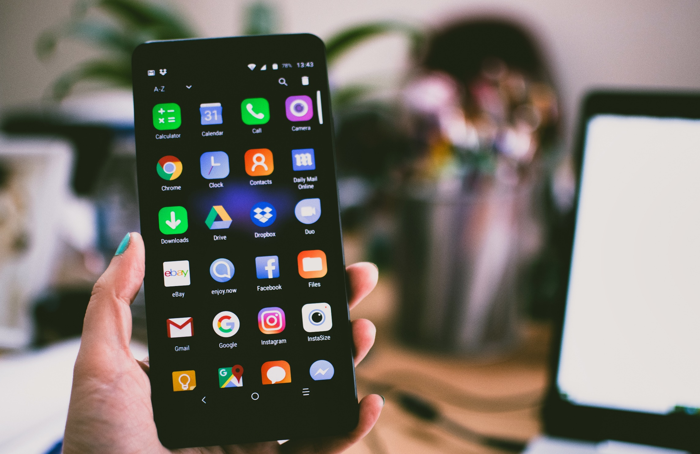
Smartphones sizes are increasing steadily
Whole front screen can not be reached without changing the grip
Predict where users want to touch

Slide 3
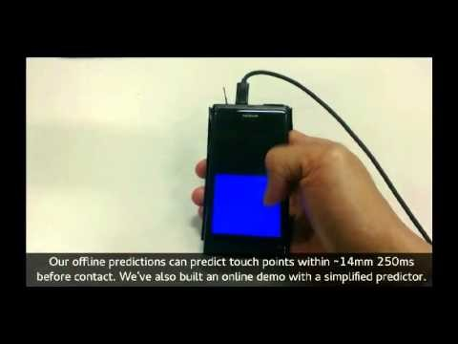
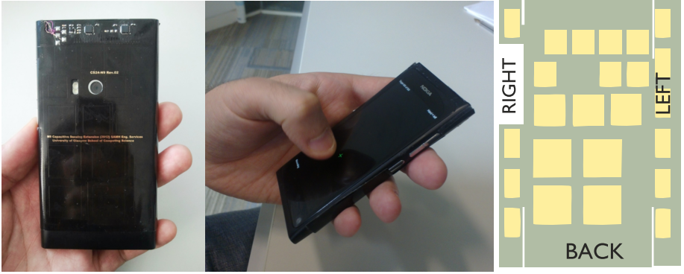
Related Work – Eines der Bilder
24 sensors on Back-of-Device (BoD)
Grip shift on BoD to predict front-of-screen targeting
Mohd Noor, M. F., Ramsay, A., Hughes, S., Rogers, S., Williamson, J., & Murray-Smith, R. 28 frames later: predicting screen touches from back-of-device grip changes. In Proc. of SIGCHI ’14 ACM.
DOI: http://dx.doi.org/10.1145/2556288.2557148
Notes:
They used Gaussian Process Regression

Slide 4
Related Work
Combination of neural networks and IMU
In order to reduce input latency
Le, H. V., Schwind, V., Göttlich, P., & Henze, N.. PredicTouch: A System to Reduce Touchscreen Latency using Neural Networks and Inertial Measurement Units. In Proc. of ACM ‘17 International Conference on Interactive Surfaces and Spaces. DOI: http://dx.doi.org/10.1145/3132272.3134138

Slide 5
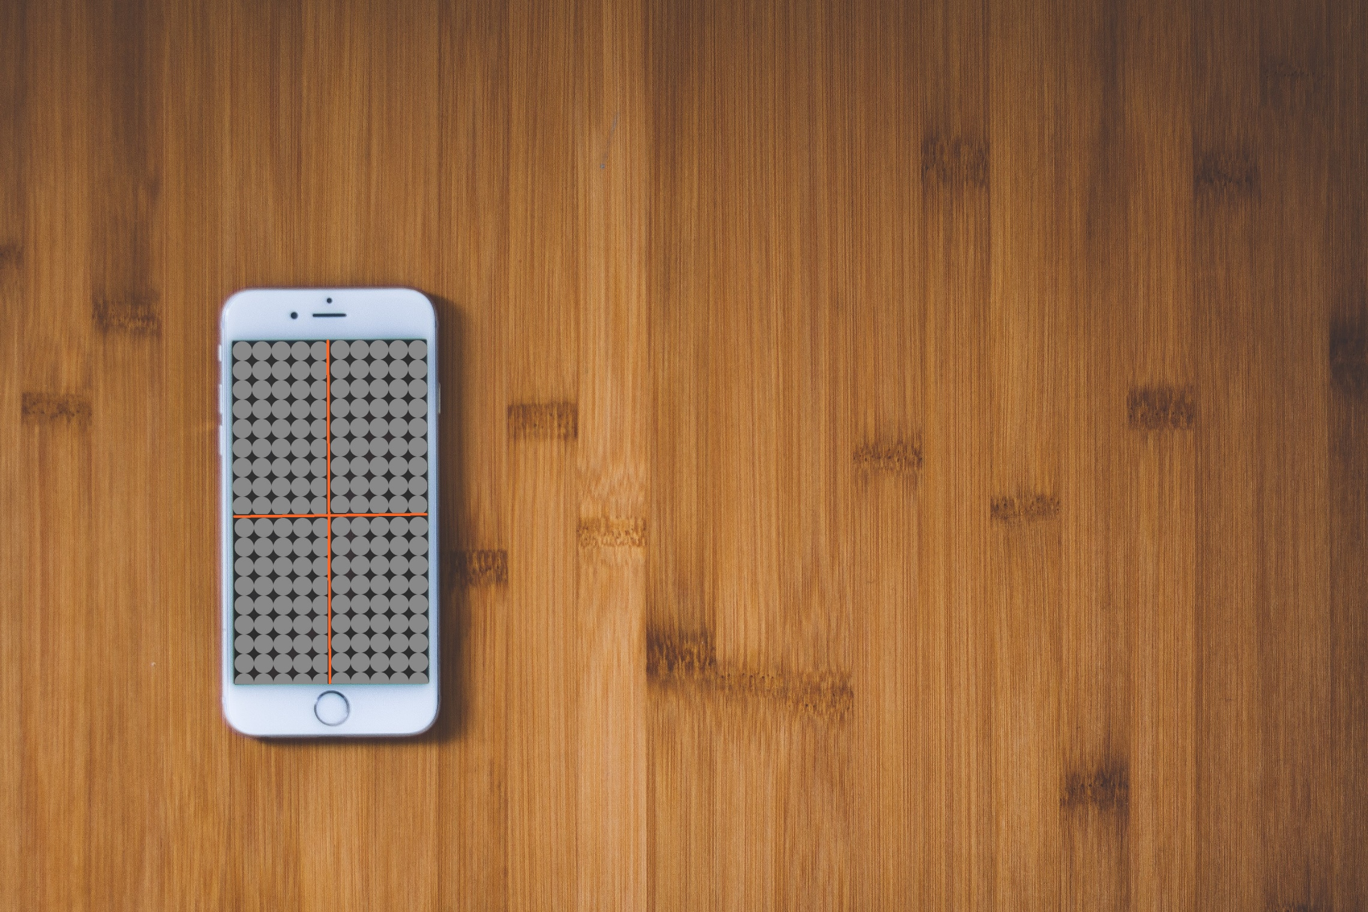
Data collection study
Training of a LSTM
Evaluation study/app
Notes:
Data collection study
20 right-handed participants performing x touches in 4 quadrants
3 different sized smartphones
Measurment with IMU‘s
LSTM Network
Time series based data
Evaluation Study
App that shows based on IMU measurements the quadrant the user wants to press

Slide 6
Agenda
Nov
Dez
Jan 2019
Feb
Heute
Discussion
11/6/2018
11/13/2018
2018
11/13/2018
Android App
11/27/2018
Data Collection Study
11/28/2018
12/11/2018
8 Tage
12/11/2018
Network Training
1/8/2019
Discussion
15 Tage
1/8/2019
1/15/2019
14 Tage
1/15/2019
Evaluation
1/29/2019
Paper Revision
29 Tage
1/29/2019
2/5/2019
8 Tage
11/27/2018
Writing Paper
2/5/2019
15 Tage
8 Tage
71 Tage

Slide 7
Questions
Data acquisition:
How big should the targets be?
How to treat targets close to the cross? (False Neg)
Eine Frage geht noch :D

