Slide 1
Simple Touch Prediction With Built-In IMUs Intermediate Presentation
Felix Bühler, Benedict Steuerlein
FaPra Machine Learning and Computer Vision for HCI | Pfaffenwaldring 5a | 27.11.18
Notes:
We are F and B an our subject is Simple Touch Prediction with built in IMUs

Slide 2
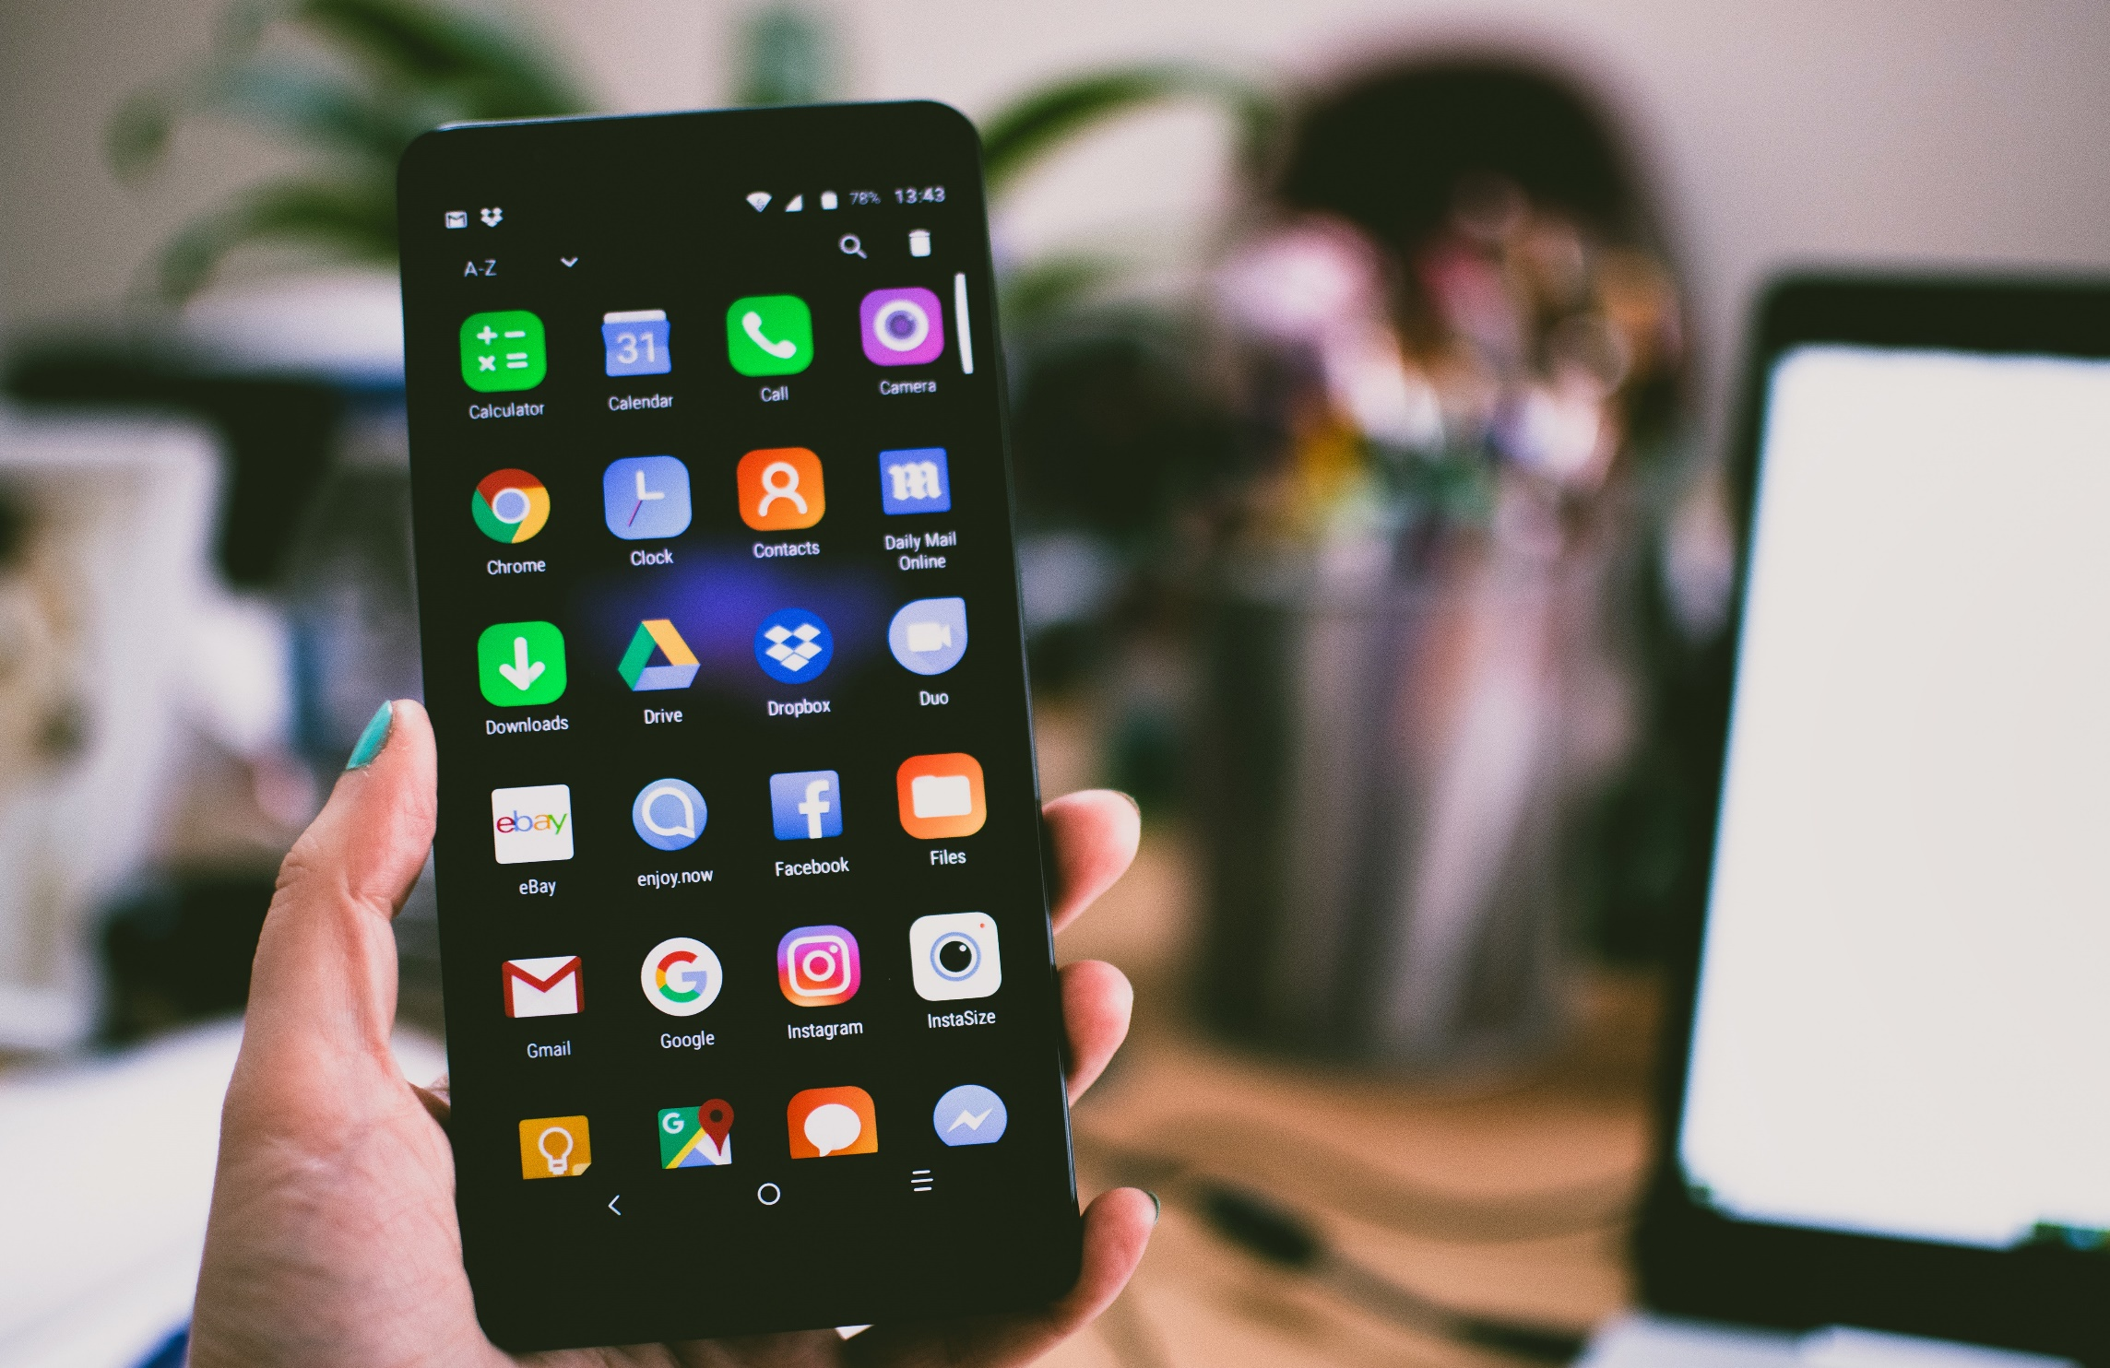
Smartphone sizes are increasing steadily
Whole front screen can not be reached without changing the grip
Predict where users want to touch

Slide 3
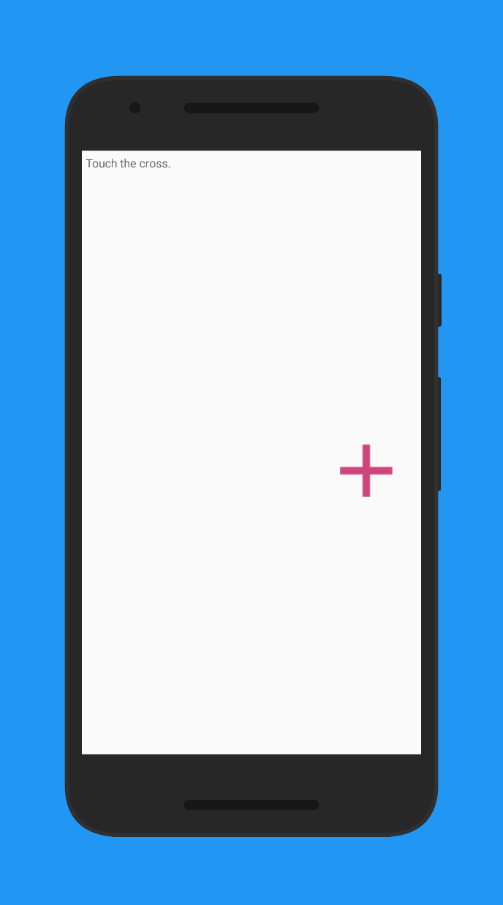
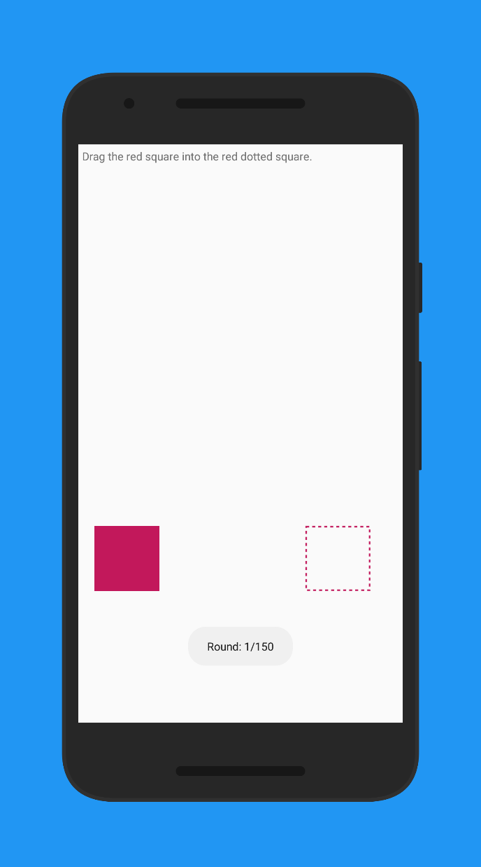
Working study app
Align crosses in a n x m grid
Users have to perform n*m touches
Fitts Task inbetween
Meanwhile record IMU
Current Status

Slide 4
Agenda
Nov
Dez
Jan 2019
Feb
Today
Discussion
11/6/2018
11/13/2018
2018
11/13/2018
Android App
11/27/2018
Data Collection Study
11/28/2018
12/11/2018
8 Tage
12/11/2018
Network Training
1/8/2019
Discussion
15 Tage
1/8/2019
1/15/2019
14 Tage
1/15/2019
Evaluation
1/29/2019
Paper Revision
29 Tage
1/29/2019
2/5/2019
8 Tage
11/27/2018
Writing Paper
2/5/2019
15 Tage
8 Tage
71 Tage
Notes:
Right no we are on schedule.
Finished implementing the study app.
From now on, we want to conduct the study

Slide 5
Can we take the S3 Mini away?
Are n x m touches sufficient? (with e.g. a 10 x 15 grid)
For writing the paper, which layout shall we use?
Questions

